Slide 1
Dual Feedback Beta Derivation
Tim Green
Senior Analog Applications Engineers
Precision Analog Linear Applications
July 18, 2013

Slide 2
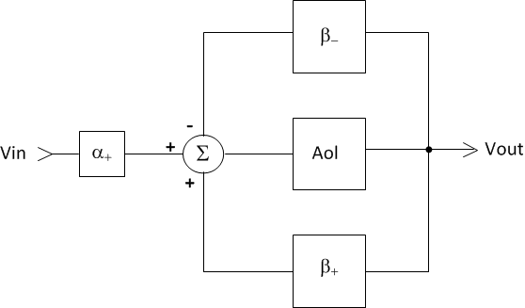
Beta Derivation for Dual FeedBACK

