Slide 1
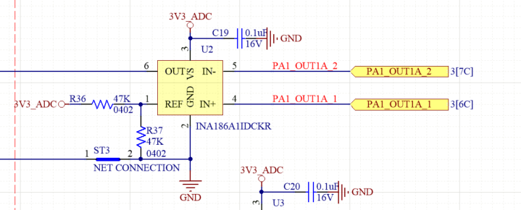
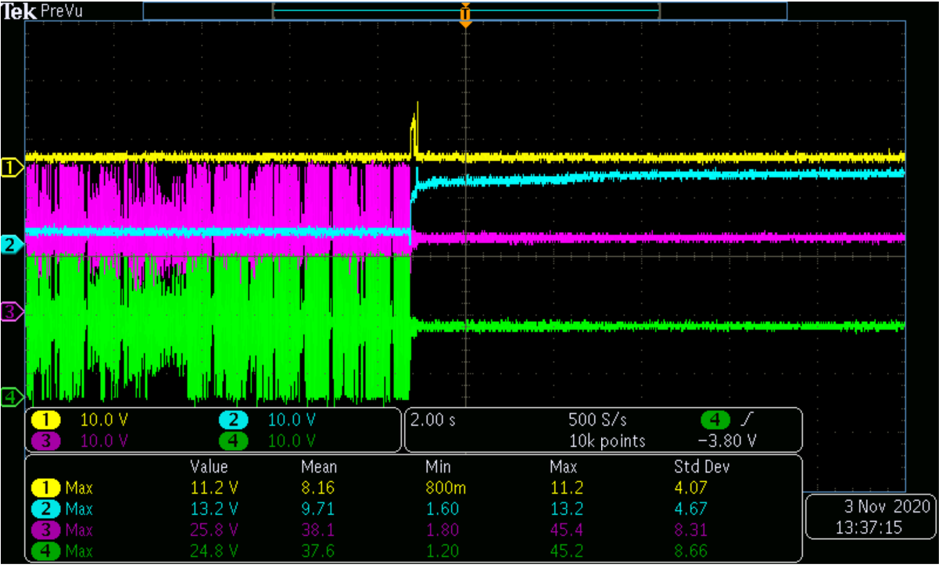
Ch2
Ch1
Ch4
Ch3
Continuous play music, INA186 o/p voltage=12V, IC burn out
Test condition:
Speaker play with max. volume
Single end channel
PVDD=24V

Slide 2
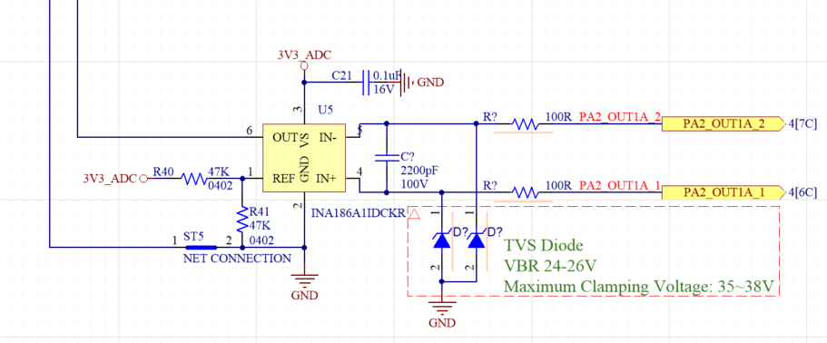
Modify circuit add TVS diode and Low pass filter

