Slide 1
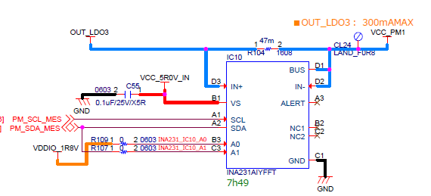
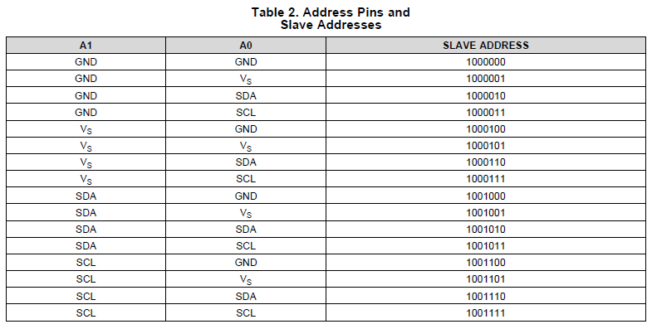
5V PWR
1.1V
1.8V I2C
1.8V PWR
■question
(1) There is a description in the "Vs at A0 terminal" data sheet, but is there any problem with 1.8V of the power supply for I2C?
(2) Is there a rule for the power-on order?
5V applied to the VS terminal and 1.8V applied to the A0 or A1 terminal are almost the same.

