Slide 1
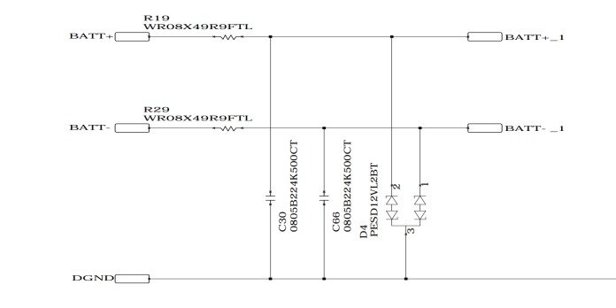
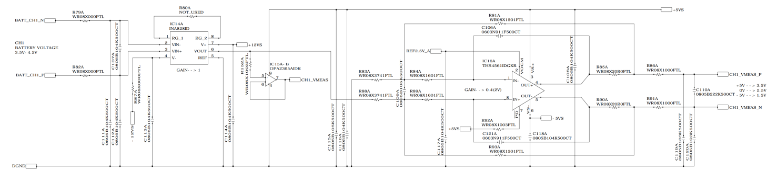
Voltage Source
Cable
Voltage Sensing SCH
- When the voltage source is OPEN (circuit floating), the voltage is charged to the condenser due to noise coming through the Voltage Sensing Cable (BATT+, BATT-), and a stray voltage is measured. (It was confirmed that stray voltage (3 ~ 5V) is measured)
The problem was solved by inserting a full down RES into the relevant area, and the voltage rise can be confirmed through testing, but technical documentation is required to confirm that there is no problem.
Customer request:
1) It is necessary to check how far the stray voltage rises.
2) Technical documentation is needed to check whether INA828ID will be damaged when the voltage rises above 12V due to floating circuit.

