Slide 1
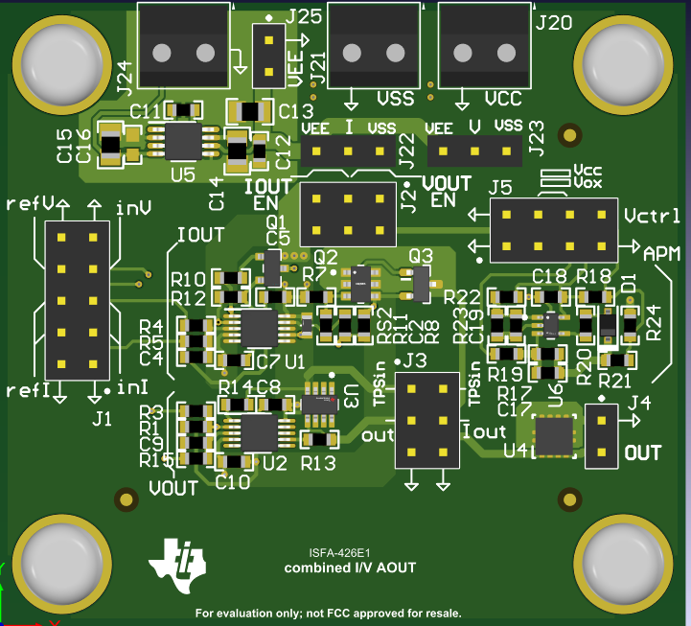
ISFA-426 Combined V/I output stage for PLC AOUT
measured
Solve following customer challenge:
Cost-optimized, protected, low noise, high compliance 4-20mA, ±10V output stage
Features
Benefits
Modes: 0-20mA, 4-20mA [RL<1kΩ, Vcc>24V], 0-10V, ±10V [RL>1kΩ, Vcc>12V, Vss<-12V]
Resolution: 17b (voltage mode), 18b (current mode)
calculated Error [1% res, 25ppm] , in %FSR
initial error at 25C: 1%(Vout),1.7% (Iout)
Residual error after cal: 0.35% (Vout), 0.5% (Iout)
VCC-VSS = 40V max, -40 to 125℃ opearation
Settling time (full scale) : 20us (no cap. or ind. load)
Compatible with adaptive power
Stage works with supply down to 3.3V (out < 3V)
Protection: Surge(33V), OV (VCC), UV(VSS), OC(30mA)
Flexible, modular implementation at low cost
Compatible with multi-channel DACs like DAC80508
Fully-protected
Low Cost, and low power
Applications
PLC AOUT
Additional details
17mm x 13mm
Key devices: OPA2990S, TPS26611, TVS3301, LM7705

