Slide 1
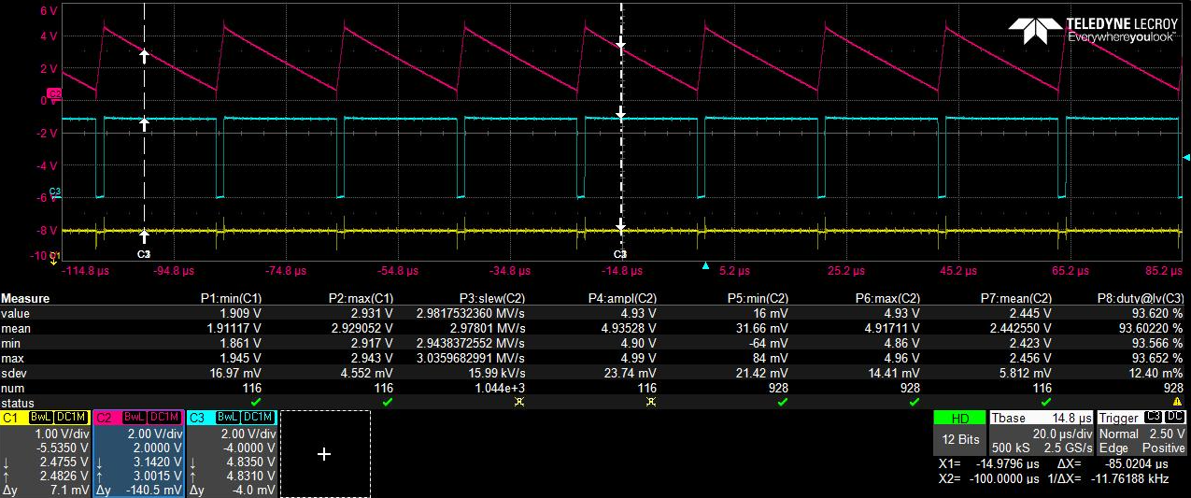
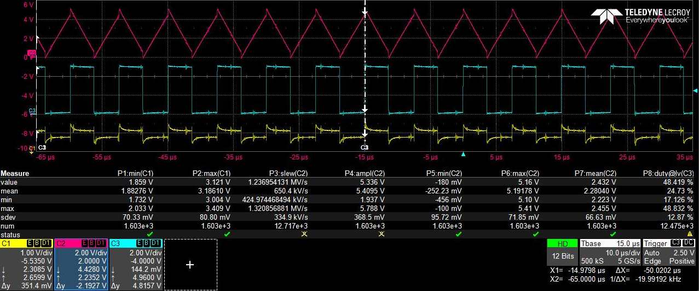
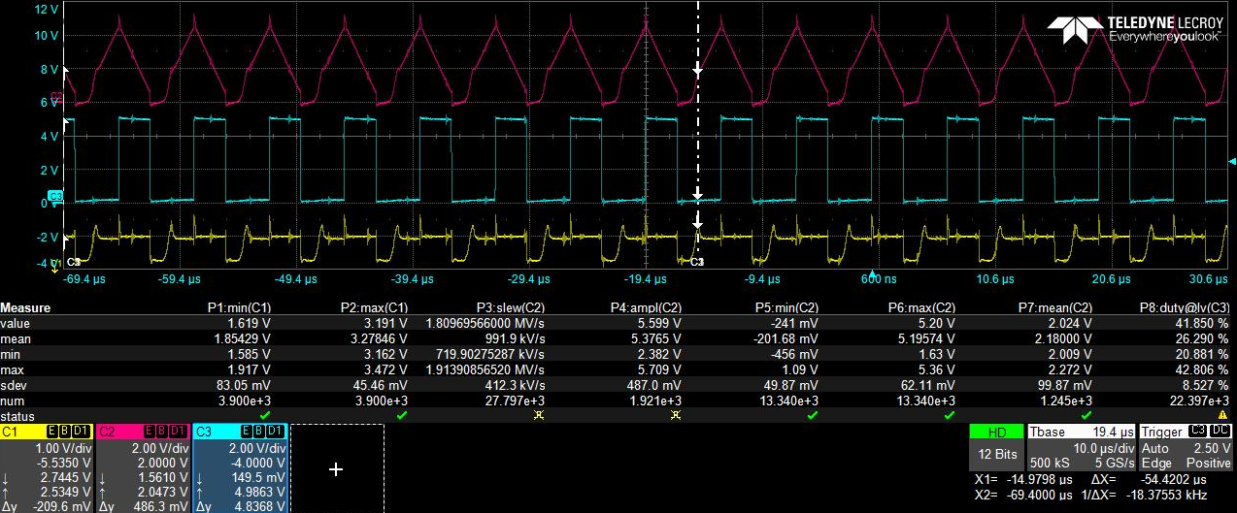
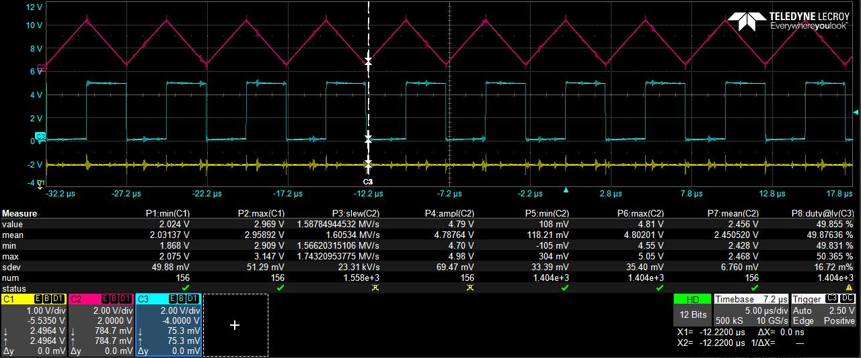
Good Behavior - MCP6292IDDFR, TSV912AIDDFR, and TLV9062IDDFR
Abnormal Behavior – differences seen on inputs but also the integrator behavior when compared to “good”
TLV9152
Inputs pulled apart causing distortion on op amp output
Error on input waveform?
OPA2374?
Unknown device?

