Slide 1
Issue of the designing TIA and comparator Using LMH34400, TLV3601
MSD / Joon
24.07.12.

Slide 2
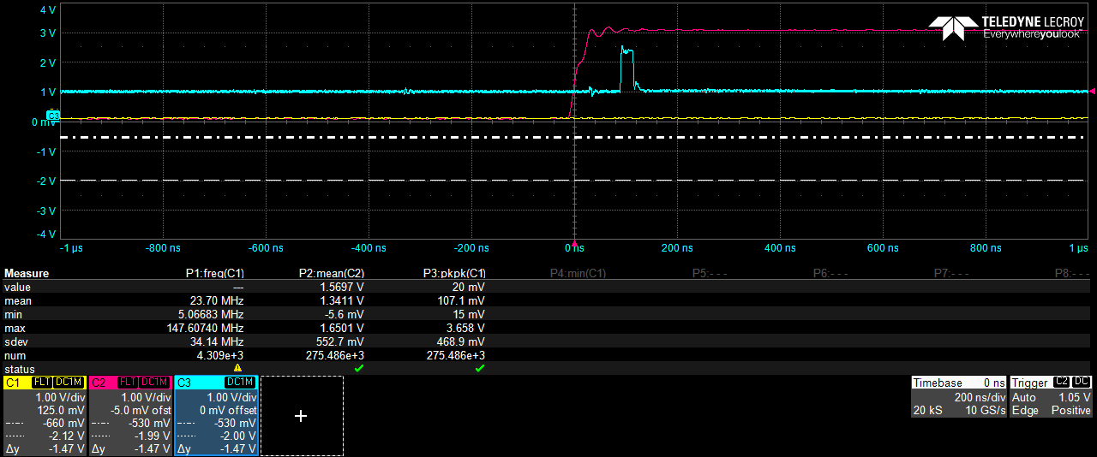
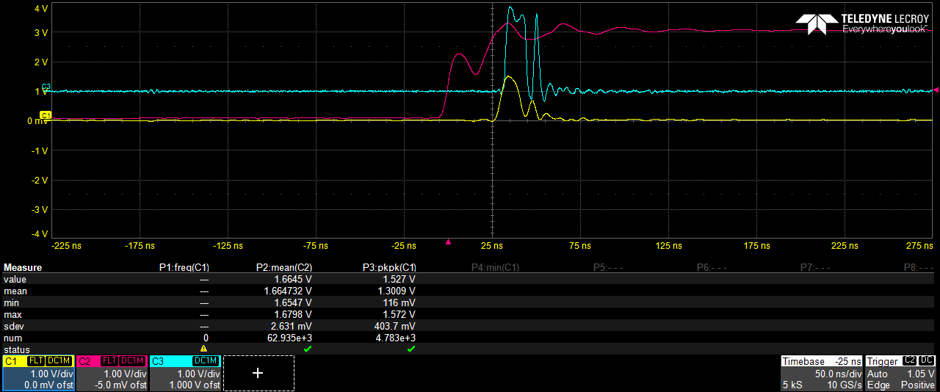
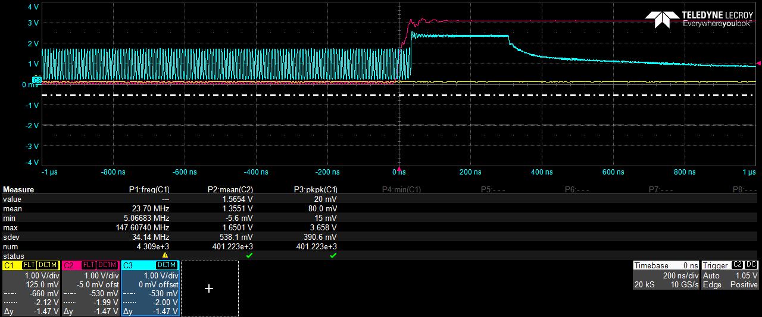
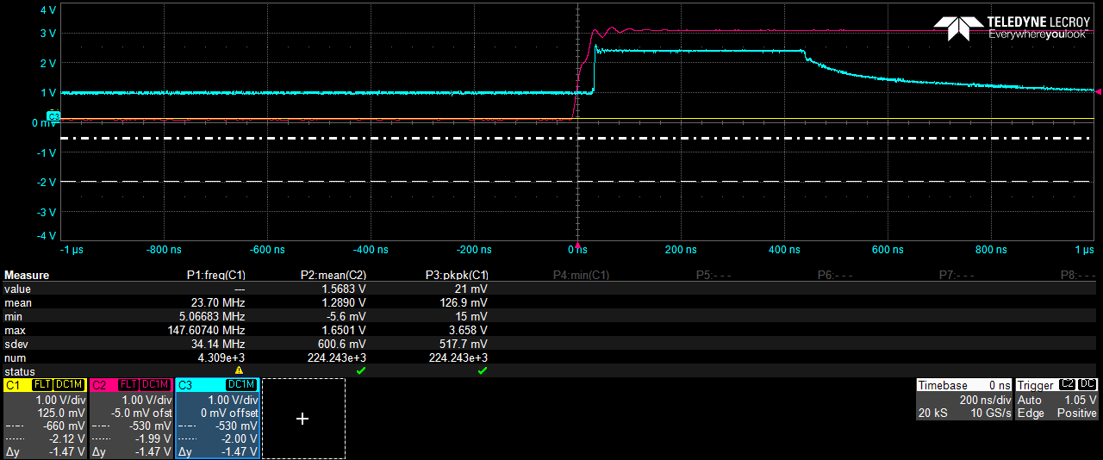
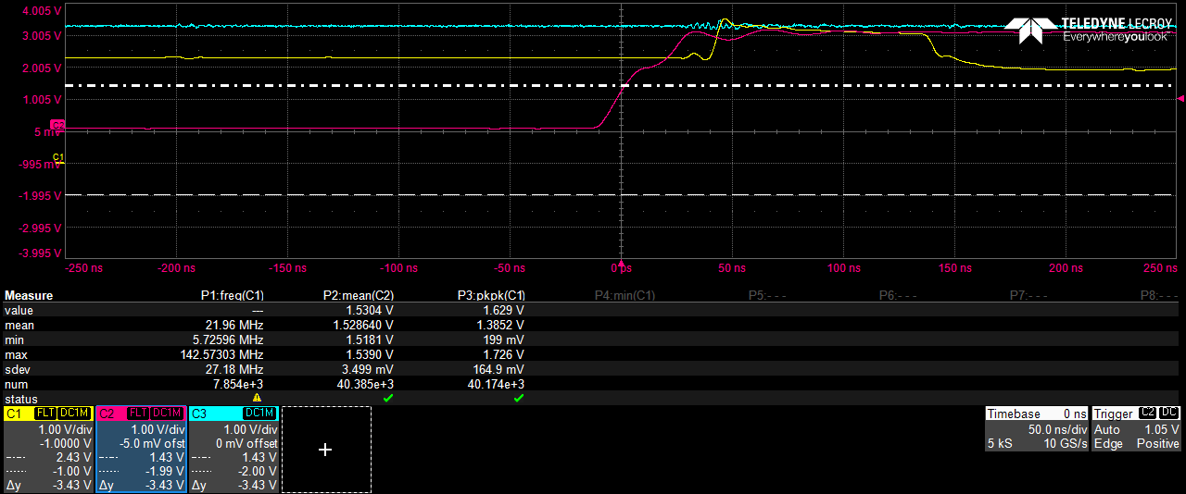
Design Objectives and Issues
Designing the TIA(LMH34400) and comparator(TVL3601) for measuring high reflective target
We want to measure only single peak signal at the comparator
TIA amplifies pulse signal well when it operates without connecting comparator
However, there are DC offset, ringings and oscillation when comparator is cascaded, especially when the measured is signals are saturated (having long pulse width).
SINGLE PEAK WITHOUT COMPARAOT
Ringing
OSCILLATION
OFFSET
SINGLE PEAK WITHOUT COMPARAOT

Slide 3
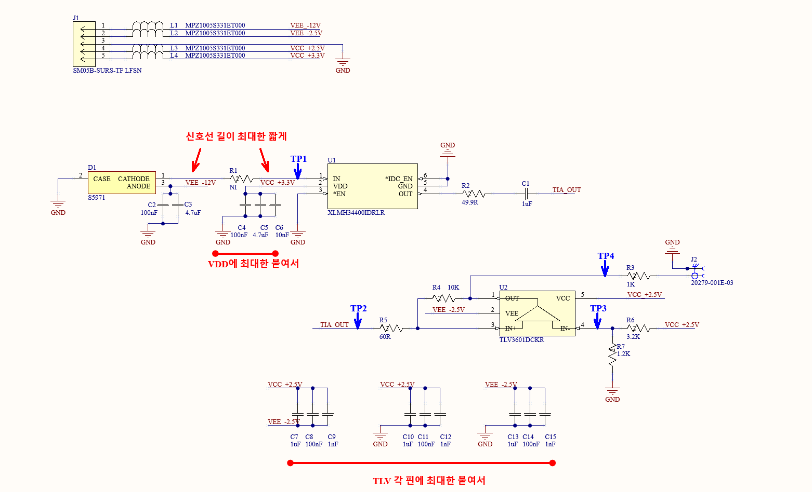
TIA and Comparator circuit

Slide 4
Design configuration
Threshold voltage : 0.7V
GND
Components | Value
R2 | 50R
C1 | 1uF
R3 | 60R
R4 | 10KR
R6 | 3.2KR
R7 | 1.2KR
R5 | 1KR
Input pulse
PW : 10ns
3.3V
$$R_{7}$$
2.5V or 3.3V
2 (VDD)
2.5V
$$R_{6}$$
4 (IN-)
5 (VCC)
TLV3601
1 (OUT)
$$R_{5}$$
GND
LMH34400
4 (OUT)
$$R_{2}$$
$$C_{1}$$
$$R_{3}$$
3 (IN+)
1 (IN)
2 (VEE)
PIN PD
GND
3 (EN)
6 (IDC EN)
Measurement point #1
$$R_{4}$$
Measurement point #2
GND
TIA
Passive HPF
Comparator with hysteresis

Slide 5
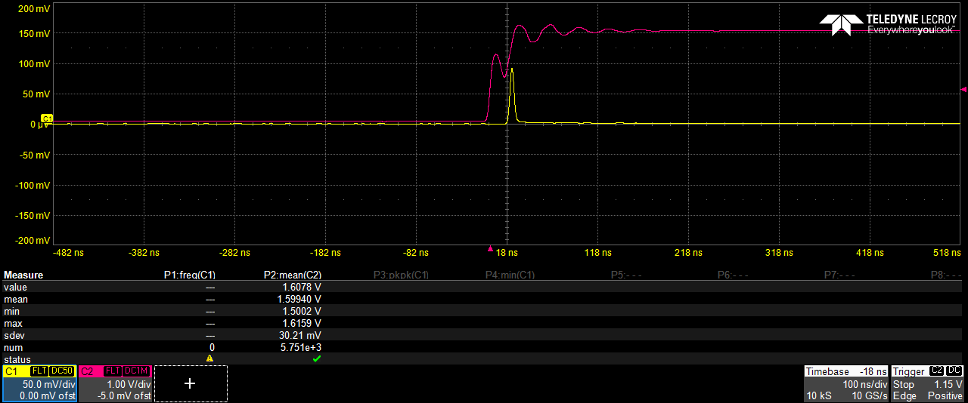
Measurement results (1/2)
Measured by reference PD
Measurement point #1
Measurement point #2
By using a reference PD (from Thorlab’s APD DET08C), the pulse signal is measured as single peak
- With designed PD circuit, we have several peaks
- 1st and 2nd peak is measured at Measurement point #2,
Other peaks looks like ringing (it seems like oscillation problem)

Slide 6
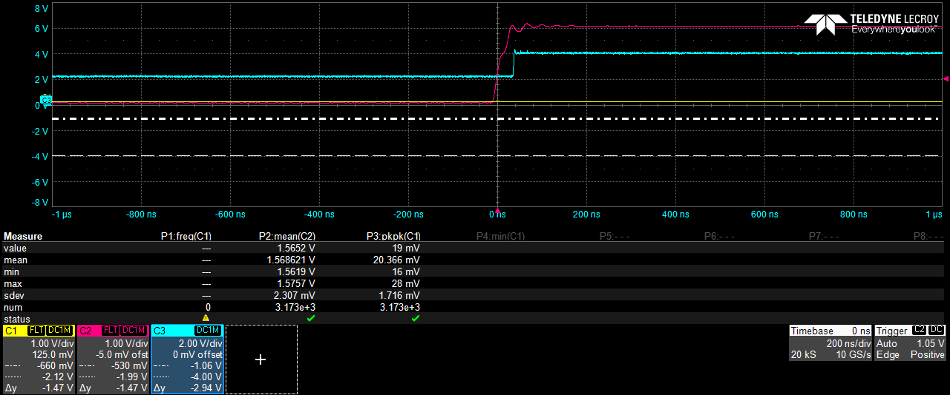
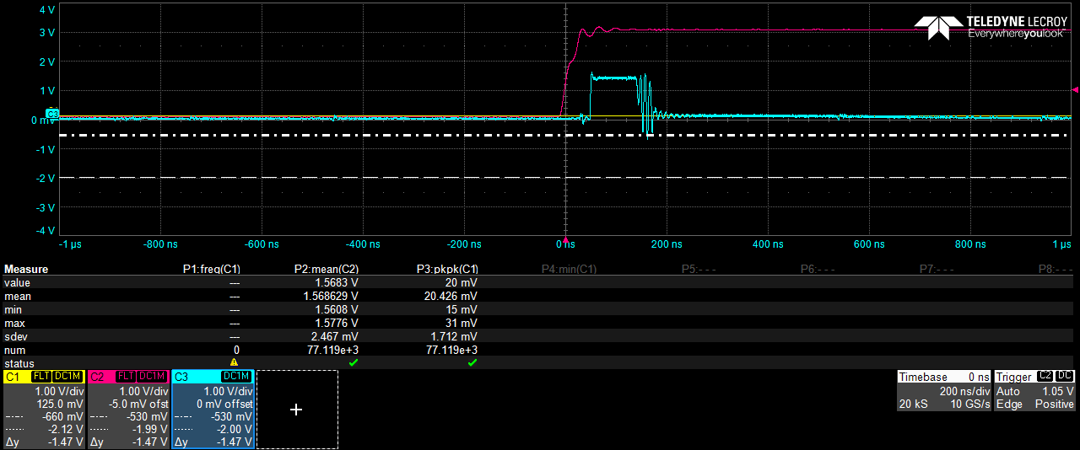
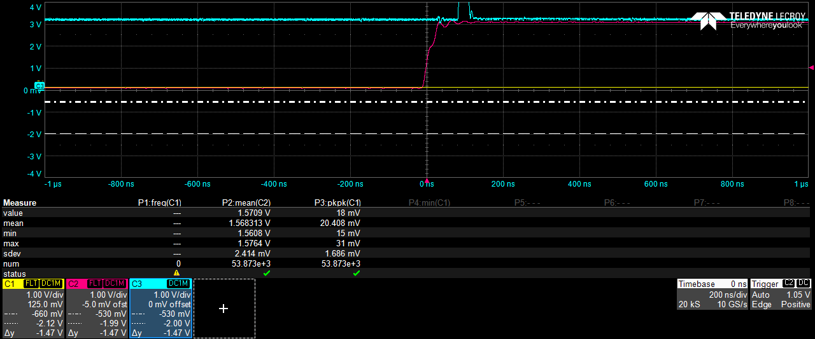
Measurement results (2/2)
Measurement point #1
Measurement point #1
Measurement point #1
When we measure high reflectivity target, we get a saturated signal with several peaks
- When pulse width increases, additional DC offset appears and ringings are disappeared.
- When ambient right increases, Dc offset also appears

Slide 7
design configuration (changing the C1)
Threshold voltage : 0.7V
GND
Components | Value
R2 | 50R
C1 | Short (or less than 1uF)
R3 | 60R
R4 | 10KR
R5 | 1KR
R6 | 3.2KR
R7 | 1.2KR
Input pulse
- PW : 10ns
3.3V
$$R_{7}$$
2.5V or 3.3V
2 (VDD)
2.5V
$$R_{6}$$
4 (IN-)
5 (VCC)
TLV3601
1 (OUT)
$$R_{5}$$
GND
LMH34400
4 (OUT)
$$R_{2}$$
$$C_{1}$$
$$R_{3}$$
3 (IN+)
1 (IN)
2 (VEE)
PIN PD
GND
3 (EN)
6 (IDC EN)
Measurement point #1
$$R_{4}$$
Measurement point #2
GND
TIA
Passive HPF
Comparator with hysteresis

Slide 8
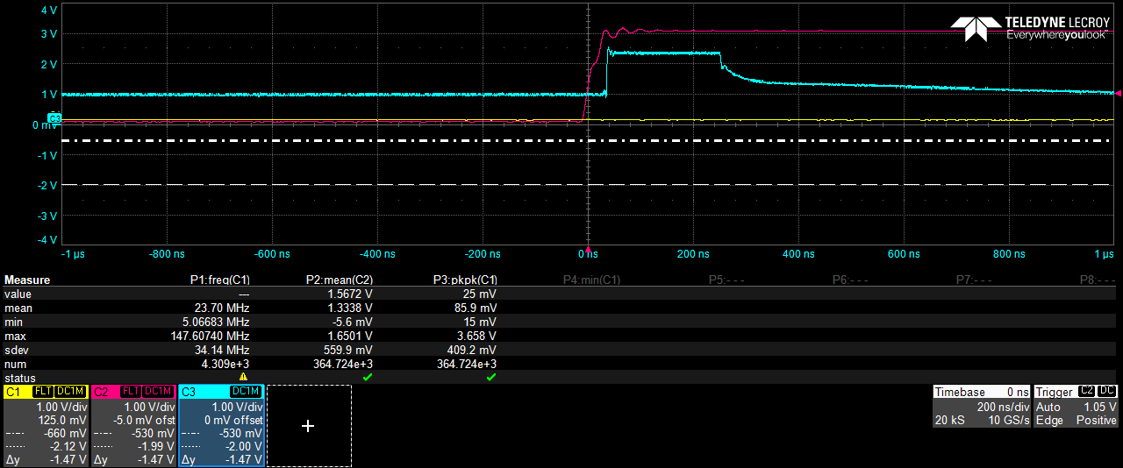
Measurement results (C1 short)
Measurement point #1
Measurement point #1
- Without HPF, there is no ringing and DC offset
- However, as pulse width increases, oscillation appears

Slide 9
Measurement results (different C1)
DC offset
Relatively low frequency drift
Ringings
C1 : 10nF
C1 : 0.2nF
C1 : short
Measurement point #1
Measurement point #2
With different C1, (for the measuring high reflective target)
- There are ringing, additional DC offset, relatively low frequency drift
When comparator is off state, this problem does not occur

Slide 10
Measurement results (comparator off)
Measurement point #1
Measurement point #1
- When comparator is off state, we have a good signal without ringing, DC offset and drift

Slide 11
design configuration (Without hysteresis)
Threshold voltage : 1.3~1.4V
GND
Components | Value
R2 | Short
C1 | Short (or less than 1uF)
R3 | Short
R4 | Open
R5 | 1KR
R6 | 3.2KR
R7 | 3.4KR
Input pulse
- PW : 10ns
3.3V
$$R_{7}$$
2.5V or 3.3V
2 (VDD)
2.5V
$$R_{6}$$
4 (IN-)
5 (VCC)
TLV3601
1 (OUT)
$$R_{5}$$
GND
LMH34400
4 (OUT)
$$R_{2}$$
$$C_{1}$$
$$R_{3}$$
3 (IN+)
1 (IN)
2 (VEE)
PIN PD
GND
3 (EN)
6 (IDC EN)
Measurement point #1
$$R_{4}$$
Measurement point #2
GND
TIA
Comparator without hysteresis

Slide 12
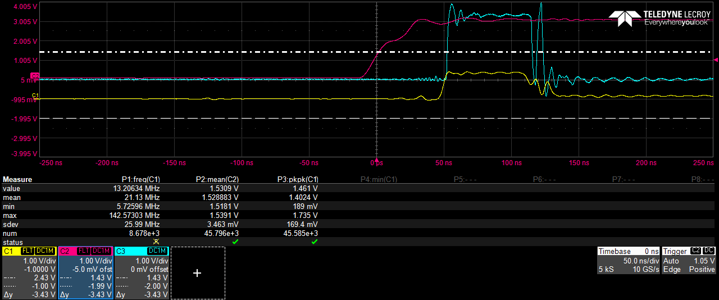
Measurement results (without HPF and hysteresis)
Measurement point #1
Measurement point #2
With different C1, (for the measuring high reflective target)
- There are ringings, additional DC offset, relatively low frequency drift
- When comparator is off state, this problem does not occur

Slide 13
Conclusion
There is DC offset, ringing, and oscillation when the comparator is cascaded to the TIA, especially when the measured signal is saturated (long pulse width).
We suspect that the ambient light cancellation function may contribute to these issues when a large current is applied at the TIA input.
When the comparator is off, these issues do not occur. it is required to consider the impedance matching between the LMH34400 and TLV3601.
I request information to solve this Issues.

