Slide 1
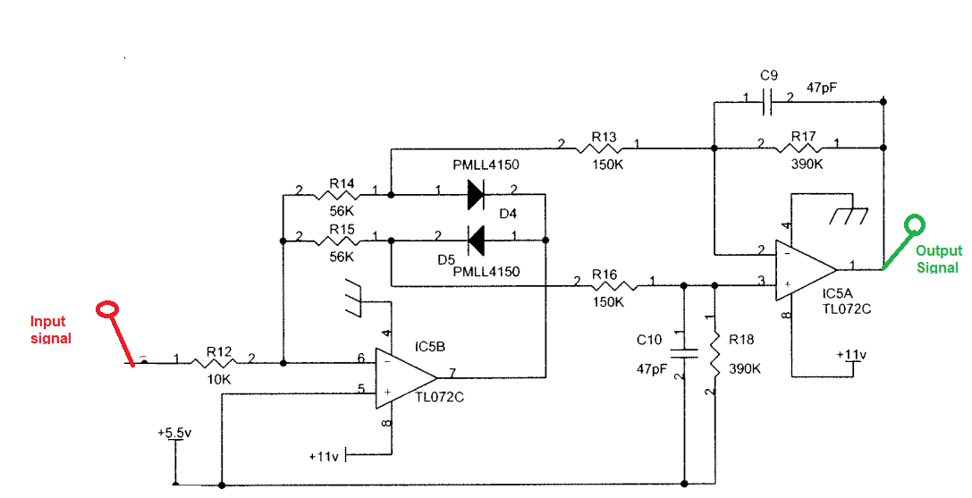
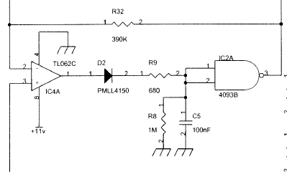

Schematic view : IC5A & IC5B are TL072CDR Part
Further stage for ref.

Slide 2
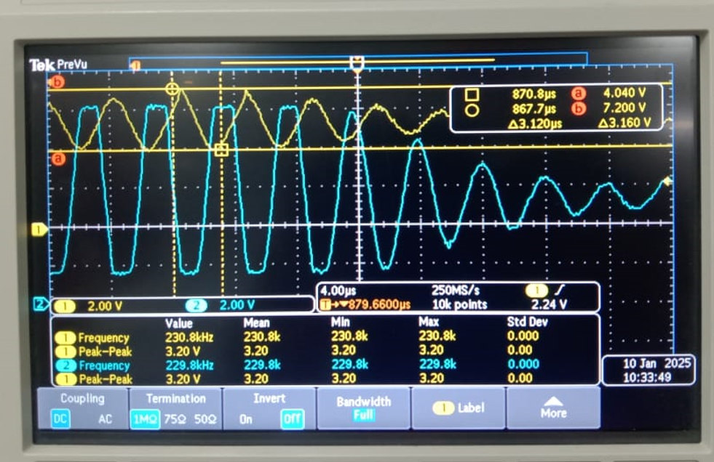
Test Results (Old Die Part)
CH-1 (Yellow)
Input signal for IC5B
3.160V (Pk-Pk)
DC offset : 5.5V
CH-2 (Blue)
7th pin of IC5B
Positive & negative
Both sides clipping
Observed in signal.

Slide 3
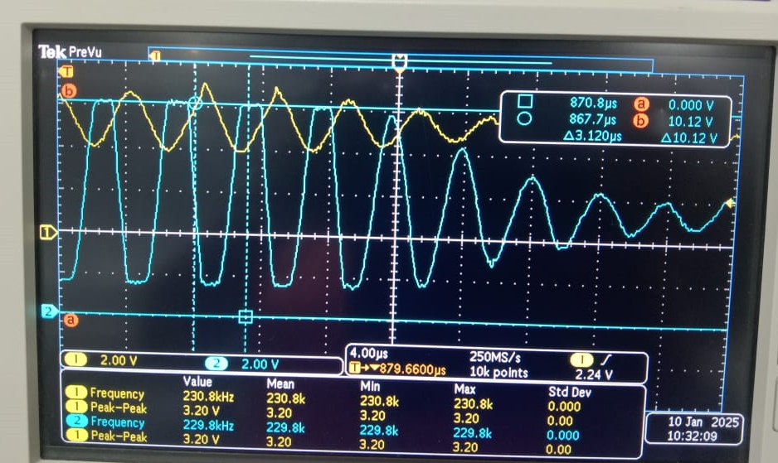
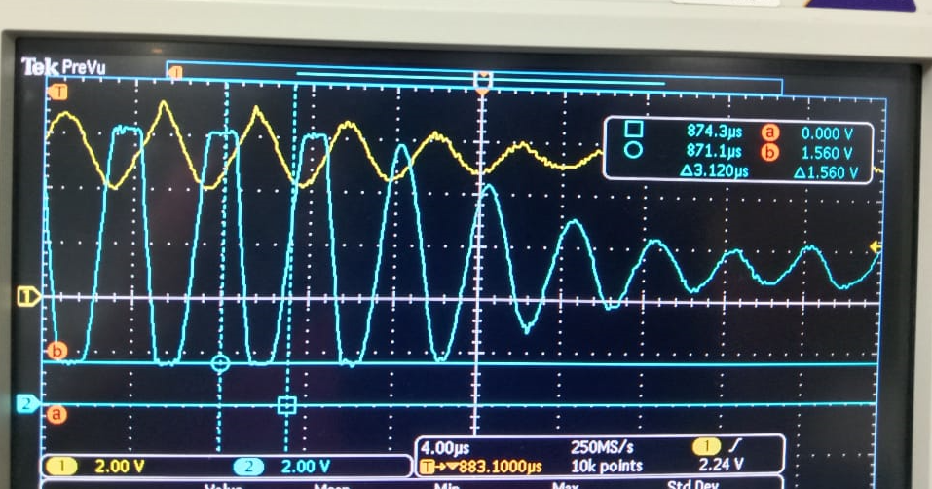
Test Results (Old Die Part)
CH-2 (Blue) 7th pin of IC5B
Max (10.12V) & Min (1.560V) Ranges

Slide 4
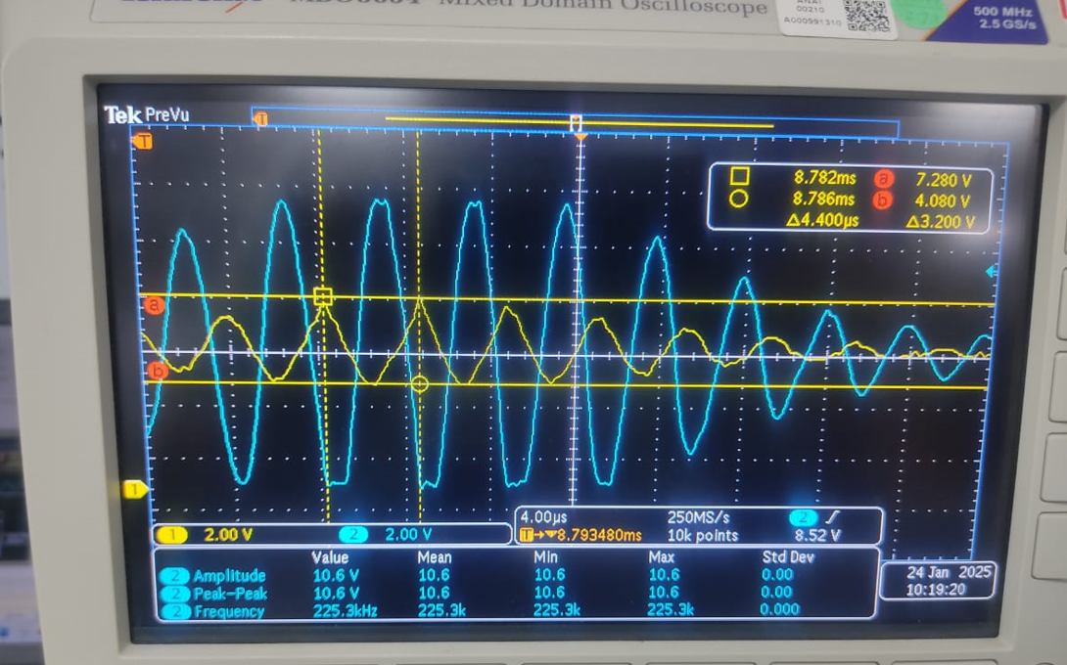
Test Results (New Die Part)
CH-1 (Yellow)
Input signal for IC5B
3.20V (Pk-Pk)
DC offset : 5.5V
CH-2 (Blue)
7th pin of IC5B
No clipping in output signal
Both sides its attaining with 200mV
Variation to rails.

Slide 5
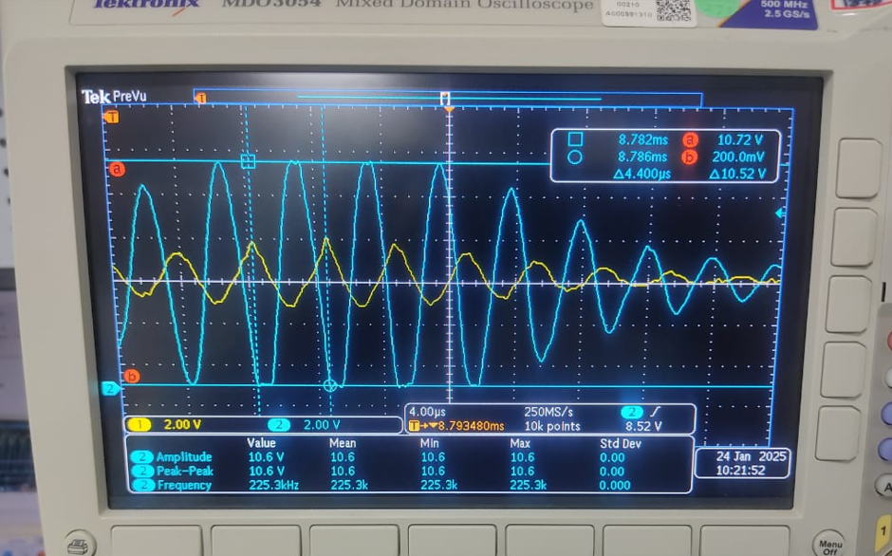
Test Results (New Die part)
CH-2 (Blue) 7th pin of IC5B
Max (10.72V) & Min (200mV) Ranges

Slide 6
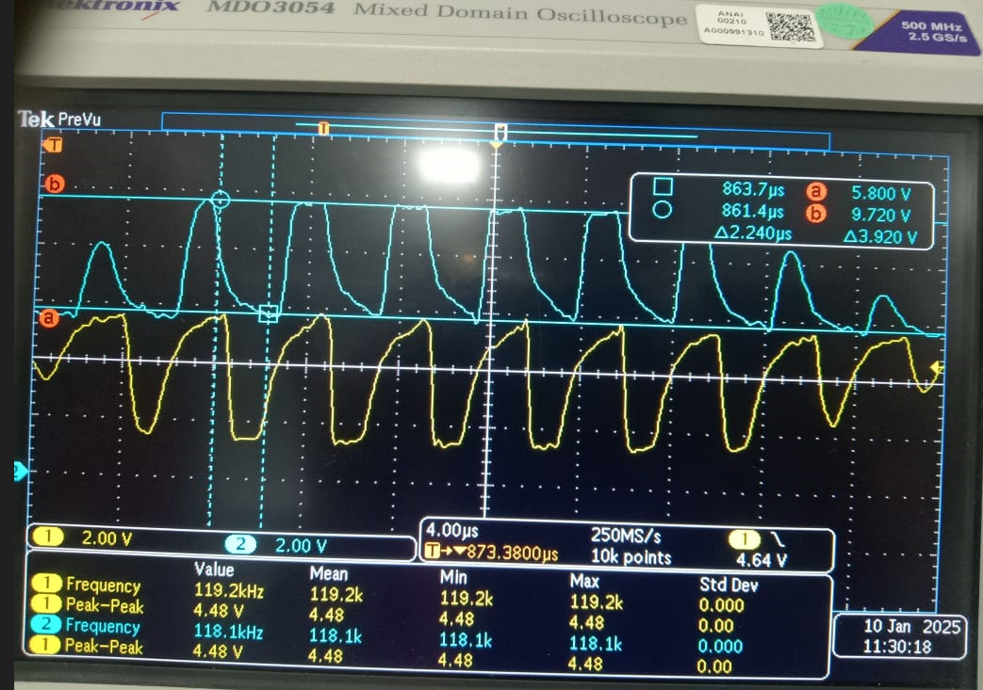
Test Results (Old die)
IC5A input data
Measured at Anode of D4 & Cathode of D5
CH-2 (Blue)
Cathode of D5
CH-1 (Yellow)
Anode of D4

Slide 7
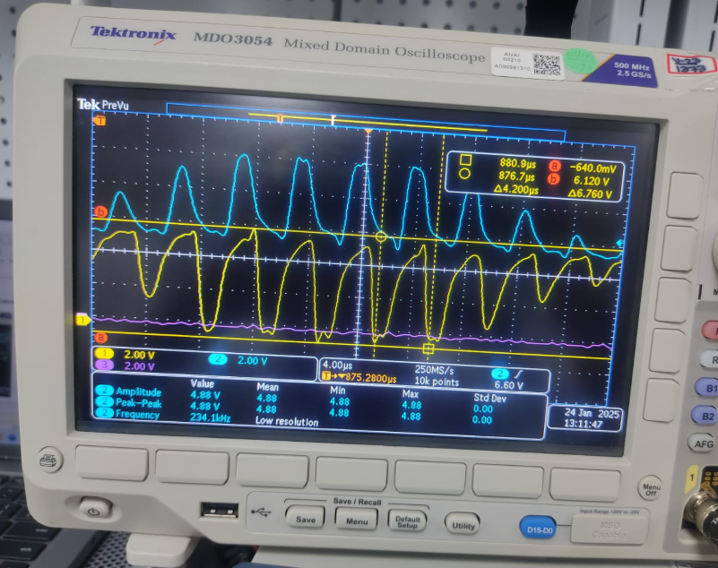
Test Results (New die)
IC5A input data
Measured at Anode of D4 & Cathode of D5
CH-2 (Blue)
Cathode of D5 (10.44V)
CH-1 (Yellow)
Anode of D4
It is winged beyond
Gnd level up to
-640mV, Its again
Input to differential
Amplifier of IC5A
I guess its not recommended to operate it

Slide 8
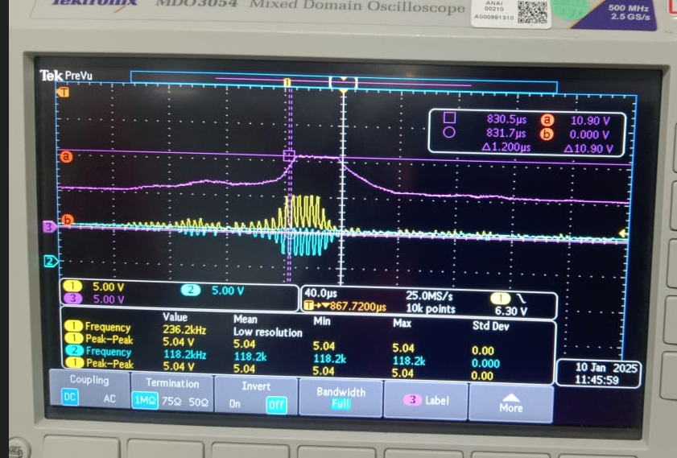
Test Results (Old Die)
IC5A input & Output data
CH-1 (Yellow)
Cathode of D5
CH-2 (Blue)
Anode of D4
CH-3 (Magenta)
1 st pin output, consider 10.4V only
(due to probe constraint)

Slide 9
Thank you.!
* ADC PLL internally locks onto a multiple of this frequency to provide a stable 4.194304 MHz

