Slide 1
LMH6644 Application -Delay Stage
Feb 2015
Emkay Kim

Slide 2
[Normal Operation]Delay Stage
When I use inputs as U1 and U2, U3 output(DRV+) has delay as next slide;
Non-inverting (+)input : CNTL- (=1.65V DC)
Inverting (-) input : CNTL+ (=1.92V → 1.66V)
Vout Delay : DRV+ rises from 0V to 3.28V in 2.77sec.

Slide 3
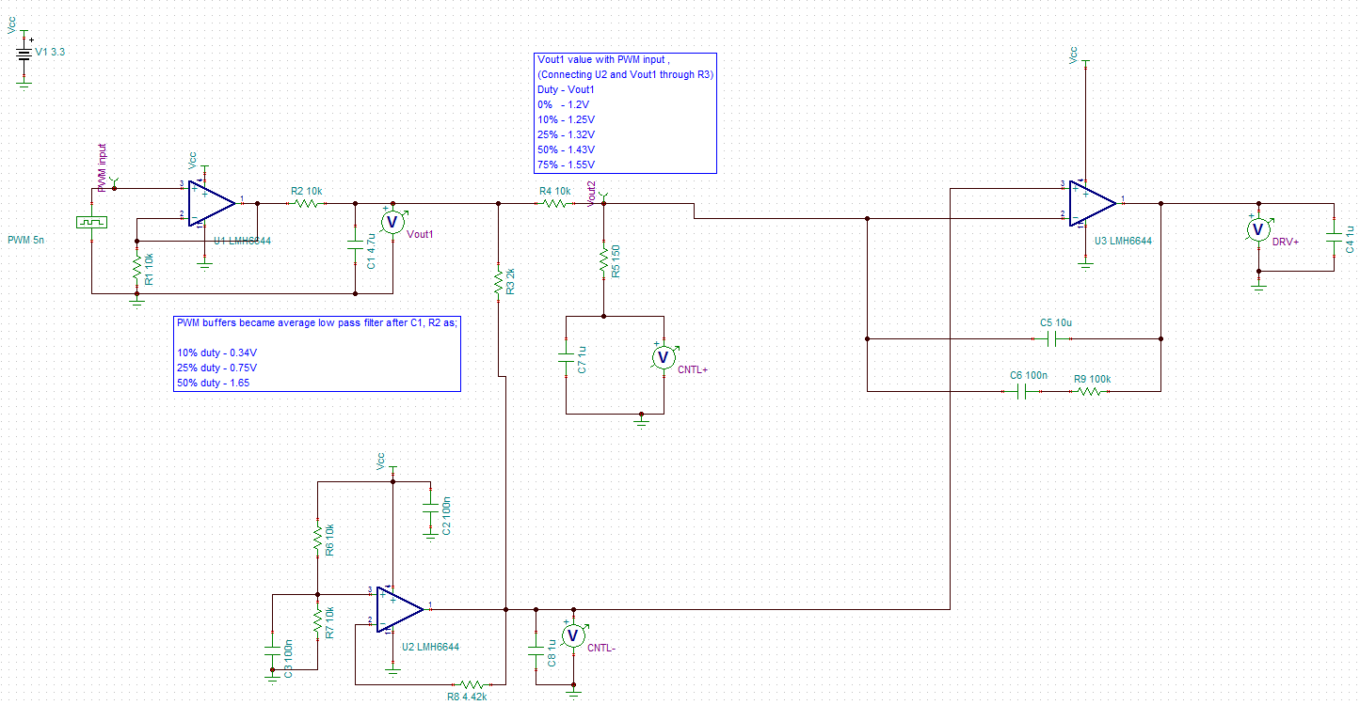
[Normal Operation]Delay Stage

Slide 4
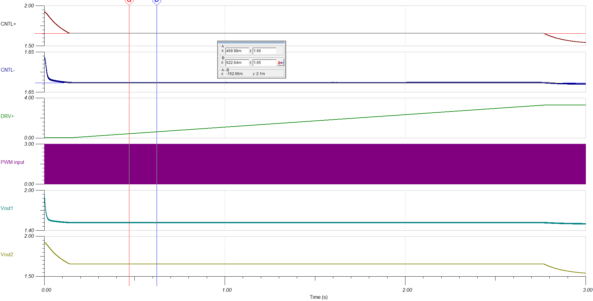
[Normal Operation]Delay Stage
2.7sec Delay
Reaches 3.28V at 2.77sec

Slide 5
[Abnormal Operation]Delay Stage
When I use inputs as Signal Generator, I couldn’t see the same delayed output as normal operation as below;
Non-inverting (+) input : CNTL-
Inverting (-) input : Vout2(=CNTL+)
Vout : zero; no change
It can be expected since non-inverting input(1.65V) never go up to inverting input(1.66V)

Slide 6
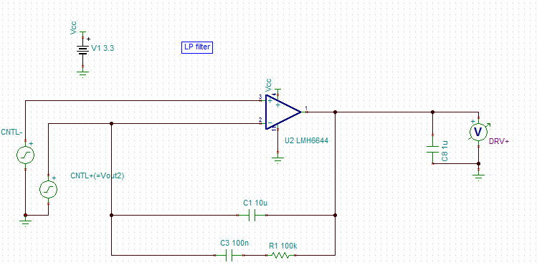
[Abnormal Operation]Delay Stage

Slide 7
[Abnormal Operation]Delay Stage

