Slide 1
Modeling CDAC SAR Input
A case study of ADS8320
Tim Green, MGTS
Precision Linear Analog Applications
April 16, 2015

Slide 2
Background Information

Slide 3
Number of Time Constants vs ADC Number of Bits to Settle <1/2 LSB
(Based on Full Scale Input)

Slide 4
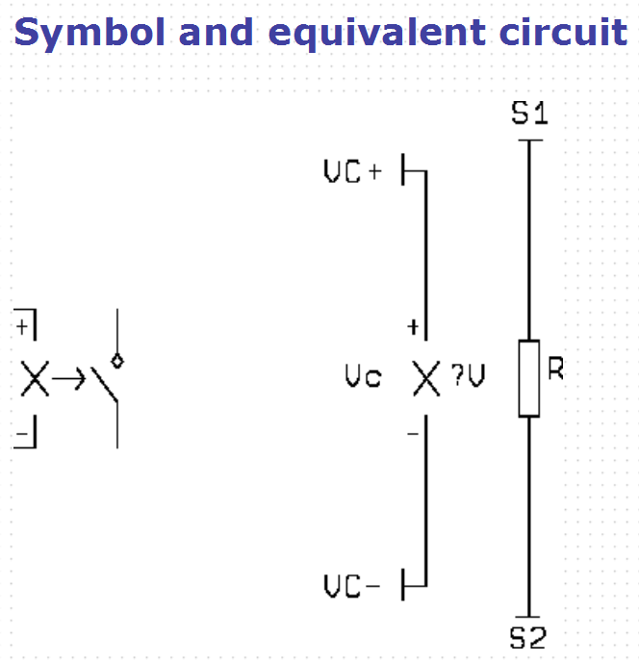
Voltage Controlled Switches in SPICE

Slide 5
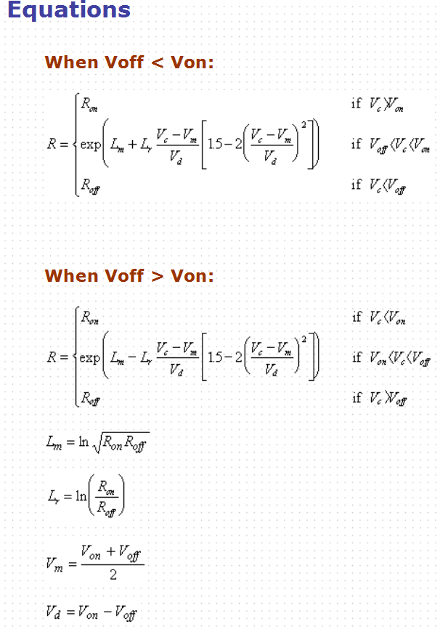
Voltage Controlled Switches in SPICE

Slide 6
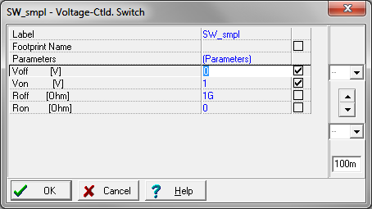
Wrong (TINA Default) Switch Parameters for Modeling SAR ADC

Slide 7
Wrong (TINA Defualt) Switch Parameters for Modeling SAR ADC

Slide 8
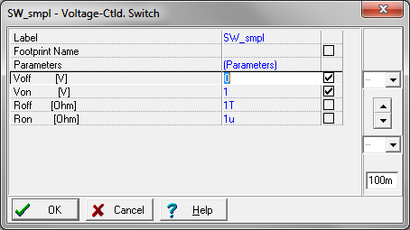
Right Switch Parameters for Modeling SAR ADC

Slide 9
Right Switch Parameters for Modeling SAR ADC

Slide 10
Modeling the SAR Input

Slide 11
ADS8320 Specifications
Analog Input:
Csh=45pF
Rsw = 100 ohms (not in data sheet and not critical as long as 1/(Rsw*Csh ) << tsmpl
Assume Csh is reset to zero at end of each conversion cycle
Full-scale Input Span = 0V to Vref
Sampling Dynamics:
Conversion Time (tconv) = 16 Clk cycles
Acquisition Time (tacq) = 4.5 Clk cycles
Clock Frequency (fclk) = 24kHz to 2.4MHz
For fclk=2.4MHz (maximum sampling rate):
tconv = 6.67us
tacq = 1.88us
Vref: 5V
Resolution : 16 Bit ADC

Slide 12
ADS8320 Input Model
Voa_SS will be used to easily measure Verror (difference between op amp output, Voa, and V_Csh at the end of tacq) in transient analysis.
Do a DC Analysis and measure Voa. Adjust Voa_SS = Voa @ DC.
Ignore Verror in DC Analysis since SW_Acq and SW_conv each have off resistance of 1T-ohm and form a DC divider which we will not care about.

Slide 13
ADS8320 Input Model Timing Voltage Sources, tacq & tconv
Set trise and tfall times at 1ns for
reasonable real world timing and ease of SPICE convergence in transient analysis.
tconv need only discharge Csh before the
next tacq. So we will switch on SW_conv
for a10ns pulse with the end of this pulse 10ns away from end of tconv to avoid SW_conv and SW_acq from ever being on
at the same time.

Slide 14
Creating tacq & tconv with PWL (PieceWise Linear) Voltage Sources

Slide 15
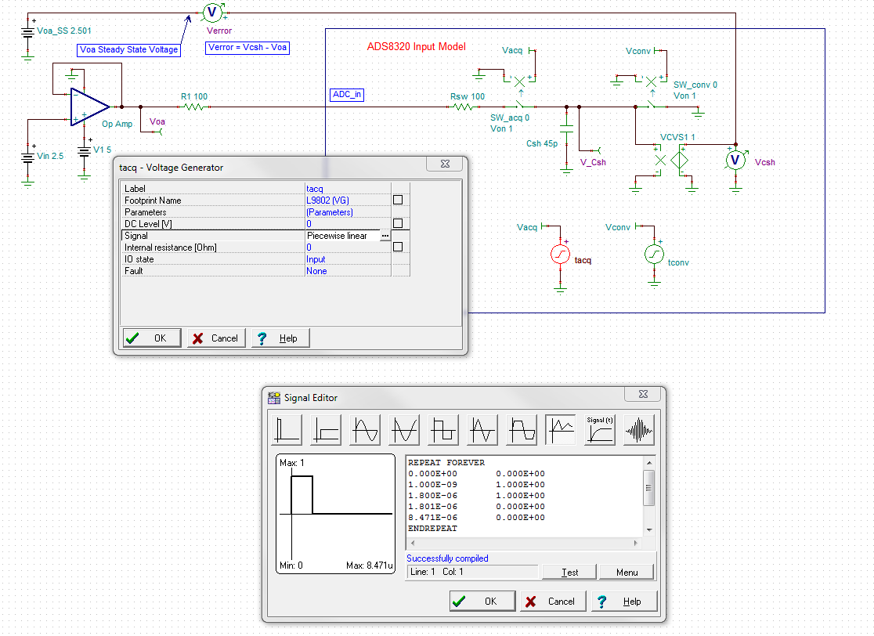
tacq PWL Voltage Source
Paste from Excel
“PWL EZ Build SAR Timing”
worksheet.

Slide 16
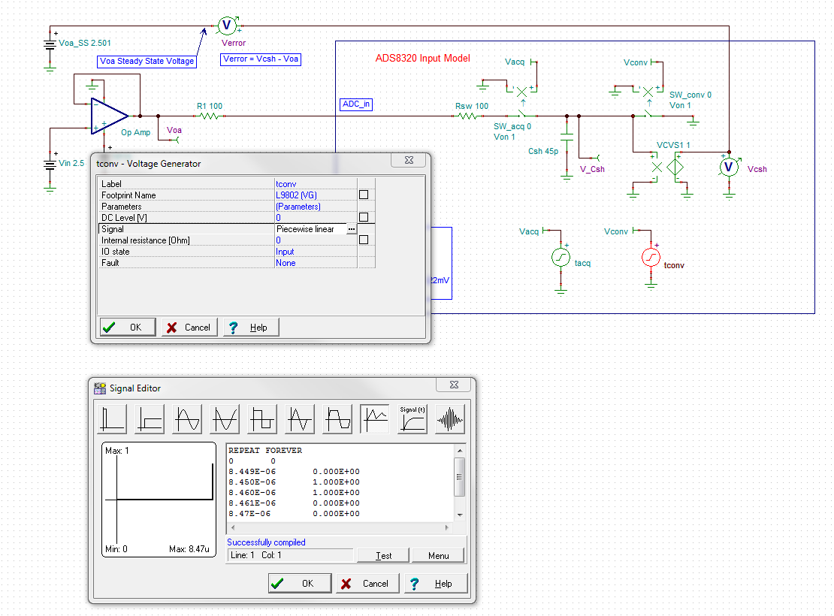
tacq PWL Voltage Source
Paste from Excel
“PWL EZ Build SAR Timing”
worksheet.

Slide 17
ADS8320 Input Model Complete

Slide 18
ADS8320 Input Model Complete – Zoom In
Note tconv pulse at the end of tconv before rise of tacq.
At end of tacq = 1, Verror = 152nV and (1/2 LSB = 38.15uV). This ideal op amp and 100 ohms into ADC_in would work.

Slide 19
Input Drive of SAR ADC

Slide 20
Improper ADC Input Drive
At end of tacq Verror is
-3.1mV or 4.23 LSBs
At end of tacq Voa is not fully settled.
Real parts will vary on Aol and settle.
Not a robust design.

Slide 21
Proper ADC Input Drive: Response with optimized Op Amp, R-C
At end of tacq Voa is fully settled.
Verror < 1/2LSB at end of tacq

Slide 22
Op Amp Stability Reference
For detailed, definition-by-example of 10 different ways to stabilize
op amps driving capacitive loads, and additional technical information
on solving op amp stability problems, visit the Texas Instruments
E2E Forum at:
http://e2e.ti.com/support/amplifiers/precision_amplifiers/w/design_notes/2645.solving-op-amp-stability-issues.aspx
Download Part 1, Part 2, Part 3, and Part 4.
All Embedded Schematics in this presentation can be run in the Free TINA_TI SPICE simulator available at:
http://www.ti.com/tool/tina-ti

