Slide 1
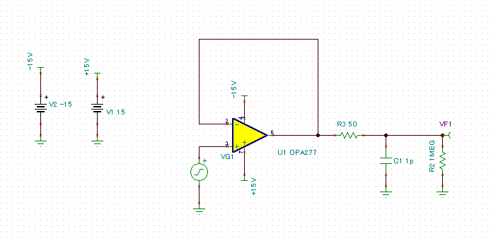
OPA277 TINA-TI Schematics

Slide 2
AC Bode Simulation Result
Using TINA-TI Default Model
TINA-TI Spice model from TI web site
http://www.ti.com/jp/lit/zip/sbom271

