Slide 1
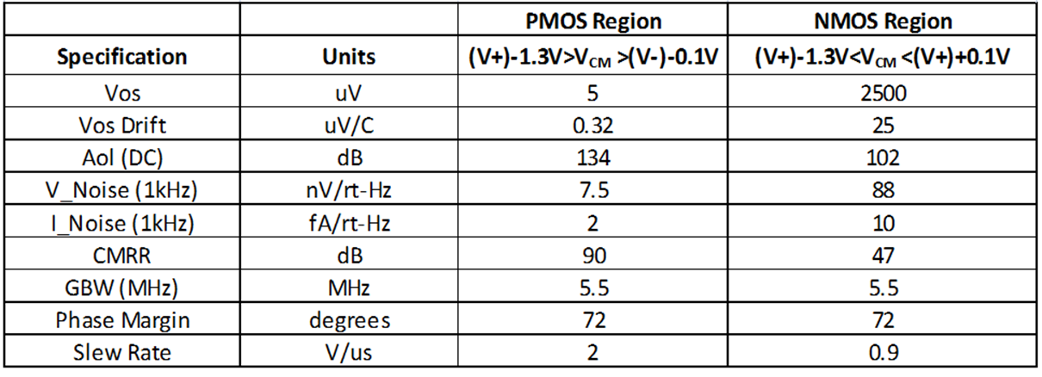
What else happens when input common mode voltage is:
(V+)-1.3V < Vcm < (V+) + 0.1V ?????
OPA376 Datasheet

