Slide 1
PADC - Isolation Collateral Overview
21AUG2023

Slide 2

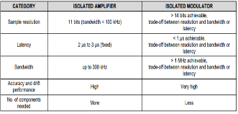

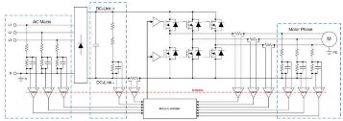

Collateral – Introduction & design considerations
Introduction to
Isolated Amplifiers and Isolated Modulators
Comparing
Isolated Amplifiers and Isolated Modulators
Literature#: Link, Video 1, Video 2
Literature#: SBAA359
Summary: Basic introduction to isolated amplifiers and isolated modulators
Summary: In-depth comparison and between isolated amplifiers and isolated modulators highlighting the advantages and disadvantages of both
Design considerations for
Isolated current sensing
Isolated voltage sensing
in AC motor drives
Literature#: SLYT810
Literature#: SLYT827
Summary: This article covers practical decisions in detail to help select an isolated amplifier best suited to a specific system.
Example
Summary: Guidance on selecting the right isolated amplifier by evaluating three common voltage measurements in an AC motor-drive end equipment.

Slide 3
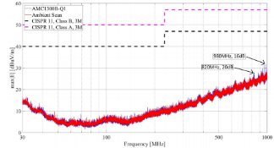
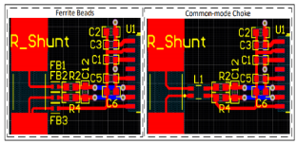
Collateral - EMI Performance
Best in Class Radiated Emissions EMI Performance with the
AMC1300B-Q1 Isolated Amplifier
Best Practices to Attenuate
AMC3301 Family Radiated Emissions EMI
Literature#: SBAA438
Literature#: SBAA515
Summary: Radiated EMI of AMC1300B-Q1 and radiated emissions performance for previous isolated amplifier generations
Summary: Demonstrates how PCB input trace or cable design affects EMI. Ferrite bead and common-mode choke selection & placement recommendations are provided.

Slide 4
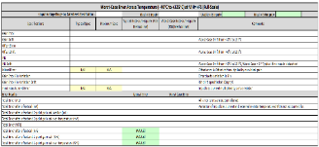
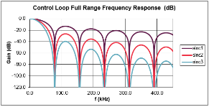
Collateral – Excel Calculators
Isolated Amplifier Voltage Sensing Accuracy
Excel Calculator
Literature#: SBAR013
Summary: Excel Calculator that provides worst-case voltage measurement accuracy with and without calibration over temperature for Isolated Amplifiers
Isolated Modulator Filter
Excel Calculator
Literature#: SBAR010
Summary: Excel Calculation that provides various output parameters and plots of digital filter behavior for isolated modulators
Isolated Amplifier Current Sensing Accuracy
Excel Calculator
Literature#: SBAR020
Summary: Excel Calculator that provides worst-case current measurement accuracy with and without calibration over temperature for Isolated Amplifiers.
Additional shunt selection section.

Slide 5
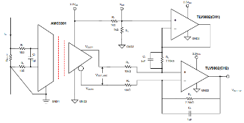
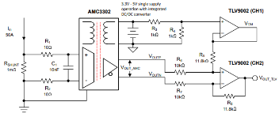
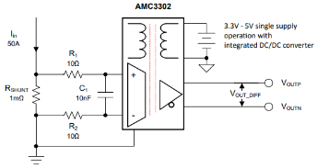
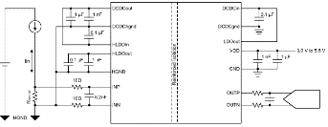
Collateral – Cookbooks: current sensing
Isolated current-measurement circuit
with ±250-mV input and single-ended output
Isolated current-measurement circuit
with ±50-mV input and single-ended output
Literature#: SBAA347
Literature#: SBAA348
Summary: This isolated current sensing circuit can accurately measure load currents from, but not limited to, –10 A to 10 A with a nominal power dissipation of 2.5 W across a 25-mΩ shunt resistor and a single-ended output.
Summary: This isolated single-supply bidirectional current sensing circuit can accurately measure load currents from –50 A to 50 A with single-ended output.
Isolated current-measurement circuit
with ±250-mV input and differential output
Isolated current-measurement circuit
with ±50-mV input and differential output
Literature#: SBAA339
Literature#: SBAA349
Summary: This isolated single-supply bidirectional current sensing circuit can accurately measure load currents from -50A to 50A with differential output.
Summary: This isolated single-supply bidirectional current sensing circuit can accurately measure load currents from –50 A to 50 A with differential output.

Slide 6
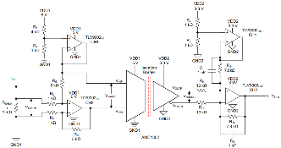
Collateral – Cookbooks: current sensing
Isolated Current-Sensing Circuit
With Front-End Gain Stage and Single-ended Output
Literature#: SBAA568
Summary: This circuit design document describes an isolated current-sensing circuit that can accurately measure nominal load currents from ±10 mA to ±10 A, while withstanding a short-circuit current up to ±200 A.

Slide 7
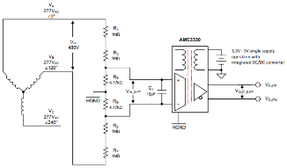
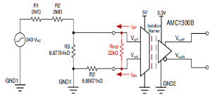
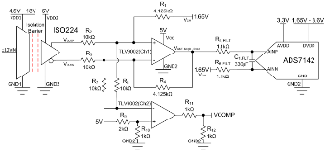
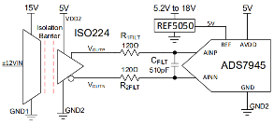
Collateral – Cookbooks: voltage sensing
Isolated voltage-measurement circuit with
±250-mV input and differential output
Split-Tap Connection for Line-to-Line
Isolated Voltage Measurement
Literature#: SBAA350
Literature#: SBAA553
Summary: Designing Isolated voltage-measurement circuit with ±250-mV low input impedance reinforced isolated amplifier, AMC1300B
Summary: This circuit performs a split-tap line-to-line isolated voltage-sensing measurement utilizing the AMC3330 isolated amplifier and a voltage-divider circuit.
±12-V voltage sensing circuit with an isolated amplifier
and pseudo-differential input SAR ADC
±12-V voltage sensing circuit with an isolated amplifier
and differential input SAR ADC
Literature#: SBAA317
Literature#: SBAA312
Summary: This circuit performs a ±12-V isolated voltage sensing measurement utilizing the ISO224 isolated amplifier, TLV9002 operational amplifier, and the ADS7142 SAR ADC.
Summary: This circuit performs a ±12-V isolated voltage sensing measurement utilizing the ISO224 isolated amplifier and the ADS7945 SAR ADC.

Slide 8
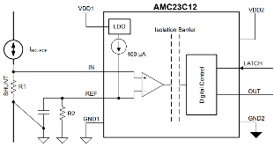

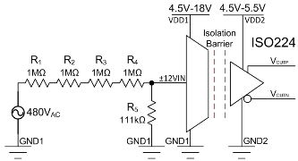
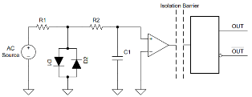
Collateral – Cookbooks: comparators
Isolated Undervoltage and
Overvoltage Detection Circuit
Isolated Overcurrent Protection Circuit
Literature#: SBAA529
Literature#: SBAA546
Summary: This high-speed, isolated undervoltage and overvoltage detection circuit is implemented with a dual isolated window comparator with an adjustable threshold: AMC23C14
Summary: This high-speed, isolated bidirectional overcurrent detection circuit is implemented with the AMC23C12.
Isolated Zero-Cross Detection Circuit
±480-V isolated voltage-sensing circuit
with differential output
Literature#: SBAA542
Literature#: SBAA321
Summary: A zero-crossing detector circuit changes output state when the AC input crosses the zero-cross reference voltage.
Summary: This circuit performs a ±480-V, isolated, voltage-sensing measurement utilizing the ISO224 isolated amplifier and a voltage-divider circuit.

Slide 9
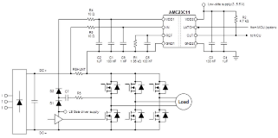
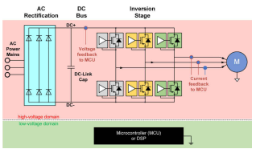
Collateral – Comparators
DC+ Bus Power-Supply Solution
Using Bootstrap Charge Pump Technique
Using isolated comparators for
fault detection in electric motor drives
Literature#: SBAA549
Literature#: SLYT820
Summary: This article introduces a cost-effective approach for generating the power supply for the isolated comparator sitting on the DC+ side.
Summary: Priority level and impact of different fault events, along with how to detect them to prevent damage to motor-drive circuits.

Slide 10
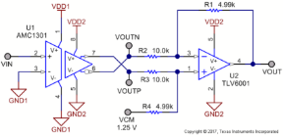
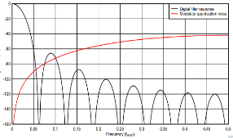
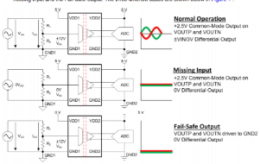
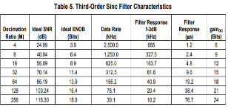
Collateral - Others
Interfacing a
Differential-Output (Isolated) Amplifier to a Single-Ended Input ADC
Digital Filter Types in
Delta-Sigma ADCs
Literature#: SBAA229
Literature#: SBAA230
Summary: Provides schematic and device recommendation to interface a Differential-Output (Isolated) Amplifier to a SE Input ADC
Summary: Discusses digital filters which are a ubiquitous feature in delta-sigma analog to digital converters (ADCs)
ISO224
Fail-Safe Output Feature
Combining the ADS1202 with an FPGA Digital Filter
for Current Measurement in Motor Control Applications
Literature#: SBAA299
Literature#: SBAA094
Summary: This document will describe the Fail-Safe output feature of the ISO224 in detail
Summary: Describes how to combine the
ADS1202 with appropriate filtering techniques for current measurement in motor control.

Slide 11
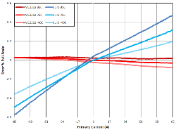
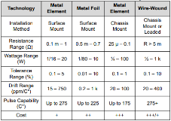
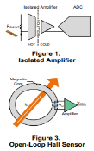


Collateral - Shunt vs Hall
Accuracy Comparison of
Isolated Shunt and Closed-Loop Current Sensing
Shunt Resistor Selection for Isolated Data Converters
Literature#: SBAA464
Literature#: SBAA460
Summary: System-level comparison with real data between AMC3302 (a single-supply, isolated amplifier) and a popular closed-loop current sensor (CLCS)
Literature#: SBAA318
Summary: Selecting the correct shunt resistor for a given application is not always straightforward. This application brief discusses shunt resistors that are often used for isolated current sensing and their tradeoffs.
Comparing shunt- and hall-based
isolated current-sensing solutions in HEV/EV
Comparing shunt- and Hall-based current-sensing solutions
in onboard chargers and DC/DC converters
Literature#: SBAA293
Literature#: SBAA318
Summary: Introductory system-level comparison between shunt- and hall-based isolated current solutions
Summary: Detailed system-level comparison between shunt- and hall-based isolated current sensing solutions in AC/DC and DC/DC converters

Slide 12
Isolated Amplifiers Portfolio: Selection Tree
Isolated Amplifiers
Current Sensing
Voltage Sensing
Dual Supply
Single Supply
Single Supply
Dual Supply
±50 mV
±250 mV
±50 mV
±250 mV
AC
DC
AC
DC
Q1
Q1
Q1
Q1
Q1
Q1
Q1
AMC1302
AMC1200
AMC3302
AMC3301
AMC3330
± 1V Input
AMC1350
± 5V Input
AMC1211
0..2V Input
Q1
Q1
AMC1300B
ISO224
±12V Input
AMC1311
0..2V Input
Q1
Q1
AMC1400
>15mm creepage
AMC1351
0..5V Input
Q1
AMC1411
0..2V Input
>15mm creepage

Slide 13
Isolated Modulators Portfolio: Selection Tree
Isolated Modulators
Current Sensing
Voltage Sensing
Dual Supply
Single Supply
Single Supply
Dual Supply
±50 mV
±250 mV
±50 mV
±250 mV
±1 V
±1 V
Q1
Q1
AMC1303x
Internal Clock, CMOS, Manchester
AMC3306x
Ext Clock, CMOS
AMC3336
Ext Clock, CMOS
AMC1333M10
Internal 10MHz Clock, CMOS
Q1
Q1
AMC1304x
Ext. Clock, LDO, LVDS/CMOS
AMC1336
Ext Clock, CMOS
Q1
AMC1305x
Ext Clock, LVDS/CMOS
Q1
AMC1306x
Ext Clock, high CMTI, CMOS, Manchester

Slide 14
Isolated Current Sensing: Selection Tree
Isolated Current Sensing
Modulator
Amplifier
Dual Supply
Single Supply
Single Supply
Dual Supply
±50 mV
±250 mV
±50 mV
±250 mV
±50 mV
±250 mV
±50 mV
±250 mV
AMC1303x
Internal Clock, CMOS, Manchester
Q1
Q1
Q1
Q1
AMC3306x
Ext Clock, CMOS
AMC3302
AMC3301
AMC1302
AMC1200
Q1
Q1
AMC1304x
Ext. Clock, LDO, LVDS/CMOS
AMC1300B
Q1
Q1
AMC1305x
Ext Clock, LVDS/CMOS
AMC1400
Q1
AMC1306x
Ext Clock, high CMTI, CMOS, Manchester

Slide 15
Isolated Voltage Sensing: Selection Tree
Isolated Voltage Sensing
AC
DC
Modulator
Amplifier
Modulator
Amplifier
Dual Supply
Single Supply
Single Supply
Dual Supply
Dual Supply
Single Supply
Dual Supply
Single Supply
Q1
Q1
Q1
Q1
Q1
AMC1035
Non-Iso, ± 1V Input
AMC3336
± 1V Input
AMC3330
± 1V Input
AMC1350
± 5V Input
AMC1211
0..2V Input
Basic Isolation
ISO224
±12V Input
Q1
Q1
AMC1311
0..2V Input
AMC1333M10
Int clock, ± 1V Input
Q1
Q1
AMC1351
0..5V Input
AMC1336
Ext clock, ± 1V Input
Q1
AMC1411
0..2V Input
>15mm creepage

Slide 16
Isolated Comparators Portfolio
 | AMC2xC10 | AMC2xC11 | AMC2xC12 | AMC2xC14
Description | Isolated differential comparator | Isolated comparator with reference | Isolated window comparator with reference | Isolated dual window comparator with reference
# of Channels | 1 | 1 | 1 | 2
Output | Open Drain and Push Pull | Open Drain | Open Drain | Open Drain
Latch Function | No | Yes | Yes | No
Applications | Zero cross detection General purpose comparator function | DC+/DC– OC detection OV detection General purpose comparator function | Bi-directional phase over-current Detection DC+/DC– OC detection | Bi-directional phase over-current and short-circuit detection UV & OV detection Over-temp detection

