Slide 1
Thermocouple formation on PC Boards Content by Ian Williams and Thomas Kuehl Precision Amplifiers Applications Engineering Texas Instruments Incorporated - Tucson

Slide 2
Thermocouple Theory
Seebeck voltage
-
Conductor
+
Cool
Thermal energy flow
Hot
Electrical charge carrier movement
T_{C}
T_{H}
Temperature gradient (∆T)
Any conductor will produce a voltage when there is a temperature gradient (ΔT) across it
Known as the “Seebeck Effect”
Notes:
A simple wire of any metal will produce a voltage when there is a temperature difference between the two ends. Yes… believe it!
When one end of a conductive material is heated to a temperature larger than the opposite end, the electrons at the hot end are more thermally energized than the electrons at the cooler end. These more energetic electrons begin to diffuse toward the cooler end. Of course, charge neutrality is maintained; however, this redistribution of electrons creates a negative charge at the cool end and an equal positive charge (absence of electrons) at the hot end. Consequently, heating one end of a conductor creates a electrostatic voltage due to the redistribution of thermally energized electrons throughout the entire material. This is referred to as the “Seebeck effect.” While a single wire does not form a thermocouple, this “Seebeck effect” is the fundamental property that governs thermocouple operation.

Slide 3
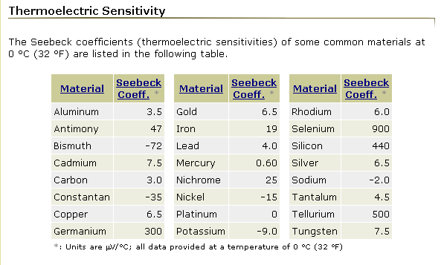
Thermocouple Theory
Source: www.efunda.com
Notes:
Different metals, metal alloys and semiconductor materials are employed in the construction of thermocouples. Their thermoelectric sensitivities, or Seebeck coefficients, can vary significantly in magnitude and may be positive or negative.
The material selections have been well characterized and standardized, and form the basis for the commonly available thermocouples.
Note that different tables may list a somewhat different Seebeck coefficients for a given material. Be sure to note the temperature at which the coefficient is specified. Thermocouples are not perfectly linear across temperature. They may produce a different Seebeck voltage coefficient within the different temperature ranges that they operate. This occurs because the Seebeck voltage generated is dependent on a complex mix consisting of the Seebeck, Peltier and Thomson effects.

Slide 4
Thermocouple Theory
Positive Seebeck coefficient
Electrical charge carrier movement
Temperature
measurement
junction
+
Copper
6.5uV/°C
41.5uV/°C
Thermal energy flow
–
Constantan
-35uV/°C
Negative Seebeck coefficient
Electrical charge carrier movement
Different metals have different thermal sensitivities
Two metals can be joined together to create a practical temperature measurement device with a known thermoelectric behavior
Notes:
Different thermocouple materials have different capacities for moving charge carriers in response to thermal flow. The current level in one conductor will overcome or complement the potential for thermally generated current flow in the other conductor. The result is a continuous current flow that is the difference between the currents generated in the two conductors.
For this example, the two selected metals are copper and constantan which have Seebeck coefficients of approximately +6.5uV/°C and -35uV/°C, respectively. The difference between these two coefficients results in a thermocouple sensitivity of about +41.5uV/°C at 0°C.

Slide 5
Thermocouples on PCBs
Junctions of dissimilar conductors are everywhere on a PCB!
Components soldered to a copper pad
Wires mechanically attached to the PCB
Jumpers and connectors
Solder joints
PCB vias
Copper traces
Resistor film
Resistor end caps
Junction #1
Junction #4
Junction #2
Junction #3
Source: “Op Amp Precision Design: PCB Layout Techniques”
Notes:
These are some common ways that parasitic thermocouples can be formed on a PCB.
As an example, a surface-mount resistor installed on a PCB contains four junctions of dissimilar conductors and therefore four thermocouples.

Slide 6
Thermocouples on PCBs
If temperature gradients are present, these junctions will create a thermoelectric voltage.
8.999 mV
14.000 mV
14.010 mV
0 mV
-0.038 mV
125.0°C
126.2°C
125.1°C
126.1°C
In this example, a temperature gradient of +1.2°C caused a total of -38 µV to appear across a resistor.
Source: “Op Amp Precision Design: PCB Layout Techniques”
Notes:
Here we assume that a temperature gradient of +1.2°C is present across the resistor. If we know the Seebeck coefficients of the metals involved, we can calculated the expected thermoelectric voltage caused by the temperature change. In this case, a total of -38uV was developed across the resistor.

Slide 7
Test Case: INA333 V_{OS} Circuit – non-symmetrical Testing vias and 0 Ω resistors for thermocouple behavior
INA333
Av = 101 V/V
Notes:
Two similar circuits were designed to test the effects of parasitic thermocouples in a precision instrumentation amplifier circuit
Circuit 1 – Asymmetrical
INA333 with gain = 101V/V
V_{IN+} and V_{IN-} shorted, no input signal applied
5 parasitic thermocouples in series on V_{IN-} copper trace
V_{OUT} of INA333 was measured to observe change in V_{OS} as a result of parasitic thermocouple effect

Slide 8
INA333 V_{OS} Circuit (Symmetrical) Testing vias and 0 Ω resistors for thermocouple behavior
INA333
Av = 101 V/V
Notes:
Circuit 2 – Symmetrical
Same as Circuit 1, but the thermocouples are present on both the V_{IN-} and V_{IN+} traces
Both circuits include both 0Ω and via thermocouple tests (selectable via jumpers or swapping resistors)

Slide 9
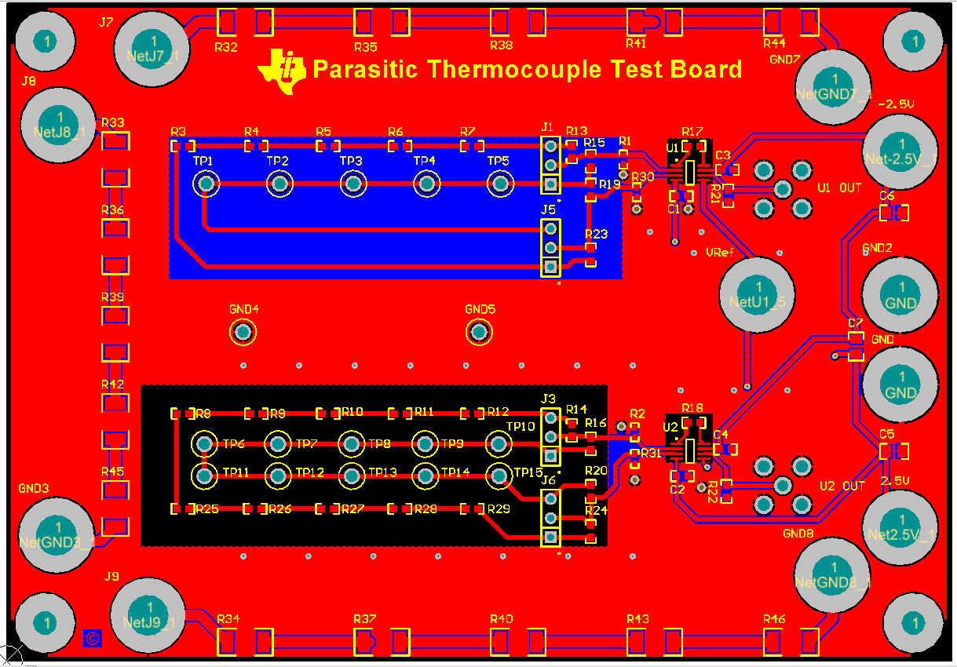
INA333 V_{OS} Circuit Layout
Notes:
This slide shows the PCB layout for this test circuit.
Note that several 5W resistor strings are included to provide controlled, on-board heat generation. Also note that there is no copper pour underneath the symmetrical circuit, while a GND pour is present on the bottom of the board beneath the asymmetrical circuit. This is done in order to test the benefit of thermally isolating the sensitive input circuitry from the thermal gradients induced on the board.

Slide 10
INA333 V_{OS} Results – 0Ω Resistors
Notes:
As you can see, heating the board caused the asymmetrical 0-ohm resistor circuit to show a huge shift of nearly 1700µV in output voltage. Referred to the input, this is a shift in V_{OS} of 17µV.
The symmetrical 0-ohm circuit did not experience as drastic of a shift. This is both due to the cancellation of thermoelectric voltages by the balanced network of resistors and the thermal isolation provided by the cutout in the ground plane.

Slide 11
INA333 V_{OS} Results – Vias
24 µV
16 µV
Notes:
The effect of the vias is not nearly as pronounced. While there were shifts observed in the output voltage, they are not significant enough to be sure that the vias are responsible. Remember that every amplifier has drift over temperature, so it’s possible that V_{OS} and gain error drift are largely responsible for the results seen here.

Slide 12
Thermocouples - Conclusions
Parasitic thermocouples can have a significant impact on V_{OS}!
As expected, asymmetrical configurations see a much more pronounced increase in offset voltage
0Ω resistors key result - V_{OS} (RTI) increased by up to 17µV!
Vias key result - V_{OS} (RTI) increased by up to 250nV
Difference small enough to be solely caused by INA V_{OS} and gain drift
Additional testing will be done to isolate the thermocouple effect from the V_{OS} and gain error drift of the INA333
Notes:
This slide gives the conclusions from our parasitic thermocouple test.

Slide 13

Thermocouples - Recommendations
Use symmetrical configurations to minimize V_{OS} and CMRR degradation
Isolate sensitive nodes from thermal gradients by removing copper pours which dissipate heat
Reduce the board’s heat generation or redirect the heat flow away from critical areas through the use of heat sinks or fans
Place critical components in areas of constant temperature
Heat travels radially, so follow thermal contour lines
Use materials with similar Seebeck coefficients (when possible)
Replace single resistors with equivalent parallel resistor combinations in order to cancel thermoelectric voltages
Notes:
This slide gives several recommendations on how to minimize the effects of parasitic thermocouples on a PCB.

Slide 14
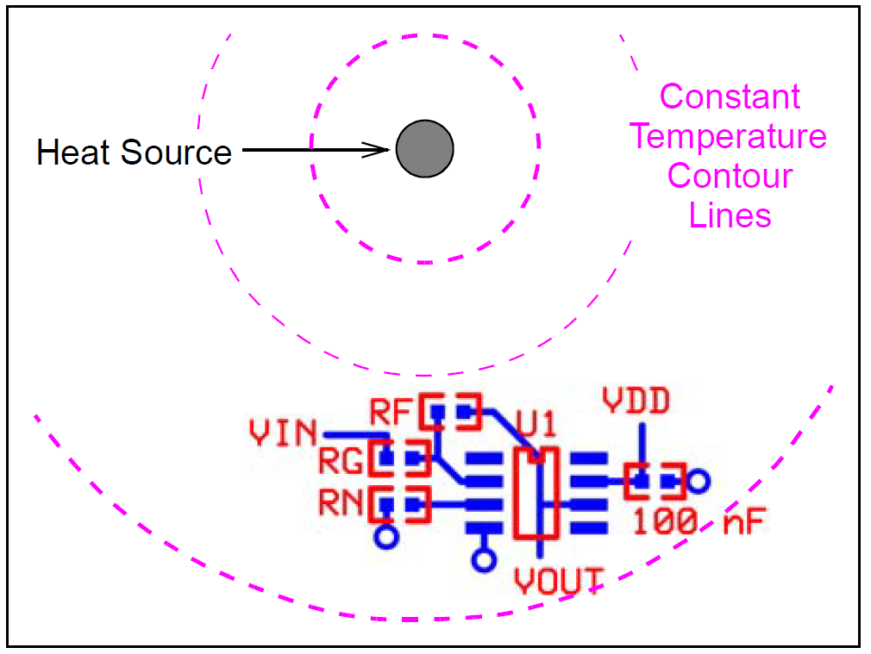
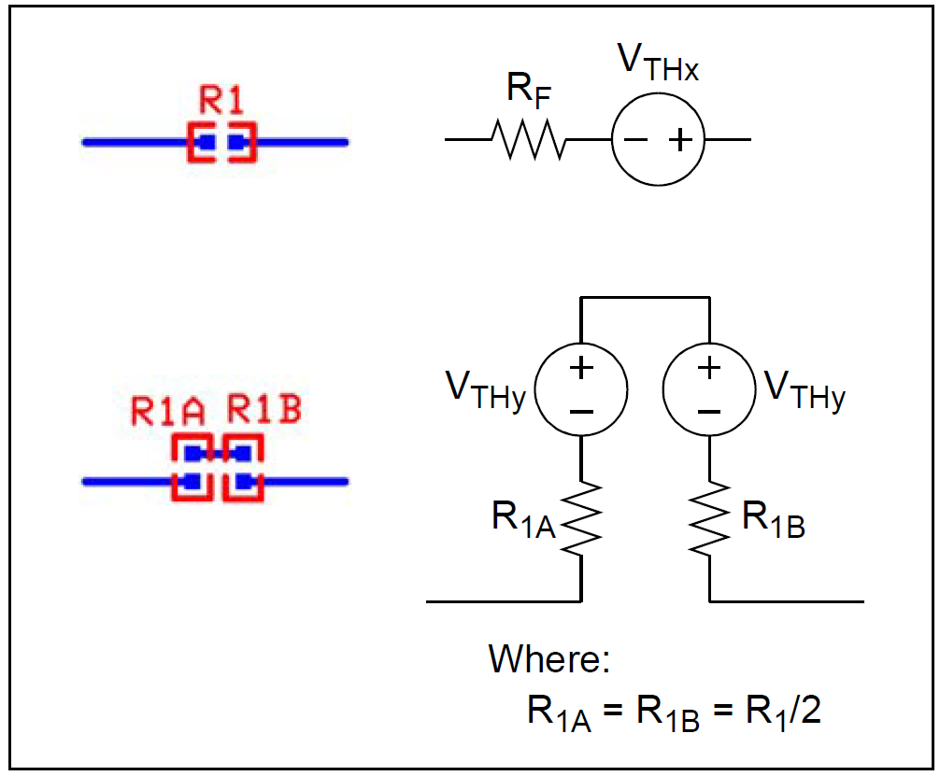
Thermocouples - Recommendations
Components aligned with
thermal contour lines
Series resistor substitution
Source: “Op Amp Precision Design: PCB Layout Techniques”
Notes:
This slide illustrates some of the recommendations given in the previous slide.

