Slide 1
PGA309EVM-USB Pre-Cal Test File and Sensor Emulation Test
November 16, 2016
Errol Leon

Slide 2
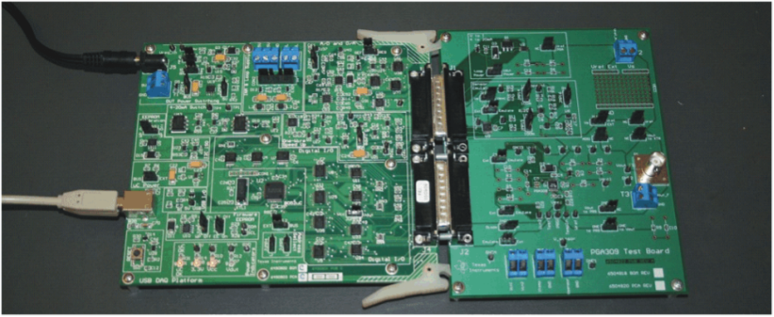
PGA309EVM-USB
Pre-Cal Loading File
Disconnect external sensors from the EVM.

Slide 3
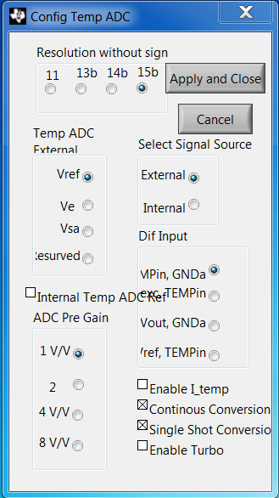
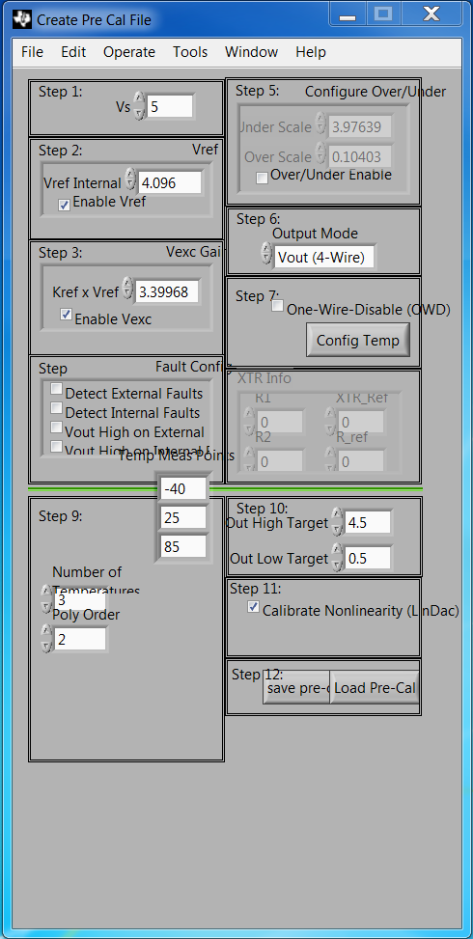
PGA309EVM-USB
Load Pre-Cal File
Load “Vout_4wire_4p096_diode_test_file.txt”
The Config Temp ADC and Pre Cal File menu should have the following settings.

Slide 4
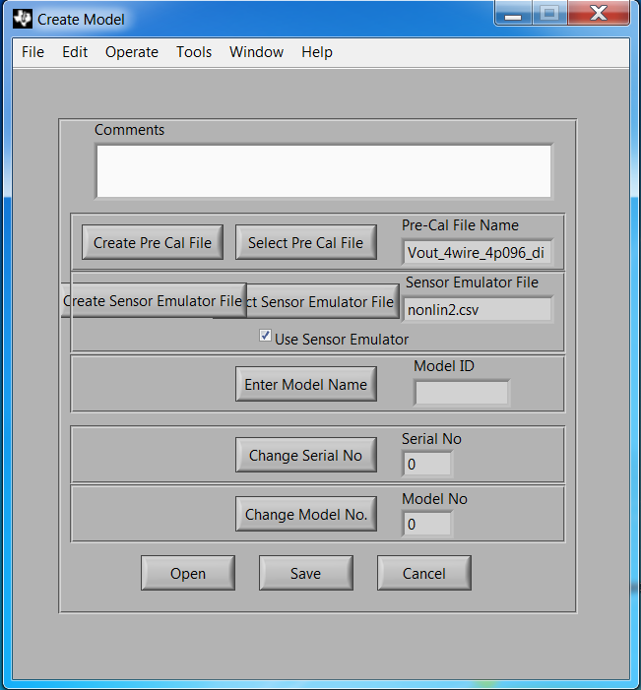
PGA309EVM-USB
Loading the Model File
Click “Select Pre Cal File”
Load “Vout_4wire_4p096_diode_test_file.txt”
Click “Select Sensor Emulation File”
Load “nonlin2.csv”
Click box “Use Sensor Emulator”
Click Save button
Save file as “4wire_4p096_diode_test_file.txt”
Close window

Slide 5
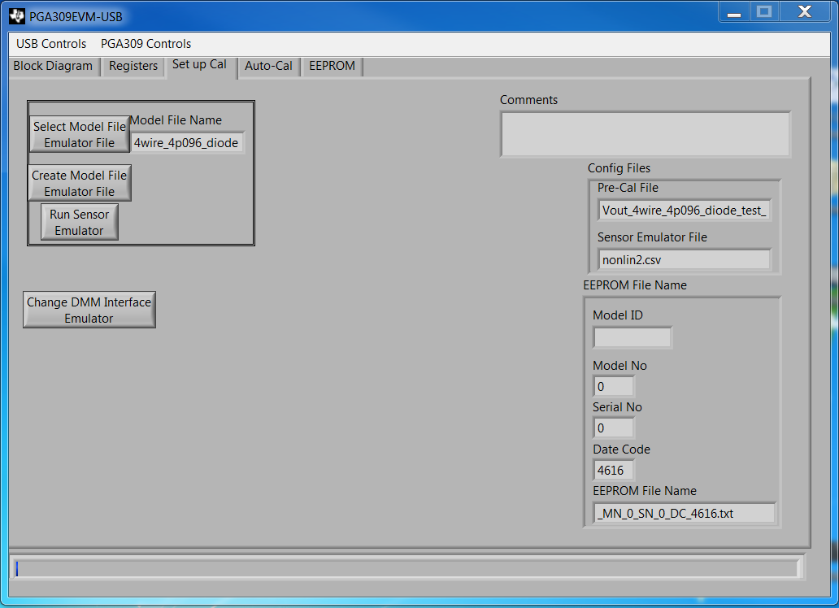
PGA309EVM-USB
Loading the Model File
Click “Select Model File Emulator File”
Load “4wire_4p096_diode_test_file.txt”
Click
Here

Slide 6
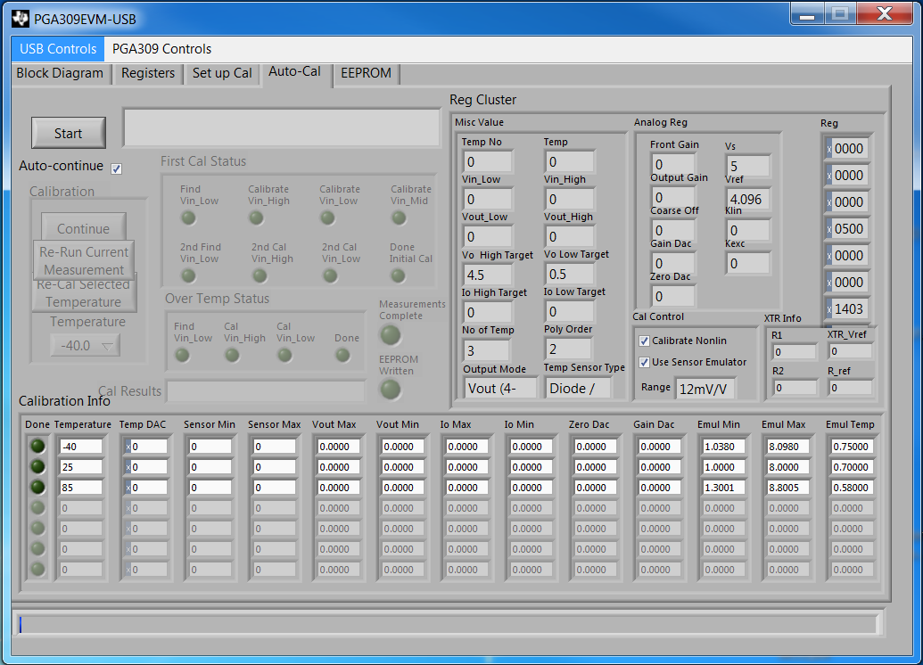
PGA309EVM-USB
Calibration
Click “Auto-continue” box
Click “Start” to initiate calibration
Click
Here

Slide 7
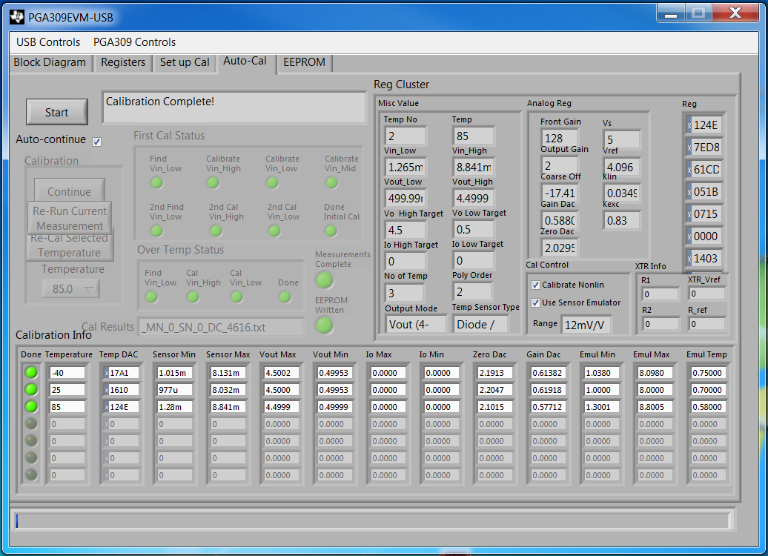
PGA309EVM-USB
Calibration
Once calibration is completed, calibration info should have the following values.

Slide 8
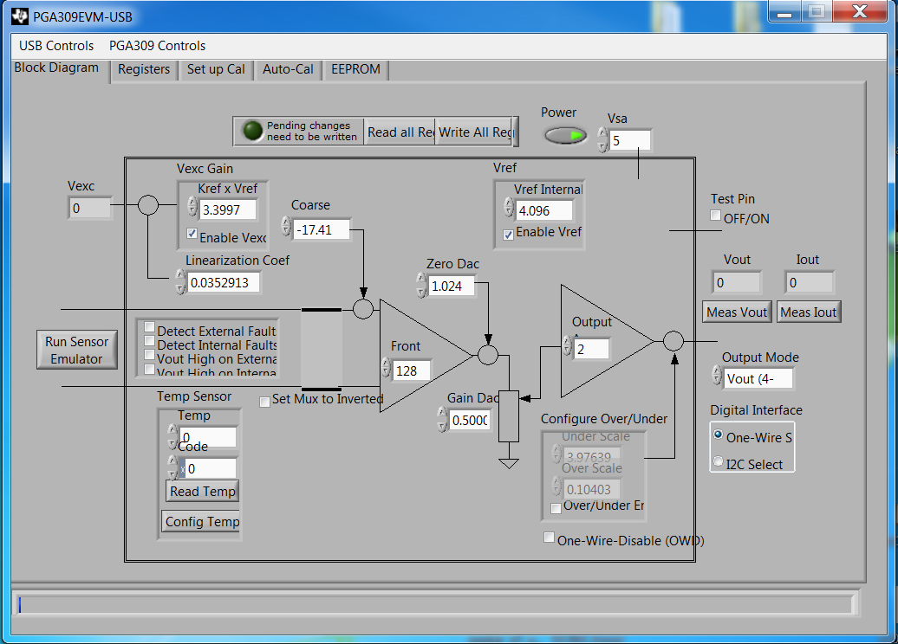
PGA309EVM-USB
Calibration
Click “Run Sensor Emulation”
Click
Here

Slide 9
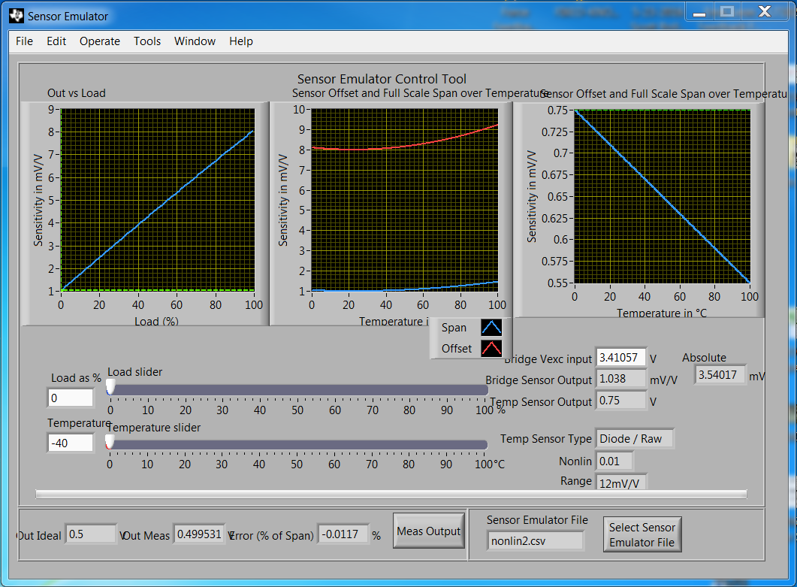
PGA309EVM-USB
Sensor Emulation
Type “-40” in the temperature box
Screen-shot results
Enter
Value Here

Slide 10
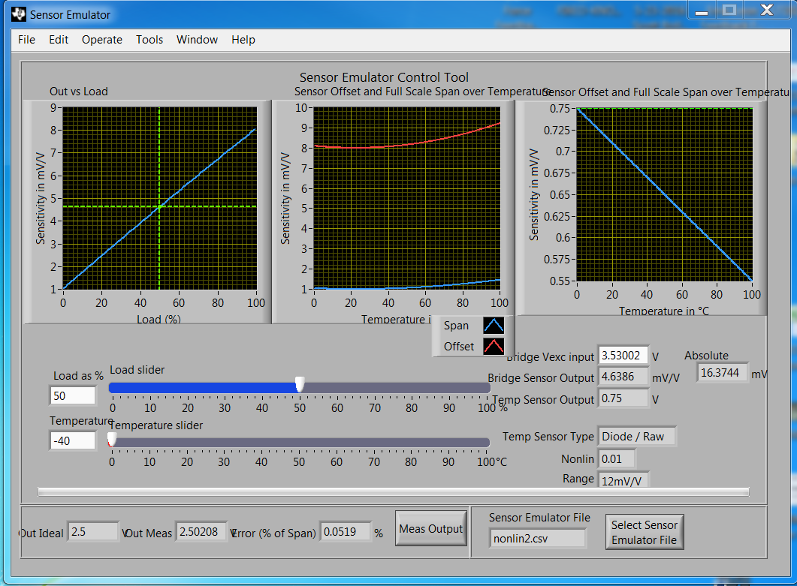
PGA309EVM-USB
Sensor Emulation
Type “50” in the Load as % box
Screen-shot results
Enter
Value Here

Slide 11
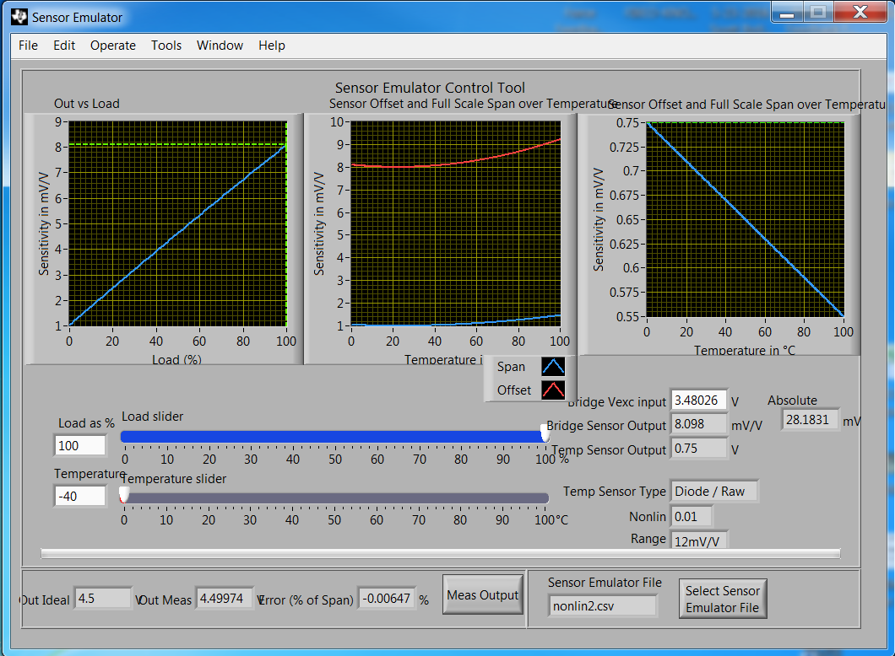
PGA309EVM-USB
Sensor Emulation
Type “100” in the Load as % box
Screen-shot results
Enter
Value Here

Slide 12
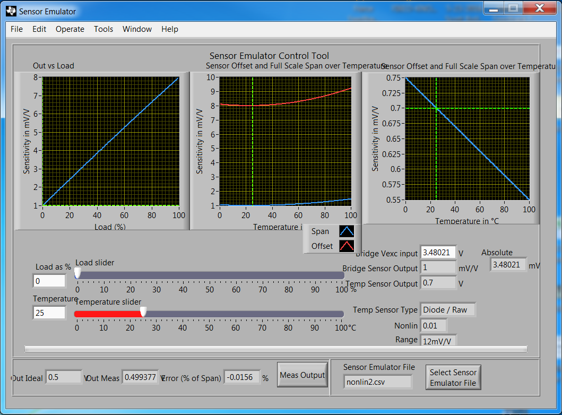
PGA309EVM-USB
Sensor Emulation
Type “25” in the temperature box
Screen-shot results
Enter
Value Here

Slide 13
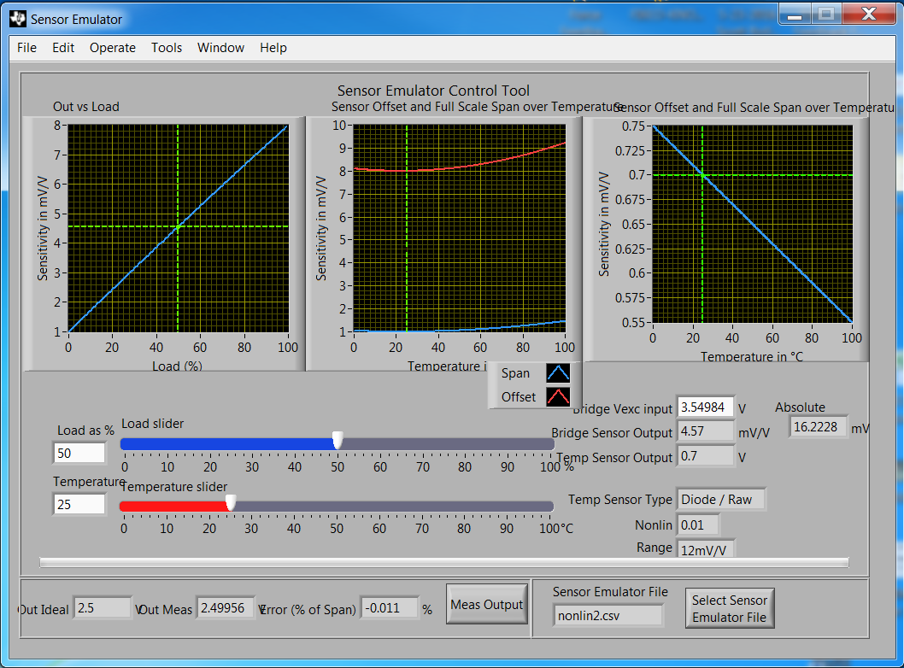
PGA309EVM-USB
Sensor Emulation
Type “50” in the Load as % box
Screen-shot results
Enter
Value Here

Slide 14
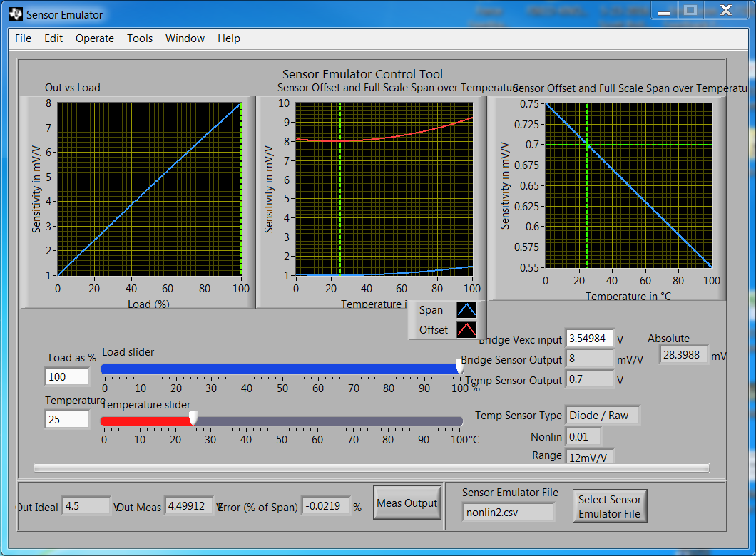
PGA309EVM-USB
Sensor Emulation
Type “100” in the Load as % box
Screen-shot results
Enter
Value Here

Slide 15
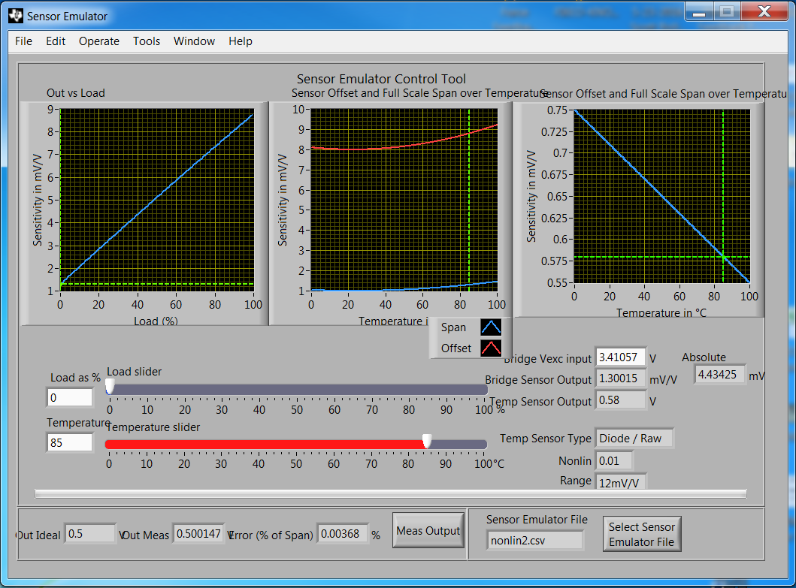
PGA309EVM-USB
Sensor Emulation
Type “85” in the temperature box
Screen-shot results
Enter
Value Here

Slide 16
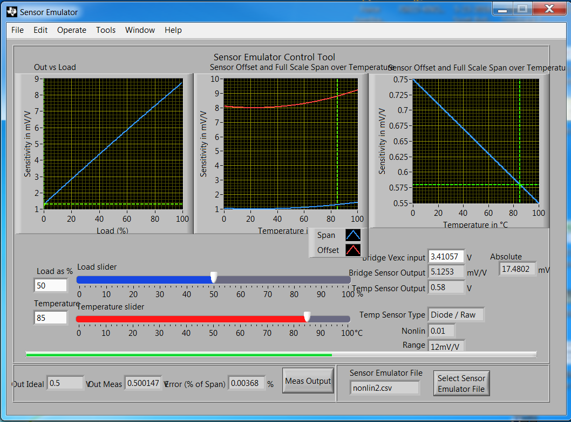
PGA309EVM-USB
Sensor Emulation
Type “50” in the Load as % box
Screen-shot results
Enter
Value Here

Slide 17
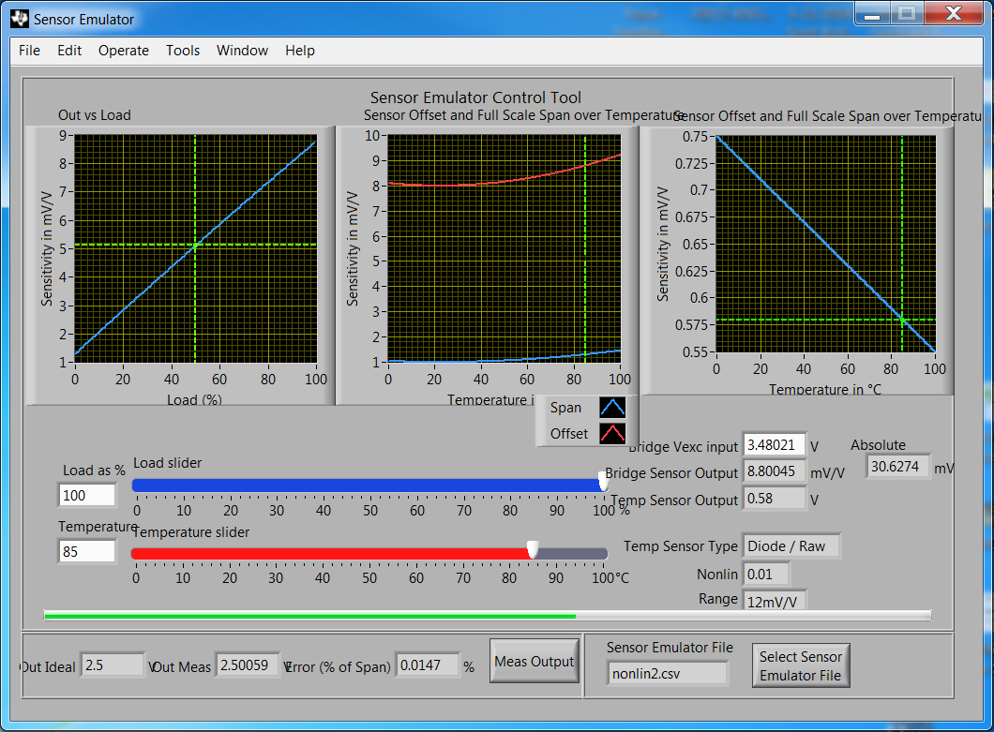
PGA309EVM-USB
Sensor Emulation
Type “100” in the Load as % box
Screen-shot results
Enter
Value Here

Slide 18
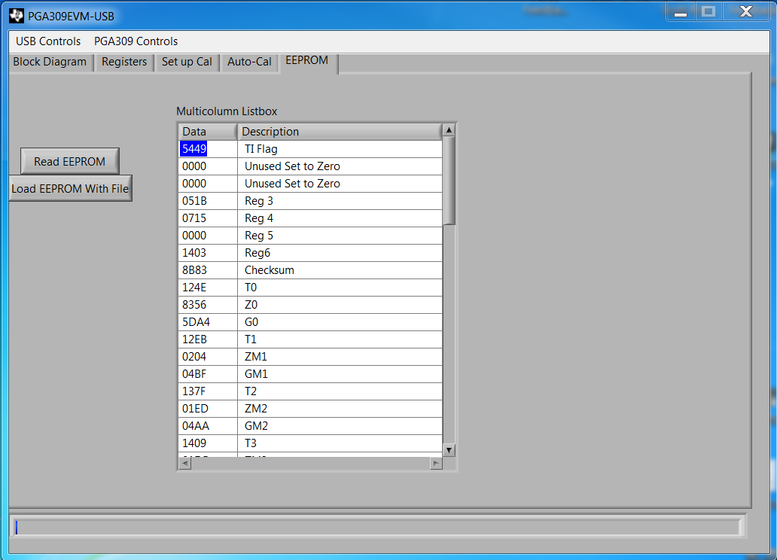
PGA309EVM-USB
EEPROM Data
Screen-shot EEPROM results

