Slide 1
PGA309EVM GUI
Turn Test Pin ON
Change value, ‘Write All Reg’ to save value, ‘Read all Reg’ to see output change

Slide 2
Q1
We observe that if we change a value in the tab 'Block Diagram' of the GUI the value is overwritten after a 'Read all Reg' was performed. Please note that we already changed into the test mode. Why does it overwrite the value?

Slide 3


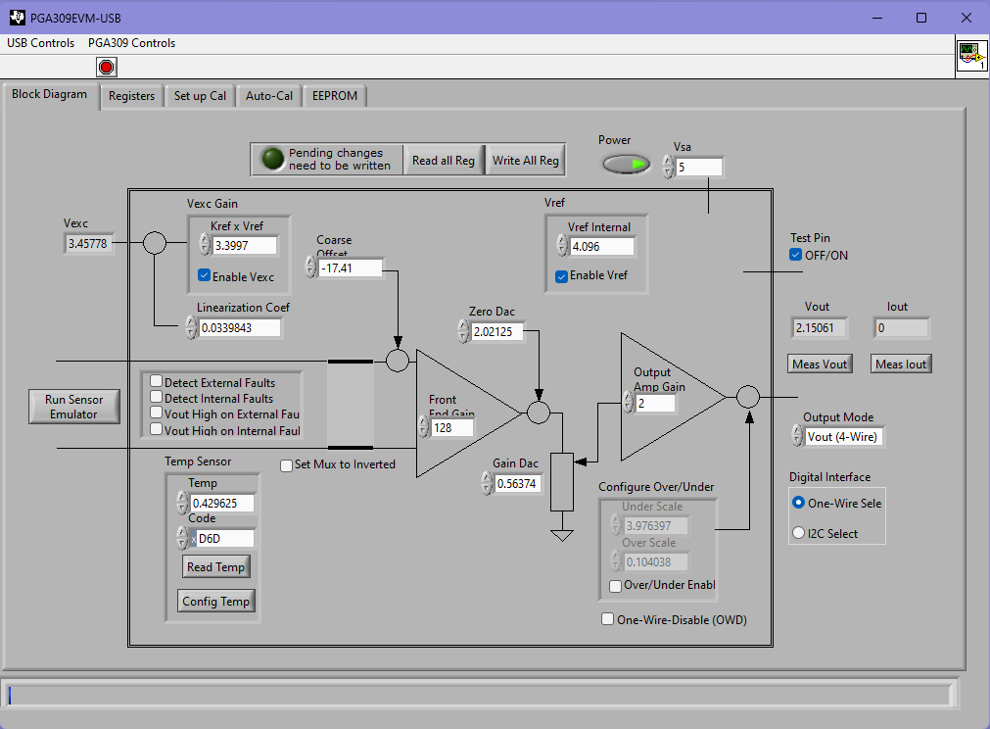
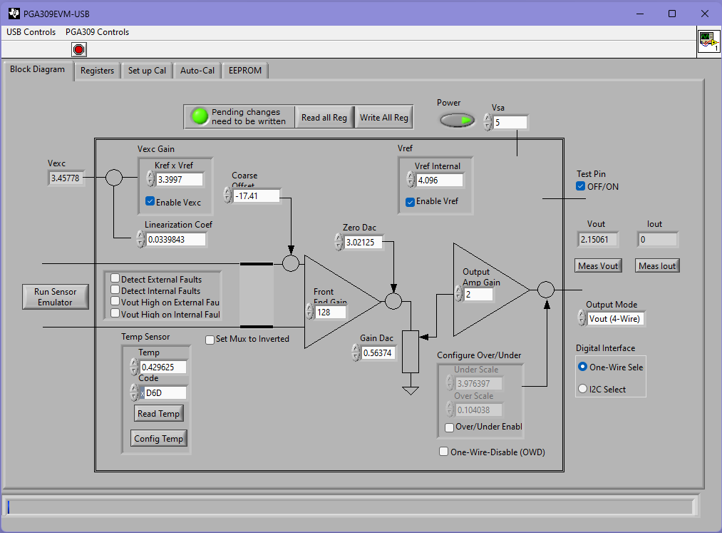
Initial & Pending values (Test Pin ON)

Slide 4



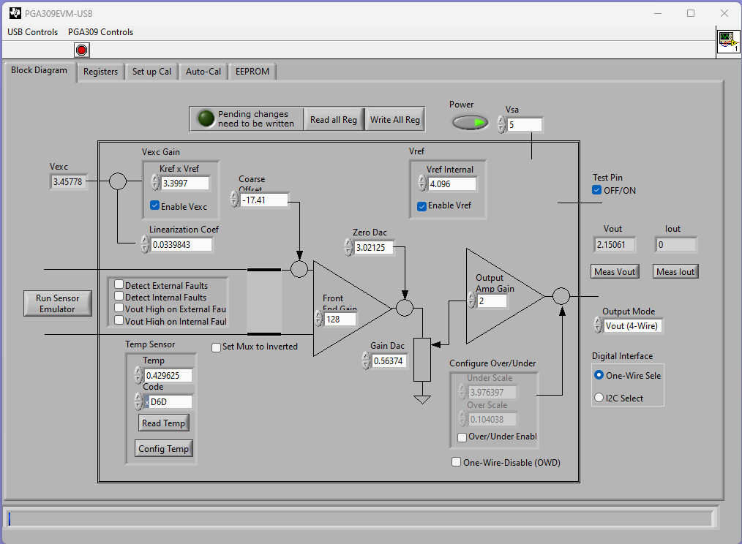
Pending values & ‘Write All Reg’
Bold when pending Not bold when written

Slide 5

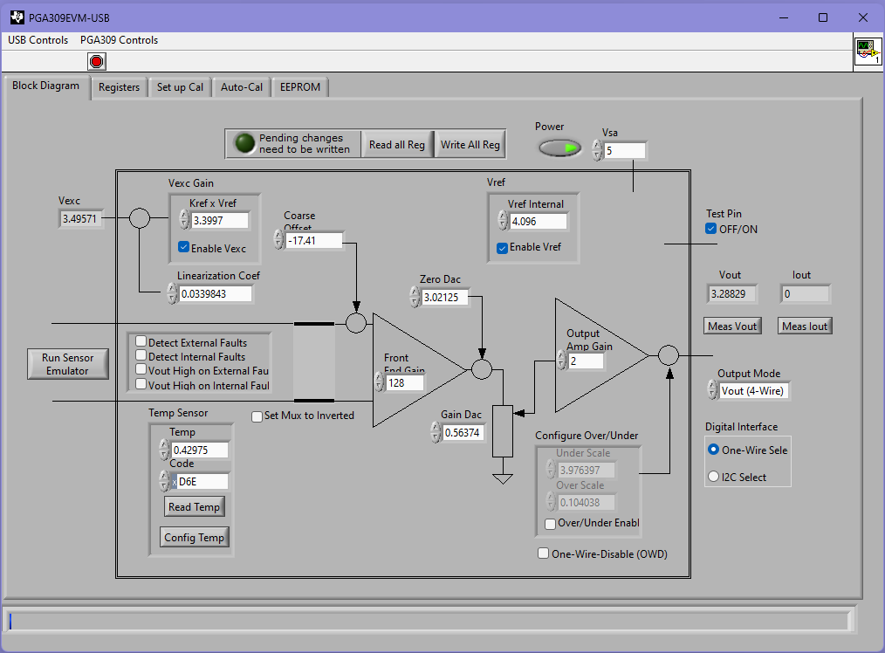
‘Write All Reg’ & ‘Read all Reg’

Slide 6

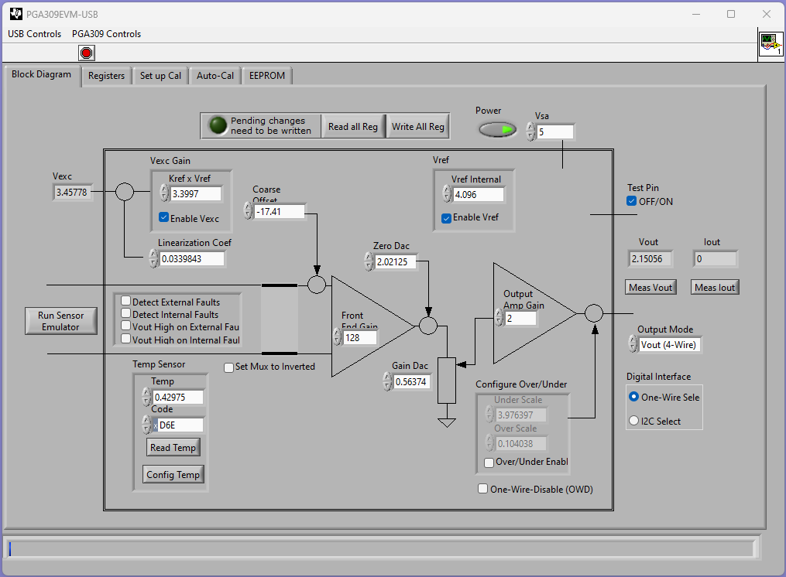
If Pending -> ‘Read all Reg’, value is overwritten

