Slide 1
PGA855 Single-ended AC performance
across different input signals (frequency, voltage, and shape)

Slide 2
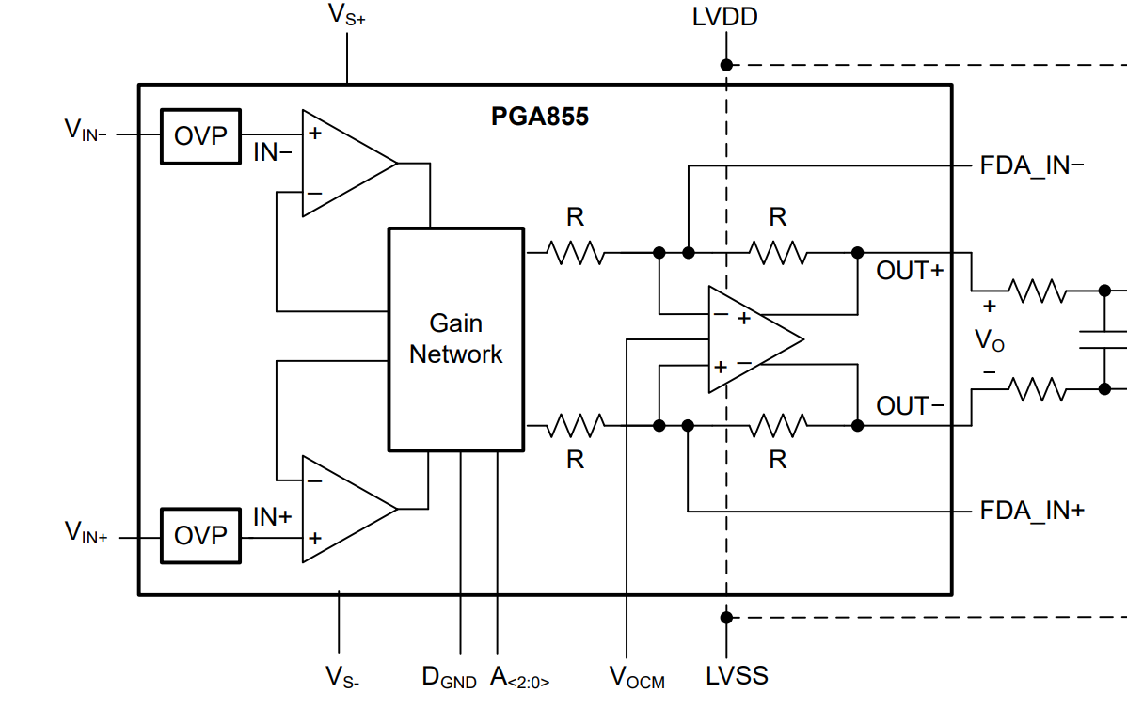
PGA855 Configuration
+12 V
5 V
0V
OUT+ (CH4)
VO (MATH)
OUT- (CH3)
VIN (CH2)
-12 V
0V
000
G = 0.125V/V
2.5 V

Slide 3
Summary Table (Gain of 0.125 V/V)
Input Voltage (Vpp) | Frequency (Hz) | Sine (Normal?) | Square (Normal?) | Triangle (Normal?)
5 | 50k | Yes; 5V, 50k, Sine | Yes; 5V, 50k, Square | Yes; 5V, 50k, Triangle
 | 250k | Yes; 5V, 250k, Sine | Yes; 5V, 50k, Square | Yes; 5V, 250k, Triangle
 | 1M | Yes; 5V, 1M, Sine | No; 5V, 1M, Square | Yes; 5V, 1M, Triangle
10 | 50k | Yes; 10V, 50k, Sine | Yes; 10V, 50k, Square | Yes; 10V, 50k, Triangle
 | 250k | Yes; 10V, 250k, Sine | No; 10V, 250k, Square | Yes; 10V, 250k, Triangle
 | 1M | No; 10V, 1M, Sine | No; 10V, 1M, Square | No; 10V, 1M, Triangle

Slide 4
Summary Table (Gain of 0.125 V/V)
Input Voltage (Vpp) | Frequency (Hz) | Sine (Normal?) | Square (Normal?) | Triangle (Normal?)
8 | 50k | Yes; 8V, 50k, Sine | Yes; 8V, 50k, Square | Yes; 8V, 50k, Triangle
 | 250k | Yes; 8V, 250k, Sine | No; 8V, 250k, Square | Yes; 8V, 250k, Triangle
 | 1M | Yes; 8V, 1M, Sine | No; 8V, 1M, Square | Yes; 8V, 1M, Triangle

Slide 5
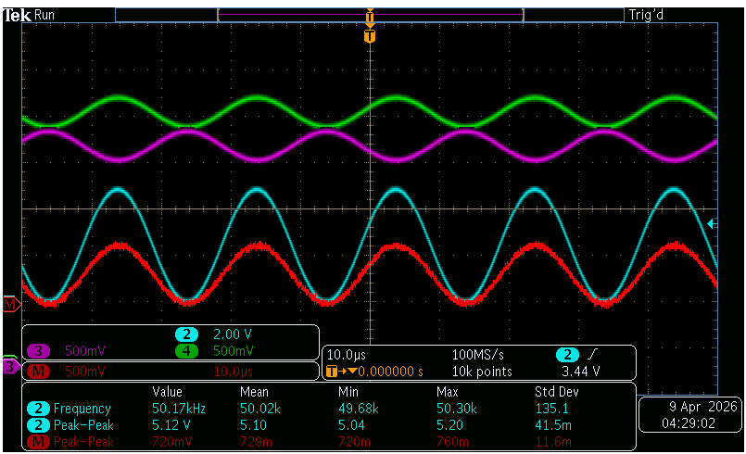
5V, 50k, Sine

Slide 6
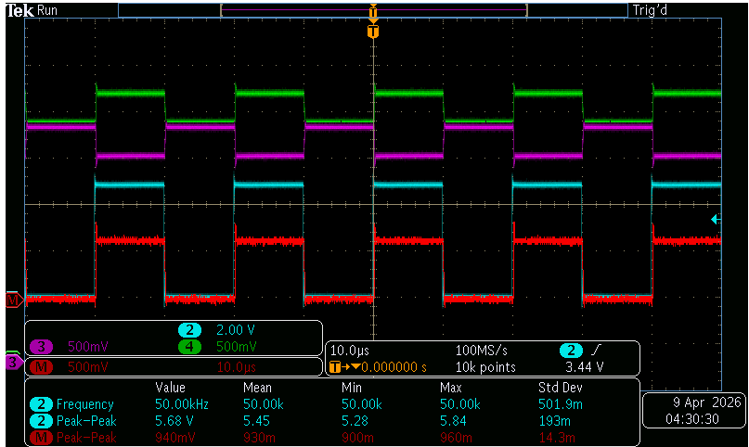
5V, 50k, Square

Slide 7
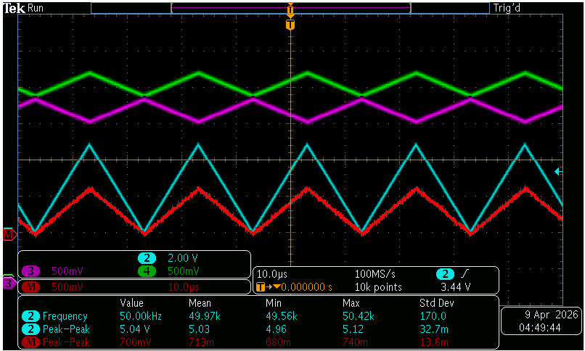
5V, 50k, Triangle

Slide 8

5V, 250k, Sine

Slide 9
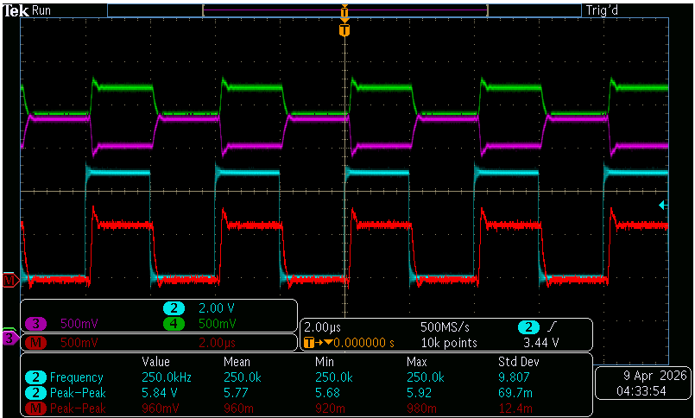
5V, 250k, Square

Slide 10
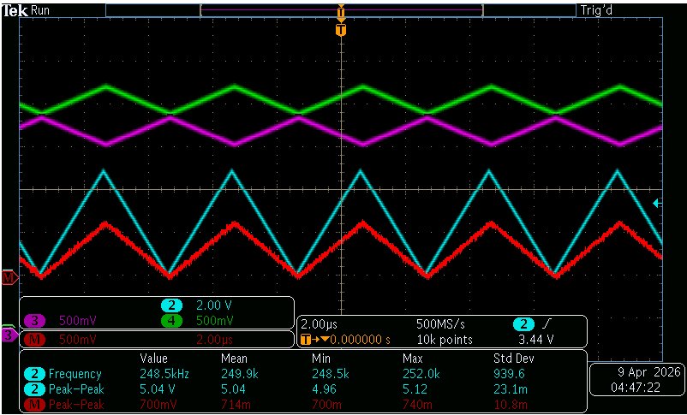
5V, 250k, Triangle

Slide 11
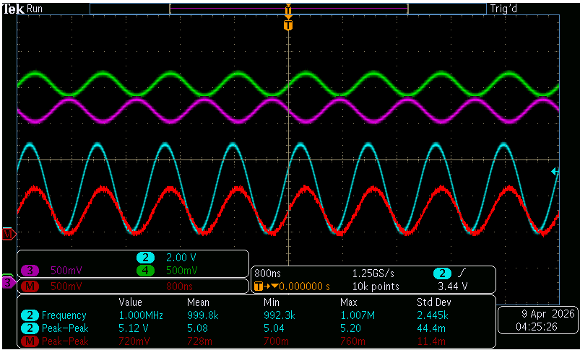
5V, 1M, Sine

Slide 12
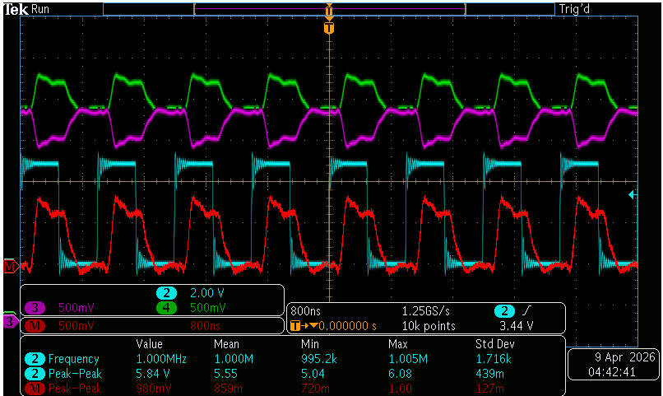
5V, 1M, Square

Slide 13
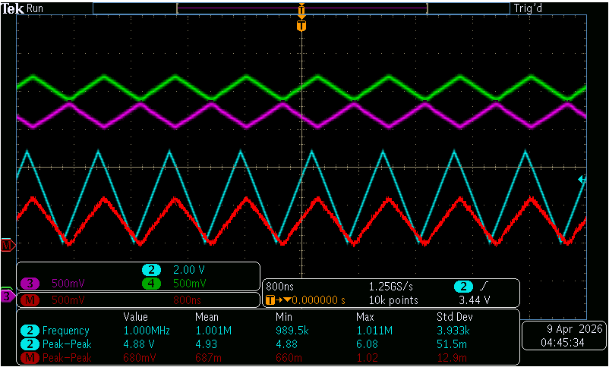
5V, 1M, Triangle

Slide 14
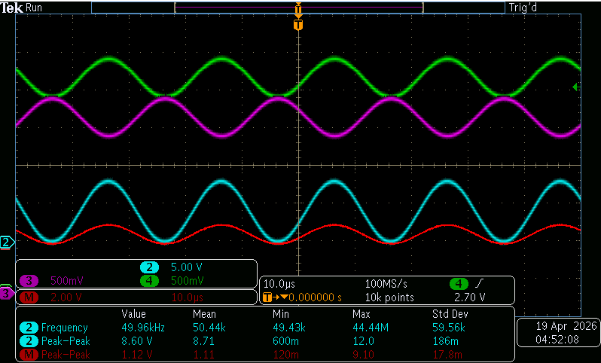
8V, 50k, Sine

Slide 15
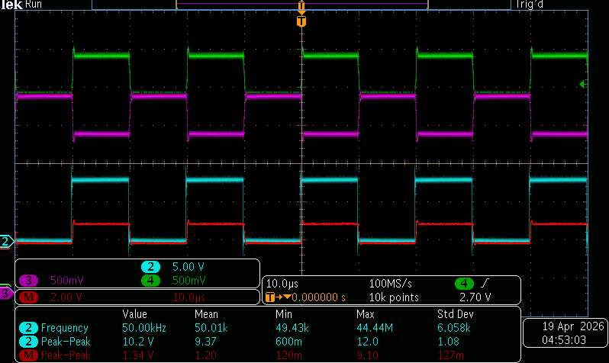
8V, 50k, Square

Slide 16
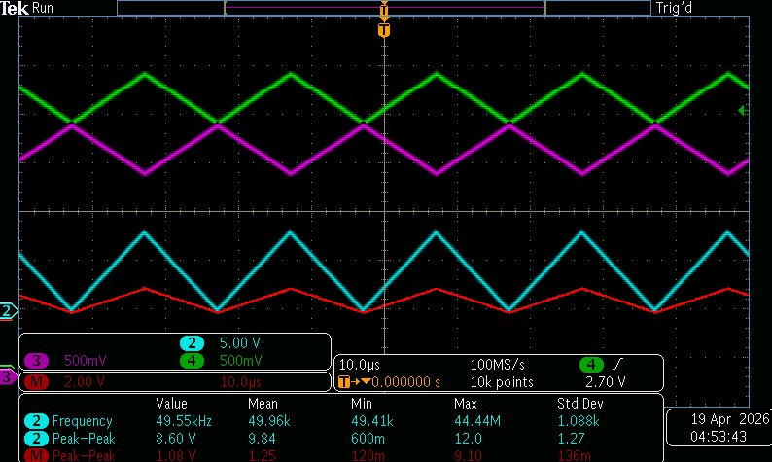
8V, 50k, Triangle

Slide 17
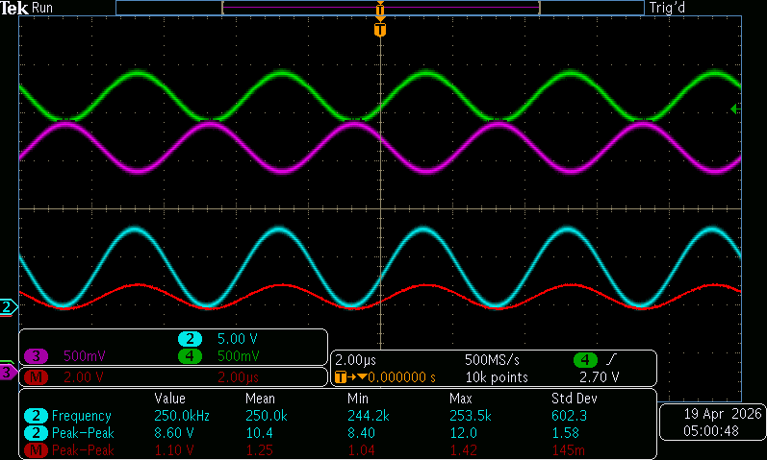
8V, 250k, Sine

Slide 18
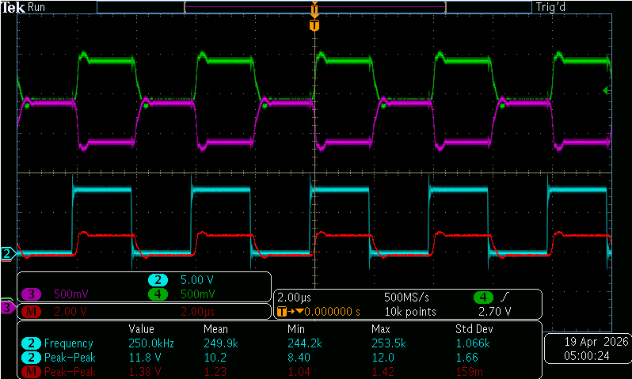
8V, 250k, Square

Slide 19
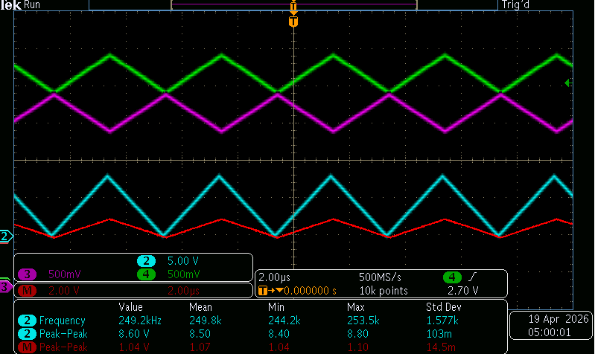
8V, 250k, Triangle

Slide 20
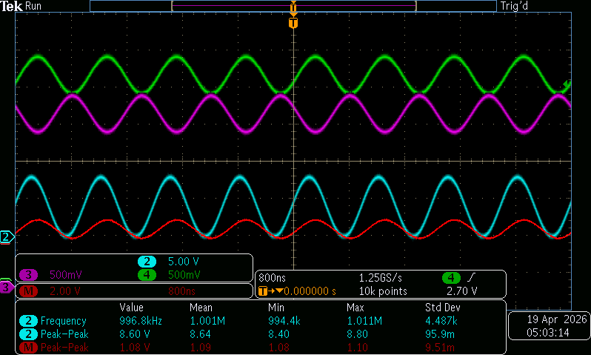
8V, 1M, Sine

Slide 21
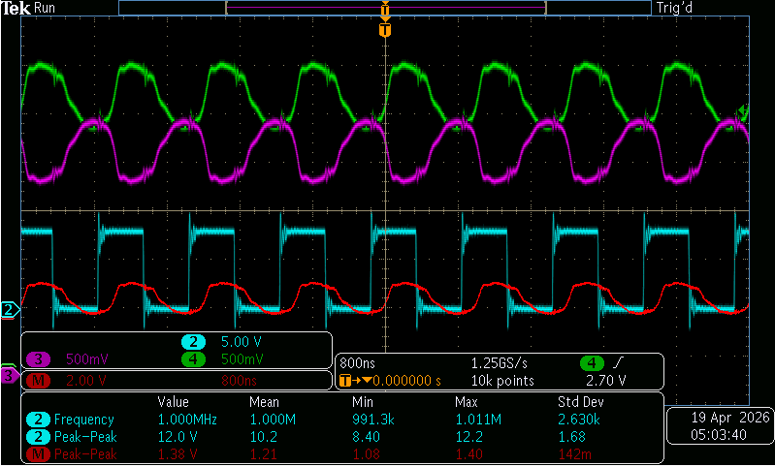
8V, 1M, Square

Slide 22
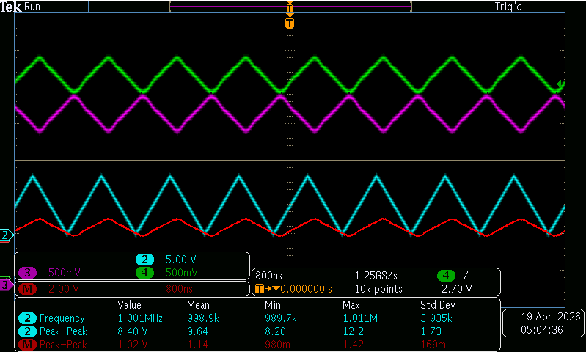
8V, 1M, Triangle

Slide 23
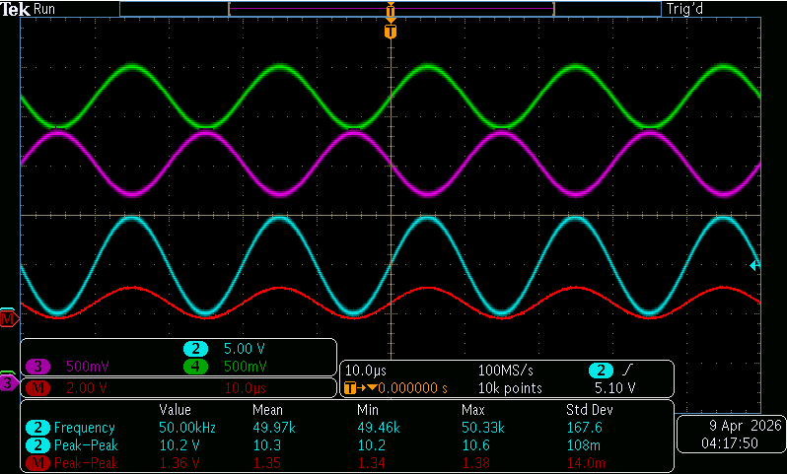
10V, 50k, Sine

Slide 24
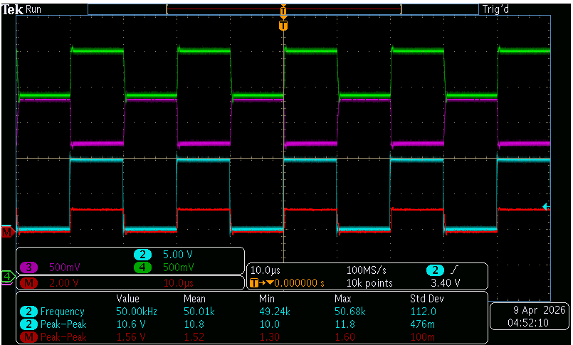
10V, 50k, Square

Slide 25
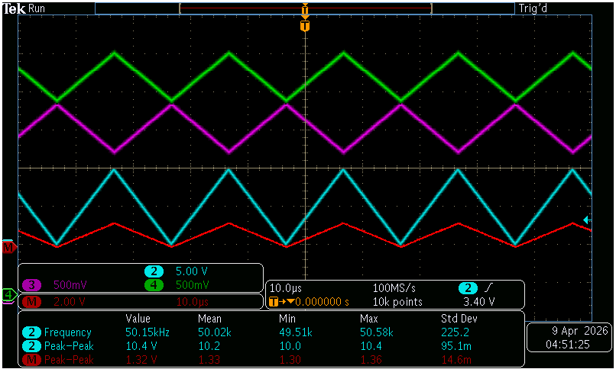
10V, 50k, Triangle

Slide 26
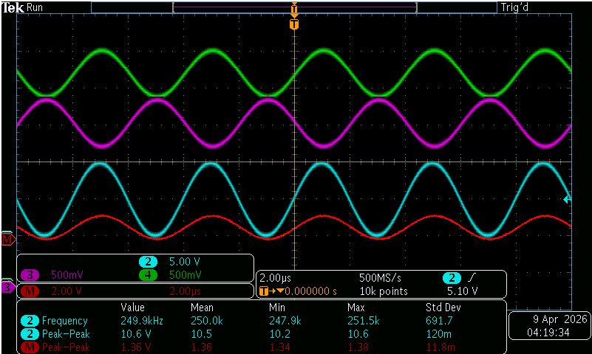
10V, 250k, Sine

Slide 27
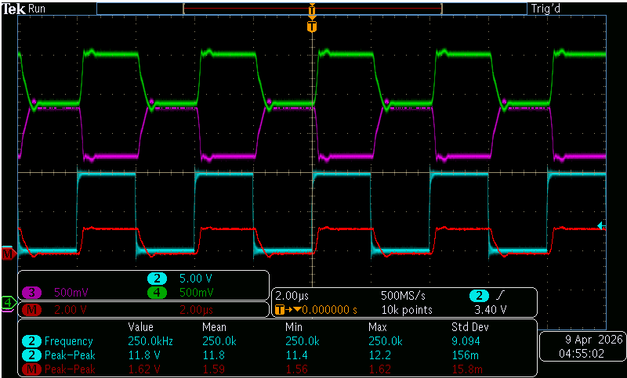
10V, 250k, Square

Slide 28

10V, 250k, Triangle

Slide 29
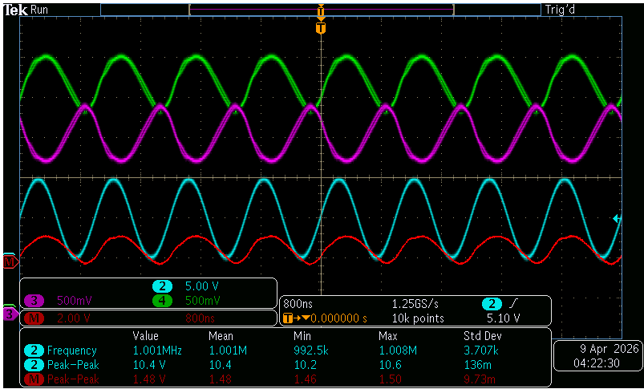
10V, 1M, Sine

Slide 30
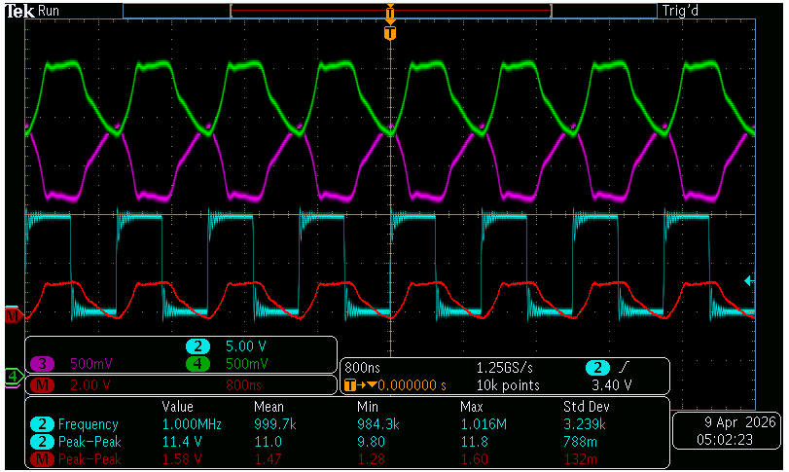
10V, 1M, Square

Slide 31
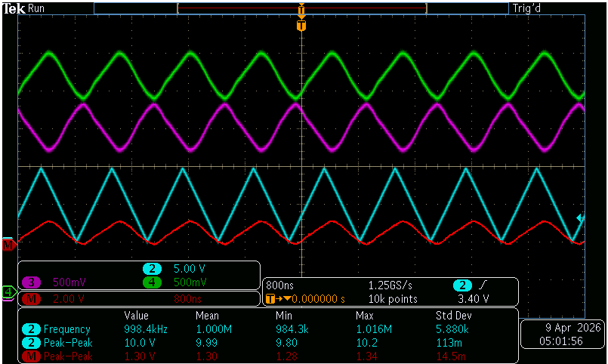
10V, 1M, Triangle

