Slide 1
PGA855 & Power Supplies
Input: ±1.2V differential with a common-mode of 30V
Feeding into the ADS127L21

Slide 2
Recommended solution (Vs = 36V)
If the input to the PGA is not AC coupled
Input: ±1.2V differential with a common-mode of 30V

Slide 3
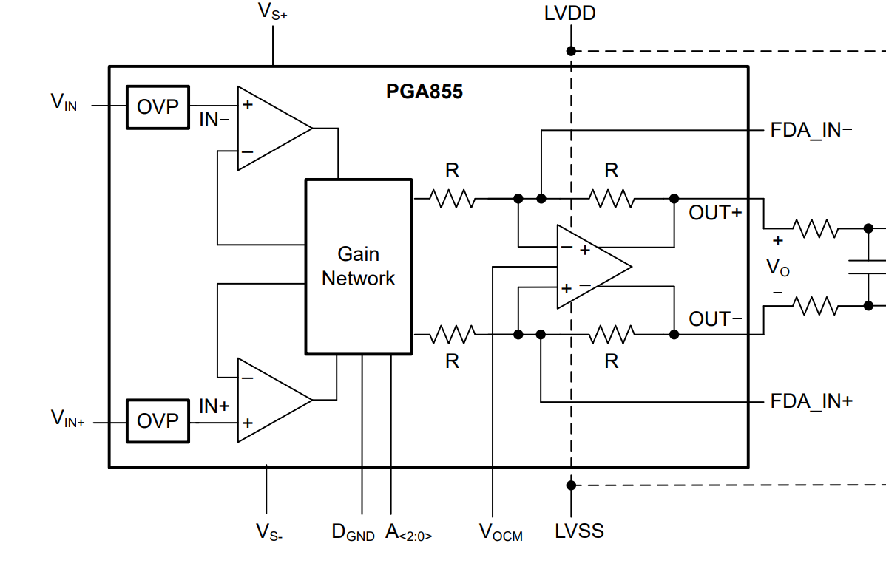
PGA855 Configuration
+36 V
5 V
0V
OUT+ (CH2)
VO (MATH)
OUT- (CH3)
VIN (CH1)
0 V
0V
2.5 V, provided by PGA, does not need to be supplied

Slide 4
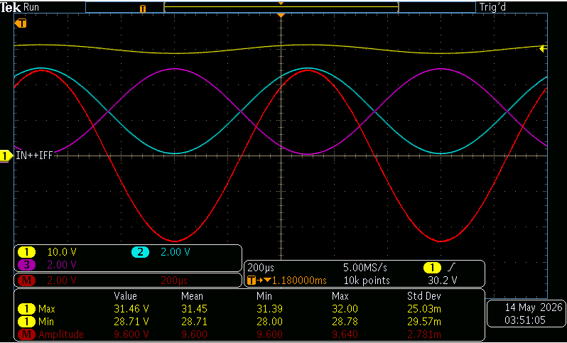
Gain of 4 (Closest to FSR of ADC)
Input: ±1.2V differential with a common-mode of 30V
OUT+ (CH2)
VO (MATH)
OUT- (CH3)

Slide 5
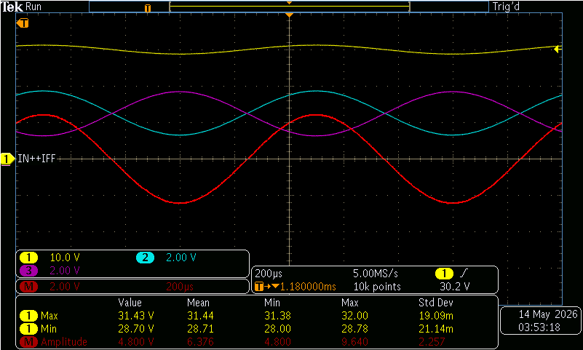
Gain of 2
Input: ±1.2V differential with a common-mode of 30V
OUT+ (CH2)
VO (MATH)
OUT- (CH3)

Slide 6
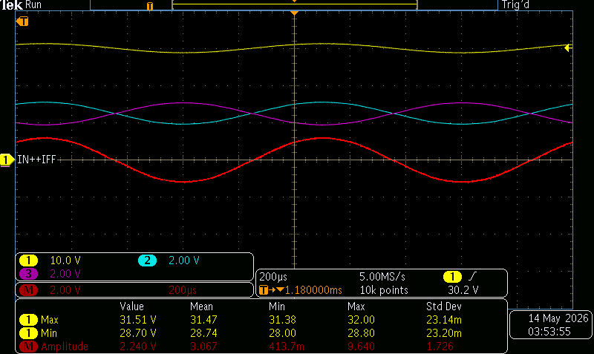
Gain of 1
Input: ±1.2V differential with a common-mode of 30V
OUT+ (CH2)
VO (MATH)
OUT- (CH3)

Slide 7
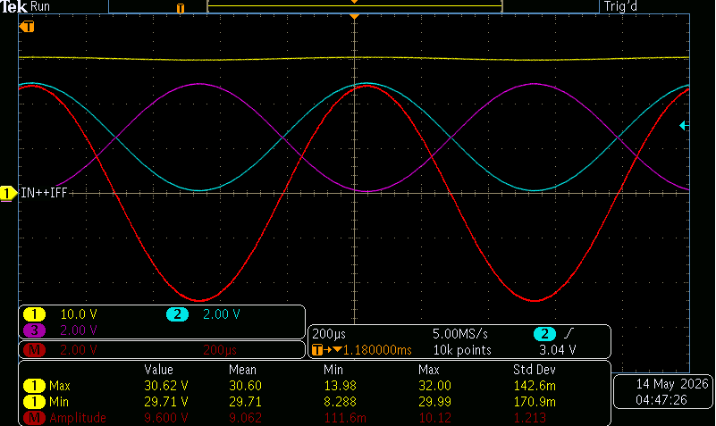
What if the input is smaller? Gain of 16V/V
Input: ±0.3V differential with a common-mode of 30V

Slide 8
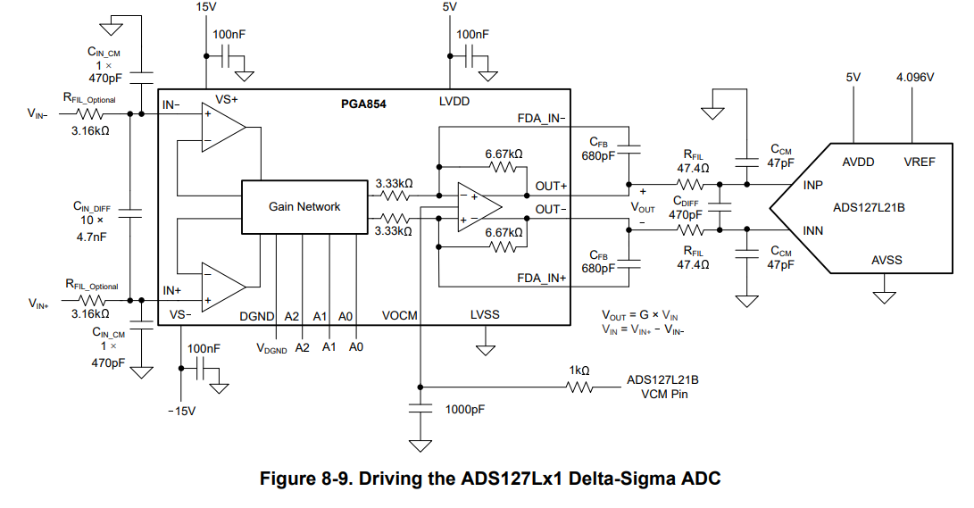
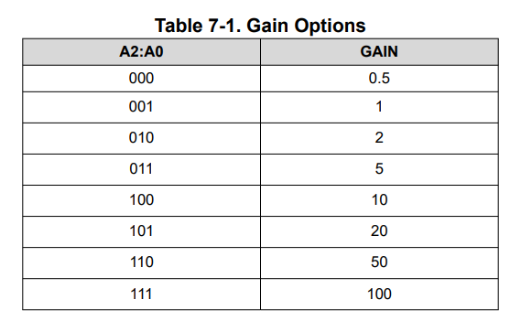
What if the input is even smaller? PGA854
Change the device to PGA854, these measurements can be repeated with the PGA854. Please let me know if that is needed.

Slide 9
Recommended solution (Vs =±5V)
If the input to the PGA is AC coupled
Input: ±1.2V differential with a common-mode of 0V

Slide 10
PGA855 Configuration
+5 V
5 V
0V
OUT+ (CH2)
VO (MATH)
OUT- (CH3)
VIN (CH1)
-5 V
0V
2.5 V, provided by PGA, does not need to be supplied

Slide 11
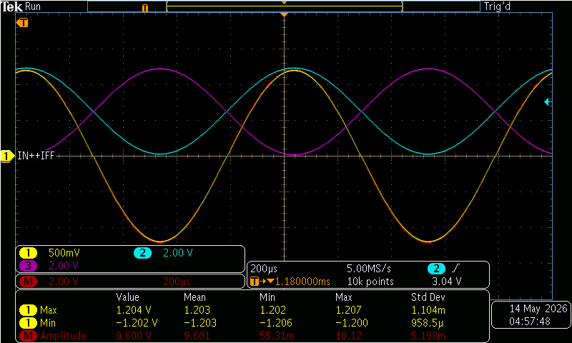
Gain of 4 (Closest to FSR of ADC)
Input: ±1.2V differential with a common-mode of 0V
OUT+ (CH2)
VO (MATH)
OUT- (CH3)

Slide 12
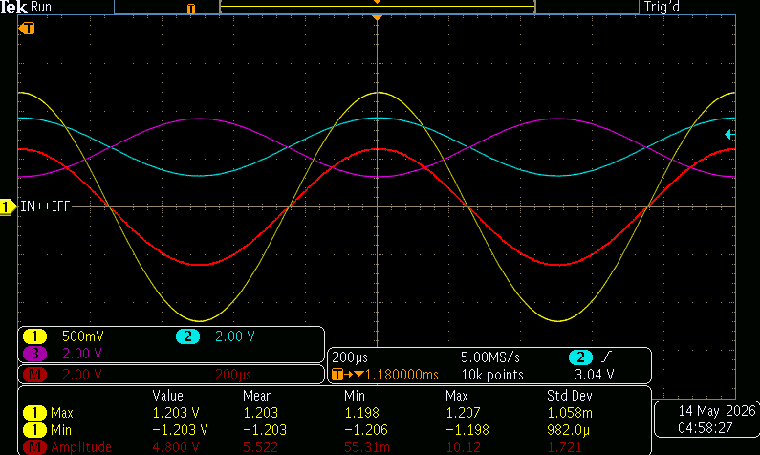
Gain of 2
Input: ±1.2V differential with a common-mode of 0V
OUT+ (CH2)
VO (MATH)
OUT- (CH3)

Slide 13
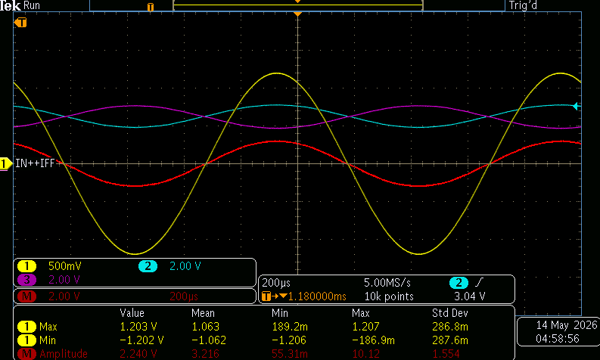
Gain of 1
Input: ±1.2V differential with a common-mode of 0V
OUT+ (CH2)
VO (MATH)
OUT- (CH3)

Slide 14
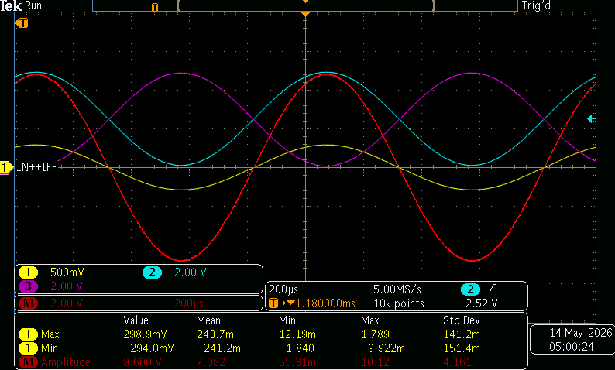
What if the input is smaller? Gain of 16V/V
Input: ±0.3V differential with a common-mode of 0V

Slide 15
What if the input is even smaller? PGA854
Change the device to PGA854, these measurements can be repeated with the PGA854. Please let me know if that is needed.

Slide 16
5V supply, not recommended
If the input to the PGA is AC coupled
Input: ±1.2V differential with a common-mode of 0V

Slide 17
PGA855 Configuration
+5 V
5 V
0V
OUT+ (CH2)
VO (MATH)
OUT- (CH3)
VIN (CH1)
0 V
0V
2.5 V, provided by PGA, does not need to be supplied

Slide 18
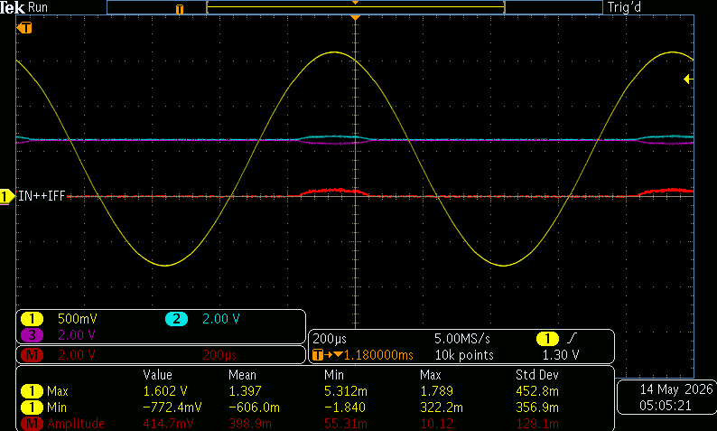
Output is severely limited

Slide 19
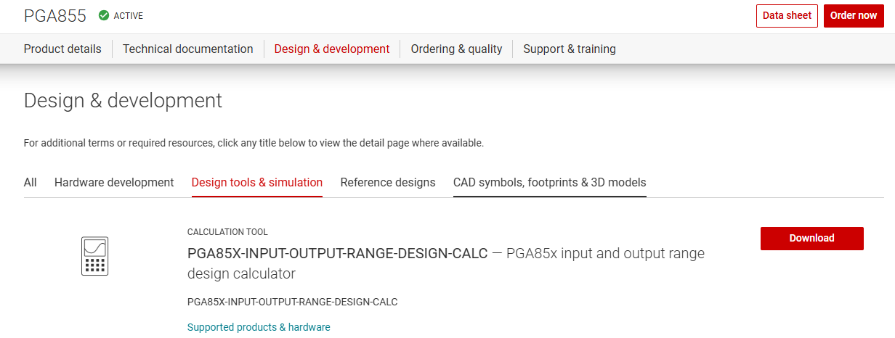
To try different power supply options,
Use the following tool:

