Slide 1
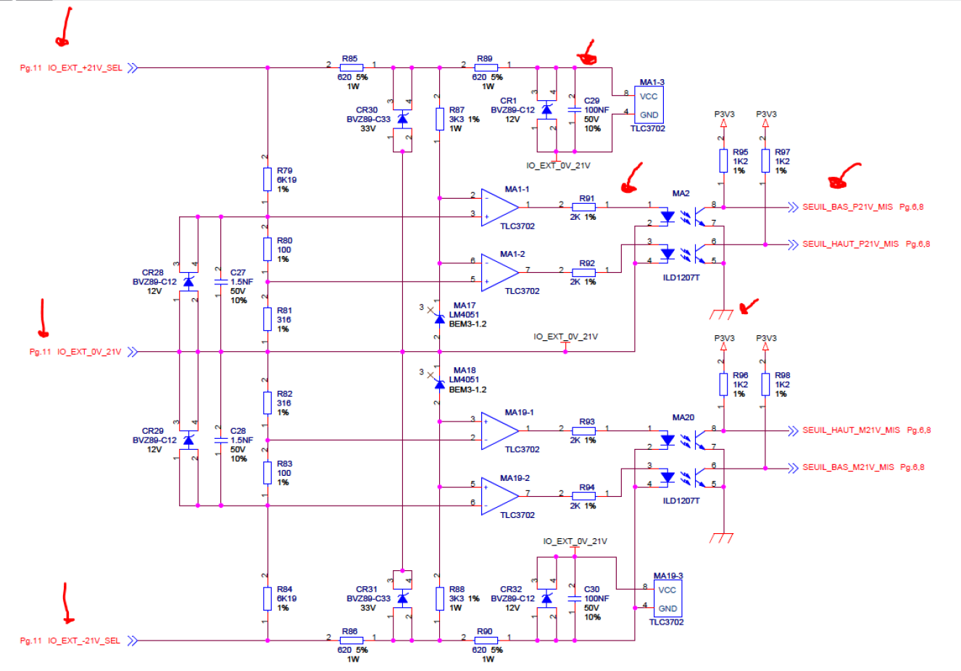
PMC
The supply thresholds +/- 21V are established in less than 4 ms

Slide 2
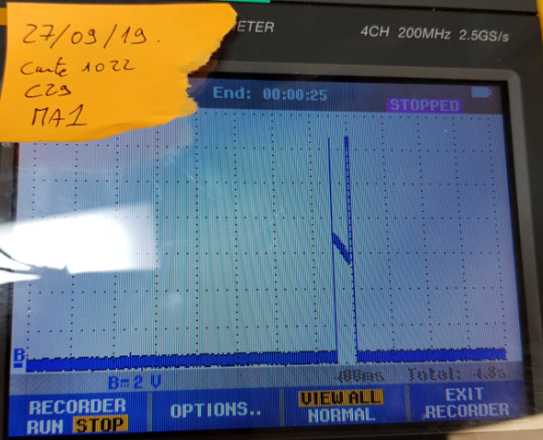
Failure: voltage across C29
Power supply test started
Test failure and reset of the CPU card

Slide 3
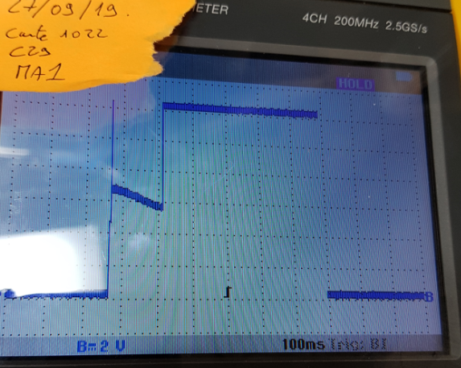
3rd consecutive test
Power supply test started

Slide 4
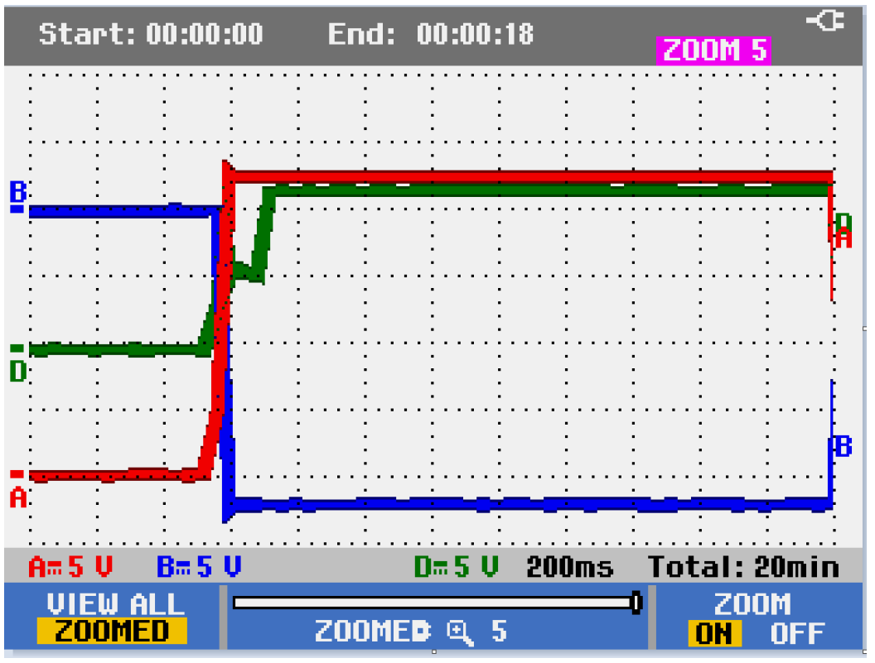
PMC SQM
When the temperature rises, the fault is obvious for 100 ms then Vcc goes to its nominal value of 12V. The test is therefore OK.

Slide 5
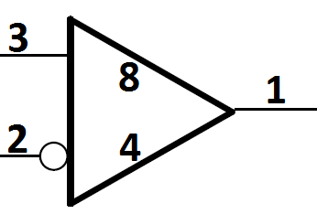
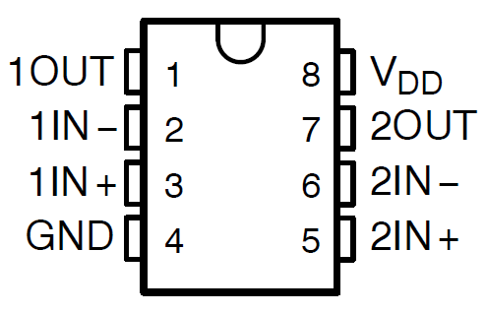
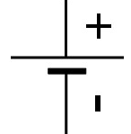
TLC3702I functional tests: Setup
V_{DD} = 12V
Hall probe:
20mA/DIV
Sine Wave :
5Vpp
2,5V offset
≈1Hz
Waveform Generator
TLC3702I
Ch1
Scope
4V
Floating
Ch2
Ch3

Slide 6
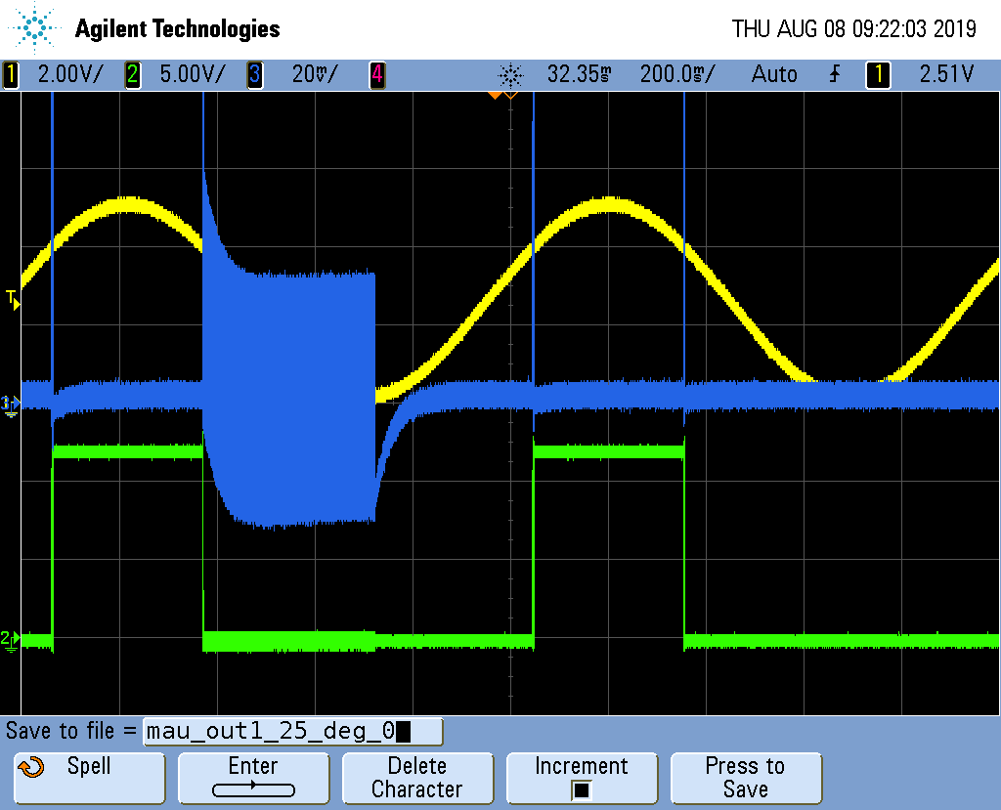
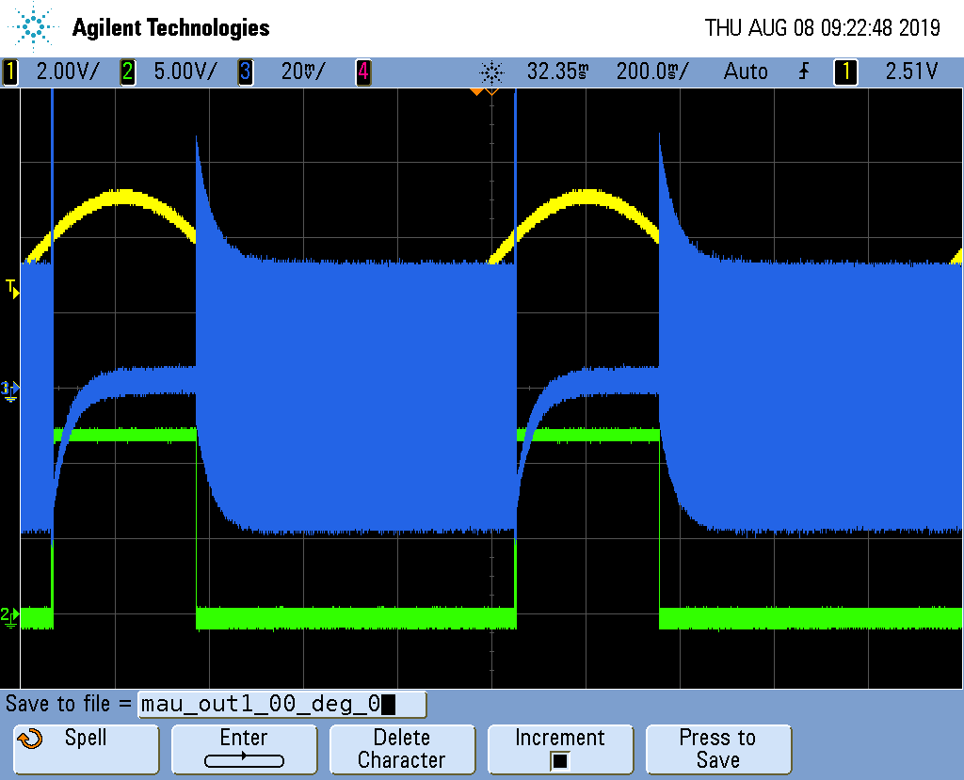
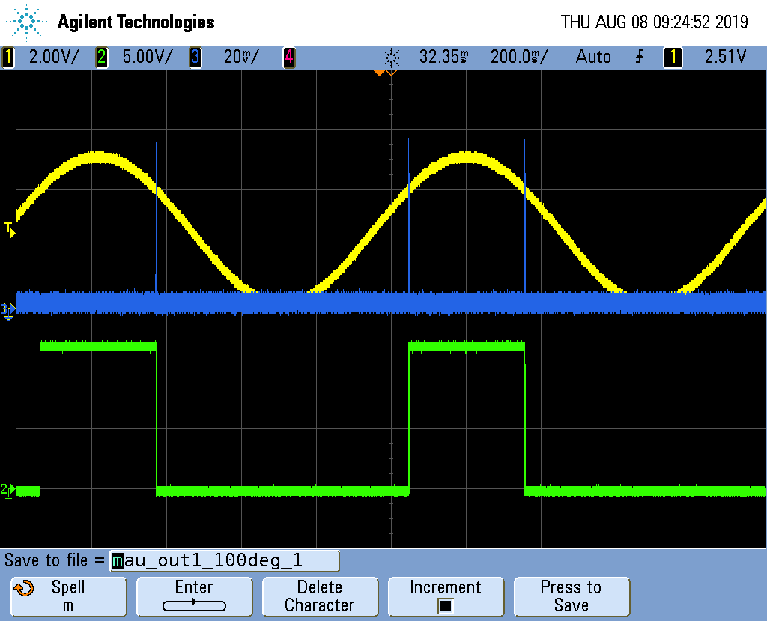
Functional tests TLC3702I: oscillograms OUT1 MA1 card n ° 1122
DEFICIENT PMC CARD
Vout1 MA1 @25°C Board n°1122
Vout1 MA1 @ COLD Board n°1122
Vout1 MA1 à HOT carte n°1122
V_{1IN+}
V_{1IN+}
V_{1IN+}
I_{DD}
I_{DD}
I_{DD}
V_{1OUT}
V_{1OUT}
V_{1OUT}
Observation on comparator 1 of MA1 of card n ° 1122:
- At room temperature, intermittent IDD over-consumption of around 40mA when V1OUT goes low
- When cold (refrigerant gas), permanent IDD overconsumption of around 40mA when V1OUT goes low
- Hot (≈100 ° C), nominal consumption of IDD_{D}

Slide 7
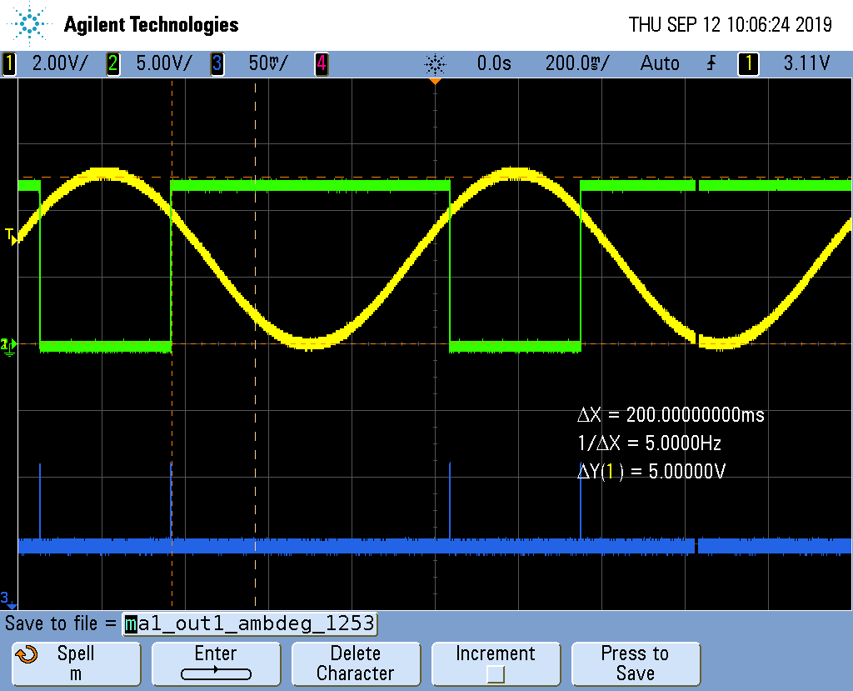
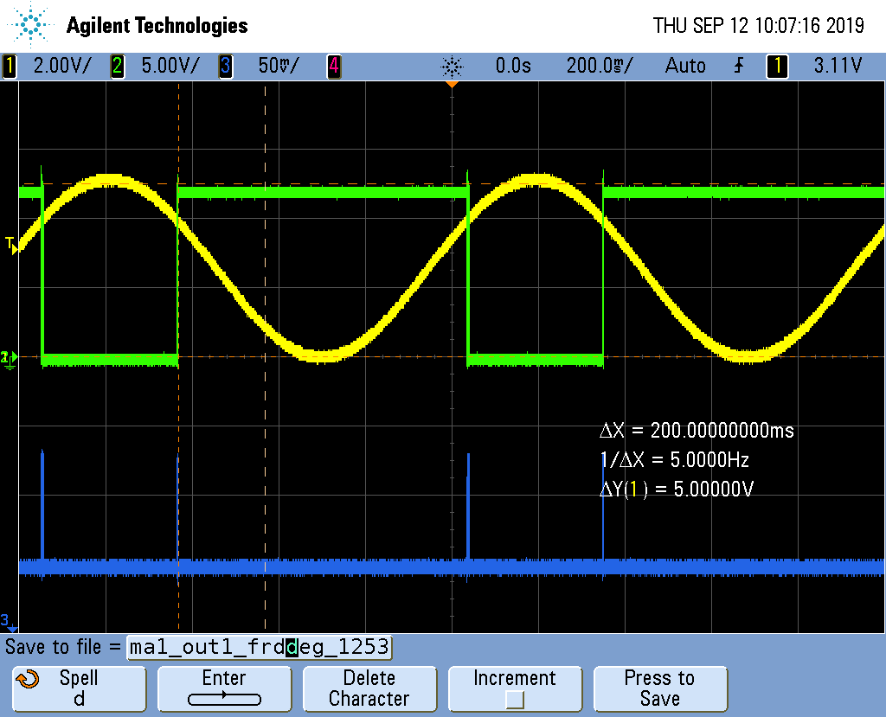
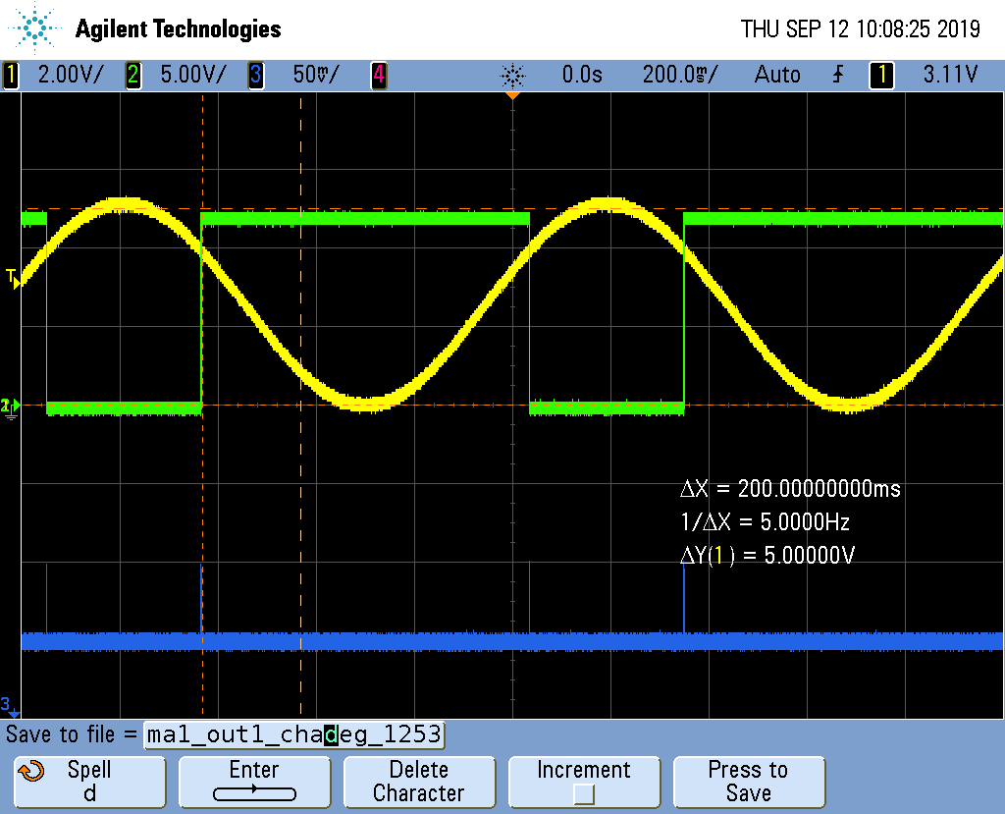
TLC3702I functional tests: OUT1 MA1 oscillograms card n ° 1253
PMC FUNCTIONAL CARD
Vout1 MA1 @25°C Board n°1253
Vout1 MA1 @ Cold Board n°1253
Vout1 MA1 @ Hot Board n°1253
V_{1IN+}
V_{1OUT}
V_{1IN+}
V_{1OUT}
V_{1IN+}
V_{1OUT}
I_{DD}
I_{DD}
I_{DD}
Observation on comparator 1 of MA1 of card n ° 1253:
- At room temperature, nominal consumption of IDD
- Cold (refrigerant gas), nominal consumption of IDD
- Hot (≈100 ° C), nominal consumption of IDD

Slide 8
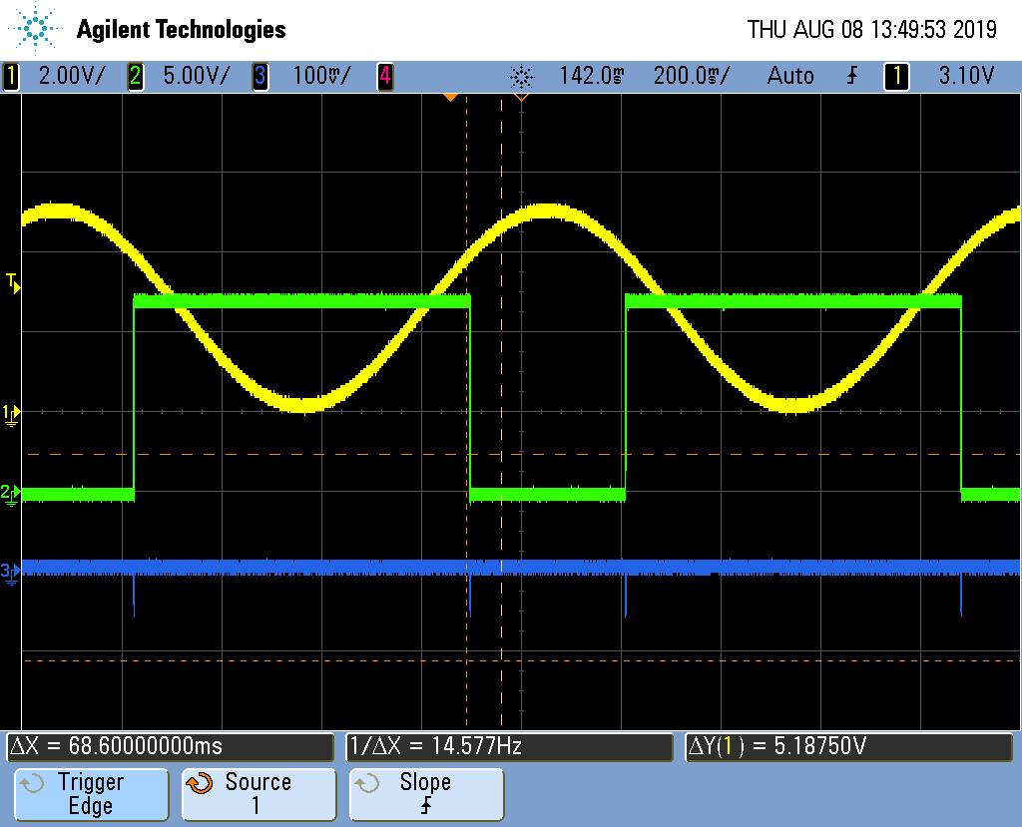
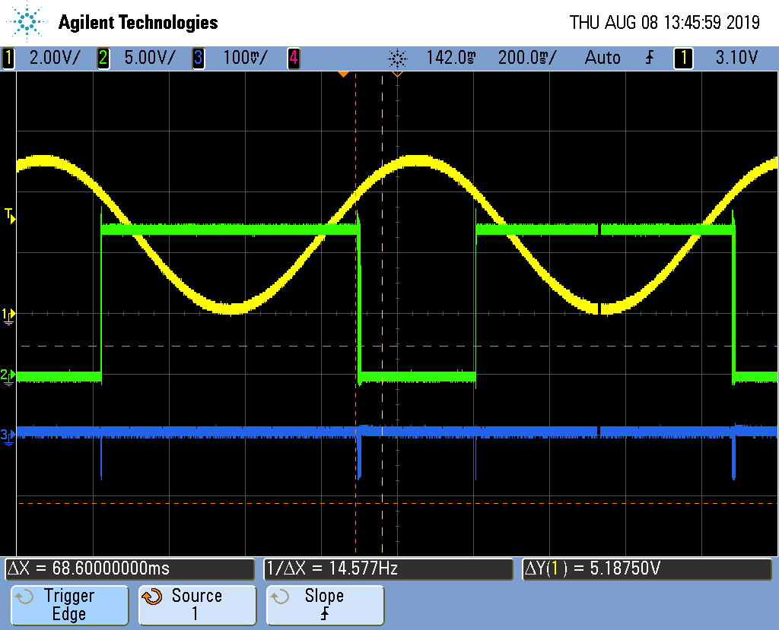
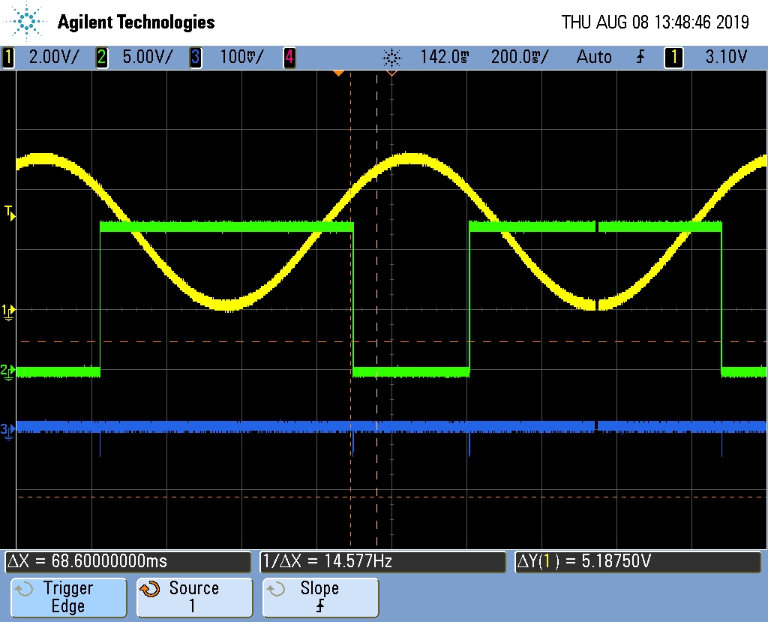
TLC3702I functional tests: OUT1 oscillograms reference component
REFERENCE COMPONENT
Vout1 @25°C DISPO REF.
Vout1 @ COLD DISPO REF.
Vout1 @ Hot DISPO REF.
V_{1IN+}
V_{1IN+}
V_{1IN+}
V_{1OUT}
V_{1OUT}
V_{1OUT}
I_{DD}
I_{DD}
I_{DD}
Observation on comparator 1 of a reference component:
- At room temperature, nominal consumption of IDD
- Cold (refrigerant gas), nominal consumption of IDD
- Hot (≈100 ° C), nominal consumption of IDD

Slide 9
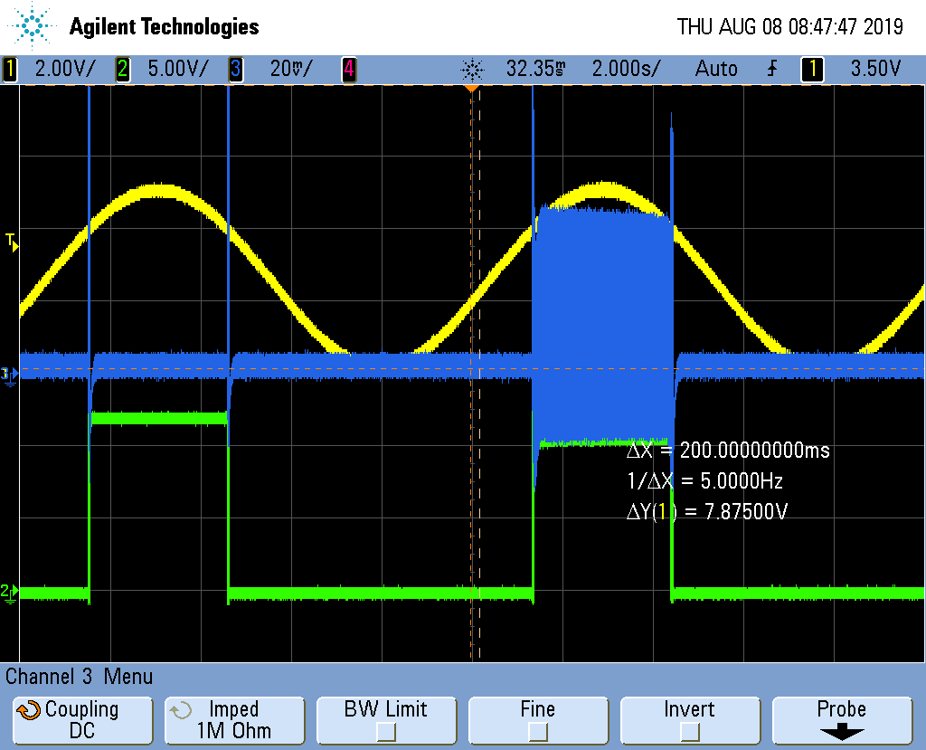
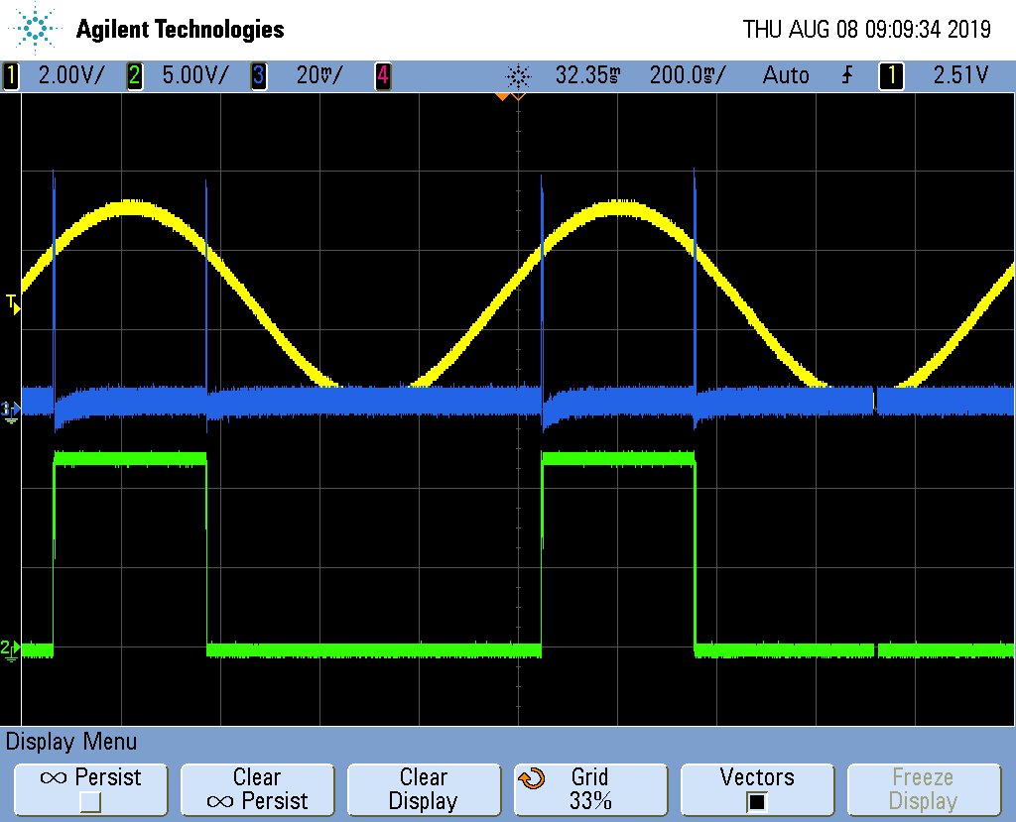
Observation on comparators 1 and 2 of MA19 of card n ° 1122:
- At room temperature, intermittent IDD over-consumption of around 40mA when V1OUT goes high
- No overconsumption on comparator 2
Vout1 MA19 @25°C Board n°1122
Vout2 MA19 @25°C Board n°1122
V_{1IN+}
V_{2IN+}
I_{DD}
I_{DD}
V_{1OUT}
V_{2OUT}
Pin8 V_{DD} = +12V
Pin2 V_{1IN-} = +4V
Pin3 V_{1IN+} = signal sinusoïdal 5Vpp; offset = 4V; Fréquence = 0,1Hz
Pin6 V_{2IN-} = GND
Pin5 V_{2IN+} = GND
Pin7 V_{2OUT} = flottant
Pin4 = GND
Pin8 V_{DD} = +12V
Pin2 V_{1IN-} = GND
Pin3 V_{1IN+} = GND
Pin6 V_{2IN-} = +4V
Pin5 V_{2IN+} = signal sinusoïdal 5Vpp; offset = 4V; Fréquence = 0,1Hz
Pin=1 V_{1OUT} = flottant
Pin4 = GND

Slide 10
Observation on comparator 1 of MA1 of card n ° 1122:
- At room temperature, intermittent IDD over-consumption of around 40mA when V1OUT goes low
- When cold (refrigerant gas), permanent IDD overconsumption of around 40mA when V1OUT goes low
Hot (≈100 ° C), nominal consumption of IDD-
Vout1 MA1 @25°C carte n°1122
Vout1 MA1 à froid carte n°1122
Vout1 MA1 à chaud carte n°1122
V_{1IN+}
V_{1IN+}
V_{1IN+}
I_{DD}
I_{DD}
I_{DD}
V_{1OUT}
V_{1OUT}
V_{1OUT}
Pin8 V_{DD} = +12V
Pin2 V_{1IN-} = +4V
Pin3 V_{1IN+} = signal sinusoïdal 5Vpp; offset = 4V; Fréquence = 0,1Hz
Pin6 V_{2IN-} = GND
Pin5 V_{2IN+} = GND
Pin7 V_{2OUT} = flottant
Pin4 = GND
Pin8 V_{DD} = +12V
Pin2 V_{1IN-} = +4V
Pin3 V_{1IN+} = signal sinusoïdal 5Vpp; offset = 4V; Fréquence = 0,1Hz
Pin6 V_{2IN-} = GND
Pin5 V_{2IN+} = GND
Pin7 V_{2OUT} = flottant
Pin4 = GND
Pin8 V_{DD} = +12V
Pin2 V_{1IN-} = +4V
Pin3 V_{1IN+} = signal sinusoïdal 5Vpp; offset = 4V; Fréquence = 0,1Hz
Pin6 V_{2IN-} = GND
Pin5 V_{2IN+} = GND
Pin7 V_{2OUT} = flottant
Pin4 = GND

Slide 11

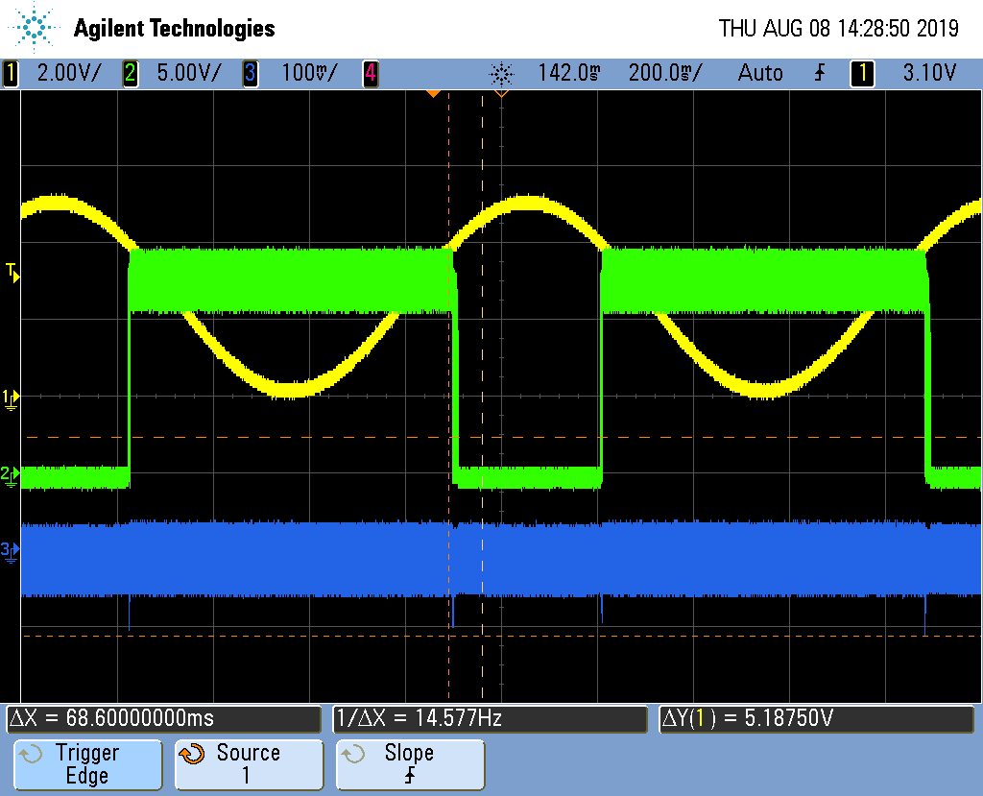

Observation on comparator 1 of MA1 of card n ° 1190:
- At room temperature, nominal consumption of IDD
- Cold (refrigerant gas), permanent IDD overconsumption of around 40mA
Hot (≈100 ° C), nominal consumption of IDD
Vout1 MA1 @25°C board n°1190
Vout1 MA1 @cold board n°1190
Vout1 MA1 @ hot board n°1190
V_{1IN+}
V_{1IN+}
V_{1IN+}
V_{1OUT}
V_{1OUT}
V_{1OUT}
I_{DD}
I_{DD}
I_{DD}
Pin8 V_{DD} = +12V
Pin2 V_{1IN-} = +4V
Pin3 V_{1IN+} = signal sinusoïdal 5Vpp; offset = 4V; Fréquence = 0,1Hz
Pin6 V_{2IN-} = GND
Pin5 V_{2IN+} = GND
Pin7 V_{2OUT} = flottant
Pin4 = GND
Pin8 V_{DD} = +12V
Pin2 V_{1IN-} = +4V
Pin3 V_{1IN+} = signal sinusoïdal 5Vpp; offset = 4V; Fréquence = 0,1Hz
Pin6 V_{2IN-} = GND
Pin5 V_{2IN+} = GND
Pin7 V_{2OUT} = flottant
Pin4 = GND
Pin8 V_{DD} = +12V
Pin2 V_{1IN-} = +4V
Pin3 V_{1IN+} = signal sinusoïdal 5Vpp; offset = 4V; Fréquence = 0,1Hz
Pin6 V_{2IN-} = GND
Pin5 V_{2IN+} = GND
Pin7 V_{2OUT} = flottant
Pin4 = GND

Slide 12
Observation on comparator 1 of MA1 of a reference component:
- At room temperature, nominal consumption of IDD
- Cold (refrigerant gas), nominal consumption of IDD
Hot (≈100 ° C), nominal consumption of IDD
Vout1 MA1 @25°C DISPO REF.
Vout1 MA1 @cold DISPO REF.
Vout1 MA1 @hot DISPO REF.
V_{1IN+}
V_{1IN+}
V_{1IN+}
V_{1OUT}
V_{1OUT}
V_{1OUT}
I_{DD}
I_{DD}
I_{DD}
Pin8 V_{DD} = +12V
Pin2 V_{1IN-} = +4V
Pin3 V_{1IN+} = signal sinusoïdal 5Vpp; offset = 4V; Fréquence = 0,1Hz
Pin6 V_{2IN-} = GND
Pin5 V_{2IN+} = GND
Pin7 V_{2OUT} = flottant
Pin4 = GND
Pin8 V_{DD} = +12V
Pin2 V_{1IN-} = +4V
Pin3 V_{1IN+} = signal sinusoïdal 5Vpp; offset = 4V; Fréquence = 0,1Hz
Pin6 V_{2IN-} = GND
Pin5 V_{2IN+} = GND
Pin7 V_{2OUT} = flottant
Pin4 = GND
Pin8 V_{DD} = +12V
Pin2 V_{1IN-} = +4V
Pin3 V_{1IN+} = signal sinusoïdal 5Vpp; offset = 4V; Fréquence = 0,1Hz
Pin6 V_{2IN-} = GND
Pin5 V_{2IN+} = GND
Pin7 V_{2OUT} = flottant
Pin4 = GND

Slide 13
Observation on comparator 1 of MA1 of card n ° 1253:
- At room temperature, nominal consumption of IDD
- Cold (refrigerant gas), nominal consumption of IDD
Hot (≈100 ° C), nominal consumption of IDD
Vout1 MA1 @25°C carte n°1253
Vout1 MA1 @coldcarte n°1253
Vout1 MA1 @hotcarte n°1253
V_{1IN+}
V_{1OUT}
V_{1IN+}
V_{1OUT}
V_{1IN+}
V_{1OUT}
I_{DD}
I_{DD}
I_{DD}
Pin8 V_{DD} = +12V
Pin2 V_{1IN-} = +4V
Pin3 V_{1IN+} = signal sinusoïdal 5Vpp; offset = 4V; Fréquence = 1,5Hz
Pin6 V_{2IN-} = GND
Pin5 V_{2IN+} = GND
Pin7 V_{2OUT} = flottant
Pin4 = GND
Pin8 V_{DD} = +12V
Pin2 V_{1IN-} = +4V
Pin3 V_{1IN+} = signal sinusoïdal 5Vpp; offset = 4V; Fréquence = 1,5Hz
Pin6 V_{2IN-} = GND
Pin5 V_{2IN+} = GND
Pin7 V_{2OUT} = flottant
Pin4 = GND
Pin8 V_{DD} = +12V
Pin2 V_{1IN-} = +4V
Pin3 V_{1IN+} = signal sinusoïdal 5Vpp; offset = 4V; Fréquence = 1,5Hz
Pin6 V_{2IN-} = GND
Pin5 V_{2IN+} = GND
Pin7 V_{2OUT} = flottant
Pin4 = GND

Slide 14
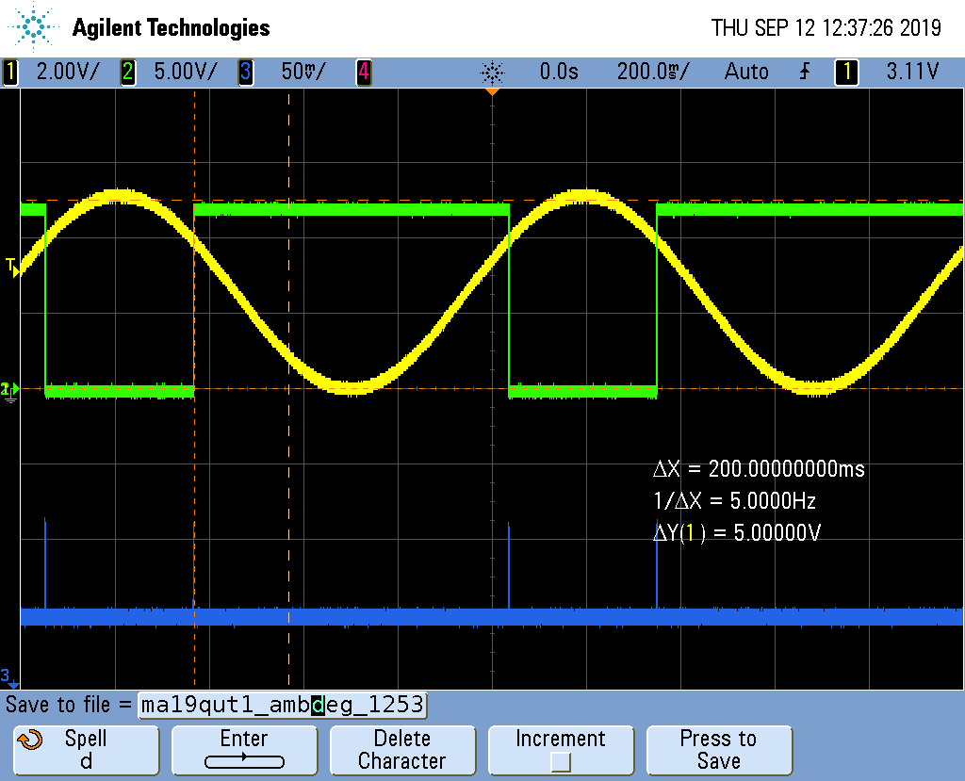
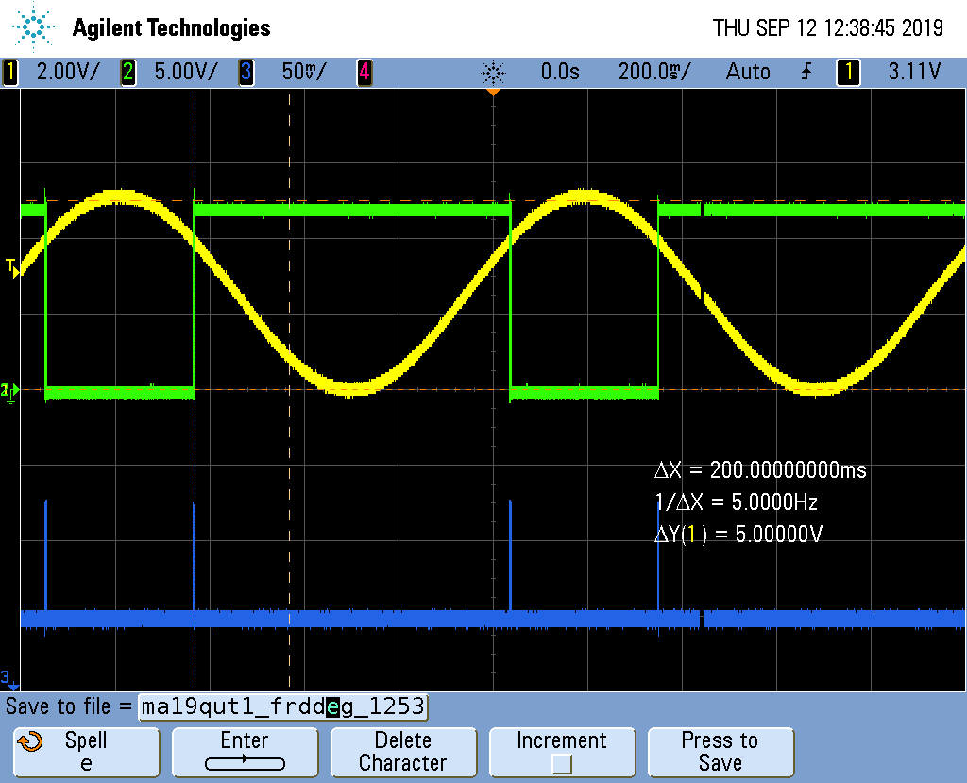

Observation on comparator 1 of MA19 of card n ° 1253:
- At room temperature, nominal consumption of IDD
- Cold (refrigerant gas), nominal consumption of IDD
Hot (≈100 ° C), nominal consumption of IDD
Vout1 MA19 @25°C board n°1253
Vout1 MA19 @cold carte n°1253
Vout1 MA19 @hot carte n°1253
V_{1IN+}
V_{1OUT}
V_{1IN+}
V_{1OUT}
V_{1IN+}
V_{1OUT}
I_{DD}
I_{DD}
I_{DD}
Pin8 V_{DD} = +12V
Pin2 V_{1IN-} = +4V
Pin3 V_{1IN+} = signal sinusoïdal 5Vpp; offset = 4V; Fréquence = 1,5Hz
Pin6 V_{2IN-} = GND
Pin5 V_{2IN+} = GND
Pin7 V_{2OUT} = flottant
Pin4 = GND
Pin8 V_{DD} = +12V
Pin2 V_{1IN-} = +4V
Pin3 V_{1IN+} = signal sinusoïdal 5Vpp; offset = 4V; Fréquence = 1,5Hz
Pin6 V_{2IN-} = GND
Pin5 V_{2IN+} = GND
Pin7 V_{2OUT} = flottant
Pin4 = GND
Pin8 V_{DD} = +12V
Pin2 V_{1IN-} = +4V
Pin3 V_{1IN+} = signal sinusoïdal 5Vpp; offset = 4V; Fréquence = 1,5Hz
Pin6 V_{2IN-} = GND
Pin5 V_{2IN+} = GND
Pin7 V_{2OUT} = flottant
Pin4 = GND

Slide 15
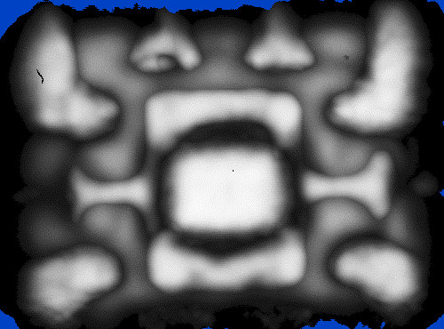
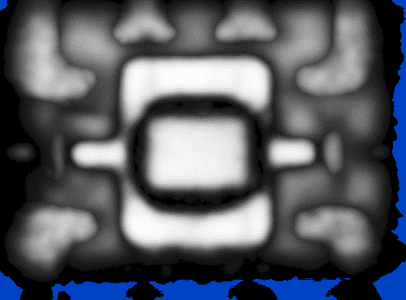
TLC3702I technological analysis: acoustic tomography examination
MA1 Board n°1122
MA19 Board n°1122
Suspicion of delamination at the lead-frame of MA1 of card n ° 1122

Slide 16
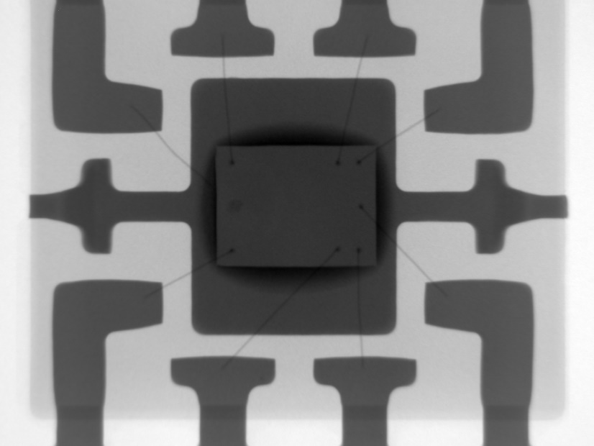
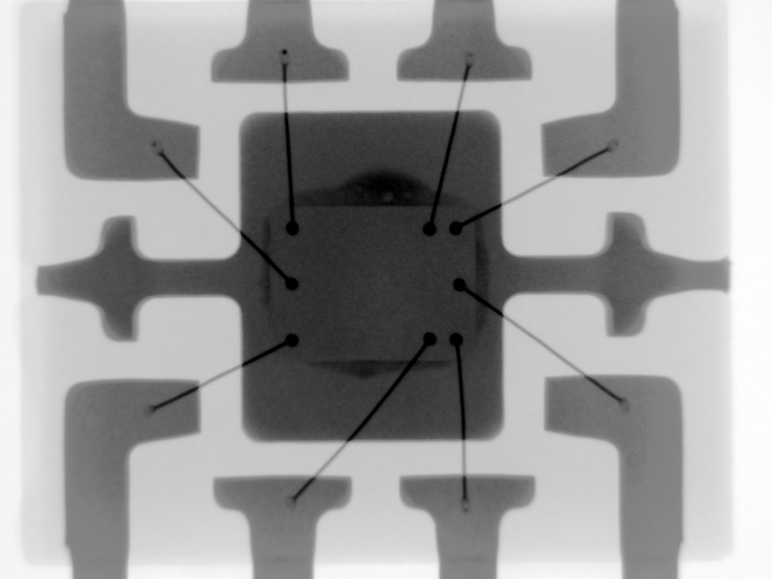
TLC3702I technological analysis: RX exam
MA1 Board n°1022
I form board N° 1105
MA19 board n°1022
OLD design RGO
MA1 and MA19 mounted on card no.1022 have two different DCs.
The bonding section of MA1 is smaller than that of the bonding of MA19
Transparency at RX of MA1 bondings → Cu bondings
MA19 bonding opacity at RX → bondings probably in Au

Slide 17
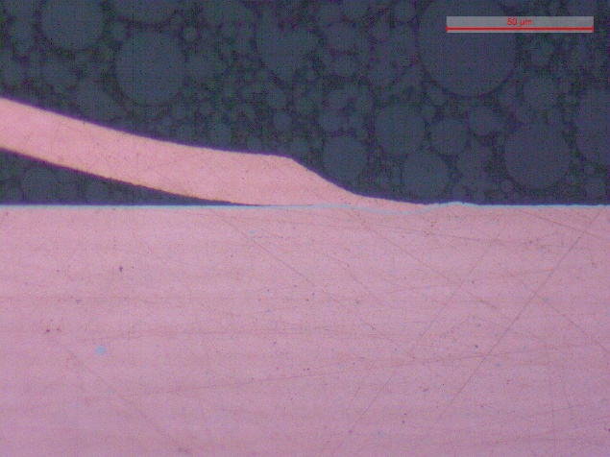

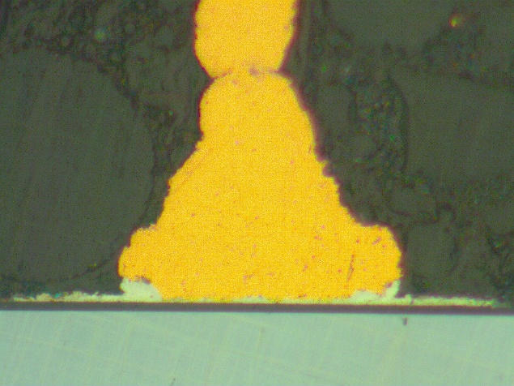
TLC3702I technological analysis: metallographic examination
MA1 Board n°1022
No delamination was detected at the resin / chip interface
No fractures were detected on the interconnections

Slide 18
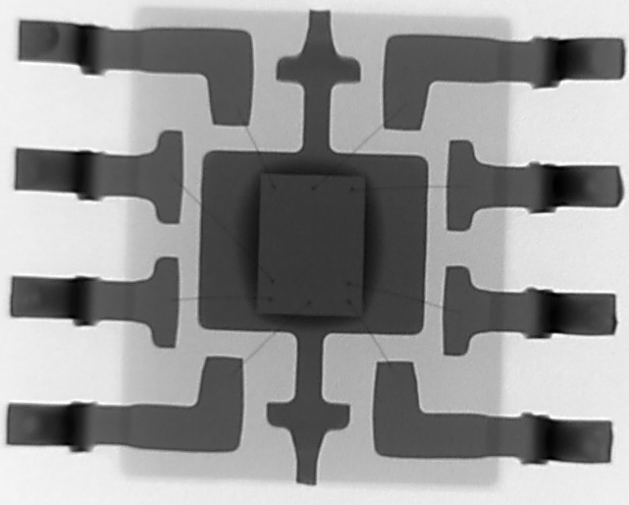
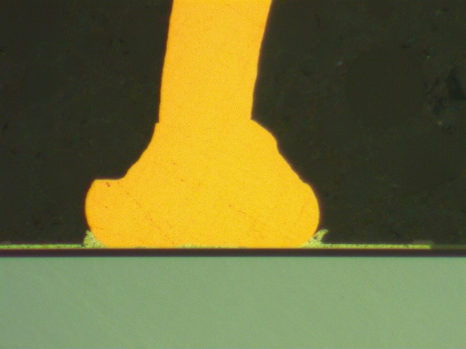
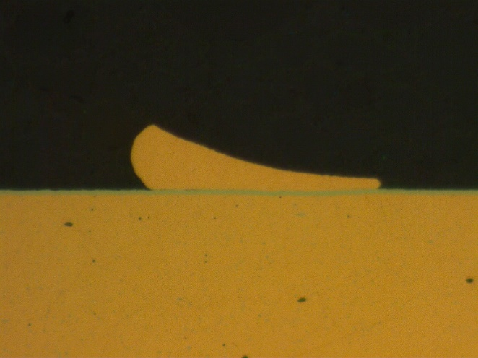
Analyse Technologique (1/3)
TLC3702I_MA19 board n°1122, DC = 42MAP4E
RX Inspection
Copper ball micro-section
Micro-section copper stitch
No sign of fatigue or corrosion of intermetallic under the copper ball
No sign of fatigue or corrosion of intermetallic under the copper stitch

Slide 19
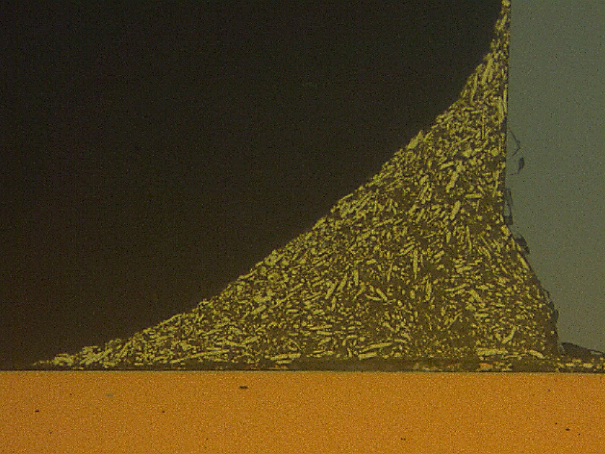
Analyse Technologique (2/3)
TLC3702I_MA19 carte n°1122, DC = 42MAP4E
RX inspection (side view)
Chip / PAD interface micro-section
Inspection MEB
Die
(Si)
Die attach
(Ag)
Die-attach delamination spreads across the entire chip / PAD (Lead-frame) interface
Delamination
Lead-frame (Cu)

Slide 20

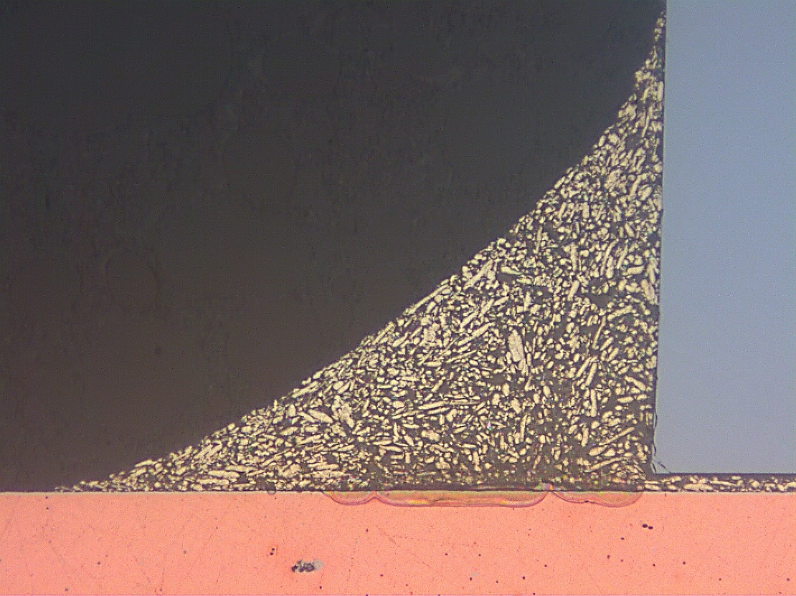
Analyse Technologique (3/3)
TLC3702I reference part supplied by FEDD, DC = 73MACDT
RX inspection (side view)
Chip / PAD interface micro-section
Inspection MEB
Die (Si)
Die attach
(Ag)
Lead-frame (Cu)
There is a void under the die-attach thread
Void

Slide 21
Date/code of the TLC3702ID in failure
Serial Number | Date Code TL3702ID | Status
1105 | 1331/1406 | Fail
1108 | 1331/1406 | Fail
1122 | 1331/1406 | Fail
1144 | 1331/1406 | Fail
1168 | 1331/1406 | Fail
1175 | 1340/1444 | Fail
1190 | 1444 | Fail
1191 | 1444 | Fail
1224 | 1710 | Fail

