Slide 1
Modifying Configurations and Tolerances for Improved Convergence in PSpice for TI
Lucas Burnette
Texas Instruments
Precision Amplifiers

Slide 2
PSPICE Convergence FAQ
What is convergence?
Convergence is when an electrical simulator is able to find a solution to a circuit. Many different factors influence convergence.
What can cause a failure to converge?
Improper connections, faulty spice models, tight tolerances, and oscillations
How can I make my simulation converge?
Fix glaring circuit issues (PWR and GND connections, current directions)
Simplify circuit
Check 3rd party models first, then TI models (isolate and simulate)
Modify
Auto-Converge
Tolerances
Simulation Conditions
The parameters above will be discussed in the following slides

Slide 3
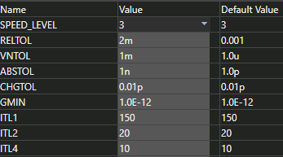
Tolerances Overview
What are tolerances in PSpice for TI?
Tolerances are how much error/iterations will be accepted when finding a circuit’s solution
Loosening tolerances can help the simulation converge and also speed up simulations
Larger tolerances mean the simulation is less accurate
(Recommended vs Default)

Slide 4
Tolerances Definitions
RELTOL – Relative accuracy of voltages and currents [%] – Universal accuracy
VNTOL – Best accuracy of voltages [V] – Smaller values are ignored
ABSTOL – Best accuracy of currents [A] – Smaller values are ignored
CHGTOL – Best accuracy of charges [C] – Smaller values are ignored
GMIN – Minimum conductance for any branch [1/Ω] – Added to nonlinear devices
ITL1 – DC and bias “blind” iteration limit – Maximum iterations
ITL2 – DC and bias “best guess” iteration limit – Maximum step iterations
ITL4 – Transient time point iteration limit – Maximum transient step iterations
TSTOP – Run to time [s]
TMAX – Maximum step size [s]

Slide 5
PSpice for TI vs TINA-TI – Default Tolerances
Tolerance | PSpice for TI | TINA-TI
RELTOL | 1m | 10m
VNTOL | 1u | 10u
ABSTOL | 1p | 10u
CHGTOL | 1p | 10f
GMIN | 1p | -
ITL1 | 150 | 1000
ITL2 | 20 | 40
ITL4 | 10 | 20

Slide 6
Recommended Steps to Fix Convergence Issues
Enable AutoConverge and run simulation
Modify simulation tolerances
Change ABSTOL to 100p
Change VNTOL to 1m
Change RELTOL to 2m
Modify pseudotransient options
Change PTRANABSTOL to 10u
Change PTRANVNTOL to 100u
Set the initial conditions (IC) of capacitors to 0
If transient:
Check the “Skip initial transient bias point calculation” (SKIPBP) checkbox
Switch power supplies to pulse and start at 0
Note: Each step reduces simulation accuracy, especially RELTOL.
Try running your simulation with each step!

Slide 7
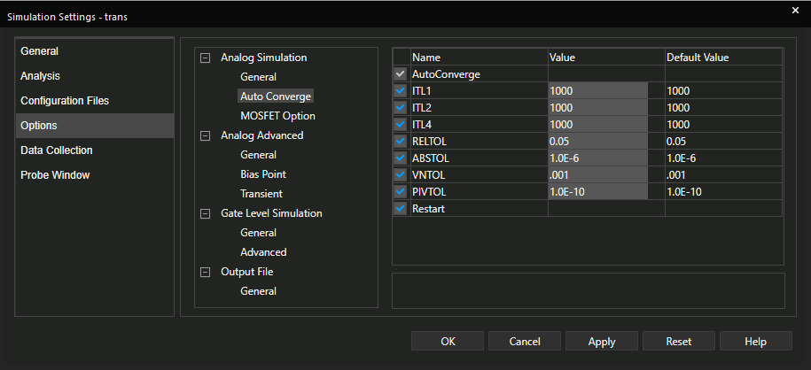
Step 1: Enabling AutoConverge
Go to Edit Simulation Profile
Go to Options > Analog Simulation > Auto Converge
Check AutoConverge
Click Apply and then OK

Slide 8
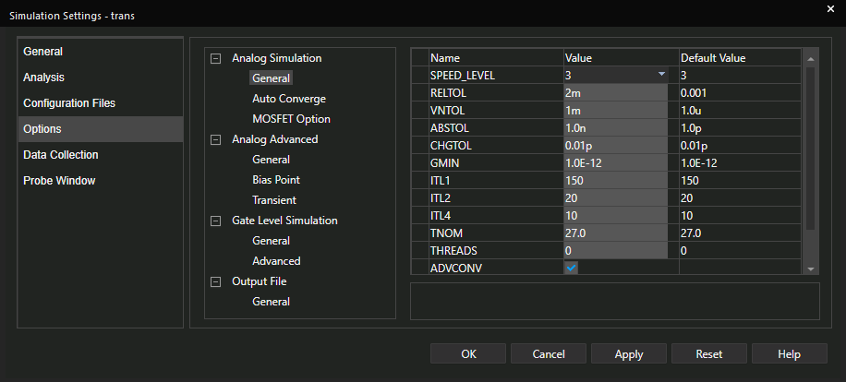
Step 2: Changing Tolerances
Go to Edit Simulation Profile
Go to Options > Analog Simulation > General
Change ABSTOL to 1n
Change VNTOL to 1m
Change RELTOL to 2m
Click Apply and then OK

Slide 9
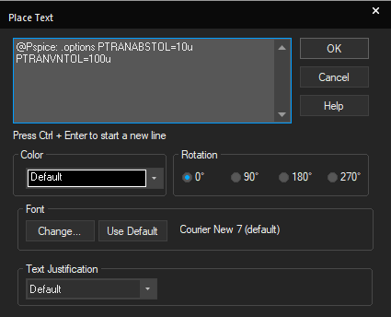
Step 3: Changing Pseudotransient Options
In your schematic, go to Place > Text (or use the hotkey “T”)
Type “@Pspice: .options PTRANABSTOL=10u PTRANVNTOL=100u”
Click OK and place text in schematic

Slide 10
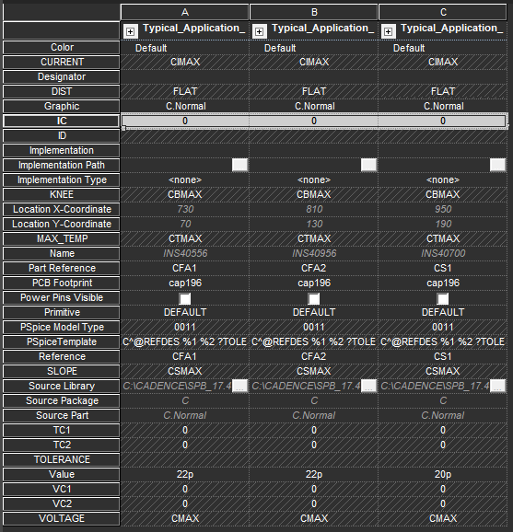
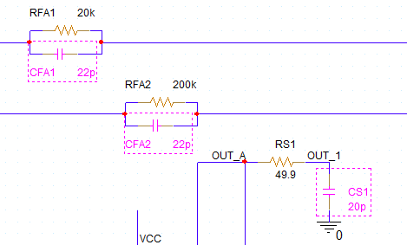
Step 4: Setting CAP Initial Conditions
CTRL+LeftClick to highlight multiple capacitors
LeftClick a capacitor twice to open Property Editor
Change all IC fields to 0
Click Apply and then close Property Editor
Click Pivot if properties are horizontal for easier viewing!

Slide 11
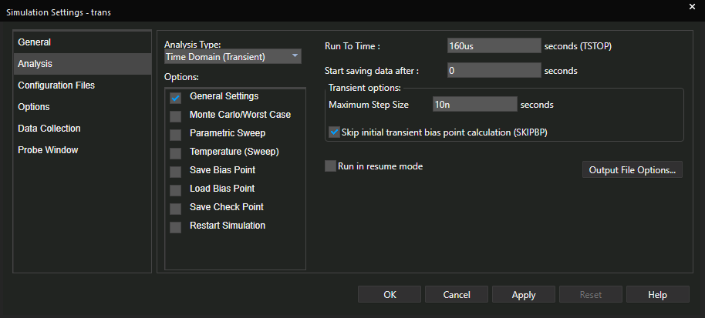
Step 5a (Transient) : Check SKIPBP
Go to Edit Simulation Profile
Go to Analysis
Check Skip initial transient bias point calculation (SKIPBP)
Click Apply and then OK

Slide 12
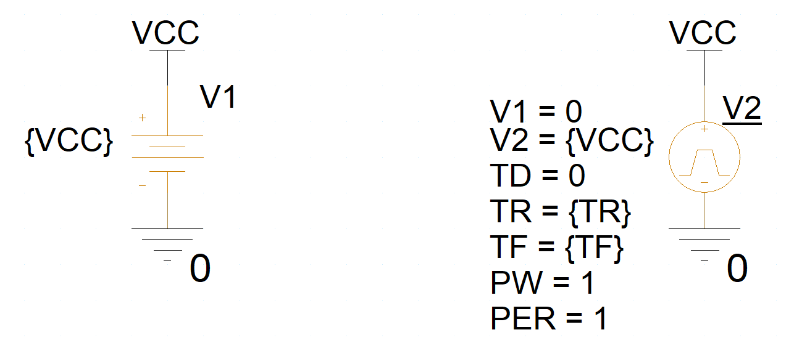
Step 5b (Transient): Use pulse power supplies
Go to Place > PSpice Component > Source > Voltage Sources > Pulse
Configure V1 as 0 and V2 as the desired VDD
Configure TD as 0
Calculate TR, TF as at least $(100ns ∗ \frac{VCC}{5 V})$
Configure PW and PER as longer than simulation time

Slide 13
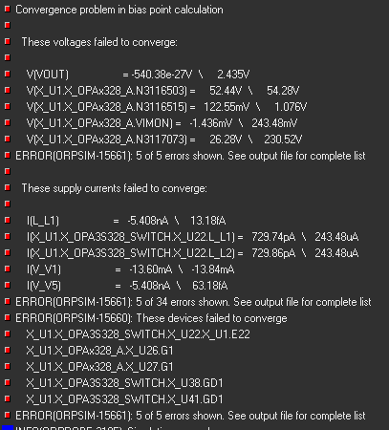
Non-Convergence Example
This is a Simulation Configuration for the
Open Loop Gain (AOL) of the OPA3S328
AC Sweep from 1 Hz – 100 MHz
The circuit will not converge with default settings

Slide 14
Non-Convergence Example - Results
After enabling AutoConverge (Step 1), the simulation converges.
After modifying the tolerances (Step 2), the simulation converges 300% faster.

