Slide 1
OCP Fault Triggered During
Battery is discharged on Storage System

Slide 2
Application: ESS system
Customer: WW Class
Device: OPA4277

Slide 3
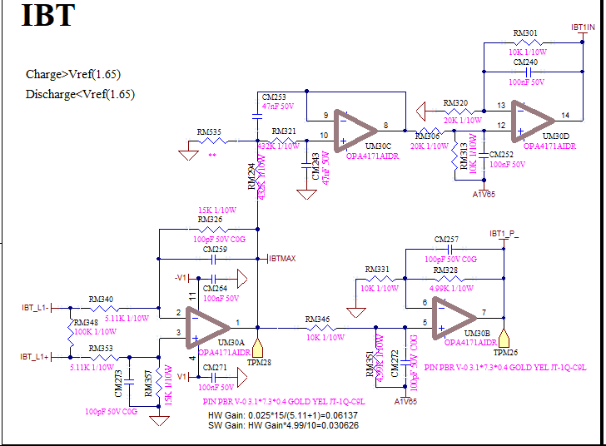
Problem 1:
Issue Description:
When battery is in discharge mode, the over current protection would
be fault Triggered.
Schematic of the Current feedback

Slide 4
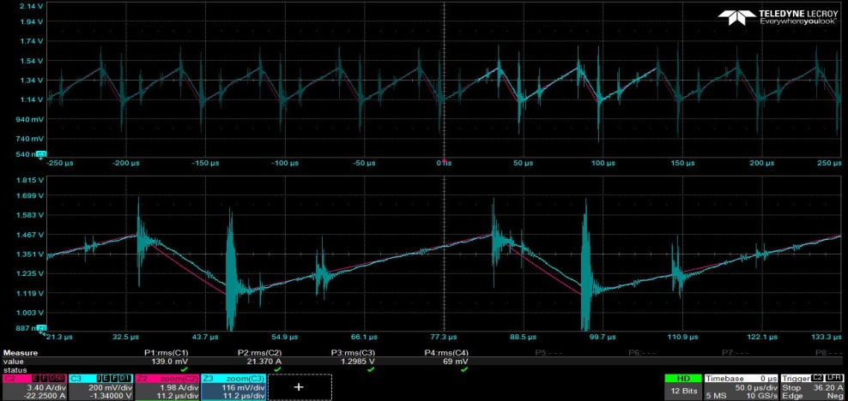
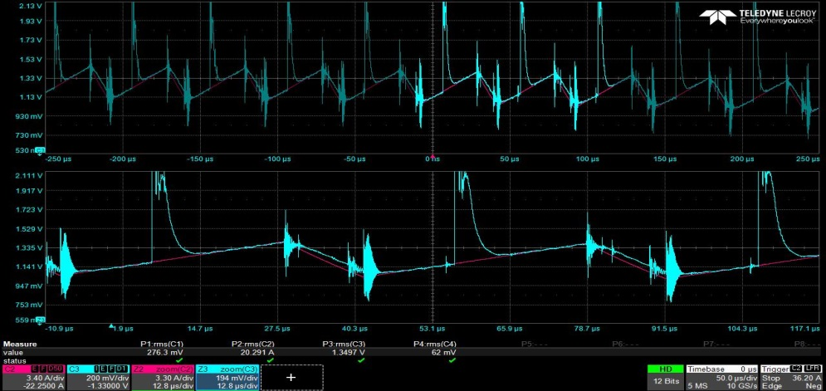
Verification Test to problem 1:
~ 20KHz freq.
Ch2(Red)：Inductor Current、Ch3(Blue)：Feedback signal of the IBTMAX)
Good
N.G
1st Source(OPA4171AIDR)
2nd Source(OPA4277UA/2K5)
Waveform Analysis：
  1. The freq. of the abnormal waveform is 20KHz which is identical to system inverter’s working freq.
  2. It looks the OPA4277 device is influenced by the inverter system’s PWM working frequency. It leads to the feedback signal of the IBTMAX abnormal and general the spike to cause the fault over current protection.

Slide 5
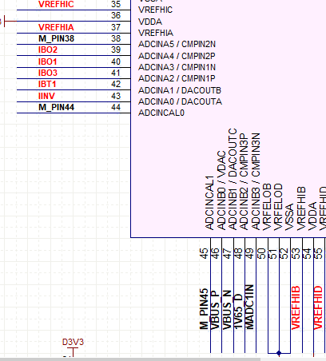
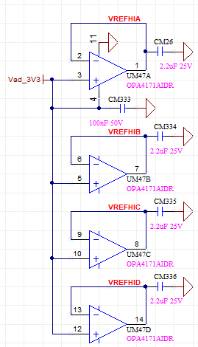
Problem 2:
Issue Description:
When using OPA4277UA as the buffer stage with 3.3V input, the measured voltage is close to 2V at C2000’s Pin 35/37/53/55.
However, when using OPA4171AIDR The voltage measurement is 3.3V.
C2000

Slide 6
Summary:
What’re the parameters of the OPA to cause the problem possibly?
Is the OPA4277 able to use on applications of the ref. Buffer, signaling and so on? What’s suggestion?
Why OPA4171 has No problem with this application?

Slide 7
