Slide 1
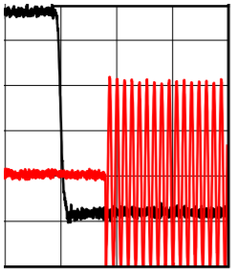
Question.1
Regarding the relationship between Ton / Toff setting and RFOUT ON / OFF, Is it correct with the following understanding?
Ton = PWDN(PowerDown) Pin Input: Low => High =RFOUT OFF
Toff = PWDN(PowerDown) Pin Input: High => Low =RFOUT ON
Ans: Yes, the understanding is correct
Question.2
When changing the PWDN terminal from low to high and turning off the output of the RFOUT terminal, the TON time of this portion(50% TTL to 100% Pout) must be 0.64 μs or less. Is this understanding correct?
5V
Ans: I have tried to give an example here of PWDN terminal
from high to low and turning ON the output of the RFOUT.
The Ton time is from 50% TTL to 90% Pout which should typically
be ~0.6 us.
PWDN pin
Pout
2V
50% TTL = 1.4V
0V
90% Pout
Typical (not max):0.6us

