Slide 1
INA350
Output Shutdown Performance

Slide 2
Schematic/Expected Output
VCC
VEE
V3 2.75
C5 100n
-
U1 INA350_G50
OUT
+
50m, 1k
+
+
V4 2.75
C6 100n
VAR = 0V
VCC
VEE

Slide 3
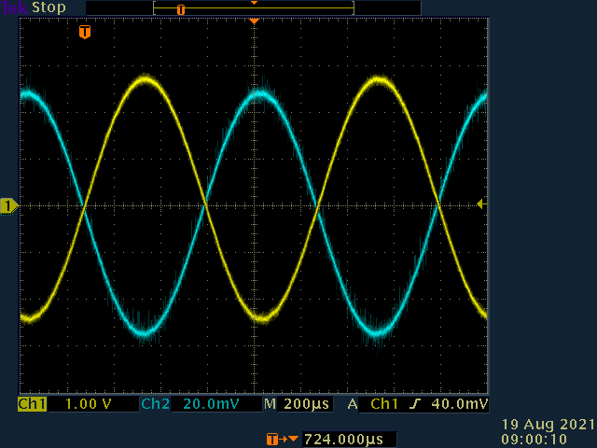
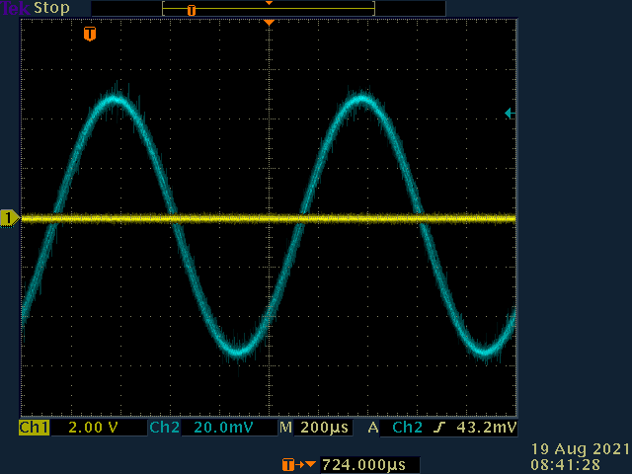
G=50 SD
SD is not High Z, is SD VREF?

Slide 4
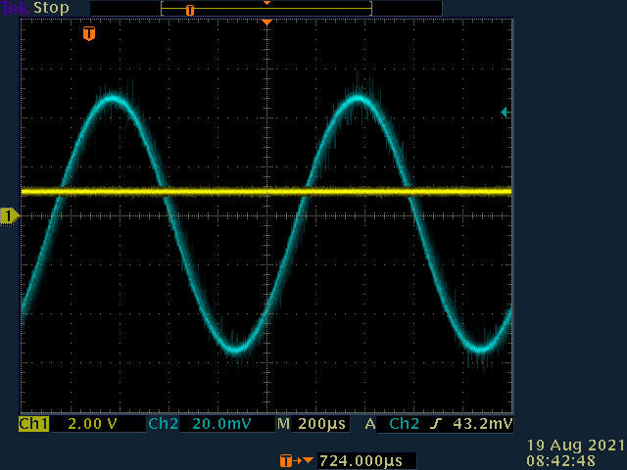
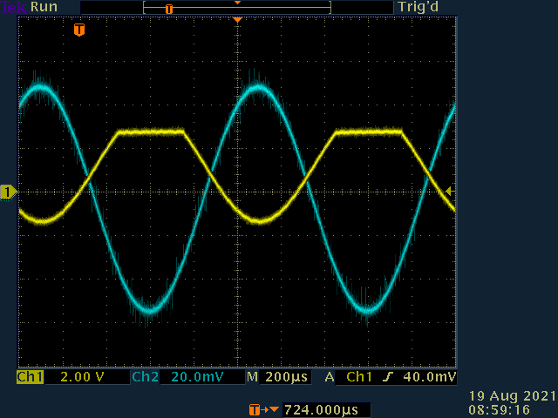
VREF = 1V SD = 1V
VEE
-
U1 INA350_G50
OUT
+
50m, 1k
+
+
1V
VCC

