Slide 1
Slew Rate vs Small-signal Rise Time
TI Precision Labs – Op Amps
Notes:
Hello, and welcome to the lecture for the TI Precision Lab discussing input offset voltage, or V_{OS}. In this lecture we’ll discuss op amp V_{OS} specifications, V_{OS} drift over temperature, input bias current (or I_{B}), and input bias current drift over temperature. We’ll also show the range of V_{OS} and I_{B} across many different Texas Instruments op amps.

Slide 2
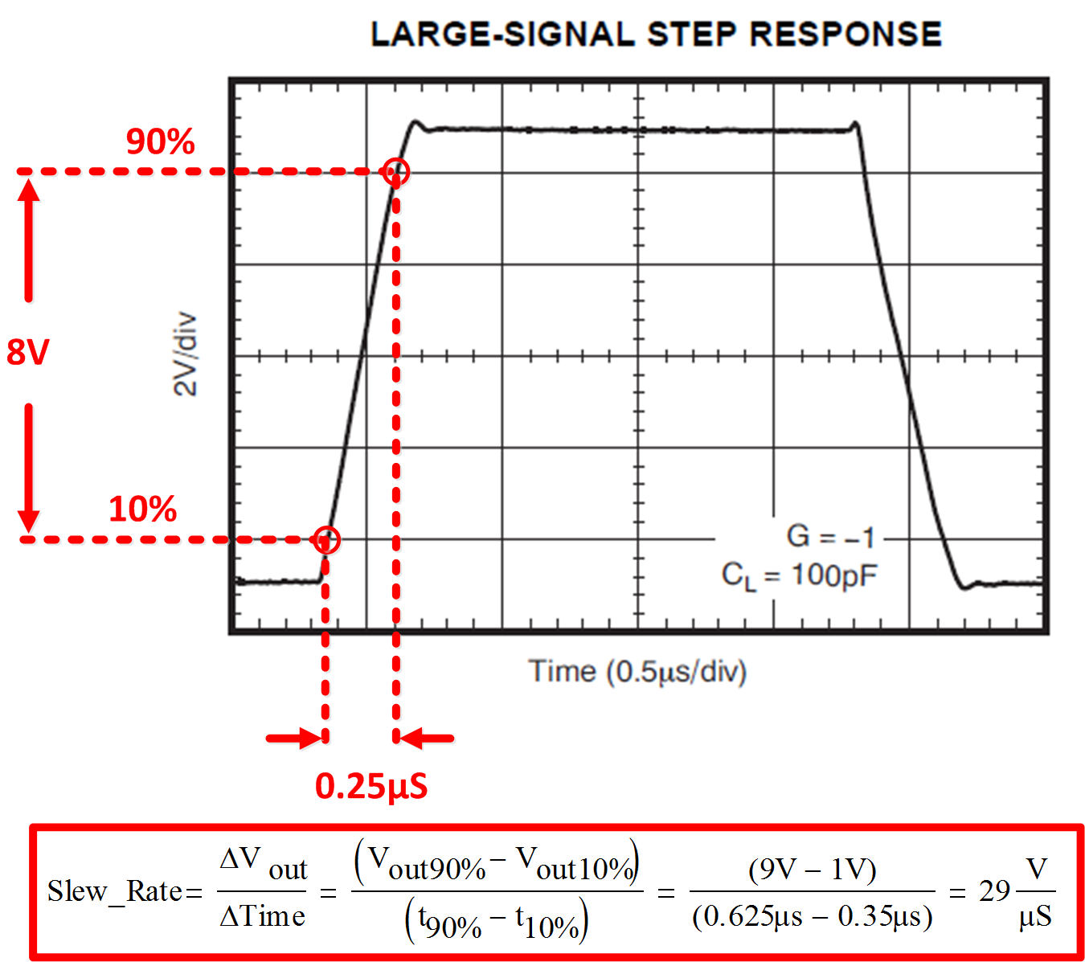
Slew Rate Defined
0.275µs
Notes:
Slew rate is defined as the maximum rate of change of an op amp’s output voltage and is given units of volts per microsecond. Slew rate is measured by applying a large signal step, such as 1V, to the input of the op amp, and measuring the rate of change from 10% to 90% of the output signal’s amplitude.
The data sheet large-signal step response is an indication of the amplifiers slew rate. In this example, we calculate the slew rate to be about 29V/us. Again, the slew rate definition only considers the rate of change of the signal from 10% to 90%, which in this case is 1V to 9V.
Slew rate is a different specification than small-signal bandwidth, which considers differential input signals of ±100mV or less.

Slide 3
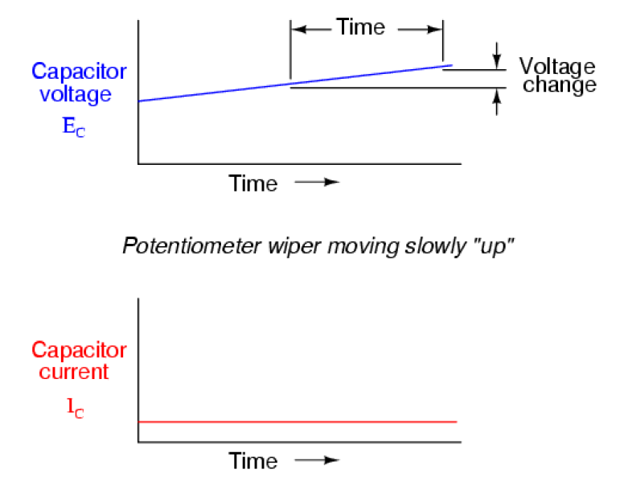
Capacitor Physics Review
With constant current applied, the voltage across a capacitor changes linearly over time
Notes:
Before we get into an in-depth slew rate discussion, let’s first review some basics.
The equation that defines how a capacitor works states that the current flow through a capacitor is equal to the capacitance times the derivative of voltage with respect to time. This behavior can also be interpreted to mean that if you have a constant current, then the voltage across the capacitor will rise linearly over time.

Slide 4
Slew Limit
For slow moving or small signals i_{CC} < i_{CC(max)}
For large, rapid moving signals i_{CC} = i_{CC(max)}
  The output is slew rate limited
  This is the fastest rate the output can change
  The input is no longer a virtual short
  Large input differential voltages are possible
  i_{CC} is constant, so V_{OUT} increases linearly across capacitor C_{C}
Notes:
This is important with respect to slew rate of an amplifier. An amplifier has an internal g_{M}, or transconductance, stage which takes the input differential voltage and converts it to an output current, I_{CC}. I_{CC} flows into the next stage where it is used to charge C_{C}, which is called the Miller capacitance. If I_{CC} is a constant, then the voltage across C_{C} will rise linearly with time, just like we discussed on the previous slide.
For slow-moving signals, I_{CC} is less than some maximum value I_{CC_MAX}. This means that I_{CC} is able to change according to the differential input voltage without being limited. But for rapidly moving, large signals, I_{CC} reaches its maximum and becomes limited to some constant value. In this case the input to the amplifier will no longer be a virtual short, and therefore a differential voltage will develop across the input pins. Since I_{CC} is constant, V_{OUT} across the Miller capacitor C_{C} increases linearly over time. This is when the output of the amplifier is considered to be slew rate-limited, which is fastest that the output voltage can change.

Slide 5
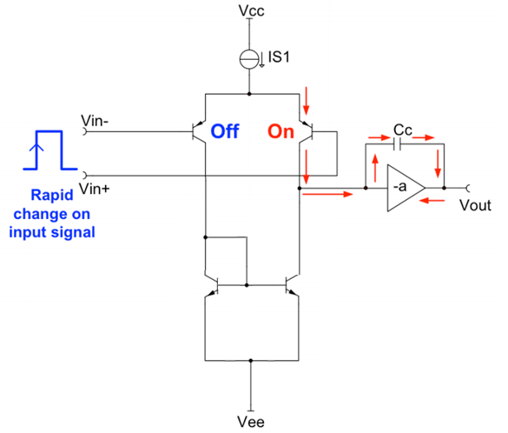
Slew Limit – Inside the Amplifier
SR = IS1/Cc

Slide 6
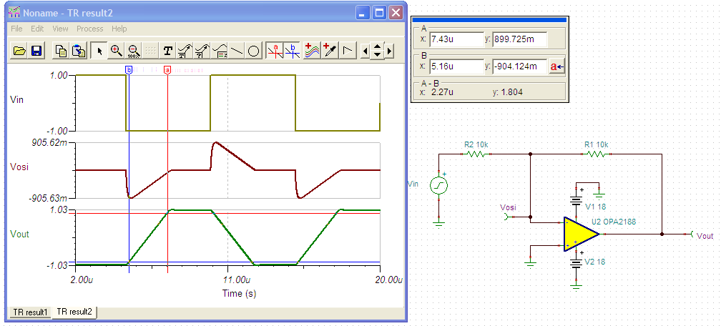
Simulate Slew Rate – OPA2188
Look at the slope of the output signal. The rate of change is the slew rate.
Notes:
We can easily simulate slew rate using TINA-TI. Simply apply a step function to the input of the amplifier, which in this case is a ±1V square wave. You can see that when this input step is applied, the input offset voltage changes from 0V - which indicates a virtual short - to some other voltage, around 900mV in this case. Most importantly, the output voltage becomes slew rate-limited, shown as a constant ramp in voltage over time until finally reaching its true value. You can observe the input offset voltage moving linearly back to 0V as well.
Calculating the slew rate from this plot gives a result of 0.795V/µs. The data sheet for this device, the OPA2188, lists the slew rate as 0.8V/µs, indicating that the model accurately simulates the slew rate of the amplifier.

Slide 7
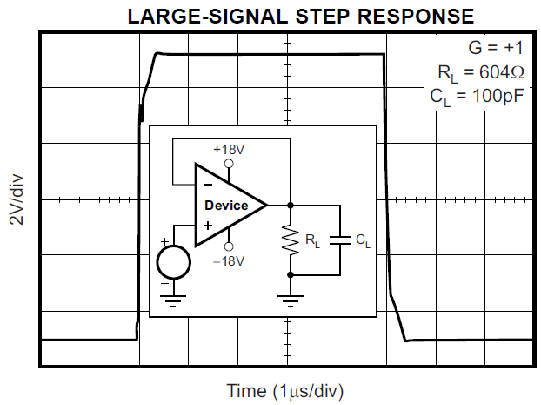
Slew Boost
Slows down as V_{OUT} approaches V_{IN}.
Notes:
Some amplifiers include a “slew boost” circuit which allows for faster slew rates. An example of an amplifier with slew boost is shown in this large-signal step response plot. What happens is that the device has two different slew rates – an initial rate which is very fast, and a second, slower rate as the output settles to its final value. You may ask yourself, “why doesn’t the amplifier just have one slew rate which is always fast?” The reason is that with one, extremely fast slew rate, the output would have a large overshoot. When that overshoot occurred, the amplifier would try to compensate for this and the negative slew would kick in, resulting in a large negative overshoot. This behavior would continue, resulting in oscillation.

Slide 8
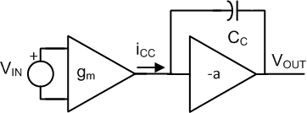
Slew Boost vs. Standard
Notes:
So how does this slew boost look compared to a standard amplifier? On the left hand side is the response of a standard amplifier. The green region shows the small-signal response (or differential input voltage greater than ±100mV), where the amplifier can linearly change the current flowing into the Miller capacitance. The blue region shows the large-signal response (or differential input voltage greater than ±100mV), where the amplifier reaches its slew rate limit and the current flow into the Miller capacitance is held constant..
We have a similar situation for an amplifier with slew boost. There is still a small-signal response shown by the green region, but once the differential input voltage exceeds a certain value we reach the slew rate limit, indicated by the blue region, and eventually the slew boost, indicated by the red region. Therefore, when a large step function is applied to the input of the amplifier, the device will initially see a large differential input voltage and will be in Slew boost mode, allowing a large output current into the Miller capacitance and therefore a quickly-ramping output voltage. As the differential input voltage decreases the amplifier will move to its standard slew rate, and finally to its small-signal response once the input voltage becomes small enough. At this point the output will settle and the inputs of the amplifier will once again be a virtual short.

Slide 9
Effect of Slew Rate with Sine Wave Input
Slew-induced Distortion
Notes:
The slew rate of an op amp also impacts sinusoidal signals. If the op amp attempts to swing its output voltage past a certain frequency and amplitude which exceed the slew rate, the output will become distorted and will start to look more like a triangle wave. This limitation is called the full power bandwidth of the op amp.

Slide 10
Full Power Bandwidth
For V_{S} = +/-15V
10V_{PK} → Distortion
7.5V_{PK} → No Distortion
Notes:
The graph above shows the maximum output sinusoidal waveform that can be generated without slew-induced distortion. This example considers a 200kHz signal at both 7.5Vpk and 10Vpk. At 7.5Vpk, the output signal is under the curve and therefore will not be distorted by slew rate limitations. At 10Vpk, the output signal is above the curve and will be distorted by slew rate limits.

Slide 11
Maximum Output vs. Frequency
7.5V_{PK}
No slew-induced Distortion
10V_{PK}
Slew-induced Distortion
Notes:
Let’s simulate the conditions of the previous slide. With 7.5Vpk output, the response is sinusoidal with minimal distortion. However, with 10Vpk output, in a condition outside the full power bandwidth curve, the device is slew-rate limited and the output distorts.

Slide 12
Maximum Output vs. Frequency – Derived
cos(ωt)=1
Hand calculation matches graph.
Notes:
This slide illustrates that the maximum output vs. frequency curve can be derived with calculus. You can go through the math on your own, but the key point is that the final equation, Vpk = SR / (2 PI f) can be used if this curve is not available. The example shown in red confirms that the equation yields the same result as the curve.

Slide 13
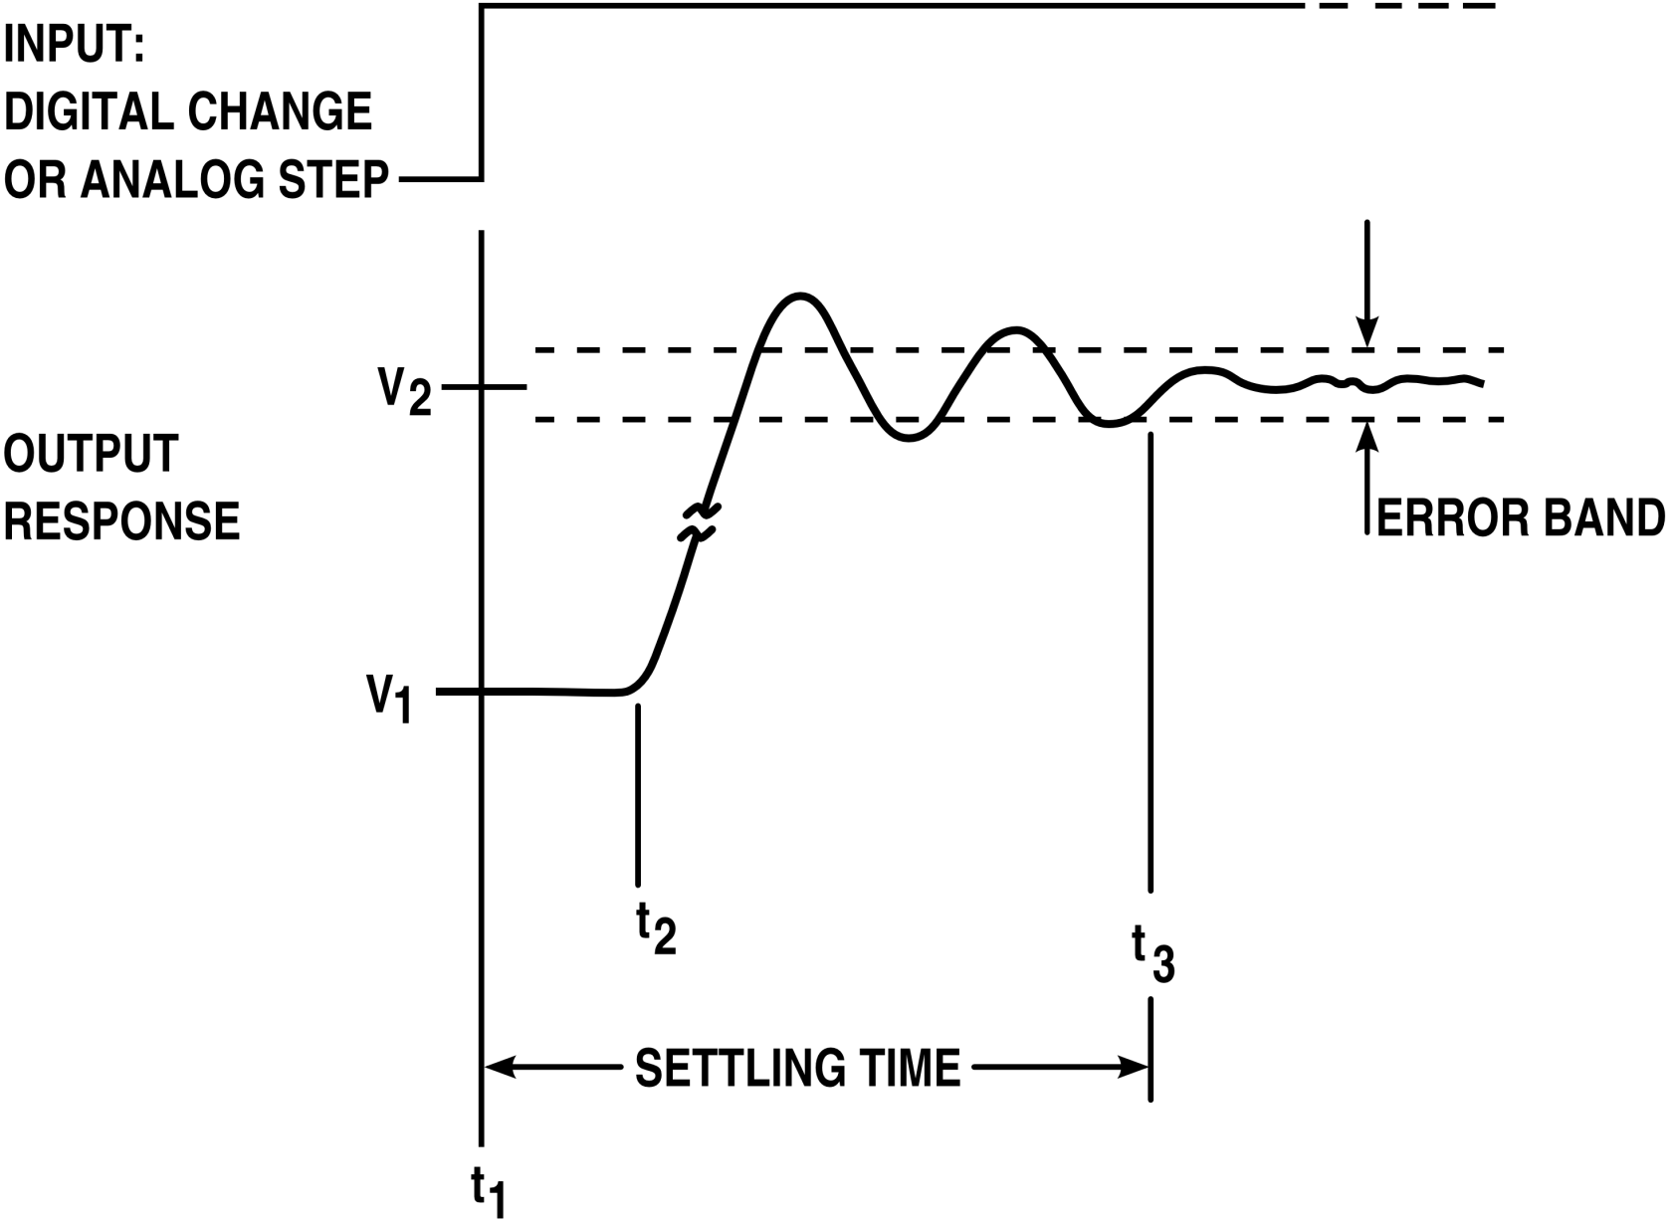
Settling Time
Notes:
Let’s now move on to discuss settling time.
Settling time is the time required for the amplifier’s output to reach and stay within a certain error band after a large-signal step is applied to the input. The error band can either be specified in terms of percentage or number of LSBs (for an ADC with a specified number of bits).
Because the input is a large-signal step, the amplifier is in slew rate limit. The tighter the error band is (i.e. smaller error percentage), the longer the settling time will be. Capacitance, closed loop gain, and loading will also effect settling time.

Slide 14
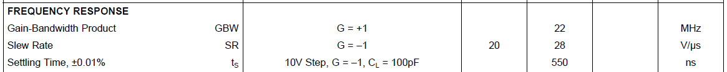
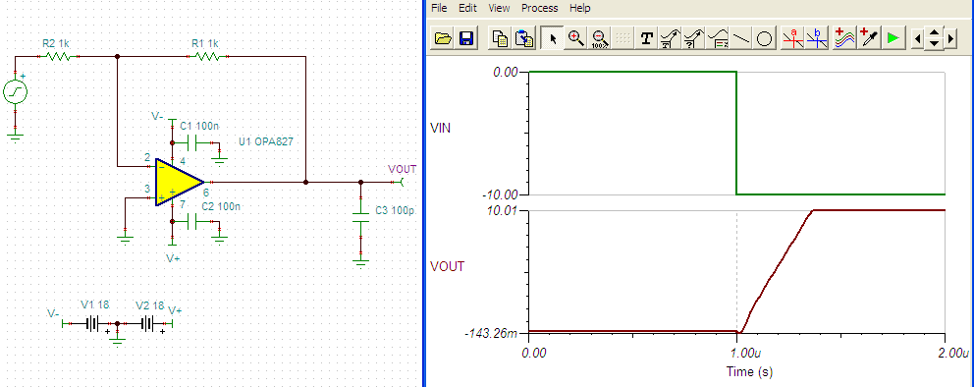
Simulating Settling Time – OPA827
Notes:
We can very easily simulate the settling time of an op-amp using TINA-TI’s transient analysis function. In order to do this, it is important to closely follow the data sheet test conditions, such as the step size, gain configuration, and load capacitance.
In this case we are testing the OPA827 in a gain of -1, with a 10V step input and 100pF of load capacitance.

Slide 15
Simulating Settling Time – Large-signal
ns
Data Sheet = 550ns
Simulated = 400ns
0.01% settling for a 10V signal
10V x 0.01% = 1mV
|Output – 10V| < 1mV
Notes:
The settling behavior, with some overshoot and damped oscillations, can really be seen once we zoom in on the plot. In this example, the output settles after an over shoot and one cycle of ringing, for a total settling time of 400ns. This is acceptably close to the typical data sheet value of 550ns.

Slide 16
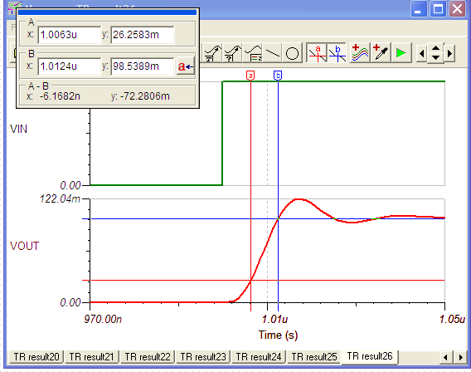
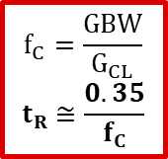
Small-signal Rise Time
Rate of change of output:
ΔV/ Δt = 72.3mV / 6.17ns
ΔV/ Δt = 11.7V/µs
Data sheet = 28V/µs
This is what you would expect with a real device!
A small signal step will not put the amplifier into slew limit.
$$f_{C}=\frac{GBW}{G_{CL}}$$
$$t_{R}≅\frac{0.35}{f_{C}}$$
Notes:
Here we observe the small-signal rise time of the same circuit, for purposes of comparison to the large-signal slew rate. Again, let’s zoom in on the rising edge of the small signal step response. Measuring delta V over delta T from 10% to 90% of the output swing, me get a rise time of 11.7V/µs. Compare this to the data sheet slew rate value of 28V/µs – they’re quite different!
Where does the difference in this behavior come from? Well, as you may remember from earlier, a large-signal step input puts an op-amp in slew limit and therefore forces it outside of its normal linear operation. A small-signal step input, on the other hand, allows the op-amp to operate in its linear region and therefore the rise time is based on the op-amp’s bandwidth.
The equation to calculate 10% to 90% rise time is given here. It is derived from the properties of a single-pole system.

Slide 17
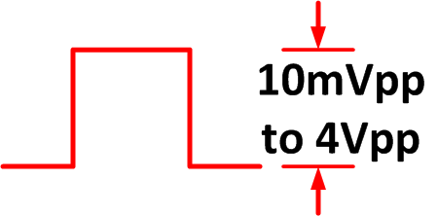
Transition from Small-signal to Large-signal
When do we transition from small signal to large signal?
Notes:
An amplifier’s small-signal or large-signal behavior, like most things in the real world, isn’t fully black and white. The way in which a circuit operates is not always fully large-signal or small-signal. In fact, there’s a gradual transition between these two operating conditions.
Here we have a simple op amp circuit configured as a non-inverting buffer. We’ll apply a range of input steps, from 10mVpp to 4Vpp, and observe the output. A transient simulation done in TINA-TI will allow us to observe whether the circuit shows small-signal or large-signal behavior.

Slide 18
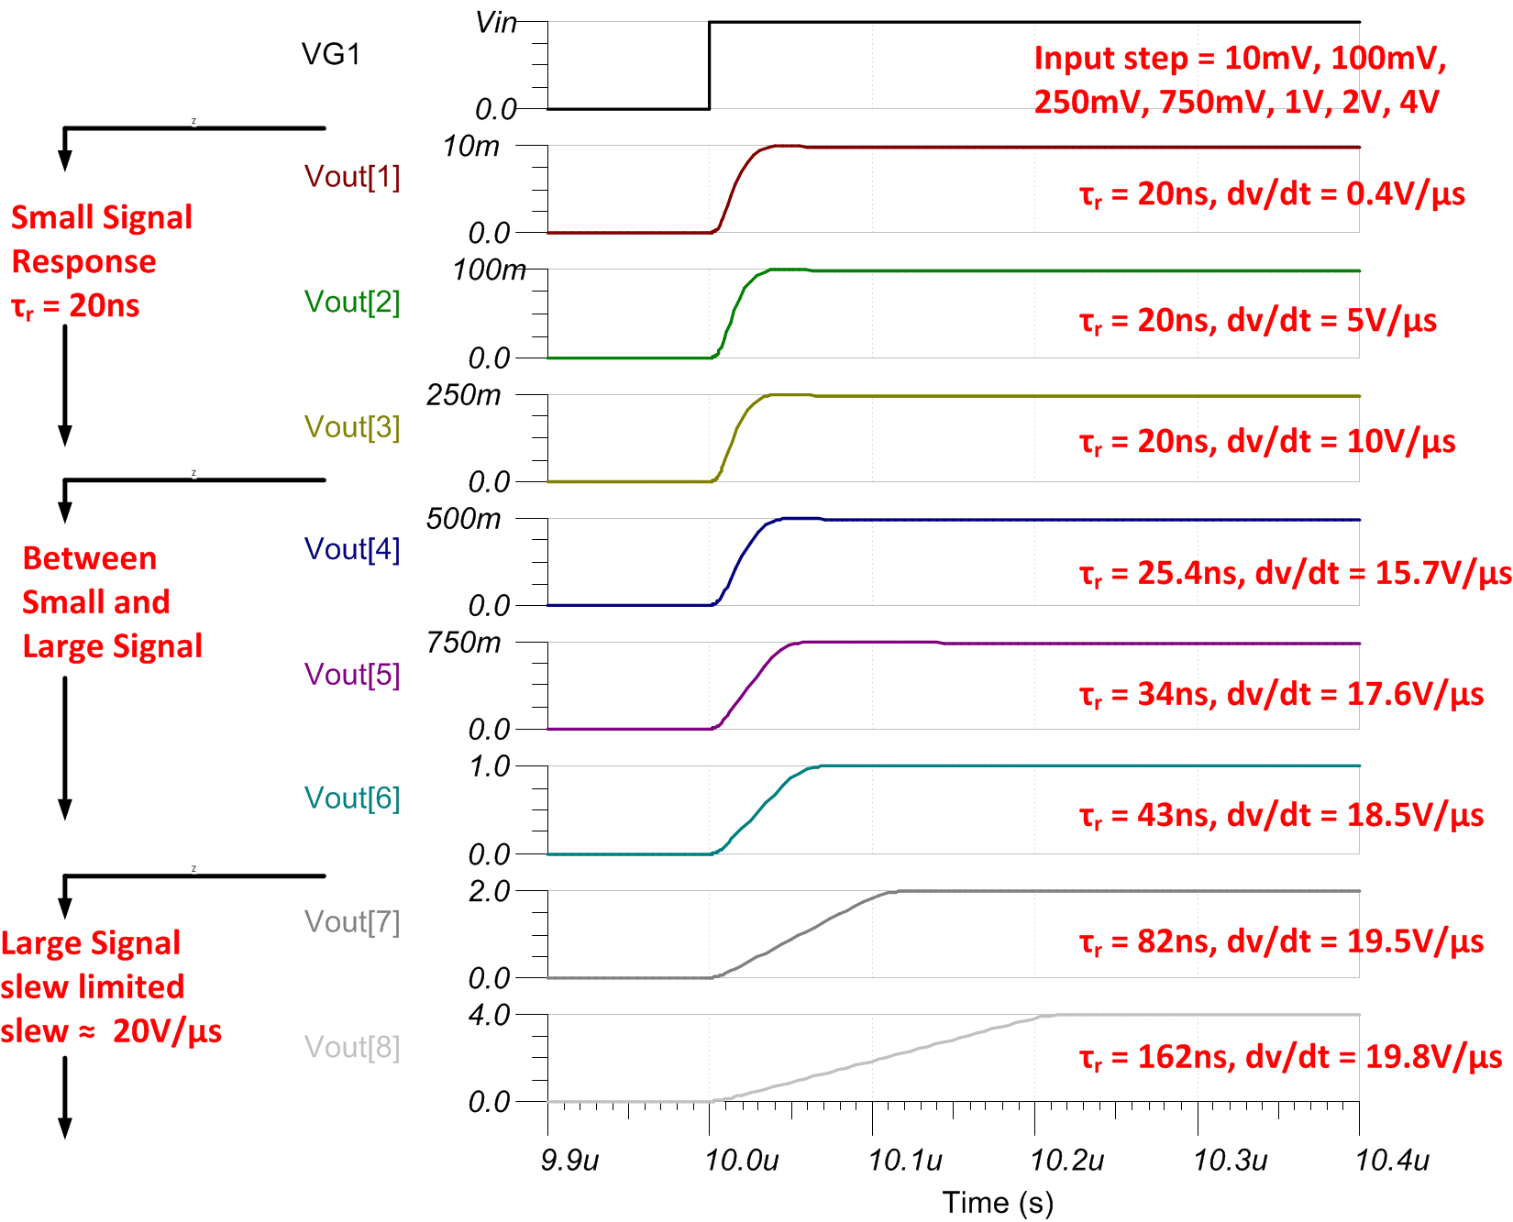
Transition from Small-signal to Large-signal
Notes:
This figure illustrates the output of the non-inverting buffer circuit from the previous slide, versus different input step sizes.
Notice that the output rise time is a constant 20ns for input steps of 10mV to 250mV. Because the rise time is constant, we know that the response is small-signal. The device in this example, the OPA192, has a slew rate of 20V/us. You can see that the rate of change for the small step response is lower than the slew rate. Also, notice that the output signal increases exponentially for the small signal response, as opposed to the linear increase for amplifiers that are slew rate-limited.
For input steps between 500mV and 1V, the amplifier is transitioning between small-signal and large-signal response. In this region the rise time is no longer constant; however, the amplifier is not yet at the full slew rate of 20V/us.
For input steps greater than 1V, the amplifier is slew rate-limited. You can see that the rate of change of the output signal is at the slew rate limit of about 20V/us. Also, notice that the output signal increases linearly in response to the input step.
In this example, input signals less than 250mV caused a small signal response and signals greater than 1V caused a large signal response. However, this transition depends on the amplifier’s design and technology. CMOS amplifiers tend to reach slew limit for signals greater than 100mV, and bipolar amplifiers can slew limit at even lower input voltages. Note that the industry standard for small signal response is a 100mV step, but in practice the actual limit may be lower.
Because of the way the output signal is scaled in this figure, it is possible to be tricked into thinking that the slew rate limited signal at the bottom of the figure is moving more slowly then the small signal response at the top of the figure. This is not the case, and the next slide will provide further clarification.

Slide 19
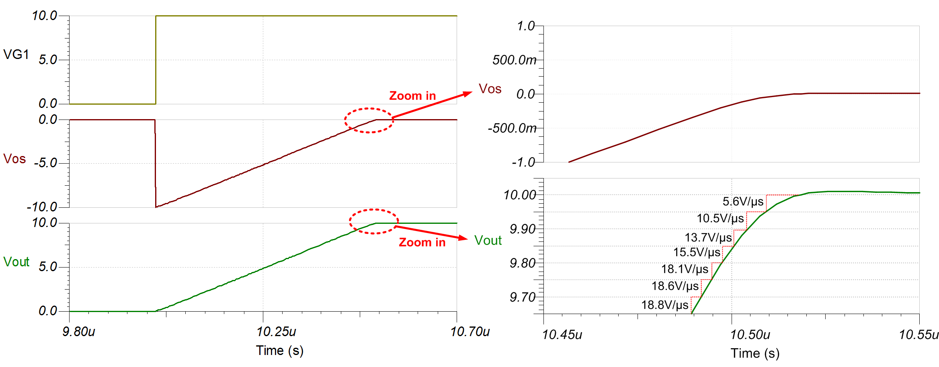
Transition from Slew Rate to Small-Signal
Notes:
Let’s take a closer look at the output of the non-inverting buffer circuit with a 10V step applied to the input.
In this case, the device is in slew-rate limit of 20V/us. However, when the signal approaches the final value of 10V, the op amp will transition to a small signal response. Zooming in on the last 300mV of the signal swing, you can see that the rate of change of the output decreases from approximately the slew rate, 20V/us, to a lower rate of change such as approximately 5V/us. Also, you can see that the shape of the output changes from the linear rise associated with slew rate limit, to the exponential behavior associated with small signal response.

Slide 20
Slew Rate vs. IQ
Op amp | Slew Rate (typ) | I_{Q} (typ)
TLV8812 | 0.0015 V/µs | 0.425µA
TLV6003 | 0.025 V/µs | 1µA
OPA2186 | 0.35 V/µs | 90µA
OPA2187 | 0.2 V/µs | 100µA
LMP7718 | 28 V/µs | 1.3 mA
TLV9361 | 25 V/µs | 2.6 mA
OPA1612 | 27 V/µs | 3.6 mA
OPA2328 | 30 V/µs | 3.8 mA
OPA593 | 40 V/µs | 3.25mA
OPA863 | 105 V/µs | 700 µA
OPA828 | 150 V/µs | 5.5 mA
Notes:
Here we compare the typical slew rate and quiescent current, or IQ, for different amplifiers.
On one end of the spectrum, we have the OPA369 which is a very low I_{Q} and low slew rate device. For 0.8µA of current we can achieve around 5mV/µs of slew. Compare that to the OPA847, which consumes 18.1mA of I_{Q} but can slew at 850V/µs. This shows us that amplifiers with higher slew rate, and therefore higher bandwidth, tend to have higher current consumption.

Slide 21
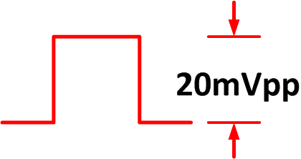
Step Input in Gain = -99V/V
The output is 2V_{PP}.
Is the response small or large signal?
Notes:
Most of the examples discussed thus far have been basic buffer circuits, also called unity-gain followers. Now let’s look at amplifiers with different closed loop gains in order to see the effect that closed loop gain has on output response.
Here we show an inverting amplifier circuit in a gain of -99V/V. The input is a small signal step of 20mVpp. Based on the gain, the output should be approximately 2Vpp. Does the output respond as a small signal or as a large signal?

Slide 22
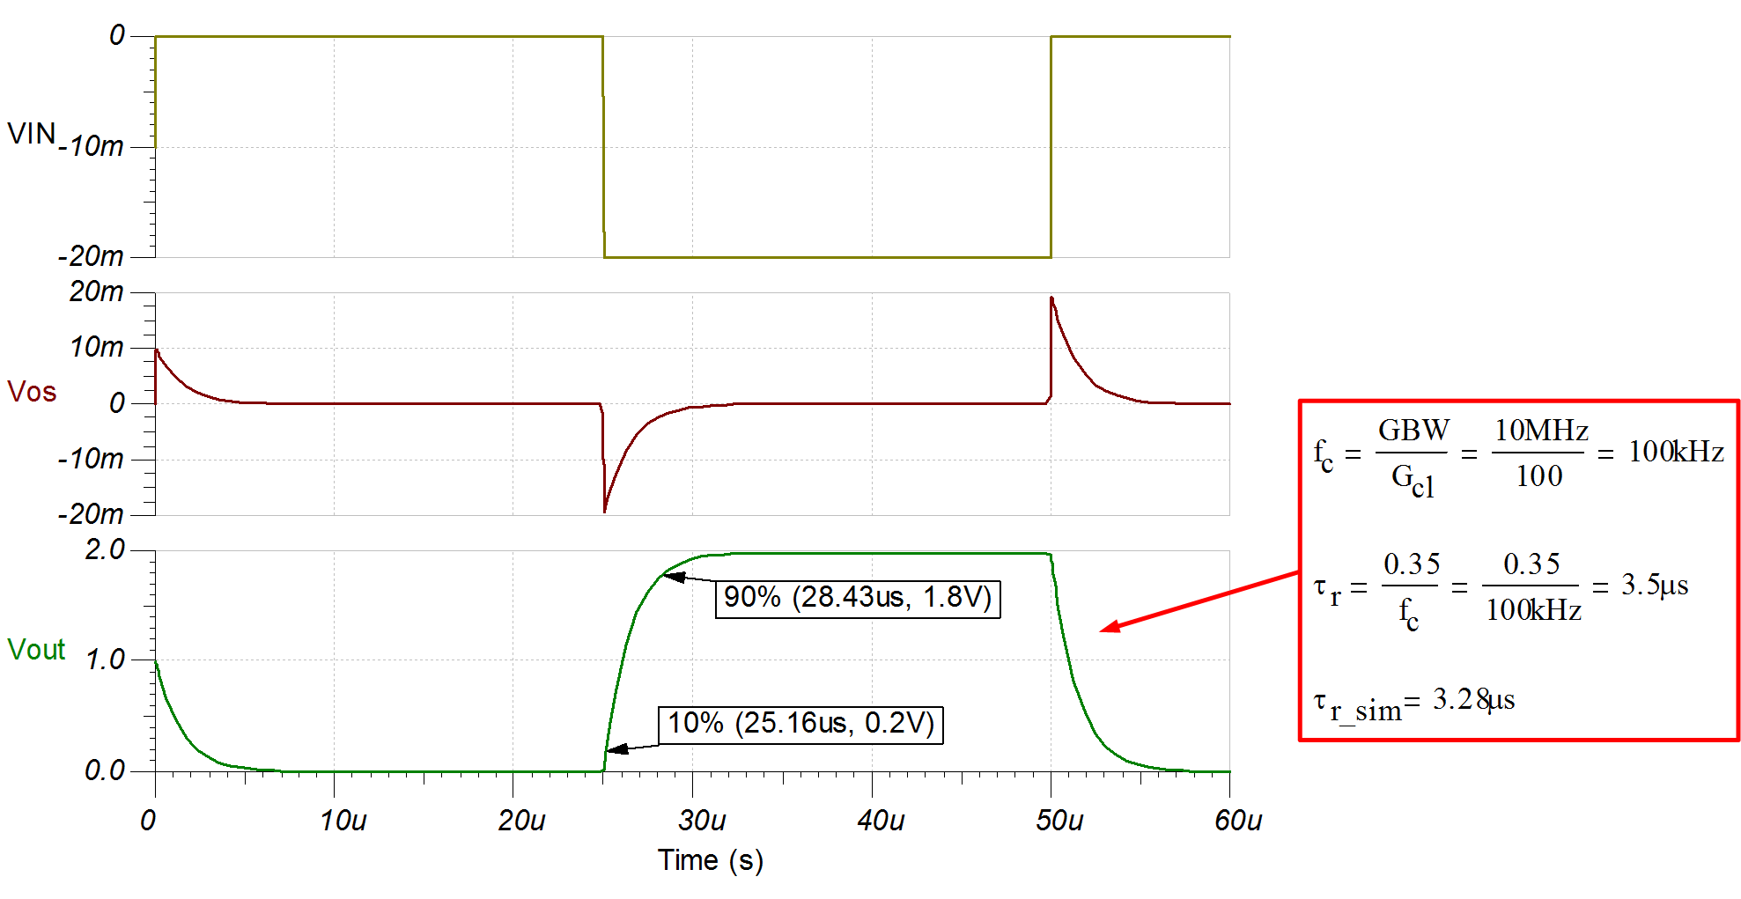
Small vs. Large Signal: Look at the Input
Slew Rate vs Small-signal Rise Time
Notes:
This is the simulated output response of the circuit from the previous slide. Notice that the output signals rise and fall in an exponential way, which indicates a small-signal response. Also, if we use the small signal rise time formula from before, we can see that the calculated rise time of 3.5us is very close to the simulated rise time of 3.28us. Thus, the amplifier responds to the 20mV input step as a small signal, and we can conclude that the amplitude of the input signal determines the behavior of the op amp. The output signal amplitude does not determine whether the response is small or large signal.

Slide 23
Questions?
Notes:
Hello, and welcome to the lecture for the TI Precision Lab discussing input offset voltage, or V_{OS}. In this lecture we’ll discuss op amp V_{OS} specifications, V_{OS} drift over temperature, input bias current (or I_{B}), and input bias current drift over temperature. We’ll also show the range of V_{OS} and I_{B} across many different Texas Instruments op amps.

Slide 24
Thank You
Notes:
Hello, and welcome to the lecture for the TI Precision Lab discussing input offset voltage, or V_{OS}. In this lecture we’ll discuss op amp V_{OS} specifications, V_{OS} drift over temperature, input bias current (or I_{B}), and input bias current drift over temperature. We’ll also show the range of V_{OS} and I_{B} across many different Texas Instruments op amps.

