Slide 1

High Current
V-I Circuits
Tim Green

Slide 2
Review - Essential Principles
Poles, Zeros, Bode Plots
Op Amp Loop Gain Model
Loop Gain Test
β and 1/β
Rate-of-Closure Stability Criteria
Loop Gain Rules-of-Thumb for Stability
R_{O} and R_{OUT}

Slide 3
Poles and Bode Plots
Pole Location = f_{P}
Magnitude = -20dB/Decade Slope
Slope begins at f_{P} and continues down as frequency increases
Actual Function = -3dB down @ f_{P}
Phase = -45°/Decade Slope through f_{P}
Decade Above f_{P} Phase = -90°
Decade Below f_{P} Phase = 0°
A(dB) = 20Log₁₀(V_{OUT}/V_{IN})

Slide 4
Zeros and Bode Plots
Zero Location = f_{Z}
Magnitude = +20dB/Decade Slope
Slope begins at f_{Z} and continues up as frequency increases
Actual Function = +3dB up @ f_{Z}
Phase = +45°/Decade Slope through f_{Z}
Decade Above f_{Z} Phase = +90°
Decade Below f_{Z} Phase = 0°
A(dB) = 20Log10(VOUT/VIN)

Slide 5
Op Amp: Intuitive Model

Slide 6
Op Amp Loop Gain Model
1/β = Small Signal AC Gain
β = feedback attenuation
V_{OUT}/V_{IN} = Acl = Aol/(1+Aolβ)
If Aol >> 1 then Acl ≈ 1/β
Aol: Open Loop Gain
β: Feedback Factor
Acl: Closed Loop Gain
Notes:
The lower diagram is the traditional control loop model which represents an op amp circuit with feedback. The top diagram depicts the sections of a typical op amp circuit with feedback which correspond to the control loop model. This model of an op amp circuit with feedback we will call the Op Amp Loop Gain Model. Notice that the Aol is the Op Amp data sheet parameter Aol, and is the open loop gain of the op amp. β (Beta) is the amount of output voltage from V_{OUT} which gets fed back as feedback. The β network in this example is a resistor feedback network.
In the derivation of V_{OUT}/V_{IN} we see that the closed loop gain function is directly defined by Aol and β.

Slide 7
Stability Criteria

Slide 8
Traditional Loop Gain Test
Op Amp Loop Gain Model
Op Amp is “Closed Loop”
SPICE Loop Gain Test:
Break the Closed Loop at V_{OUT}
Ground V_{IN}
Inject AC Source, V_{X}, into V_{OUT}
Aolβ = V_{Y}/V_{X}
Notes:
When analyzing a circuit built in SPICE for simulation the traditional Loop Gain Test breaks the closed loop op amp circuit through the use of an inductor and capacitor. A very large value of inductance ensures the loop is closed at DC (a requirement for SPICE simulation is to be able to calculate a DC Operating Point first before performing an AC Analysis) but open at AC frequencies of interest. A very large value of capacitance ensures that our AC Small Signal Source is not connected at DC but is directly connected at the frequencies of interest.

Slide 9
β and 1/β
β is easy to calculate as feedback network around the Op Amp
1/β is reciprocal of β
Easy Rules-Of-Thumb and Tricks to Plot 1/β on Op Amp Aol Curve
Notes:
Before we simulate a circuit in SPICE we will want to know what the approximate outcome will be. Remember GIGO (Garbage In Garbage Out)!!
Beta (β) and its reciprocal 1/Beta (1/β) along with the data sheet Aol Curve will provide a powerful method for first-order approximations of Loop Gain analysis before we run SPICE. Beta (β) is easy to compute and its reciprocal even easier to plot!

Slide 10
Loop Gain Using Aol & 1/β
Plot (in dB) 1/β on Op Amp Aol (in dB)
Aolβ = Aol(dB) – 1/β(dB)
Note how Aolβ changes with frequency
Proof (using log functions):
20Log₁₀[Aolβ] = 20Log₁₀(Aol) - 20Log₁₀(1/β)
= 20Log₁₀[Aol/(1/β)]
= 20Log₁₀[Aolβ]
Notes:
The 1/β plot plotted on the Aol curve will provide a clear picture of exactly what the Loop Gain (Aolβ) plot is. From our derivation above we clearly see that the Aolβ magnitude plot is simply the difference between Aol and 1/β when we plot 1/β in dB on an Aol curve. Note that as frequency increases Aolβ decreases. Aolβ is the gain left to correct for errors in the V_{OUT}/V_{IN} or Closed Loop response. So as Aolβ decreases the V_{OUT}/V_{IN} response will become less accurate until the point where Aolβ goes to 0dB where from then on the V_{OUT}/V_{IN} response will simply follow the Aol curve.

Slide 11
Stability Criteria using 1/β & Aol
At fcl: Loop Gain (Aolβ) = 1
Rate-of-Closure @ fcl =
(Aol slope – 1/β slope)
*20dB/decade Rate-of-Closure @ fcl = STABLE
**40dB/decade Rate-of-Closure@ fcl = UNSTABLE
Notes:
Once we plot 1/β on the Aol curve there is an easy first-order check for stability called Rate-Of-Closure. This Rate-Of-Closure stability check is defined as the “rate of closure” of 1/β curve with the Aol curve at fcl, where loop gain goes to 0dB. A 40db/decade rate-of-closure implies an UNSTABLE circuit and a 20dB/decade rate-of-closure implies a STABLE circuit. The 40dB/decade rate-of-closure implies instability because it implies two poles in the Aolβ plot before fcl which can mean a 180 phase shift. Four examples are shown above with their respective rate-of-closure computed below.
fcl1: Aol-1/β1 = -20dB/decade - +20dB/decade = -40dB/decade → 40dB/decade rate-of-closure & UNSTABLE
fcl2: Aol-1/β2 = -20dB/decade - 0dB/decade = -20dB/decade → 20dB/decade rate-of-closure & STABLE
fcl3: Aol-1/β3 = -40dB/decade - 0dB/decade = -40dB/decade → 40dB/decade rate-of-closure & UNSTABLE
fcl4: Aol-1/β4 = -40dB/decade - -20dB/decade = -20dB/decade → 20dB/decade rate-of-closure & STABLE

Slide 12
Loop Gain Bandwidth Rule: 45 degrees for f < fcl
Aolβ (Loop Gain) Phase Plot
Loop Stability Criteria: <-180 degree phase shift at fcl
Design for: <-135 degree phase shift at all frequencies <fcl
Why?:
Because Aol is not always “Typical”
Power-up, Power-down, Power-transient → Undefined “Typical” Aol
Allows for phase shift due to real world Layout & Component Parasitics
Notes:
The established loop stability criteria is less than a 180 degree phase shift at fcl, the frequency at which loop gain goes to zero. How close the phase shift is to a full 180 degrees phase shift at fcl is defined as phase margin. As detailed in this slide the recommended rule-of-thumb for real world circuits is to design for 135 degree phase shift (45 degree phase margin) throughout the loop gain bandwidth (f < fcl). This allows for the real world cases of power-up, power-down and power-transient conditions where the op amp can have changes in its Aol curve which may result in transient oscillations. This is especially undesirable in power op amp circuits. This rule-of-thumb also allows for extra phase margin in the loop gain bandwidth to account for additional real world phase shifts due to parasitic capacitances and PCB layout parasitics. Also, phase margins less than 45 degrees within the loop gain bandwidth can result in undesired peaking in the closed loop transfer function. The lower the phase margin dip and the closer it is to fcl, the more pronounced the closed loop peaking will be.

Slide 13
Poles & Zeros Transfer: (1/β, Aol) to Aolβ
Aol & 1/β Plot
Loop Gain Plot
(Aolβ)
To Plot Aolβ from Aol & 1/β Plot:
Poles in Aol curve are poles in Aolβ (Loop Gain)Plot
Zeros in Aol curve are zeros in Aolβ (Loop Gain) Plot
Poles in 1/β curve are zeros in Aolβ (Loop Gain) Plot
Zeros in 1/β curve are poles in Aolβ (Loop Gain) Plot
[Remember: β is the reciprocal of 1/β]
Notes:
This slide reminds us of the relationship between the Loop Gain plot and the Aol plot with a 1/β plot included on it. This relationship allows us to use the manufacturer’s Aol curve from an op amp data sheet and plot our feedback curve, 1/β, on it. From these two plots it is easy to infer what is going on in the Loop Gain plot and therefore easy to synthesize what we need to modify our feedback to for good stability. Think of the Loop Gain plot as a “open loop” plot. The Aol plot is already an open loop plot and therefore poles in the Aol plot are poles in the Loop Gain plot, and zeros in the Aol are zeros in the Loop Gain plot. The 1/β plot is a plot of small-signal AC closed loop gain. If we want to open the loop and look at the effects of the feedback network we will see an inverse relationship as we analyze the network. A simpler way to remember the translation between the 1/β plot and Loop Gain plot is that the Loop Gain plot is Aolβ and the closed loop feedback plot is 1/β. Therefore, since β, is the reciprocal of 1/β, poles in the 1/β plot will become zeros in the Loop Gain (Aolβ) plot and zeros in the 1/β plot will become poles in the Loop Gain plot (Aolβ).

Slide 14
Frequency Decade Rules for Loop Gain
Loop Gain View: Poles: fp1, fp2, fz1; Zero: fp3
Rules of Thumb for Good Loop Stability:
Place fp3 within a decade of fz1
fp1 and fz1 = -135° phase shift at fz1
fp3 < decade will keep phase from dipping further
Place fp3 at least a decade below fcl
Allows Aol curve to shift to the left by one decade
Notes:
The “decade rules” for frequency in the Loop Gain plot are detailed in the slide above. These frequency decade rules will be used for 1/β plots and Aol plots as well as Aolβ, loop gain plots, which we can predict directly from the Aol and 1/β plots. For the circuit shown in this slide the Aol curve contains a second pole, fp2, around 100kHz due to the capacitive load, CL, and the op amp’s R_{O}, the details of which will be presented in Part 6 of this series. We will create a feedback network that will meet our Loop Gain Bandwidth rule of 45 degrees margin for f< fcl. We will analyze and synthesize the feedback network using the 1/β plot and Aol plot with the knowledge of what we are doing to the Loop Gain plot, Aolβ. fp1 gives us a first pole at 10Hz in the Loop Gain plot which implies a 45 degree phase shift at 10Hz with phase shifting to a 90 degrees by 100Hz. At 1kHz, fz1, a zero in the 1/β plot, we add a pole in the Loop Gain plot and another 45 degree phase shift at 1kHz. Our total phase shift now is -135 degrees at 1kHz. But if we continue on in frequency with just fz1 we will reach -180 phase shift at 10kHz!! So we add fp3, a pole in the 1/β plot, which is a zero in the Loop Gain plot at 10kHz. This keeps the phase shift at 1kHz to -135 degrees and flattens the phase plot to -135 degrees phase shift from 1kHz to 10kHz (remember poles and zeros have an effect a decade above and a decade below their actual frequency location). fp2 adds another pole in the Loop Gain plot at 100kHz since fp2 is from the Aol plot. Between 10kHz, where fp3 is, and 100kHz, where fp2 is, we expect no change in phase shift since fp3 is a Loop Gain plot zero and fp2 is a Loop Gain plot pole.
So if we keep poles and zeros spaced a decade away from each other they will keep the phase shift from dipping between them since each has an effect on one another a decade above and a decade below their location. The final key part of the Frequency Decade Rules for Loop Gain is to place fp3 no closer than a decade away from fcl. This allows for a decade shift in Aol towards the lower frequency range before we would be in a marginal stability condition. Typical Aol curves may shift as much as ½ decade in the real world.
The V_{OUT}/V_{IN} for this circuit is predicted to be flat until loop gain goes away at 100kHz, at which point it will then follow the Aol curve on down.

Slide 15
Op Amp Model for Derivation of R_{OUT}
R_{OUT} = R_{O} / (1+Aolβ)
From: Frederiksen, Thomas M. Intuitive Operational Amplifiers.
McGraw-Hill Book Company. New York. Revised Edition. 1988.
Notes:
As hinted at in the previous slide RO and ROUT are related. ROUT is RO reduced by loop gain. This slide will define the op amp model used for the derivation of ROUT from RO. This simplified op amp model focuses solely on the basic DC characteristics of an op amp. A high input resistance (100mΩ to GΩ), RDIFF develops an error voltage across it, VE, due to the voltage differences between -IN and +IN. The error voltage , VE, is amplified by the open loop gain factor Aol and becomes VO. In series with VO to the output, VOUT, is RO, the open loop output resistance.

Slide 16
Op Amp Model for Loop Stability Analysis
R_{O} is constant over the Op Amp’s bandwidth
R_{O} is defined as the Op Amp’s Open Loop Output Resistance
R_{O} is measured at I_{OUT} = 0 Amps, f = 1MHz
(use the unloaded R_{O} for Loop Stability calculations since it will be the largest value → worst case for Loop Stability analysis)
R_{O} is included when calculating β for Loop Stability analysis
Notes:
This slides summarizes the key points of RO.

Slide 17
R_{O} & Op Amp Output Operation
Bipolar Power Op Amps
CMOS Power Op Amps
Light Load vs Heavy Load

Slide 18
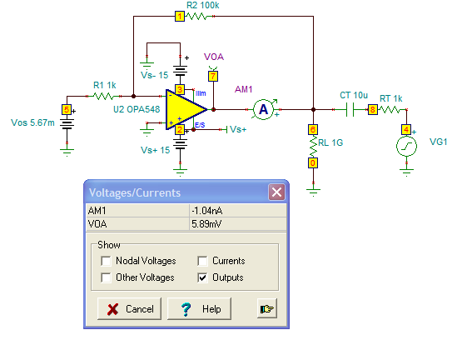

R_{O} Measure w/DC Operating Point: I_{OUT} = 0mA

Slide 19
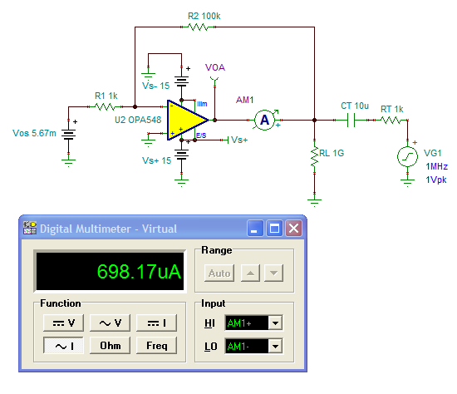
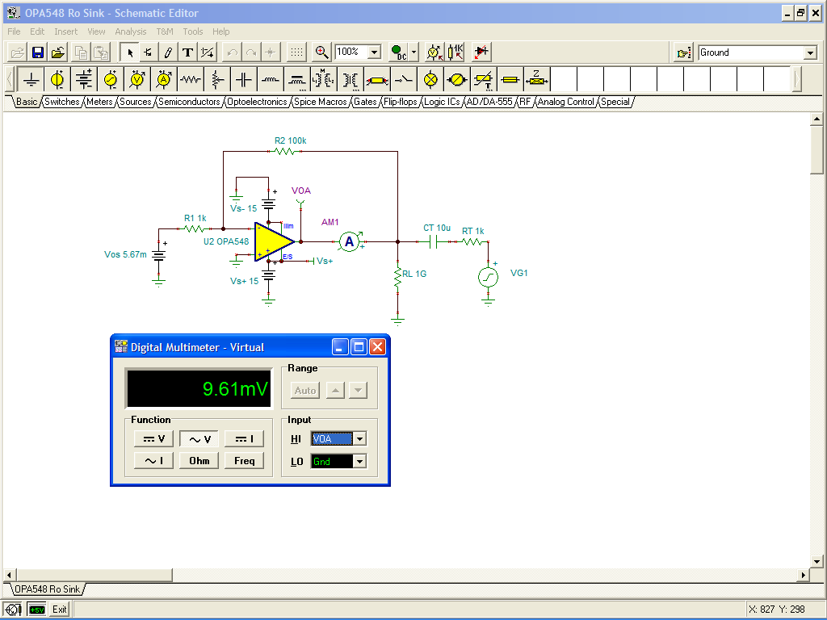
R_{O} Measure w/DC Operating Point: I_{OUT} = 0mA
R_{O} = VOA / AM1
R_{O} = 9.61mVrms / 698.17μArms
R_{O} = 13.765Ω

Slide 20
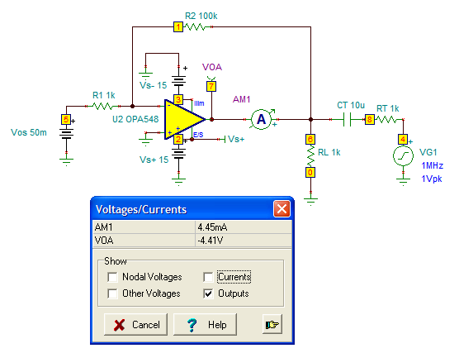
R_{O} Measure w/DC Operating Point
I_{OUT} = 4.45mA Sink

Slide 21
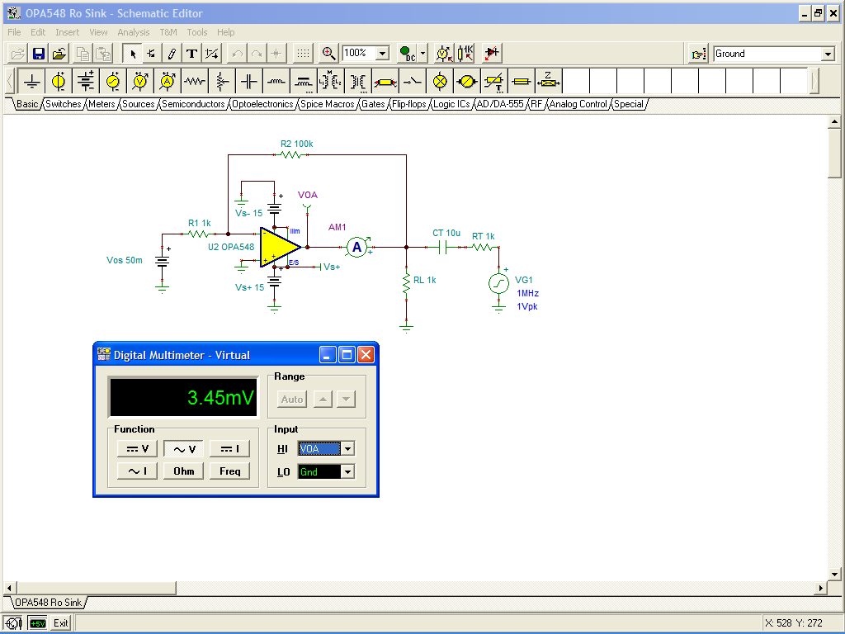

R_{O} Measure w/DC Operating Point
I_{OUT} = 4.45mA Sink
R_{O} = VOA / AM1
R_{O} = 3.45Vrms / 706.25µArms
R_{O} = 4.885Ω

Slide 22
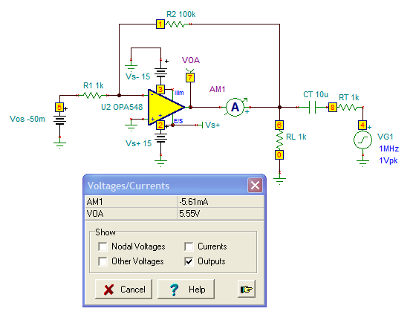
R_{O} Measure w/DC Operating Point
I_{OUT} = 5.61mA Source

Slide 23
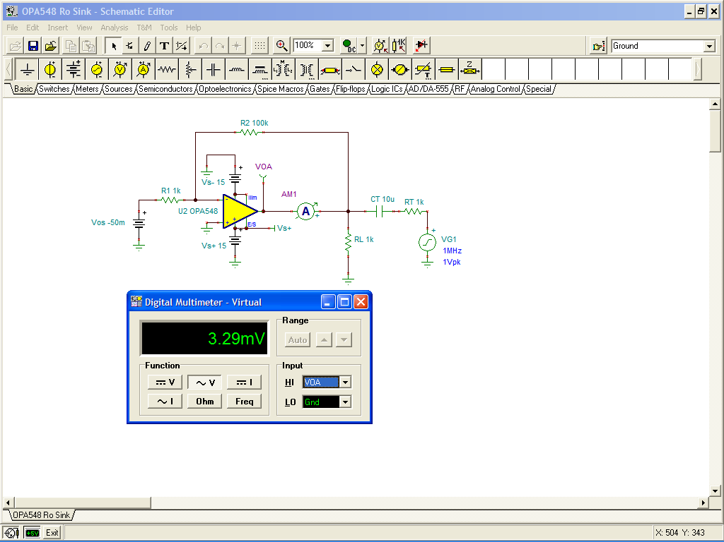
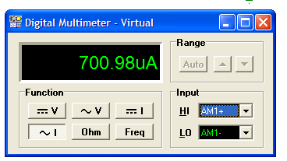
R_{O} Measure w/DC Operating Point
I_{OUT} = 5.61mA Source
R_{O} = VOA / AM1
R_{O} = 3.29mVrms / 700.98μArms
R_{O} = 4.693Ω

Slide 24
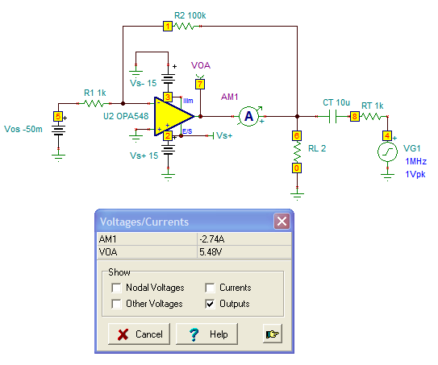
R_{O} Measure w/DC Operating Point
I_{OUT} = 2.74A Source

Slide 25
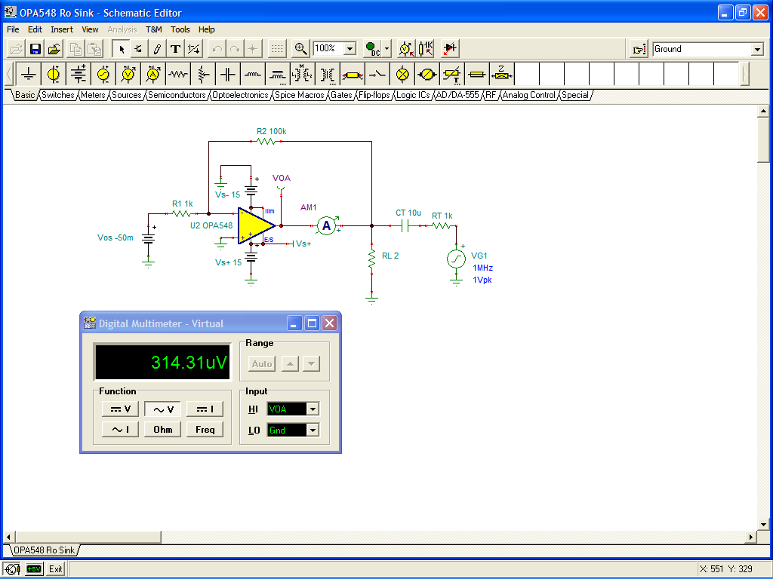
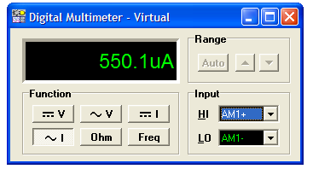
R_{O} Measure w/DC Operating Point
I_{OUT} = 2.74A Source
R_{O} = VOA / AM1
R_{O} = 314.31uVrms / 550.1μArms
R_{O} = 0.571Ω

Slide 26
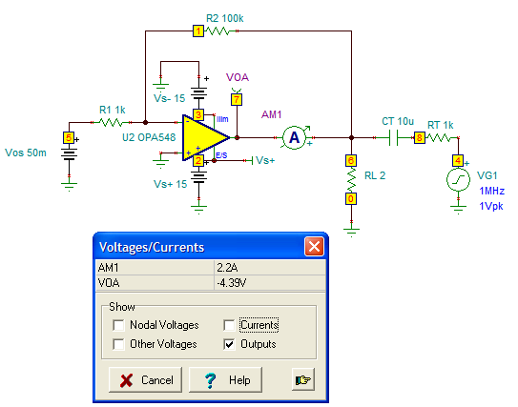
R_{O} Measure w/DC Operating Point
I_{OUT} = 2.2A Sink

Slide 27
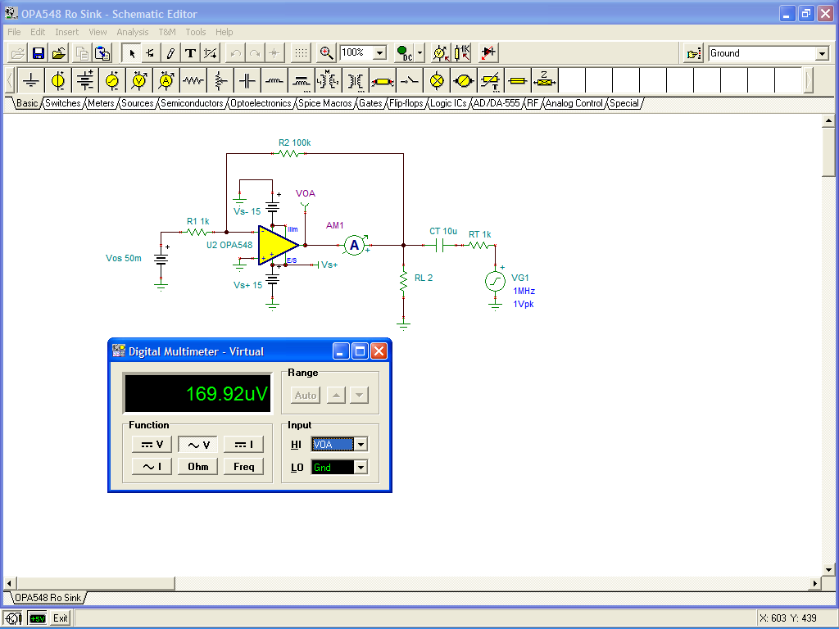

R_{O} Measure w/DC Operating Point
I_{OUT} = 2.2A Sink
R_{O} = VOA / AM1
R_{O} = 169.92uVrms / 635.16μArms
R_{O} = 0.267Ω

Slide 28
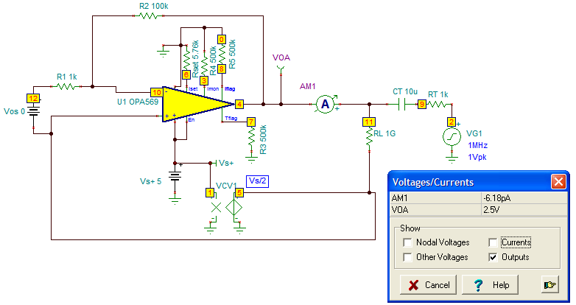
R_{O} Measure w/DC Operating Point
I_{OUT} = 0A

Slide 29
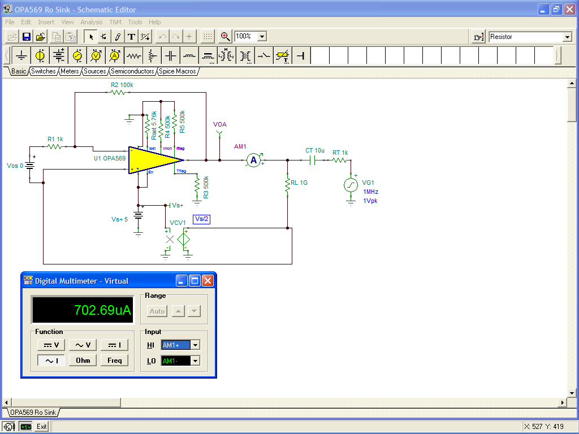

R_{O} Measure w/DC Operating Point
I_{OUT} = 0A
R_{O} = VOA / AM1
R_{O} = 4.42mVrms / 702.69μArms
R_{O} = 6.29Ω

Slide 30
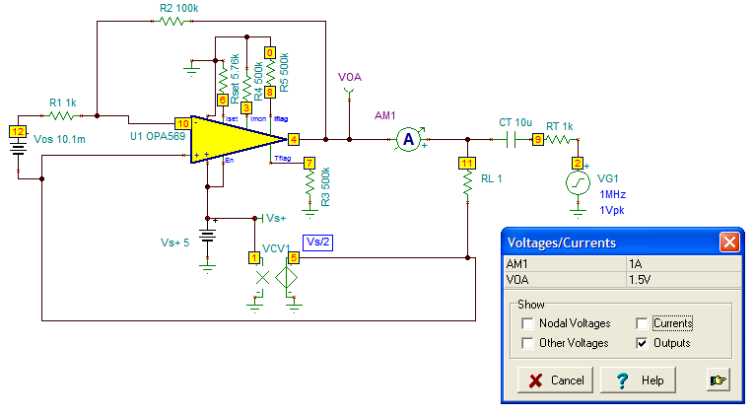
R_{O} Measure w/DC Operating Point
I_{OUT} = 1A Sink

Slide 31
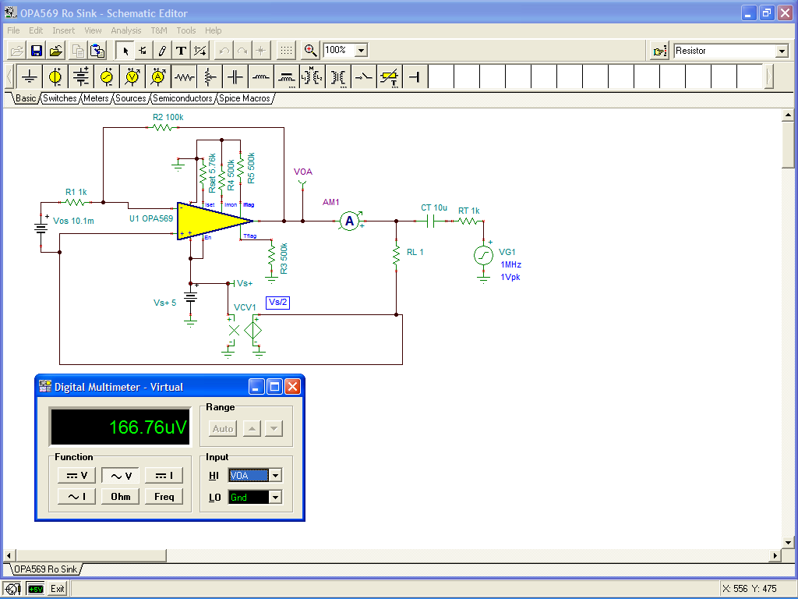

R_{O} Measure w/DC Operating Point
I_{OUT} = 1A Sink
R_{O} = VOA / AM1
R_{O} = 166.76μVrms / 540.19μArms
R_{O} = 0.309Ω

Slide 32
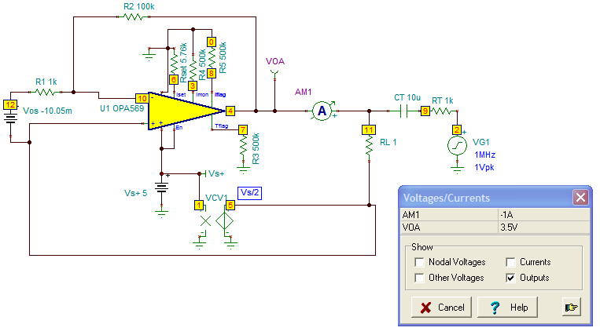
R_{O} Measure w/DC Operating Point
I_{OUT} = 1A Source

Slide 33
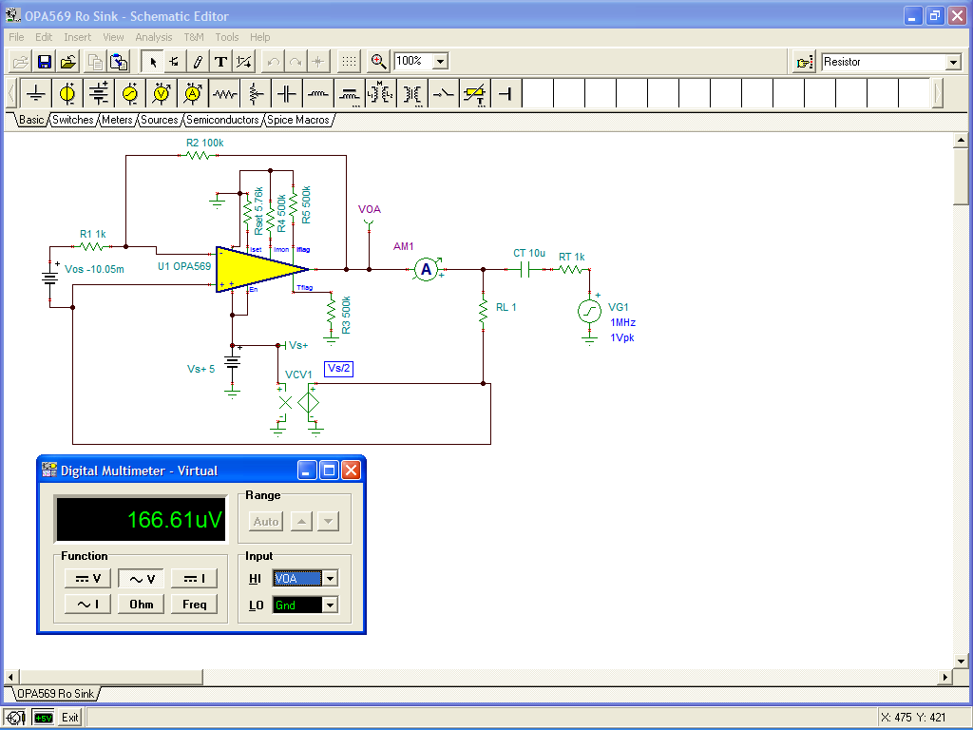
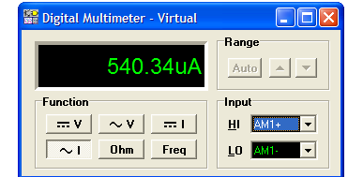
R_{O} Measure w/DC Operating Point
I_{OUT} = 1A Source
R_{O} = VOA / AM1
R_{O} = 166.61μVrms / 540.34μArms
R_{O} = 0.308Ω

Slide 34
Non-Inverting Floating Load V-I
Basic Topology
Stability Analysis (w/effects of Ro)
  1/β & Aol Test
  Loop Gain Test
  Transient Test
Small Signal BW for Current Control

Slide 35
Non-Inverting V-I Floating Load
VP
+5V
VP
3.03A
-5V
-3.03A
+1V
-1V
VP
Op Amp Point of Feedback is VRS
Op Amp Loop Gain forces +IN (VP) = -IN = VRS
IOUT = VP / RS
IOUT = {(R2*VIN) / (R1A + R1B + R2)} / RS

Slide 36
Non-Inverting V-I Floating Load
R_{O} Reflected Outside of Op Amp

Slide 37
Non-Inverting V-I Floating Load
FB#1 DC 1/β Derivation

Slide 38
Non-Inverting V-I Floating Load
FB#1 1/β Derivation

Slide 39
Non-Inverting V-I Floating Load
FB#1 1/β Data for R_{O} No Load & Full Load
 | I_{OUT} | R_{O} | fz | DC 1/β
No Load | 0A | 13.765Ω | 165Hz | 33.49dB
Full Load | 1A | 0.267Ω | 22.25Hz | 16.06dB

Slide 40
OPA548 Data Sheet Aol

Slide 41
Non-Inverting V-I Floating Load
FB#1 1/β Plot for R_{O} No Load & Full Load

Slide 42
Non-Inverting V-I Floating Load
FB#1 1/β Tina SPICE

Slide 43
Non-Inverting V-I Floating Load
FB#1 1/β Tina SPICE Results

Slide 44
Non-Inverting V-I Floating Load
FB#1 1/β Tina SPICE Results

Slide 45
Non-Inverting V-I Floating Load
FB#1 Loop Gain Tina SPICE Results

Slide 46
Non-Inverting V-I Floating Load
FB#1 Transient Analysis Tina SPICE Circuit

Slide 47
Non-Inverting V-I Floating Load
FB#1 Transient Analysis Tina SPICE Results

Slide 48
Non-Inverting V-I Floating Load
Add FB#2 and Predict 1/β
Note: Load Current Control begins to roll-off in frequency where FB#2 dominates

Slide 49
How will the two feedbacks combine?
Answer:
The largest β (smallest 1/β) will dominate!
Large β
Small β

Slide 50
Non-Inverting V-I Floating Load
FB#2 Circuit

Slide 51
Non-Inverting V-I Floating Load
FB#2 High Frequency 1/β

Slide 52
Non-Inverting V-I Floating Load
FB#2 fz1

Slide 53
Non-Inverting V-I Floating Load
Tina SPICE Loop Test

Slide 54
Non-Inverting V-I Floating Load
Aol and 1/β Tina SPICE Results

Slide 55
Non-Inverting V-I Floating Load
Loop Gain Tina SPICE Results

Slide 56
Non-Inverting V-I Floating Load
I_{OUT}/V_{IN} AC Response Circuit

Slide 57
Non-Inverting V-I Floating Load
I_{OUT}/V_{IN} AC Tina SPICE Results

Slide 58
Non-Inverting V-I Floating Load
I_{OUT}/V_{IN} Transient Circuit

Slide 59
Non-Inverting V-I Floating Load
I_{OUT}/V_{IN} Transient Tina SPICE Results

Slide 60
Inverting V-I Floating Load
+5V
-5V
-3.03A
+3.03A
Op Amp Point of Feedback is VRS
Op Amp Loop Gain forces VRS = -VIN (RF/RI)
-1V
+1V
IOUT = {-VIN*(RF/RI)} / RS
IOUT = -VIN*{RF/ (RI*RS)}
Stability Analysis & Compensation Techniques similar to Non-Inverting V-I Floating Load

Slide 61
Grounded Load V-I
Improved Howland Current Pump
Basic Topology
Stability Analysis (w/effects of Ro)
  1/β & Aol Test
  Loop Gain Test
  Transient Test
Small Signal BW for Current Control

Slide 62
Improved Howland Current Pump
IL Accuracy Circuit
RT allows for trim to optimum Z_{OUT} and improved DC Accuracy

Slide 63
Improved Howland Current Pump
V-I DC Accuracy Calculations
1% Resistors (w/RT=0) could yield only 9% Accuracy at T=25°C
Still useful for V-I control in Motors/Valves → V-Torque Control
Outer position feedback adjusts V for final position

Slide 64
Improved Howland Current Pump
General Equation
Set RX=RF and RZ=RI

Slide 65
Improved Howland Current Pump
Simplified Equation

Slide 66
Improved Howland AC Analysis
RI
RF
Op Amp sees differential [(-IN) – (+IN)] feedback
β = β- - β+ (Must be positive number else oscillation!)

Slide 67
Improved Howland AC Analysis

Slide 68
Improved Howland AC Analysis
Include Effects of RO
RI
RF

Slide 69
Improved Howland β- Calculation

Slide 70
Improved Howland β+ Calculation

Slide 71
Improved Howland 1/β Calculation

Slide 72
Improved Howland β- Calculation
RO = Full Load

Slide 73
Improved Howland β+ Calculation
RO = Full Load

Slide 74
Improved Howland 1/β Calculation
RO = Full Load

Slide 75
Improved Howland 1/β Calculation
No Load & Full Load
 | IL | RO | fz | fp | DC 1/β | Hi-f 1/β
No Load | 0A | 6.29Ω | 75.8Hz | 31.83kHz | 17.62dB | 77.17dB
Full Load | 1A | 0.308Ω | 44.08Hz | 31.83kHz | 19.45dB | 77.15dB
Change in RO from No Load to Full Load has no
significant impact on the 1/β Plot

Slide 76
OPA569 Data Sheet Aol

Slide 77
Improved Howland 1/β Plot - Full Load

Slide 78
Improved Howland 1/β Tina SPICE Plot - Full Load

Slide 79
Improved Howland Loop Gain
Tina SPICE Plot - Full Load

Slide 80
Improved Howland
Tina Transient Analysis Circuit
RI
RF

Slide 81
Improved Howland
Tina Transient Analysis Results

Slide 82
Improved Howland
Modified 1/β for Stability

Slide 83
β+ FB#2 Calculation to Modify 1/β for Stability

Slide 84
Improved Howland AC Analysis
Final Design for Stability
RI
RF

Slide 85
Improved Howland AC Analysis
1/β - Final Design for Stability
fcl

Slide 86
Improved Howland AC Analysis
Loop Gain - Final Design for Stability
fcl

Slide 87
Improved Howland AC Transfer Analysis
IL/VIN - Final Design for Stability
RI
RF

Slide 88
Improved Howland AC Transfer Analysis
IL/VIN - Final Design for Stability

Slide 89
Improved Howland Transient Analysis
IL/VIN - Final Design for Stability
RI
RF

Slide 90
Improved Howland Transient Analysis
IL/VIN - Final Design for Stability

Slide 91
High Current V-I General Checklist
  Large Signal & Transient SOA Considerations (V=L*di/dt)
  Bipolar Output Stages & Oscillations
  High Current Grounding
  High Current PCB Traces
  High Current Supply Issues
  Power Supply Bypass (Low f & High f)
  Transient Protection (Supply, VIN, VOUT)
  Power Dissipation Considerations
    (see “V-I Circuits Using External Transistors” section)
    Consider:
      Short Circuit to Ground Power Dissipation
      Heatsink Selection
      Current Sense Resistor (RS) Power Dissipation

Slide 92
V-I Large Signal Limits: V=Ldi/dt

Slide 93

Violate the Laws of Physics and Pay the Price!

Slide 94
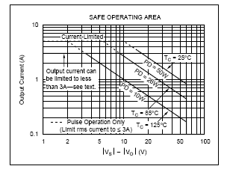
Instant V-I Reversal → SOA Violations

Slide 95
Output Stages
fosc > UGBW
oscillates unloaded? -- no
oscillates with V_{IN}=0? -- no
PROBLEM
SOLUTION
Some Op Amps use composite output stages, usually on the negative output, that contain local feedback paths. Under reactive loads these output stages can oscillate.
The Output R-C Snubber Network lowers the high frequency gain of the output stage preventing unwanted oscillations under reactive loads.

Slide 96
Ground Loops
fosc < UGBW
oscillates unloaded? -- no
oscillates with V_{IN}=0? -- yes
SOLUTION
PROBLEM
Ground loops are created from load current flowing through parasitic resistances. If part of V_{OUT} is fed back to Op Amp +input, positive feedback and oscillations can occur.
Parasitic resistances can be made to look like a common mode input by using a “Single-Point” or “Star” ground connection.

Slide 97
PCB Traces
fosc < UGBW
oscillates unloaded? -- may or may not
oscillates with V_{IN}=0? -- may or may not
DO NOT route high current, low impedance output traces near high impedance input traces.
DO route high current output traces adjacent to each other (on top of each other in a multi-layer PCB) to form a twisted pair for EMI cancellation.

Slide 98
Supply Lines
fosc < UGBW
oscillates unloaded? -- no
oscillates with V_{IN}=0? -- may or may not
PROBLEM
PROBLEM
Power supply lead inductance, Ls, interacts with a capacitive load, CL, to form an oscillatory LC, high Q, tank circuit.
Load current, IL, flows through power supply resistance, Rs, due to PCB trace or wiring. Modulated supply voltages appear at Op Amp Power pins. Modulated signal couples into amplifier which relies on supply pins as AC Ground.

Slide 99
Proper Supply Line Decouple
SOLUTION
C_{LF}: Low Frequency Bypass
10μF / Amp Out (peak)
Aluminum Electrolytic or Tantalum
< 4 in (10cm) from Op Amp
C_{HF}: High Frequency Bypass
0.1μF Ceramic
Directly at Op Amp Power Supply Pins
R_{HF}: Provisional Series C_{HF} Resistance
1Ω < R_{HF} < 10Ω
Highly Inductive Supply Lines

Slide 100
Transient Protection

