Slide 1
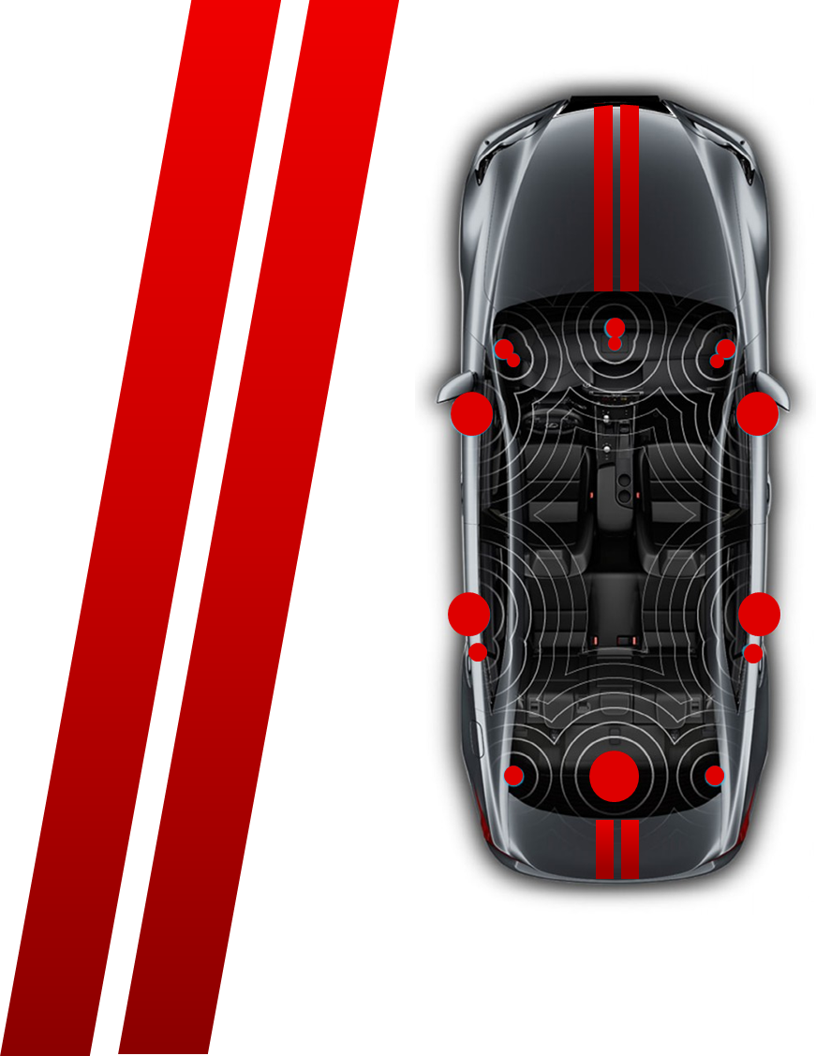
TAS67 Family Layout Guidance
Note: This guidance is aligned with datasheet section 7.1 “Layout Guidelines”
Shadow He

Slide 2
Design Checklist
Item |  | Priority | Key Points | Detailed Guide | Check
Schematic | 1 | High | Follow closely to the latest datasheet schematic at chapter 6.2.1 | Page 3
 | 2 | Mid | Capacitor type and rating | Page 3
Layout | 1 | High | PVDD 100nF decoupling cap, must be put at the same layer of IC, close to both IC’s PVDD and GND pins. | Page 4
 | 2 | High | Recommend put LC filter at the same layer of IC, provide smallest loop size, and direct ground return path. | Page 5
 | 3 | High | Clean and intact GND plane at both Top and second layer. | Page 6
 | 4 | High | 1nF/10nF cap at the PCB connector, works as Y-cap. | Page 6
 | 5 | Mid | OUTP side snubber, put close to OUTP pins. | Page 7
 | 6 | Mid | Internal power supply decoupling cap, put at the same layer and close to the pins. | Page 7
 | 7 | Mid | Heatsink mounting screws, put close to the IC | Page 8
 | 8 | Low | PVDD supply trace is suggested to put into internal layer, and symmetrical to IC | Page 8
 | 9 | Low | OUT trace is suggested to put into internal layer, and symmetrical to IC | Page 8

Slide 3
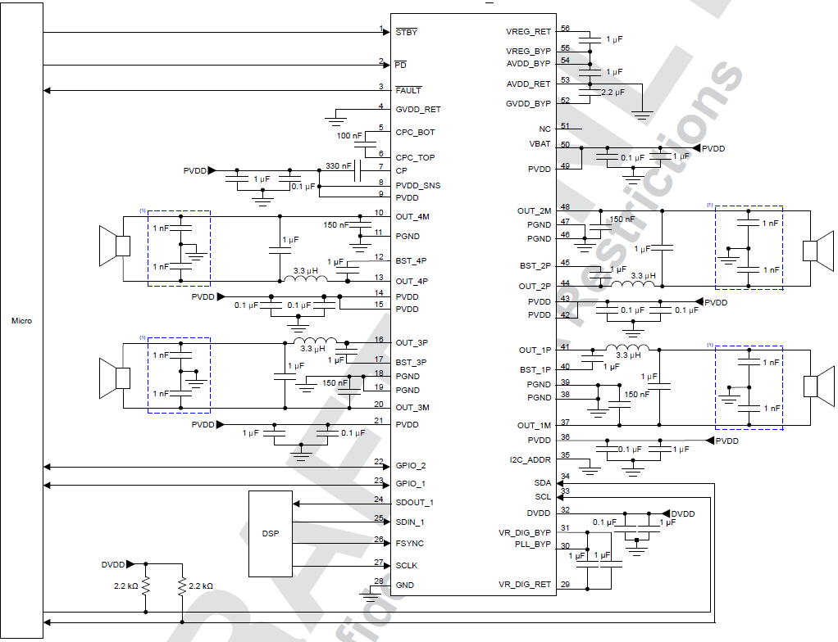
Schematic - item 1
PVDD decoupling capacitor, suggest to use 8PCS 100nF, and 4PCS 1uF. Check Layout item 1 for detailed placement guidance.
Pin31 is connected to pin30, to provide power supply for PLL circuit. Pin29 is connected to internal ground, keep it float to avoid noise interference from board ground
AVDD_BYP(pin 54) connected to VREG_BYP(pin 55) directly
Reserve placeholder for 330pF+3.3Ω snubber at OUTP before 3.3uH inductor, for the EMC consideration. It can be removed at next version if EMC test confirm pass without snubber
Each of the OUT trace should have 1nF~10nF cap to GND, put them close to PCB connector.
Schematic - item 2
X7R type could provide stable capacitance across large temperature/voltage level, guarantee performance on the complex automotive using environment.
1uF of output LC filter. 0805 size/50V rating is recommended, to provide enough effective capacitance with biased voltage
150nF capacitor from OUTM to GND. 0603 size/50V rating is recommended.
100nF capacitor between pin 5 and 6. 16V rating is recommended.
330nF capacitor at pin 7 to PVDD. 16V rating is recommended.
1uF capacitor of AVDD, VREG. 0603 size/16V rating is recommended.
2.2uF capacitor of GVDD. 0805 size/16V rating is recommended.
3

Slide 4
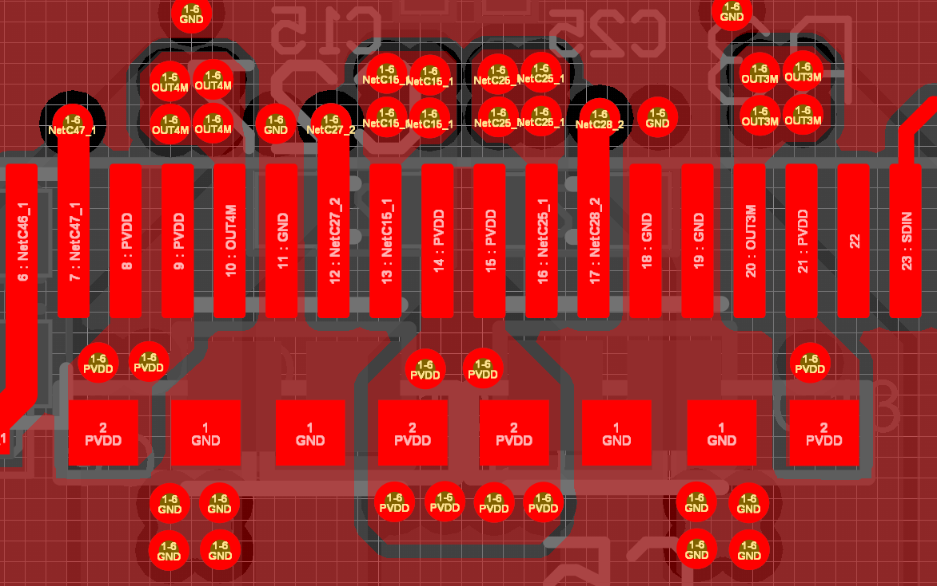
Layout – item 1
1. 4PCS 100nF PVDD decoupling cap at each side of the IC.
2. Must put at the same layer of IC.
3. Must close to both PVDD and GND pins.
To realize above requirement, BST cap need to put at the back of PCB to provide room.
To realize above requirement, OUT trace need to go into internal layer from pins (all through vias ).
This requirement is essential to achieve both reliability, and EMC performance from 30MHz to 300MHz frequency range.

Slide 5
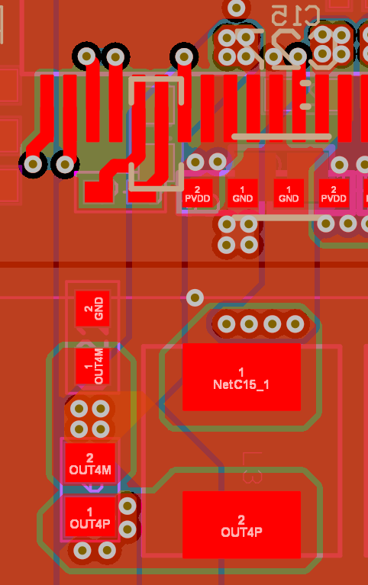
Layout – item 2
LC filter, recommend put at the same layer with IC. (If has to put LC filter at different layer than IC, contact TI for technical support.)
2. Must provide smallest loop size for the LC filter, from IC’s OUT pins, through filter components, until IC GND pins.
3. From OUTM 150nF capacitor ground, provide a directly path to IC’s GND pins. One of the essential part of the whole LC filter loop.
The LC filter loop size, will directly affected 30MHz to 80MHz EMC performance, which is inductor leakage noise energy amplified by the filter loop on the PCB.

Slide 6
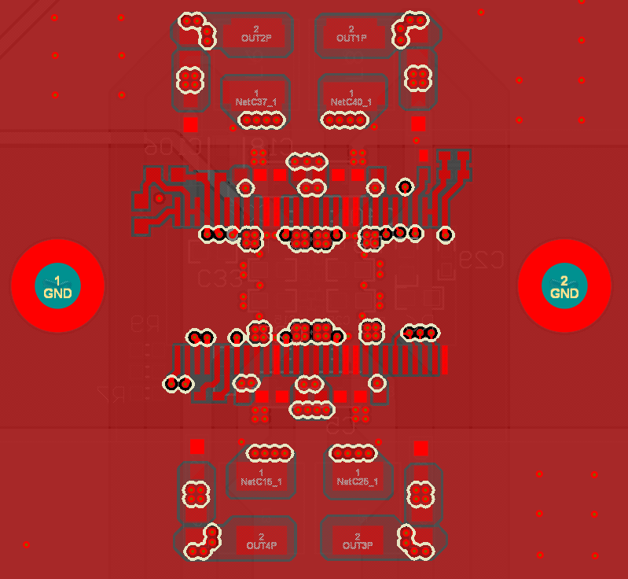
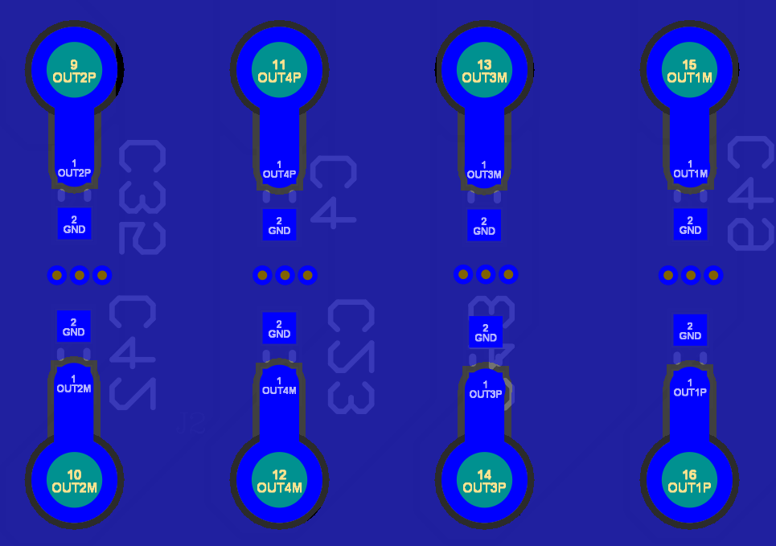
Layout – item 3
1. Clean and intact GND plane at both Top and second layer.
2. Do Not cut the GND layer.
To realize this requirement, all the signal wire, PVDD supply trace, and OUT trace, should avoid Top and second layer.
A clean and intact GND plane, is the key for all of noise signal go back to the source, will affect the EMC performance across all of frequency band.
Layout – item 4
1. Each of the OUT trace, should have 1nF~10nF capacitor to GND, must be put close to PCB connector.
Works similar as Y-cap, effectively reduce the resonant happened on the output cable, which is high frequency band from 100MHz to 300MHz.
Must put close to PCB connector to take effect, otherwise the PCB impedance will quickly eliminate the capacitor benefits.
The best cap value is related with PCB/Connector/Cable setup, need to check EMC data to decide. Usually the value would between 1nF and 10nF.

Slide 7
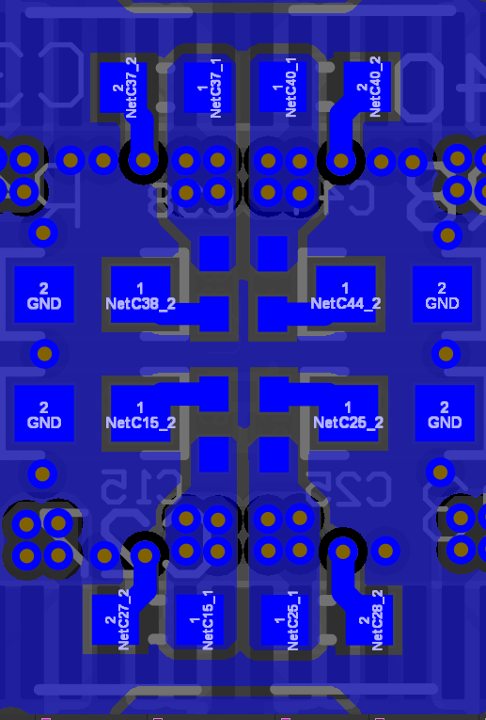
Layout – item 5
OUTP side should have snubber 330pF+3.3Ω, to remove the ringing energy created by OUTP 2.1MHz high speed witching.
  330pF : 0402 rating is recommended
  3.3Ω : 0603, 1/10W is recommended for 14.4V PVDD application.
2. Theoretically the closer to the pins the better. But PVDD decoupling cap and the LC filter is more important. So the best position for the snubber, is at the back of PCB and close to the OUT trace vias.
Layout – item 6
Internal power supply decoupling cap, as datasheet listed PLL_BYP, VR_DIG_BYP, VR_DIG_RET, AVDD_BYP, AVDD_RET, VREG_BYP,VREG_RET, GVDD_BYP, DVDD. All suggested to put at the same layer of IC, and close to IC’s pins, for the best audio and EMC performance.
Need to choose smaller package size to realize this requirement. Sometimes means not overdesign for these decoupling caps, no matter the rated voltage, or the capacitance value.

Slide 8
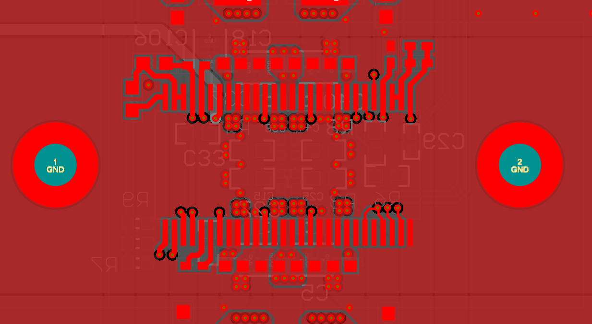
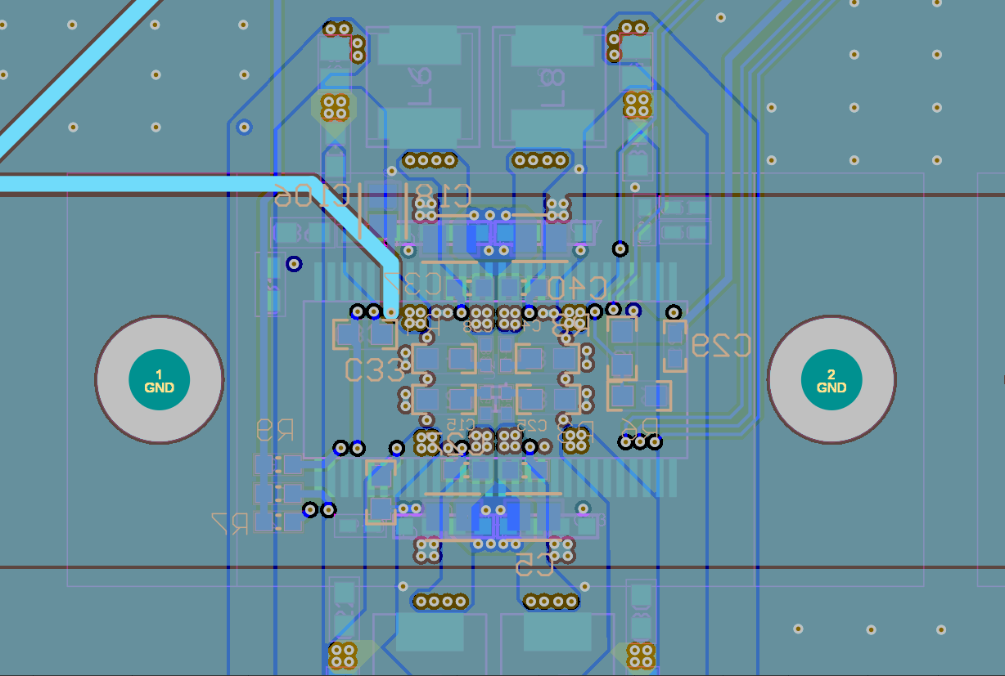
Layout – item 7
High frequency band noise (100MHz~300MHz), possibly be coupled into heatsink, and should have a low impedance path for noise to return to PCB. Need to have heatsink screws to realize it.
The screw grounding position is better to close to device
Layout – item 8
1. PVDD supply trace is suggested to put into internal layer, and symmetrical to IC, to reach the best audio and EMC performance
Layout – item 9
1. OUT trace is suggested to put into internal layer, and symmetrical to IC, to reach the best audio and EMC performance
PVDD
PVDD
OUT
OUT

Slide 9
Thank you

