Slide 1
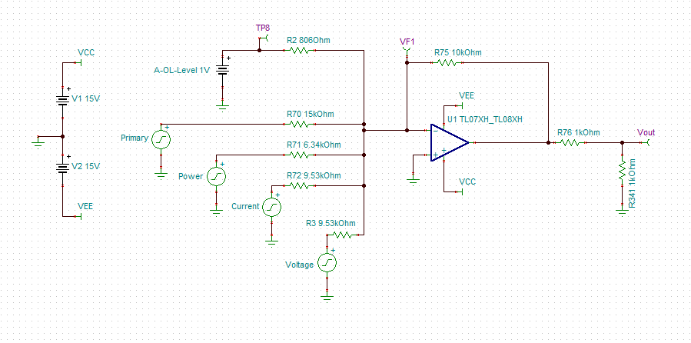
What Voltage level is here?
-15V
-1.496V
What Voltage level is here?
6.34V
What Voltage level is here?
15V
What Voltage level is here?
What Voltage level is here?

