Slide 1
TLC271 Stability
Investigation
Tim Green, MGTS
Precision Linear Analog Applications
February 25, 2015

Slide 2
Loop Gain Analysis

Slide 3
Loop Gain Analysis

Slide 4
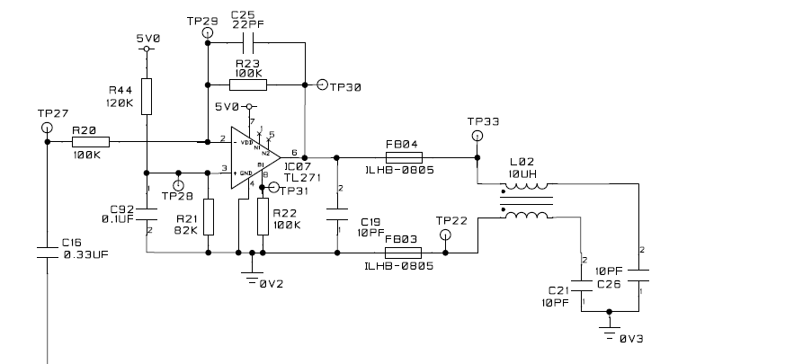
Customer Schematic: See Speaker Notes for Comments
Notes:
Ensure a 0.1uF capacitor is directly across pin 7 pin 4 of TLC271. This bypass capacitor must be located directly close to the op amp.
Where and how does 0V2 connect to 0V3 as these appear to be two different grounds.
I made some assumptions in my SPICE analysis for Loop stability on what exactly is connected to the other end of C16 as input signal source impedance. Any more specifics if my assumptions are not close?
Do you have a PCB layout we can look at? Is it possible any output traces are routed near either of the op amp inputs? You do not want low impedance traces (output) coupling in to the high impedance inputs.
Replace R22 with a short and see if the problem goes away.
You mention a DAC output. Is this a mixed signal PCB with BOTH digital and analog running about?
If it is a mixed signal PCB get me the complete schematic of the entire PCB.
Is there a switching power supply on the PCB? If so get me detailed schematic with part numbers on it.

Slide 5
TLC271 Stability
5V Supplies Only
Appendix
Tim Green, MGTS
Precision Linear Analog Applications
February 24, 2015

Slide 6
TLC271_5V_HB
TLC271: 5V Supply, High Bias Mode
Zo Revised for Proper Cload Phase Margin

Slide 7
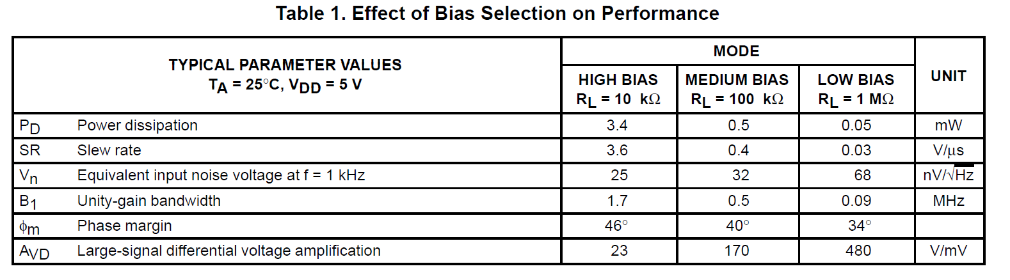
TLC271 – Bias Modes of Operation
CL=20pF
CL=20pF
680uA
100uA
10uA
HB

Slide 8
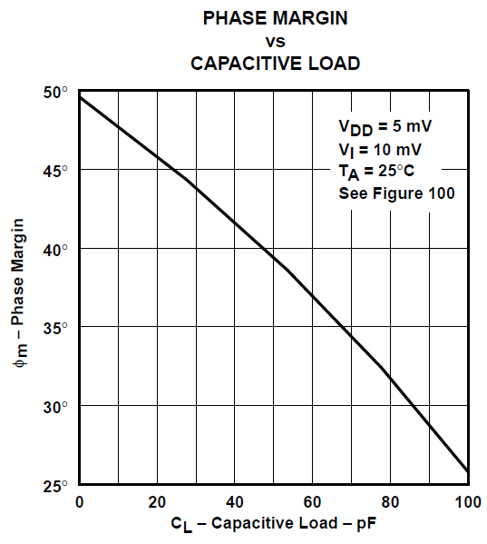
TLC271_5V_HB Cap Load Testing
Test 3
45.7deg
Test 2
39.4deg
Test 1
25.8deg

Slide 9
TLC271_5V_HB Web Cap Load Test 1

Slide 10
TLC271_5V_HB Web Cap Load Test 1

Slide 11
TLC271_5V_HB TG-Revised Cap Load Test 1

Slide 12
TLC271_5V_HB TG-Revised Cap Load Test 1

Slide 13
TLC271_5V_HB TG-Revised Cap Load Test 2

Slide 14
TLC271_5V_HB TG-Revised Aol Test

Slide 15
TLC271_5V_HB TG-Revised Aol Test

Slide 16
TLC271_5V_MB
TLC271: 5V Supply, Medium Bias Mode
Zo Revised for Proper Cload Phase Margin

Slide 17
TLC271 – Bias Modes of Operation
CL=20pF
CL=20pF
680uA
100uA
10uA
MB

Slide 18
TLC271_5V_MB Cap Load Testing
Test 3
40deg
Test 2
39.4deg
Test 1
25.8deg

Slide 19
TLC271_5V_MB Web Cap Load Test 1

Slide 20
TLC271_5V_MB Web Cap Load Test 1

Slide 21
TLC271_5V_MB TG-Revised Cap Load Test 1

Slide 22
TLC271_5V_MB TG-Revised Cap Load Test 1

Slide 23
TLC271_5V_MB TG-Revised Cap Load Test 2

Slide 24
TLC271_5V_MB TG-Revised Aol Test

Slide 25
TLC271_5V_MB TG-Revised Aol Test

Slide 26
TLC271_5V_LB
TLC271: 5V Supply, Low Bias Mode
Zo Revised for Proper Cload Phase Margin

Slide 27
TLC271 – Bias Modes of Operation
CL=20pF
CL=20pF
680uA
100uA
10uA
LB

Slide 28
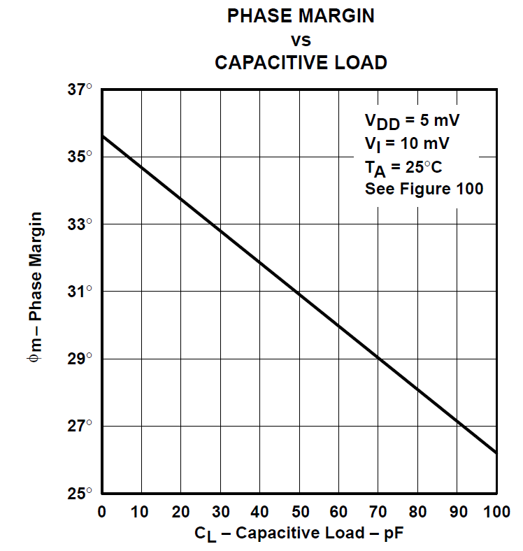
TLC271_5V_LB Cap Load Testing
Test 3
33.7deg
Test 2
30.9deg
Test 1
26.3deg

Slide 29
TLC271_5V_LB Web Cap Load Test 1

Slide 30
TLC271_5V_LB Web Cap Load Test 1

Slide 31
TLC271_5V_LB TG-Revised Cap Load Test 1

Slide 32
TLC271_5V_LB TG-Revised Cap Load Test 1

Slide 33
TLC271_5V_LB TG-Revised Cap Load Test 2

Slide 34
TLC271_5V_LB TG-Revised Aol Test

Slide 35
TLC271_5V_LB TG-Revised Aol Test

Slide 36
Op Amp Stability Reference
For detailed, definition-by-example of 10 different ways to stabilize
op amps driving capacitive loads, and additional technical information
on solving op amp stability problems, visit the Texas Instruments
E2E Forum at:
http://e2e.ti.com/support/amplifiers/precision_amplifiers/w/design_notes/2645.solving-op-amp-stability-issues.aspx
Download Part 1, Part 2, Part 3, and Part 4.
All Embedded Schematics in this presentation can be run in the Free TINA_TI SPICE simulator available at:
http://www.ti.com/tool/tina-ti

