Slide 1
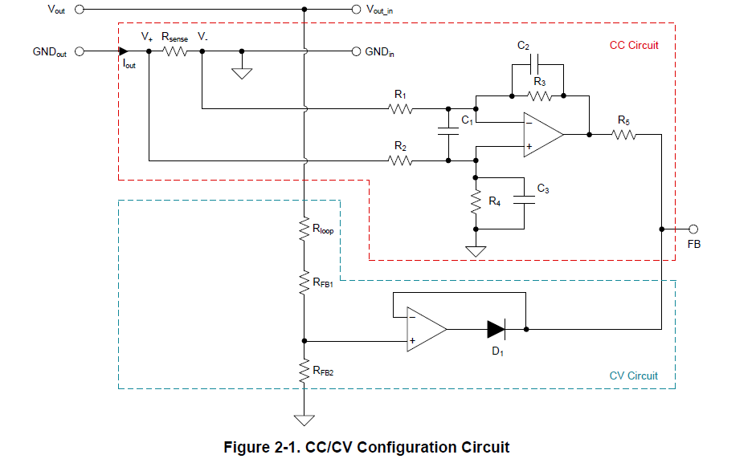
47k
To TPSM63610
FB PIN
75k
47k
20k
-
20k
A5V
＋
1k
47k
75k
51
100
47k
100k
RD 5.6V
VR 1k
100
6.8k
Additional
Offset Circuit
A-5V
SNVAA85
Application Note
How to Implement a Simple Constant Current Regulation
Scheme to a PCM Based Buck

