Slide 1
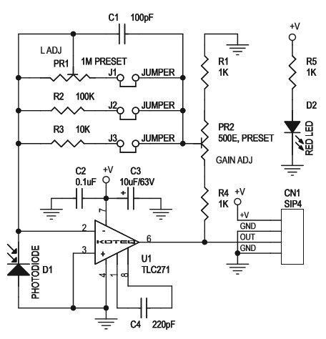
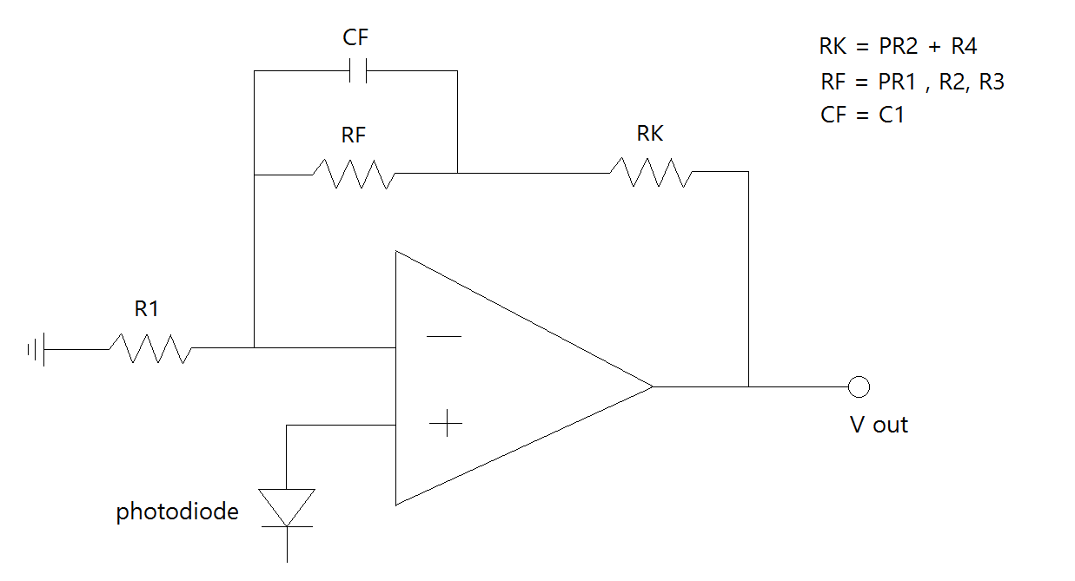
I try to simple
Simple circuit

Slide 2
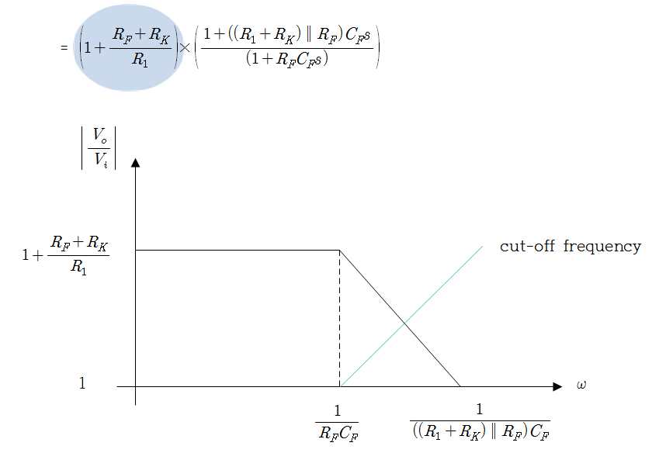
Calculate the gain based on simple circuit
gain
After that, We simulate through the Labvie Multisim program
However, expect voltage
Simulation voltage

Slide 3
So, I ask you that TLC271CP op amp property
Already, We read the spec sheets.
IN op amp, is this Load resistor?
analysis circuit is not correct?

