Slide 1

V_{OS} & I_{B} – Lab
TI Precision Labs – Op Amps
Developed by Art Kay and Ian Williams
Notes:
Hello, and welcome to the presentation for the TI Precision Lab supplement for op amp input offset voltage (VOS) and input bias current (IB). This lab will walk through detailed calculations, SPICE simulations, and real-world measurements that greatly help to reinforce the concepts established in the op amp VOS and IB lecture.

Slide 2
Experiment 2
R_{IN} = 5kΩ
Notes:
For the next part of the lab, we’ll repeat the same procedure as experiment 1, but this time with 5kΩ of input resistance. This will emphasize the effects of input bias current, IB.

Slide 3
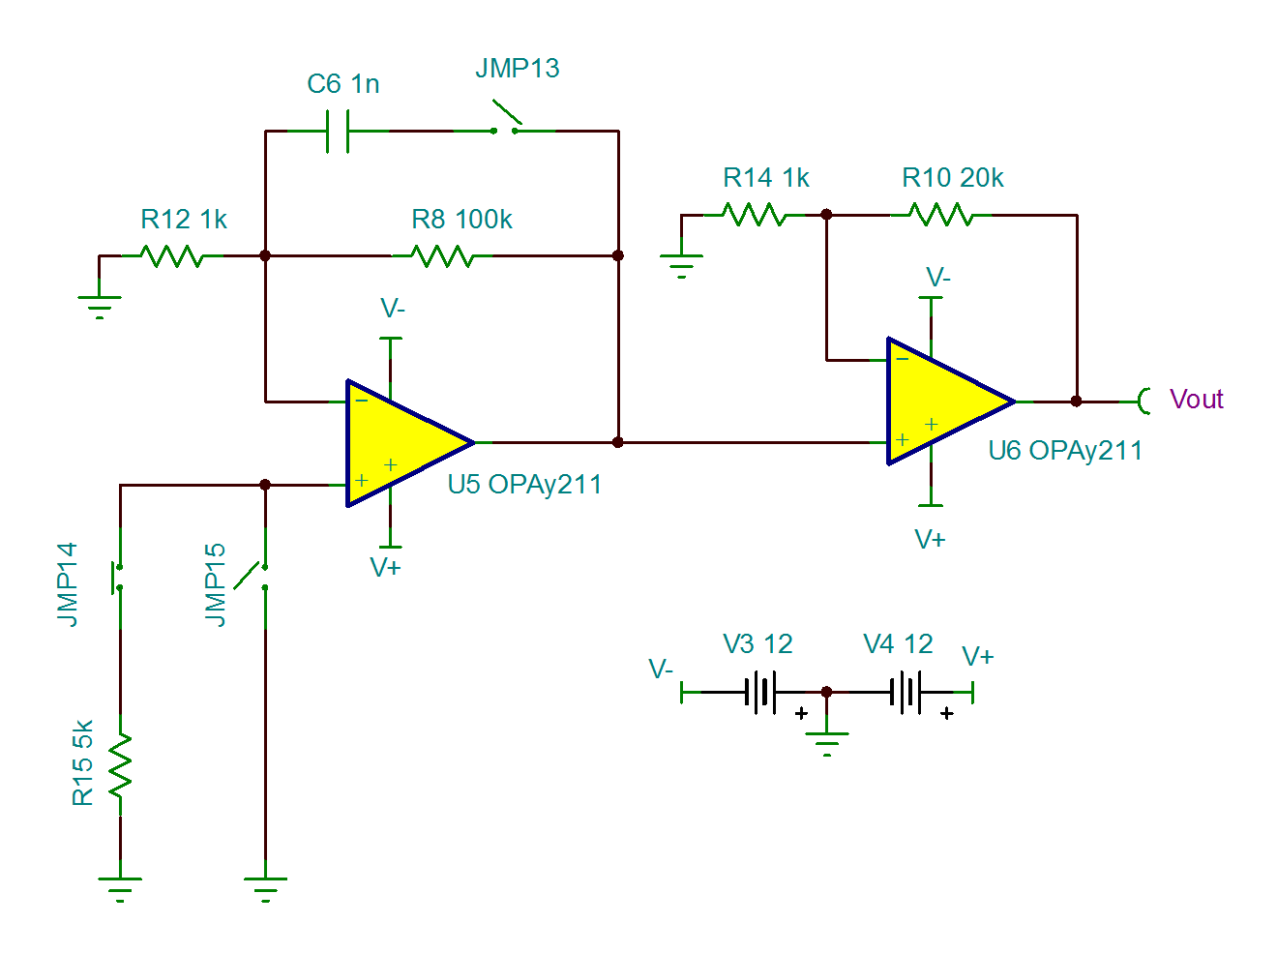
Calculation – R_{IN} = 5kΩ
Calculate the total output voltage due to V_{OS} and I_{B} for the circuit shown below. Use the typical and maximum values for V_{OS} and I_{B} given on the next slide.
Jumper | Position | Description
JMP13 | OPEN | C5 disconnected
JMP14 | CLOSED | R15 connected
JMP15 | OPEN | VIN+ connected to R15
Calculate the result for both OPA211 and OPA188!
Notes:
As shown in the schematic, jumper JMP15 shorting the positive input of U5 to ground is now removed. Jumper JMP14 is now installed in order to connect the positive input of U5 to a 5kΩ resistor. The IB of U5 will now flow through this resistor, developing a DC voltage due to Ohm’s law and increasing the amount of offset voltage.
As before, calculate the total output voltage due to VOS and IB for this circuit, using both the OPA211 and OPA188.

Slide 4
Calculation – R_{IN} = 5kΩ
PARAMETER |  | OPA211
 |  | MIN | TYP | MAX | UNIT
Input Offset Voltage | V_{OS} |  | ±30 | ±125 | µV
Input Bias Current | I_{B} |  | ±60 | ±175 | nA
PARAMETER |  | OPA188
 |  | MIN | TYP | MAX | UNIT
Input Offset Voltage | V_{OS} |  | ±6 | ±25 | µV
Input Bias Current | I_{B} |  | ±160 | ±1400 | pA
Device | Typical Output | Maximum Output
OPA188 | ±15mV | ±71mV
OPA211 | ±191mV | ±2492mV
Notes:
The data sheet parameters for both devices are provided again for reference. Enter your calculated results in the lower table. The answers have been provided so that you can check your work.

Slide 5
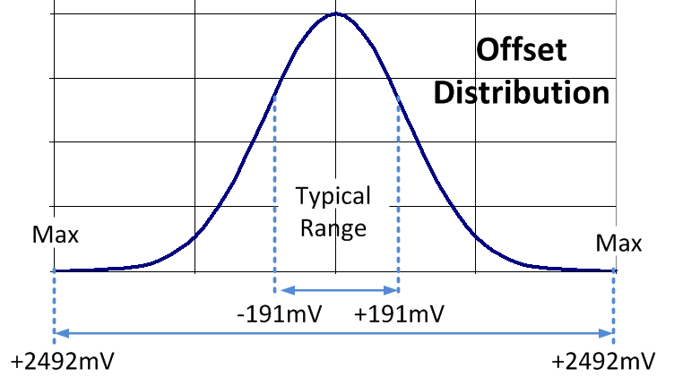
Calculation – R_{IN} = 5kΩ
Notes:
With RIN = 5k, the calculations change slightly since the voltage caused by IB is now affected by R_IN. Use the new equation VIB = IB*R_EQ + IB*R_IN. Otherwise, the steps are the same as in experiment 1. Repeat the calculations for the maximum values.

Slide 6
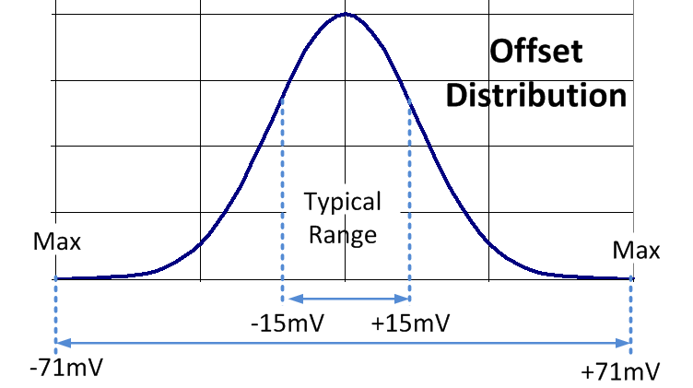
Calculation – R_{IN} = 5kΩ
Notes:
Repeat both sets of calculations for the OPA188, again using typical and maximum values. As before, the different electrical characteristics of the OPA188 will result in different output voltage calculations.

Slide 7
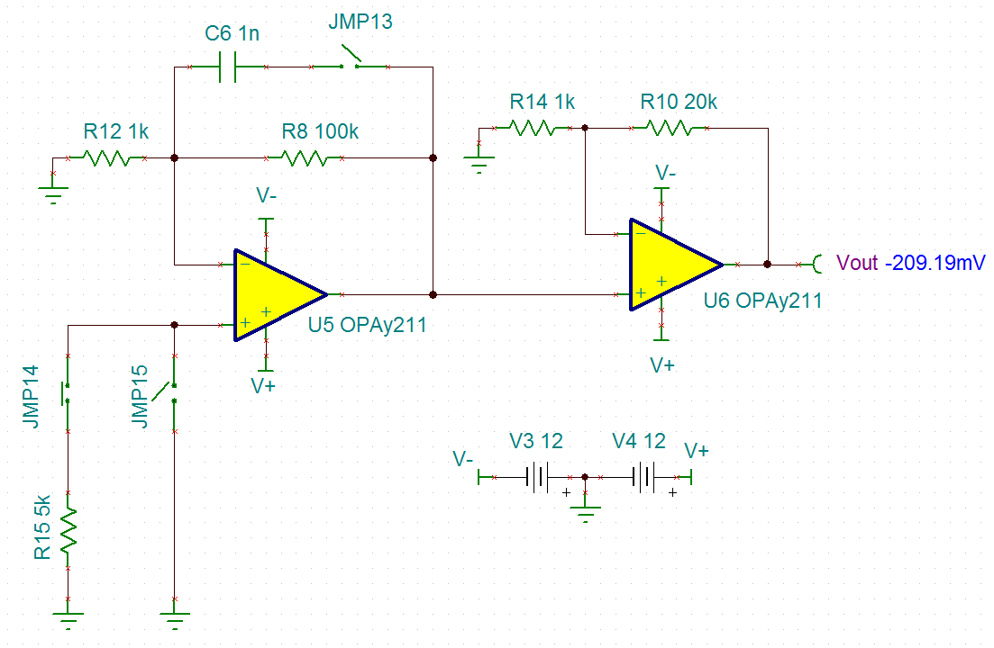
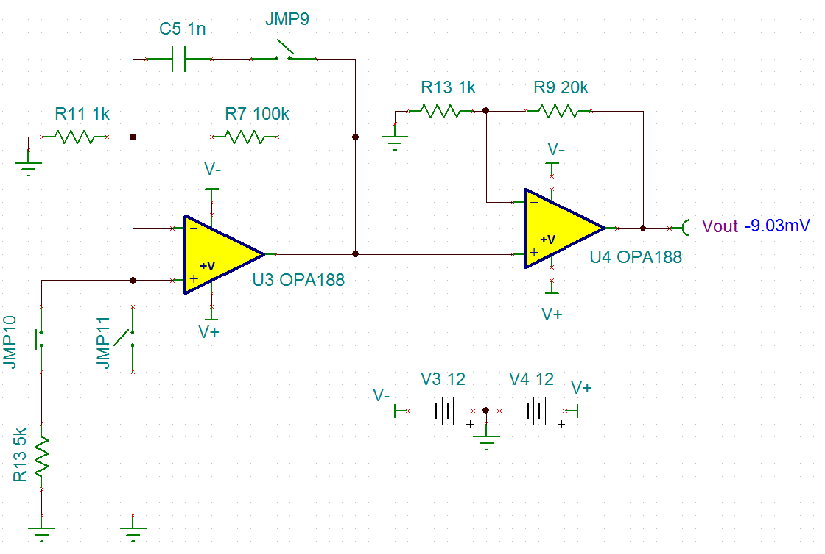
Simulation Results – R_{IN} = 5kΩ
Open switches JMP15 and JMP11, and close switches JMP14 and JMP10. Re-run the simulation to determine the new output voltage due to V_{OS} and I_{B}.
OPA211
Vout = -209.19mV
OPA188
Vout = -9.03mV
Notes:
Re-run the simulated DC nodal voltage analysis, making sure to use the proper jumper settings.
In the OPA211 circuit, JMP13 and JMP15 are open, and JMP14 is closed.
In the OPA188 circuit, JMP9 and JMP11 are open, and JMP10 is closed.

