Slide 1
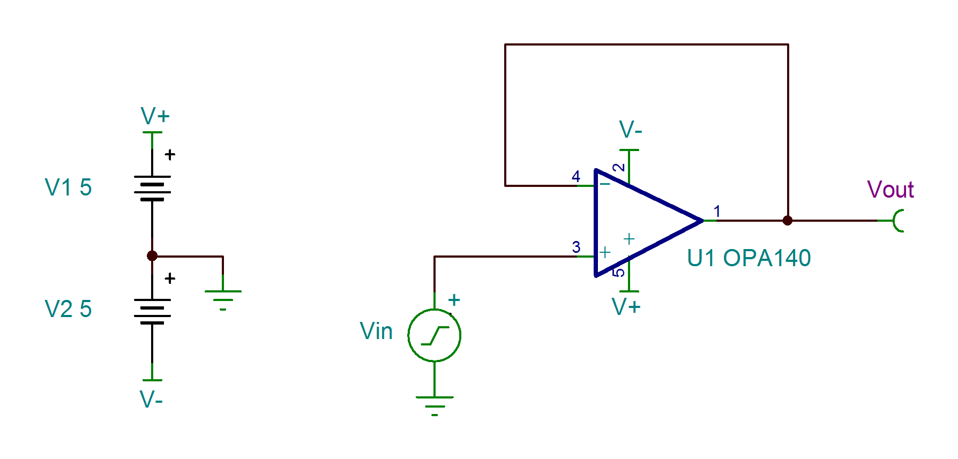
Calculation – Voltage Follower
Calculate the input common mode voltage range and output voltage swing for the circuit shown below. Use the data sheet parameters given on the next slide.
Notes:
First, calculate the input common mode voltage range and output voltage swing for the circuit shown here, using the techniques and equations given in the input/output limitations lecture. Use the data sheet parameters given on the next slide.

Slide 2
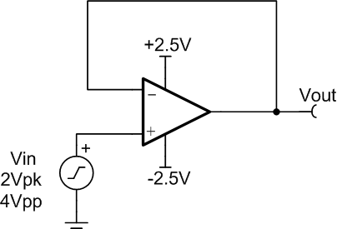
Calculation – Voltage Follower
PARAMETER |  | OPA140
 |  | MIN | TYP | MAX | UNIT
Input Voltage Range | V_{CM} | (V-) – 0.1 |  | (V+) – 3.5 | V
Voltage Output Swing from Rail | V_{O} | (V-) + 0.2 |  | (V+) – 0.2 | V
Calculated Answers | Min | Max
Common Mode Input Range
Output Swing Range
Calculated Answers | Min | Max
Common Mode Input Range | -5.1 | +1.5V
Output Swing Range | -4.8 | 4.8V
-5V
Vin
4.5Vpk
9Vpp
+5V
With a 9Vpp (4.5Vpk) input signal, is the circuit limitation caused by input common mode range or output voltage swing?
Answer: | The maximum input common mode voltage of +1.5V is the limit, since the peak input signal is +4.5V.
Notes:
This circuit uses the OPA140. In order to perform the calculations, you need to know the input voltage range and voltage output swing values for that device. Those values are given here.
Enter your answers in the table in the middle of the slide. The solutions are already provided to allow you to check your work.
Also answer the question at the bottom of the slide. Again, the solution is already provided.

Slide 3
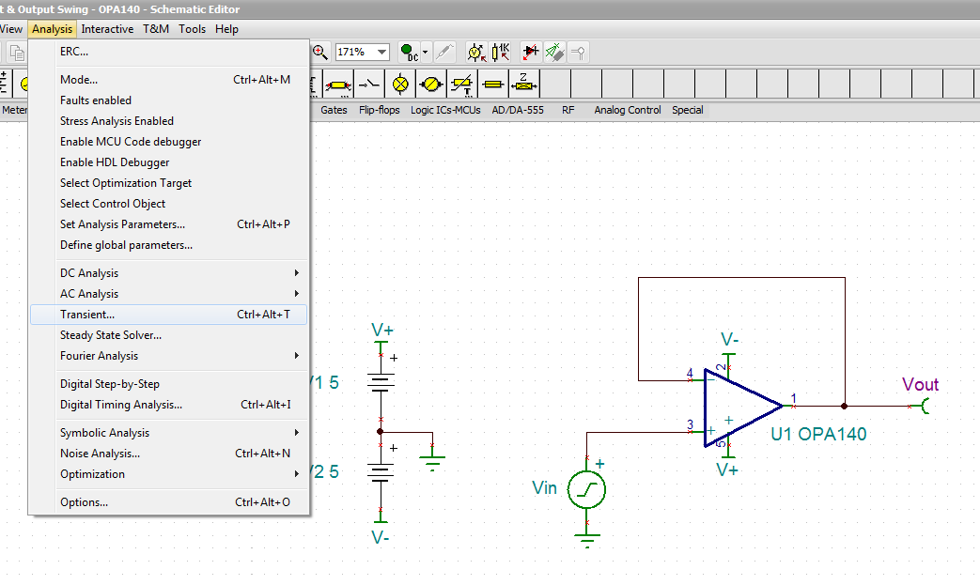
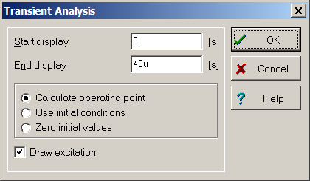
Simulation Setup – Voltage Follower
Click Analysis → Transient to show the common mode limitations for the OPA140. Run the analysis from 0µs to 40µs. The input is a 4.5Vpk, 50kHz triangle wave.
Notes:
The next step is to run a SPICE simulation analysis for the transient output voltage behavior. This will allow us to see the op amp’s output voltage response for a specified input signal, which in this case is a 2Vp, 1kHz triangle wave.
The necessary TINA-TI simulation schematic is embedded in this slide set – simply double-click the icon to open it. To simulate the transient output behavior, click Analysis → Transient. Run the analysis from 0ms to 2ms.

Slide 4
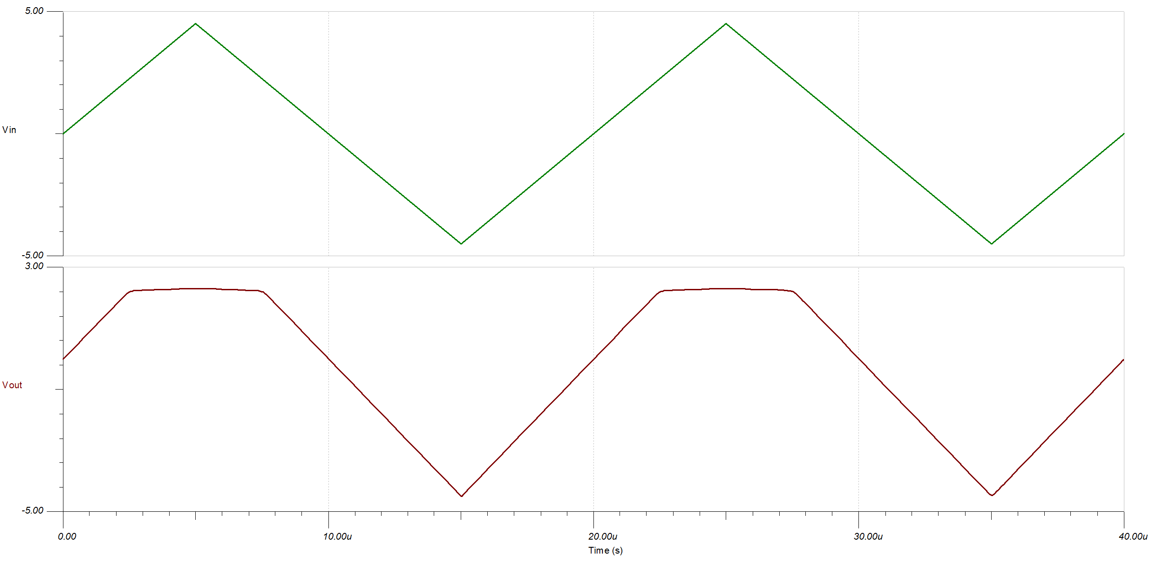
Simulation Results – Voltage Follower
Clipping due to input common mode voltage limitation
Notes:
You should see a result similar to this. Vin is a triangle wave, as expected, but Vout cannot exceed +1V. This is due to the input common mode voltage limitation of the OPA735.

Slide 5
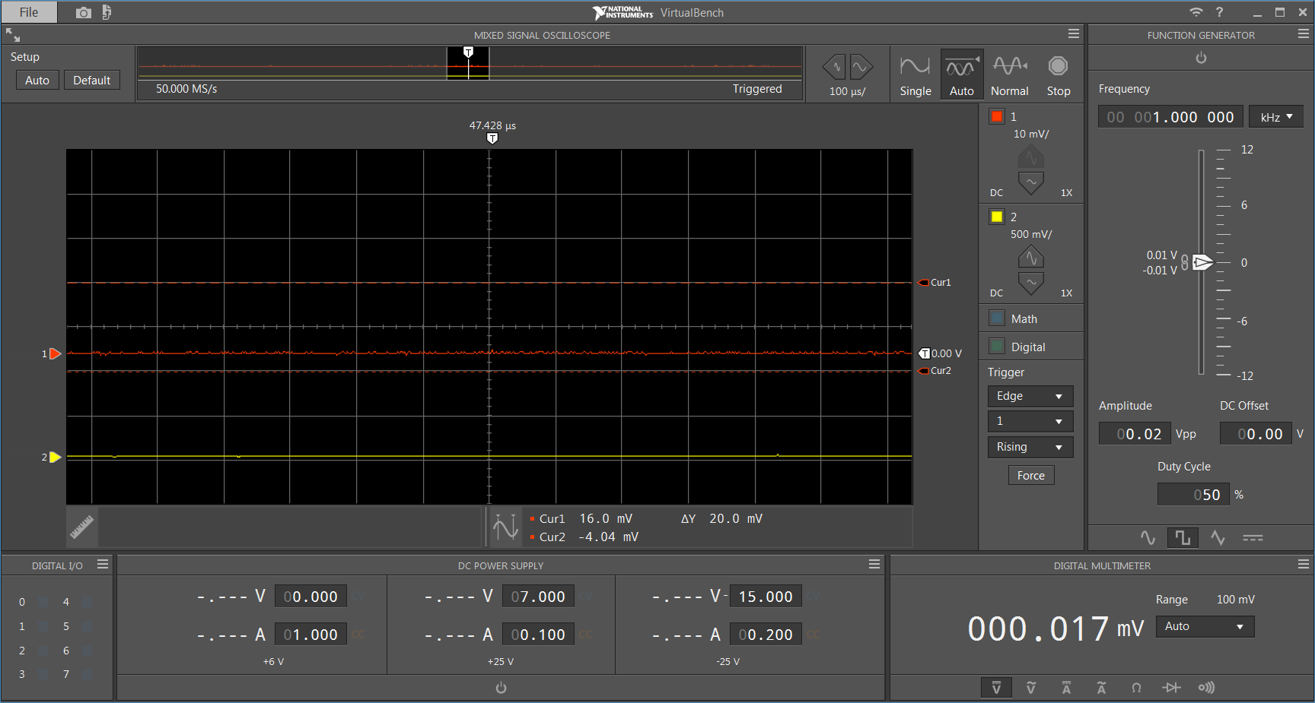
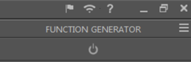
Disable Function Generator
Power button GRAY =
Function Generator OFF
Notes:
Also make sure the Function Generator is OFF.

Slide 6


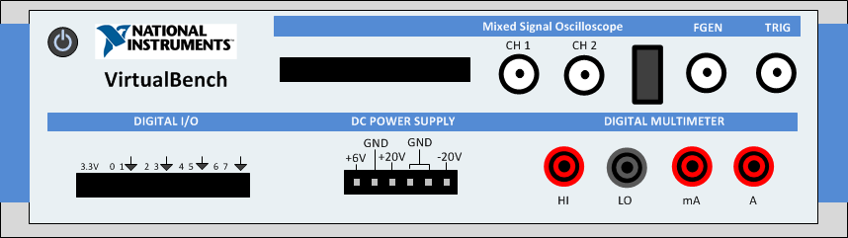
Disable DC Power Supply
Power button GRAY = DC power supply OFF
LEDs OFF = DC power supply OFF
Notes:
Make sure to disable the DC power supply before setting up the test PCB! In the VirtualBench software, click the power button in the DC Power Supply area to turn off the power. Check the front panel of the VirtualBench unit to make sure the LEDs are OFF!

Slide 7
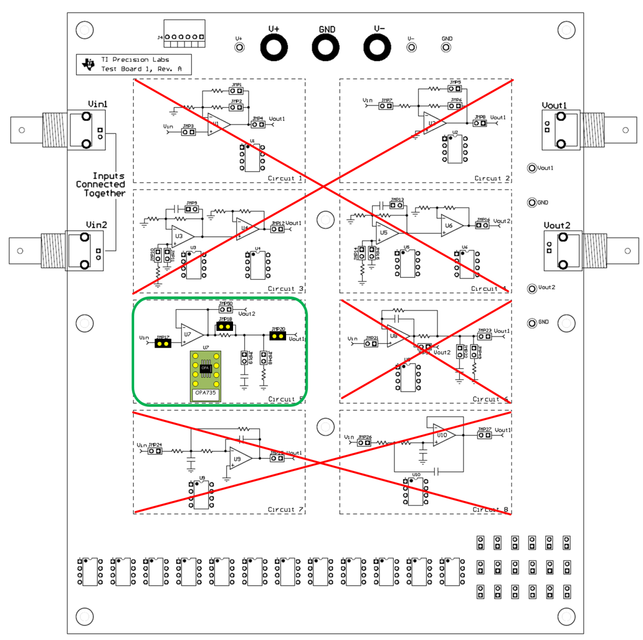
Test Board Setup
Do not install!
Install Circuit 5
only.
OPA140
Do not install!
Store unused jumpers and devices here.
Notes:
For the test board to function properly, it is important that you only install jumpers and devices in circuit 5. Do not install any jumpers or devices in any other circuits on the PCB! Remove any jumpers or devices from the unused circuits and store them in the storage area at the bottom of the test board.

Slide 8
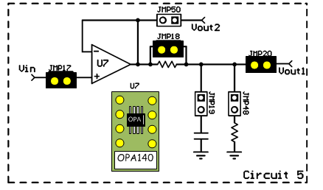
Test Board Setup – Jumpers
Jumper, Device | Description
JMP17 | Connect input to signal source.
JMP18 | Short output resistance
JMP20 | Connect Circuit 5 output to Vout1
U7 | Install OPA140
Notes:
To prepare the test board for the measurement, install the jumpers and devices on circuit 5 as shown here.
Install JMP17, JMP18, and JMP20, as well as the OPA735 in socket U7.

Slide 9
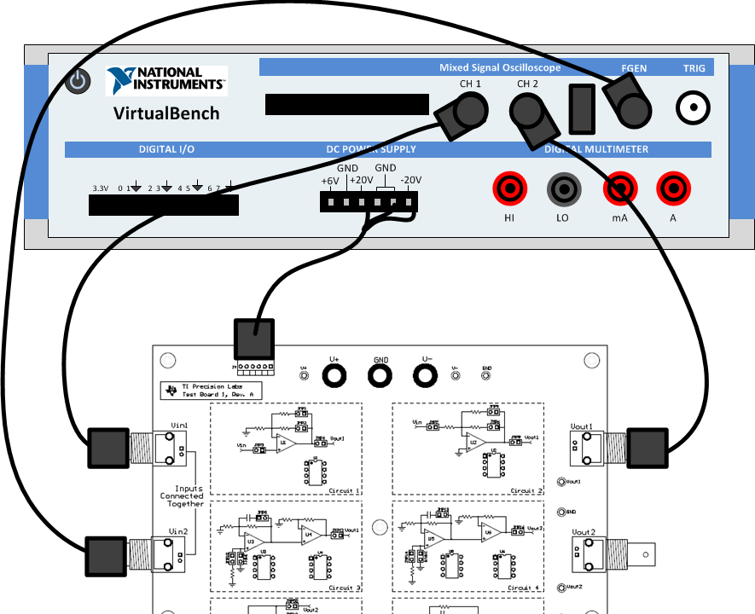
Hardware Setup – Cables
Notes:
This slide gives the connection diagram between the TI Precision Labs test board and the National Instruments VirtualBench. Connect the provided power cable to the DC power supply of the Virtual Bench and power connector J4 on the test board. Connect Vin2 on the test board to VirtualBench channel FGEN, or function generator. Then connect Vin1 on the test board to VirtualBench oscilloscope channel 1, and Vout1 on the test board to VirtualBench oscilloscope channel 2.

Slide 10
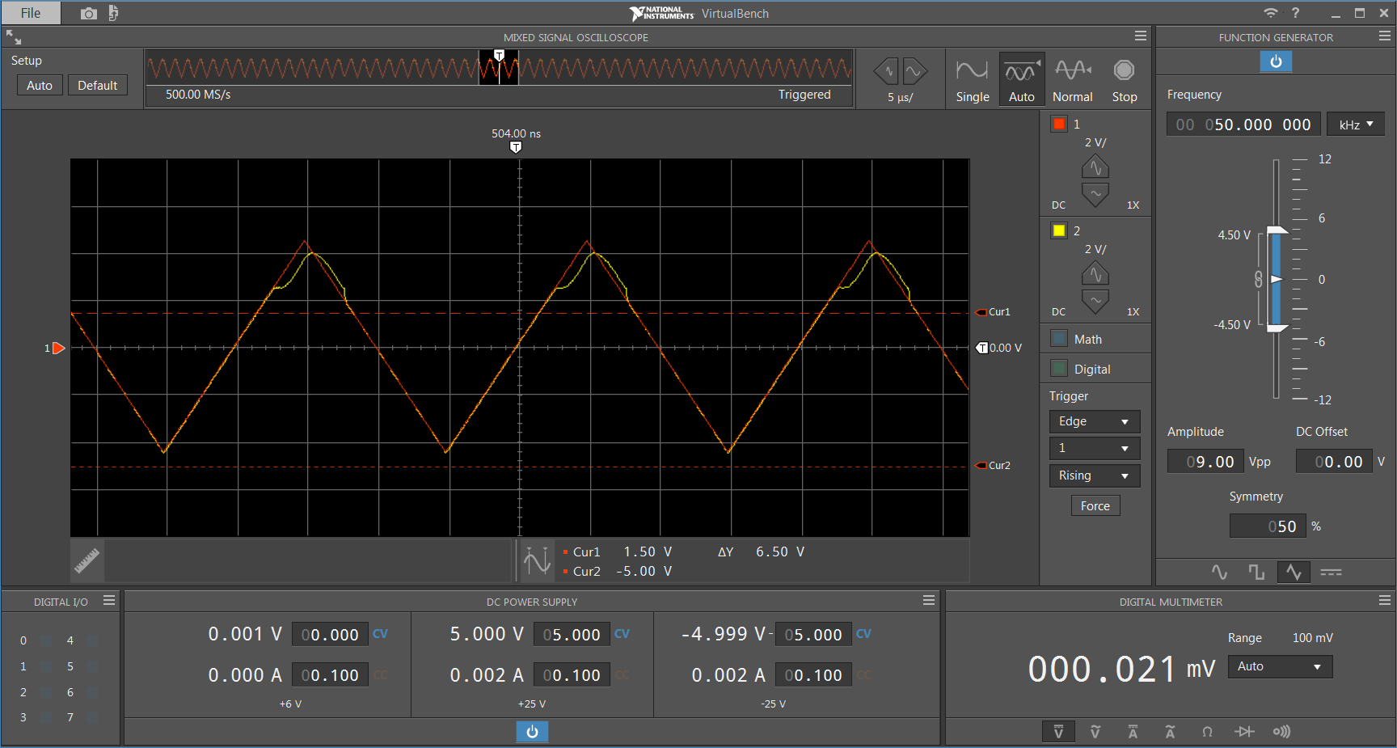
VirtualBenchTM Instrument Setup
5µs/div, “Auto” acquisition
50kHz signal frequency
DC coupled, 1x, 2V/div
9Vpp, 0V offset, 50% symmetry triangle wave
First:
Power supply
enable/disable
±5V , 0.100A
power supply
Set cursors to +1.5V and -5.1V to show valid common mode range.
Notes:
Next apply power to the National Instruments VirtualBench and connect it to your computer with a USB cable. The hardware should be detected as a virtual CD drive, and you can run the VirtualBench software directly from the drive. Once the software opens, configure the software as follows:
Set the time scale to 5us per division, with the acquisition mode set to “Auto.” Enable channels 1 and 2 on the oscilloscope, and set them to 1x, DC-coupled mode, 2V/div. Enable the function generator and setup the signal as follows:
50kHz frequency, 9Vpp, 0V offset, 50% symmetry triangle wave.
Enable the cursors and set them to +1.5V and -5V to show the valid input common mode range.
Set the +25V power supply to +5V, 0.500A. Set the -25V power supply to -5V, 0.500A. Press the power button to turn on the power supply rails.

Slide 11

Measurement Results – Voltage Follower
1. Compare TINA-TITM simulation results to measured results.
2. Use the cursors on the VirtualBench and TINA-TITM tool to measure the voltage where Vout becomes limited (clipped). Compare this to your calculation.
Answer (calculation): | clipped at +1.5V
Answer (simulation): | clipped at +2.3V
Answer (measurement): | visible distortion above +2.5V
Notes:
The expected measurement results are shown here. Compare the oscilloscope display of the VirtualBench to the simulation results from TINA-TI. Also, use the cursors on the VirtualBench and TINA-TI tool to measure the voltage where Vout becomes limited, or clipped. Compare this to your calculation.
The results have already been entered into the table to allow you to check your results. You may have different results in your experiment.

Slide 12
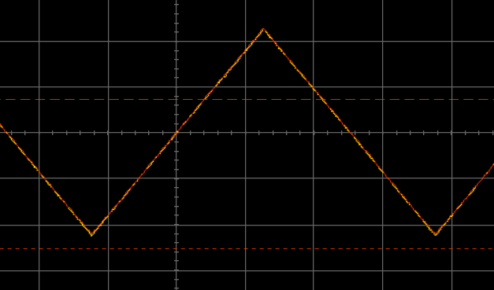
Extra Experiment: 1kHz vs. 50kHz Input
3. Change the triangle waveform frequency to 1kHz and compare the common mode range to the 50kHz wave. Change the time scale to 200µs/div.
1kHz
50kHz
4. What conclusion do you draw from the measurement?
The 1kHz waveform does not show the common mode limitation, but the 50kHz waveform does. This device is actually “rail-to-rail” for low frequencies, but common mode performance ~2V from the positive rail degrades at higher frequencies.

