Slide 1
XTR111 Vout or Iout Analysis
Tim Green, MGTS
Precision Op Amp Applications Manager
April 10, 2018

Slide 2
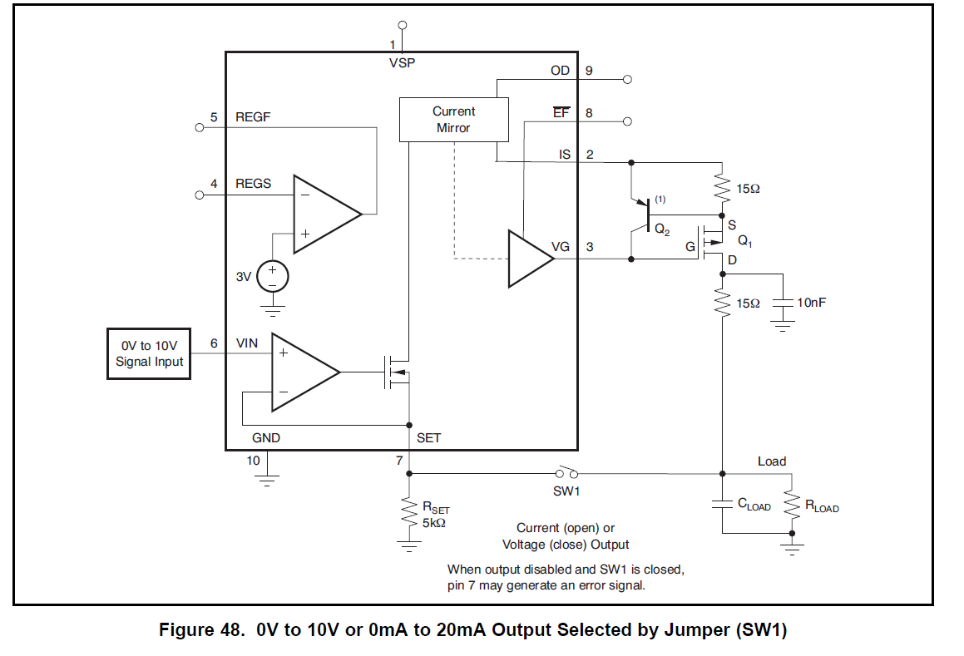
XTR111 Datasheet Excerpt
Leave open to Disable the output current control for Voltage Output Mode
Vout
In Voltage Output Mode the source impedance driving Vout is RSET and so there will be an error unless it is going into a high impedance like the input of an op amp. Whatever is on Vin will appear at SET pin and be Vout.

Slide 3
Additional Comments from Collin Wells
  Questions about the Voltage/Current output as shown in Figure 48 of the datasheet
Answer: In general I’m not a fan of this circuit and will consider removing it if we update the XTR111 datasheet in the near future. The circuit works and I have measured data showing that performance is as would be expected without any surprises or unexpected issues. That said, the SET pin maximum voltage is +14V, irrespective of the supply voltage which makes this design near to impossible to protect from IEC transients because there isn’t a +14V (or less) rail to clamp the SET pin to. The best solution is to buffer the voltage output with a standard non-inverting amplifier scaled to meet the desired output voltages. That way the op amp can be protected as would be commonly done in a 3-wire voltage output design (See TIPD153)

