Slide 1
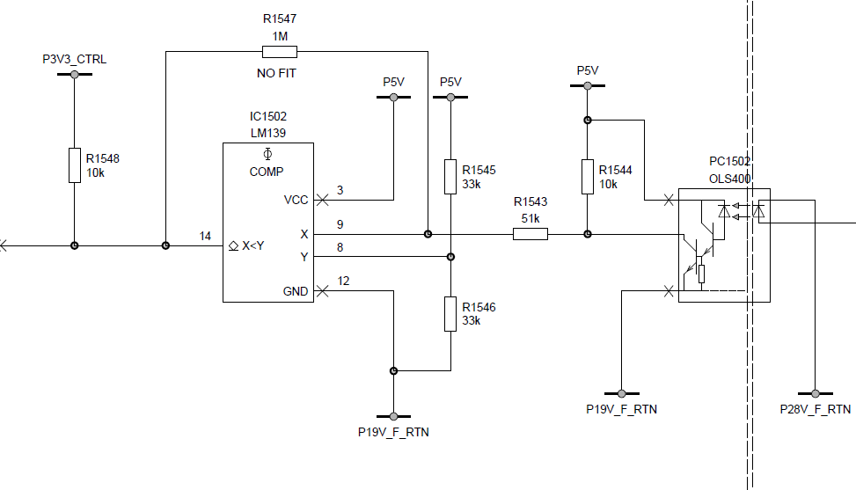
3.7V measured
2.5V

