Slide 1
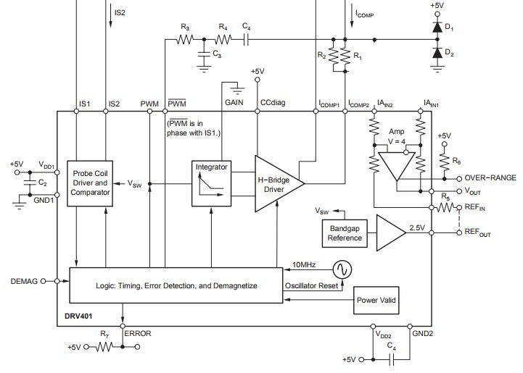

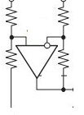
Busbar
Ch4
INA826 or OPA197
Ch2
Ch3
2018.6.14 up date

Slide 2
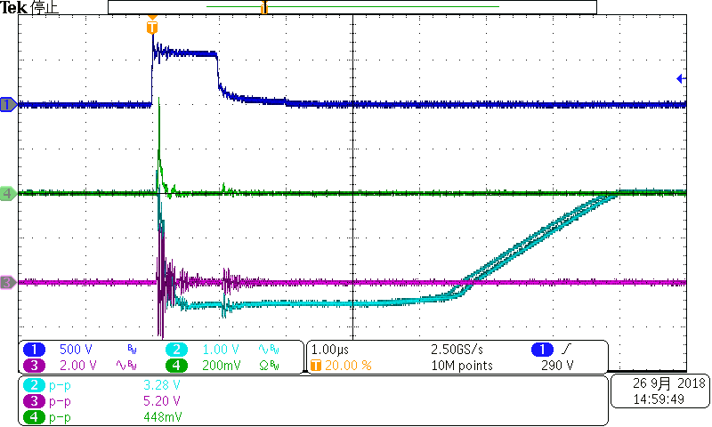
Ch1:impulse Noise
Ch4: IN+ to IN-
Differential probe
Ch3:REF
Ch2:Vout

Slide 3
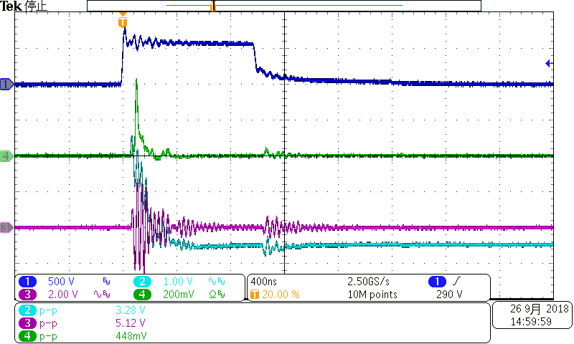
Ch1:impulse Noise
Ch4: IN+ to IN-
Differential probe
Ch3:REF
Ch2:Vout

Slide 4
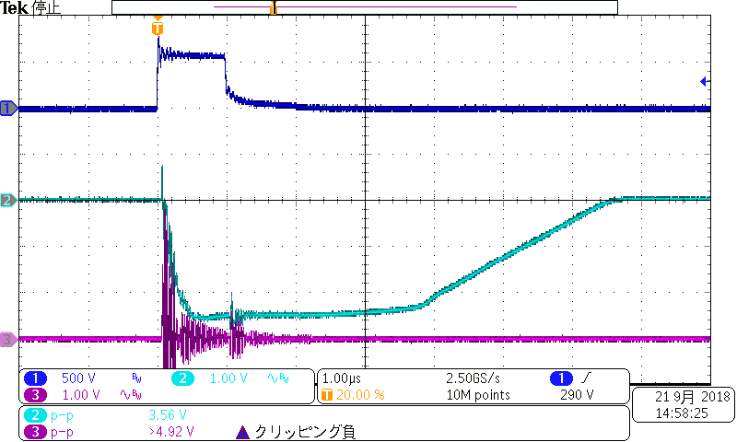
INA826
Impulse Noise
Vout
Vref

Slide 5
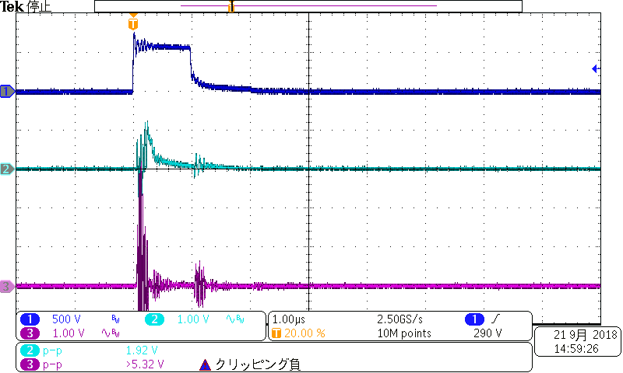
OPA197
Impulse Noise
Vout
Vref

