Slide 1
Developing the SAR
Reference Input Model
TIPL 4505
TI Precision Labs – ADCs
Created by Luis Chioye
Presented by Cynthia Sosa
Notes:
Hello, and welcome to the TI Precision Lab series showing how to develop the SAR ADCs reference input. In the last section we described all the different components in the model. In this section we will show how to configure all the different components in the model to verify the ADC reference input settling performance. We will also look show an example of system performance verification using this model.

Slide 2
We need to configure the switch timing
Notes:
As a reminder, in this presentation we are developing at the reference input model for the ADS8881 ADC. This slide shows the timing used for this reference input model. We need to develop waveforms to close and open the switches at the appropriate time to model the reference input behavior of the device. A logic high on the control signal closes the switch and a logic low opens the switch.
Note that for this design we will be modeling eight MSB CDAC bit decisions. This is done by connecting Cref to the reference output eight times via the CTRL and BIT switches. The CTRL switch acts as a gate to allow eight bit switches to pass through. In other words, the BIT switch is running continuously so the CTRL switch is used to select the number of times the BIT switch connects CREF to the voltage reference. Each time the BIT switch closes, the CREF capacitor is charged by the reference and its associated filter capacitor. This creates a large current pulse, Iref. Between each CREF charge cycle, the RESET switch is used to reset the capacitor. Note that Iref is the same amplitude each time the BIT switch is closed as CREF is always discharged from the RESET switch.
The BIT switch timing is set by the ADC conversion timing. The conversion period is 500ns from the ADC data sheet. The ADS8881 is an 18 bit converter, so the conversion time is broken into 18 different clocks, or 30ns per clock. Thus, the BIT switch timing is set to 30ns. The control switch allows 8 bit conversion clock pulses to pass, and is set high for 8 conversion clock periods or 240ns.
You might wonder why we only pass 8 pulses for this 18 bit converter example. This is because the current pulses generated by this model are always equal to the amplitude of the MSB pulse. In the actual device, the pulses will be binary weighted and will generally be smaller than the MSB pulse. Thus, the reason we only use 8 pulses in this model is because the average current from the 8 pulses in this model provides a conservative approximation to the average current consumed in the actual device.
Now that we have a general understanding of how the model works, we will look at how to configure the switches to implement this example timing.

Slide 3
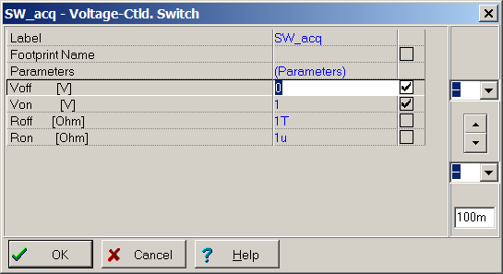
Configure the voltage controlled switch
Set all parameters as shown.
Default Roff=1GΩ and Ron=0Ω will impact accuracy.
Notes:
Let’s look at how to configure the switches. Double click on the switch symbol and you can set the switch parameters. The default parameters can have some impact on performance, so you need to change them as shown. Specifically, Roff should be a 1T ohm and Ron should be 1u ohm. The default is Roff = 1G ohm, and Ron = 0 ohm. Von and Voff set the voltage level that will cause the switch to close or open. We will use square wave signals from the source tacq to open and close the switch. In this case the switch will open with a 0V input and will close with a 1V input.

Slide 4
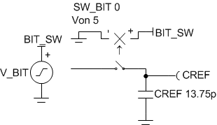
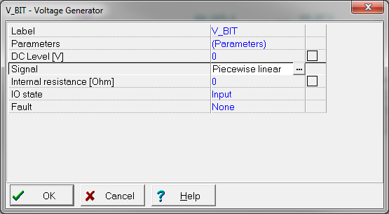
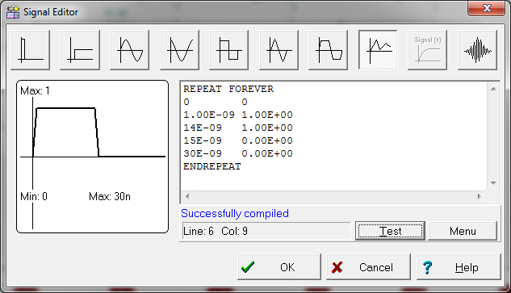
Configure the signal source to control the switch
1. Click on source to select and edit switch control signal
3. Select “Piecewise linear”
2. Under signal, click here to edit.
Notes:
Configure the signal source to control the SW_BIT switch.
First, double click on the signal source to configure the control signal. Second, under “signal”, press the button with the three dots. This will open the “signal editor”. Third, select the piecewise linear function type. This waveform type will allow us to generate a square wave that will control switch operation.

Slide 5
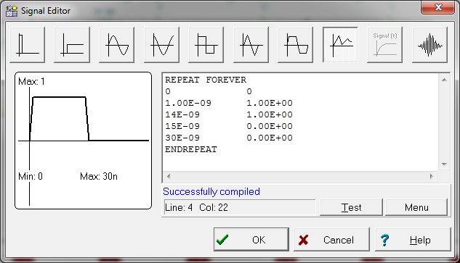
Configure the signal source to control the switch
Voltage levels
On: V ≥ 1V
Off: V ≤ 0
Time
SW on
SW off
Notes:
In the piecewise linear function we can create any waveform shape or timing. In this case we are simply creating a square wave that will turn the switch on when it is at 1V and turn it off when it is at 0V. The pattern will always start with the command “REPEAT FOREVER” end with “ENDREPEAT”. This will repeat the waveform between the two commands forever. Each pattern corresponds to one conversion cycle. This example shows the pattern used to control the switch for the acquisition period. The switch will be closed for the first 13ns period and will remain open for the reminder of the cycle. Note that the rise and fall time of the waveform is limited to 1ns. The left hand side of the waveform corresponds to the time and the right hand side corresponds to the voltage. In this example, at 0 seconds the voltage level is 0V. At 1ns the voltage is changed to 1V. TINA will connect any two points in the list with a straight line, so the first two points transition the input from 0V to 1V in 1ns. The third point keeps the voltage at 1V from 1ns to 14ns. The forth point transitions the voltage from 1V to 0V in 1ns and the final point extends the period to 30ns.

Slide 6
Example simulation: simulator settings
V_BIT
V_RESET
V_CNTL
Notes:
Here we show the timing that was used for the SW_BIT, SW_BIT_R and SW_CNTL switches.
The Top switch signal, V_BIT, turns on and off at the conversion clock frequency, at half duty cycle with 30ns period.
The middle signal, V_RESET, resets the CREF voltage right after V_BIT turns off. The switch turns on at 23ns and turns off at 26ns, with a period of 30ns
The bottom signal V_CNTL, is on for 240ns or 8 conversion clocks. Since the ADC has a 1-MSPS sampling rate, this signal has a period of 1us. Notice that all waveforms maintain a 1ns rise and fall time.

Slide 7
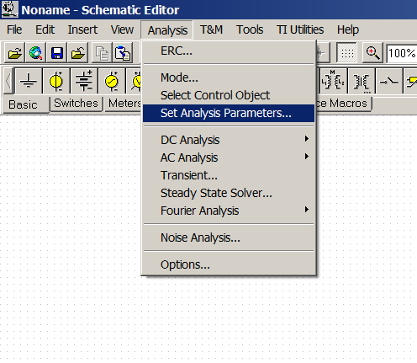
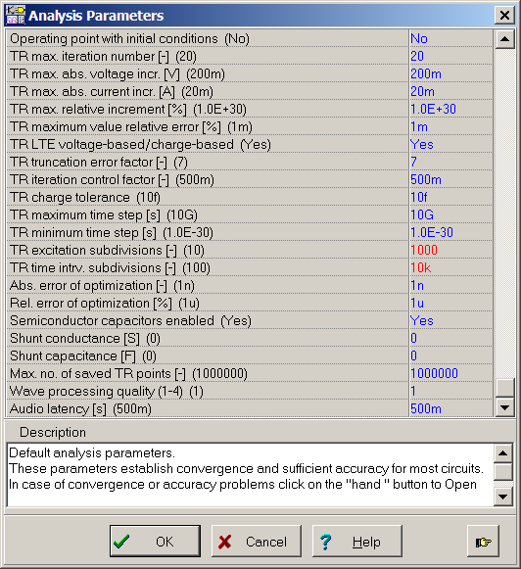
Optimizing Simulation Results
TR excitation subdivisions = 1000
TR time intrv. subdivisions = 10k
This increases the number of points vs time so that transient behaviors aren’t obscured.
“Set Analysis Parameters” adjusts how the simulator math engine operates.
Press this button to expand the list.
Notes:
SAR drive transient simulations require fine time increments to avoid obscuring important waveform information . Using the default settings in TINA may result in errors, as the number of points, or time resolution, are optimized for fast simulation time. The “Set Analysis Parameters” feature allows you to optimize the way the SPICE math engine works. Increasing the “TR excitation subdivisions” to 1000 and the “TR time intrv. Subdivisions” to 10k will increase the number of points versus time so that we don’t obscure fast transient behaviors. Make sure you make this change before running SAR simulations. Note that you will need to press the finger button at the bottom to expand the list so that you can edit these parameters.

Slide 8
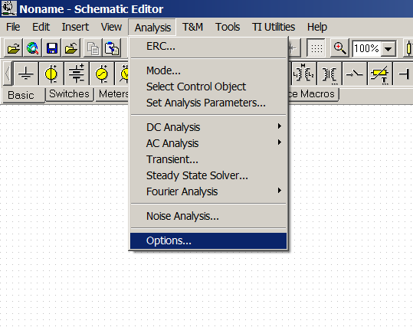
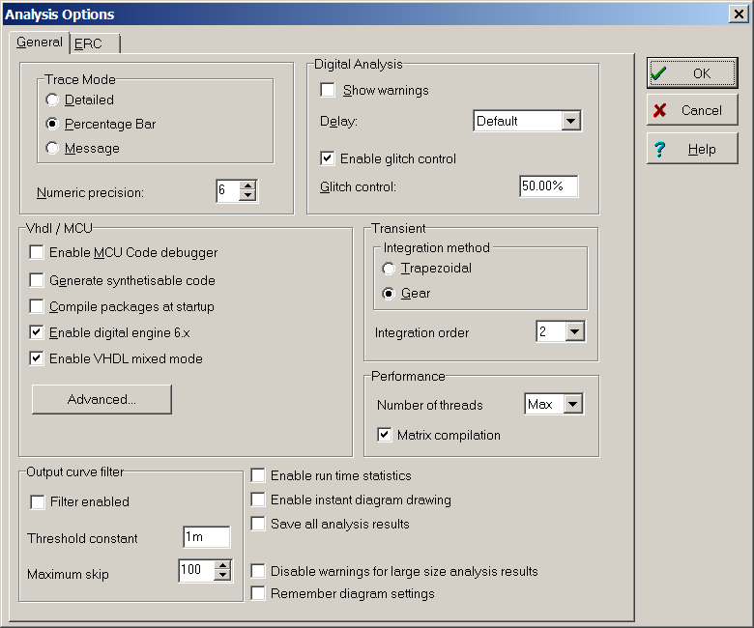
Optimizing Simulation Results
Set the “numeric precision” to 6 digits. This will allow us to see dc operating points to six digits. The importance of this is highlighted on the next slide.
Notes:
Another change you should make before running spice simulations is to increase the numeric precision to six digits under the “options” menu. This will allow us to see the dc operating point to six digits. This is needed to set up the error measurement circuit as we will see in the next slide.

Slide 9
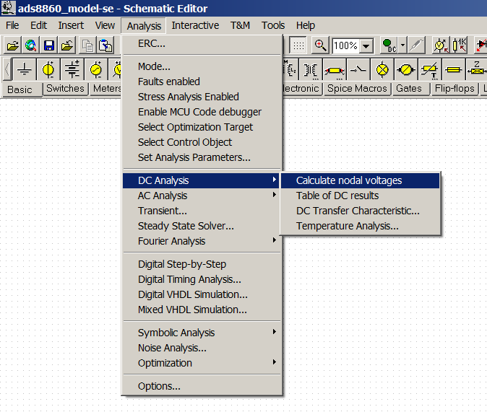
Steady state Simulation Results
The steady state Reference input to the includes external reference initial accuracy error.
Set the V_SS source to match the steady state Reference input.
Notes:
In this slide, we will configure the reference settling error measurement meter. The meter needs to be configured to read zero error when the voltage at the reference input is settled to the steady state output of the reference driver circuit. In other words, when the reference voltage is fully settled, the error should read zero volts. This is achieved by setting the voltage source V_SS on the bottom side of the meter to a dc voltage equal to the steady state reference output. It is important that this voltage is accurate to the microvolt level as we will settle to microvolts of error. This is why we increased the simulation numeric precision to six digits in the last slide. The transient reference output voltage is then compared to the dc steady state voltage source V_SS and when the voltage at the reference input is fully settled, the VREF_error meter reads zero volts.

Slide 10
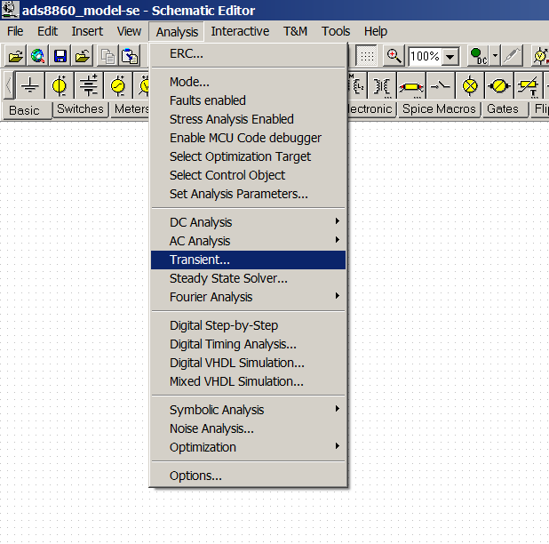
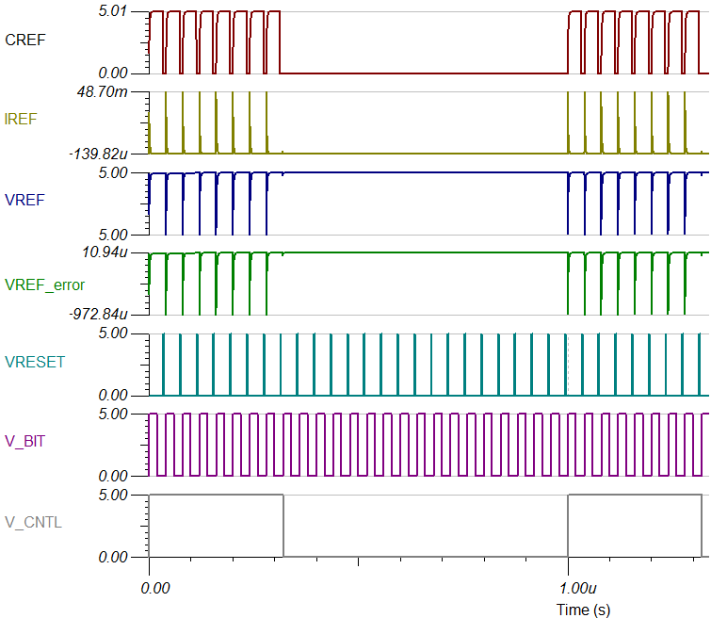
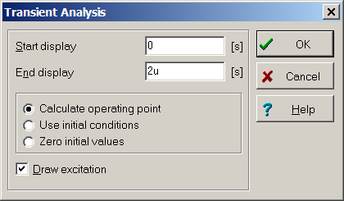
Example simulation: transient results
Voltage across CREF Load Cap
Transient Current into REFIN Pin
REFIN Pin voltage
REFIN error Voltage
Switch control signal
RESETs C_{REF} voltage
Switch control signal Conv Clock (CCLK)
CNTL switch signal
(8xC_{REF} Loads per Conv)
Notes:
Now we are prepared to look at ADC settling using transient analysis. To do this select “Analysis>Transient” in the TINA SPICE menu. Next select a time range that allows you to examine a few conversions. For this example the sampling rate is 1MHz, so we run the transient for 2us for two full cycles.
The transient results for this example include the voltage across the CREF load capacitor, transient current into the reference input (IREF), the reference input voltage (VREF,) the reference settling error (VREF_error), the switch control signal that resets the CREF voltage (V_RESET), the conversion clock frequency signal (V_BIT), and the switch control signal that masks the number of times the reference is sampled on each conversion cycle (V_CNTL).

Slide 11
Key Result: Error Signal
Zoom in
Reference settling error
Verify settles within ~1 LSB
Notes:
The most important signal that is monitored in this type of simulation is the error signal, VREF_error. This signal compares the voltage at the reference input pin to a steady state voltage source, V_SS. The dc voltage on V_SS is set equal to the normal dc output of the reference when it is fully settled. The goal is to get a zero VREF_error signal when the voltage at the SAR reference input is equal to the steady state reference output. In other words, the error will read zero when the reference input is fully settled.
For proper Reference input settling, we will look at the VREF_error within each conversion clock cycle. Also notice that the CREF load capacitor is reset at the end of each conversion clock cycle.

Slide 12
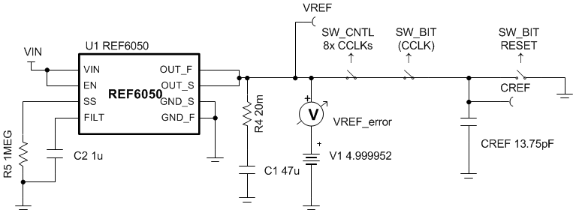
Key Result: Error Signal
Check Settling
Look at droop error over many conversions
Droop < ~1LSB
Notes:
In addition to looking at the settling of the reference within each conversion clock cycle, it is important to look at the droop of the reference input voltage after many conversions. This is done to ensure the reference driver circuit has enough bandwidth or low enough output impedance after may conversions.
In this example, we look at the reference input voltage droop after 100 conversions. Ideally, the voltage droop will be less than 1 LSB or 38uV. You can see in this example that the droop is about 25uV which is less than 1 LSB.

Slide 13
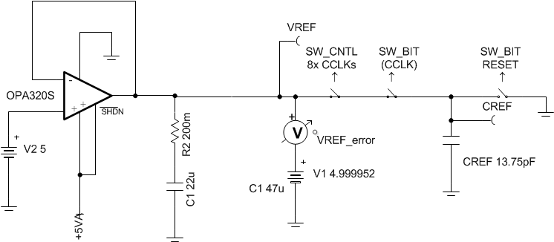
Key Result: Error Signal
Example with excessive droop
OPA320 Stable driving load,
but unable to recover at 1-MSPS.
Check Settling
Look at droop error over many conversions
~500 conversions
Droop 7mV >> ~1LSB
(not Optimal)
Notes:
This slide shows an example of a SAR reference driver circuit that is unable to recover after every conversion, where the reference input voltage droops.
(1) The OPA320 is stable driving the 22uF bypass capacitor, and is able to drive the reference input at lower sampling rates. However, the amplifier is unable to recover at the fast throughput of 1-MSPS.
(2) A transient simulation over many conversions is performed to look at the droop of the reference (500 conversions).
(3) After 500 conversions, VREF_Error shows a loagrge voltage droop at the reference input, exceeding 7mV. This circuit is not optimal for a 1-MSPS throughput but could work for the slower datarates.

Slide 14
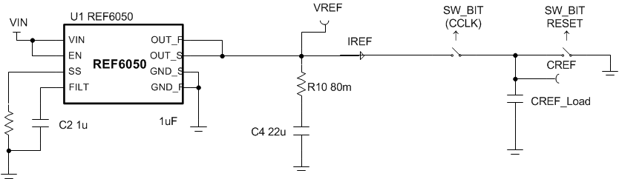
Key Result: Average Current
Average Current per Datasheet spec is 300µA
Average Current per simulation spec is 530µA
Useful to compare sim vs datasheet
Simulation Current
Meter
Notes:
After building the TINA reference input macro-model, it is useful to correlate is average current consumption versus the datasheet specification.

Slide 15
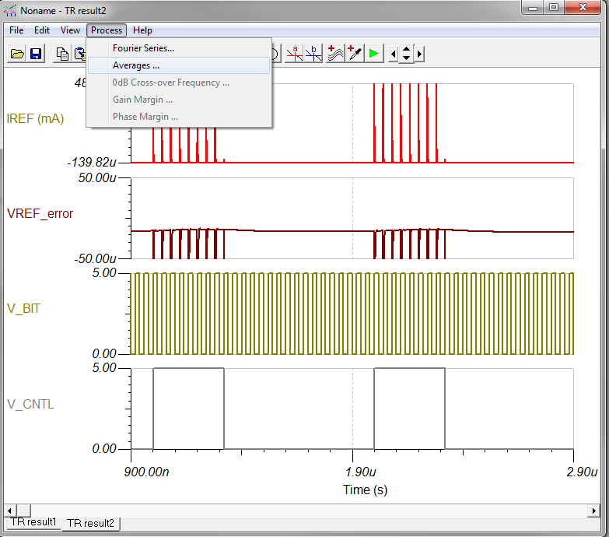
Key Result: Average Current
Average Current per Datasheet spec is 300µA
Average Current per simulation spec is 530µA
Useful to compare sim vs datasheet
1. Click/select the Current transient curve
Simulation Current
Meter
2.Select Process… → Averages… on Top Menu.
Notes:
After performing the transient simulation, on the transient simulation results, click or select the current transient (IREF).
On the Top menu in the transient simulation results, select ‘Process→Averages’

Slide 16
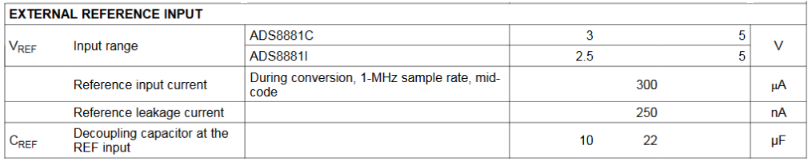
Key Result: Average Current
Average Current per Datasheet spec is 300µA
Average Current per simulation spec is 530µA
Useful to compare sim vs datasheet
Simulator calculates average current and displays value
Simulation Current
Meter
Notes:
The Simulator will calculate and display the “Average Value” and “Absolute Average Value” of the reference input current.
Many SAR ADC datasheets provide the average “Reference input current” specification at full-throughput. Use the simulated “Average Value” to compare to the “Reference input current’. The simulated value should be close or exceed the reference input current.
In this example, a conservative approach was used, where the reference input sees the worst case MSB load capacitance 8 times per conversion. The simulation model consumes 530uA at full throughput of 1-MSPS, which is in the same order of magnitude of the datasheet spec of 300uA. By adjusting the duration of the CNTL Signal, the user can increase or reduce number of times the reference input sees the MSB switch capacitive load, and adjust the current consumption.,. In most cases, allowing the CNTL signal high for 4 to 8 conversion clocks produces a good approximation of the reference input load.

Slide 17
Agenda
Reference Performance Specifications:
  Initial Accuracy, Drift, Long Term Drift, Noise and Output Drive
Overview of SAR REF Drive Topologies:
Reference standalone VS Buffered Reference
  SAR ADCs with Internal Reference Buffer
SAR REF Input Overview: The Capacitive DAC (CDAC)
Build TINA REF Input Model for a SAR:
Discrete Charge Model
TI Device Specific Model
SAR REF Drive Circuit Design:
Reference Bypass Capacitor
Reference Buffer Stability and Compensation
Notes:
Next, we examine a different time of SAR reference input model, the TI device specific model

Slide 18
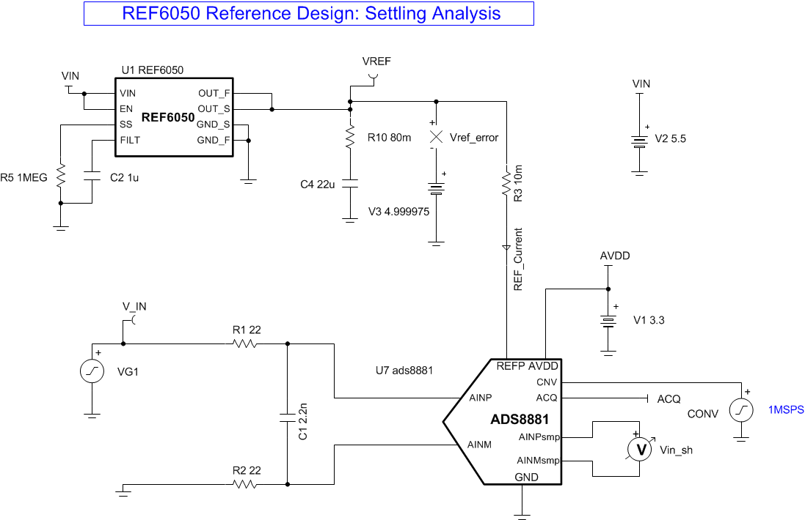
REFIN TI Device Specific Model
  Device specific: model closer to device topology
  Uses variable weighted switching capacitor load
  Behavior may be more accurate and/or closer to real silicon, at the cost of slower simulations/circuit complexity
Notes:
The TI device specific model is provided directly by the factory.
The model is built based on the specific topology of the device, and uses a weighted switching capacitive load
The behavior may be closer to the real silicon, however the macro-model is more complex, and will tend to take a longer time to converge and perform simulations.

Slide 19
REFIN TI Device Specific Model: transient results
Convert Start signal
Transient Current into REFIN Pin
ADC Input Signal
REF voltage
Voltage across C_{SH}
REFIN error Voltage
Notes:
The TI SAR Reference input model transient simulation results are similar to the previous discrete charge model.
This slide shows the transient results for the ADS8881 TI device specific SAR model available on the web. The model includes the reference input model as well as the SAR ADC input (sample-and-hold) voltage.
The transient results for this example include the conversion start signal (CONV), the transient current into the reference input (REF_current), the reference input voltage (VREF,) and the reference settling error (VREF_error). It also includes the transient simulation of the SAR ADC input, including theivoltage at the SAR ADC inputs (V_IN) as well as the voltage across the sample-and-hold (Vin_sh).

Slide 20
Device Specific VS Discrete Charge Model
Discrete Charge REFIN model | Device Specific Model
Conservative approach to load: switching MSB load several times per conversion. | Binary Weighted or variable switching capacitive load, modeling specific device topology.
Offers faster simulation results, conservative approach | More accurate results, sometimes at the cost of circuit complexity and slower simulation.
Robust convergence/ fast simulations allows easy Reference drive circuit optimization | Tends to be more accurate, but slower. May have convergence issues on complex circuits. Can be used to verify final circuit.
Created from datasheet parameters | Provided by factory, not available on old devices
Notes:
This table summarizes the differences between the SAR reference input discrete charge model (based on datasheet parameters) and the TI device specific reference input model provided by the manufacturer.
The Discrete charge reference input model is created based on datasheet parameters, and uses a conservative approach to the reference input capacitive load. In this simplified model, the reference input sees the worst case MSB load, switching several times per conversion. The circuit is relatively simple, so it offers fast and robust convergence, and quick combination results. It can be applicable to any new or legacy SAR ADC.
The TI device specific model uses a binary weighted or variable switching capacitive load, modeling the specific ADC device topology. More accurate results, sometimes at the cost of circuit complexity and slower simulation. It is provided by factory, and may not be available on old devices. Since the simulation results may be slower, in many cases, it is just used to verify final circuit after performing the design with the discrete charge model.

Slide 21
Thanks for your time!
Notes:
That concludes this video. In the next video we focus on op amp buffer circuit design issues such as stability. Thank you for watching! Please try the quiz to check your understanding of this video’s content.

Slide 22

Notes:
This slide should be leveraged for external recordings. Leave on screen for 5 seconds.

