Slide 1
THS3217 Testing
Andrew Baek

Slide 2
X
X
0
0
PATHSEL1
0: internal
1: external

Slide 3
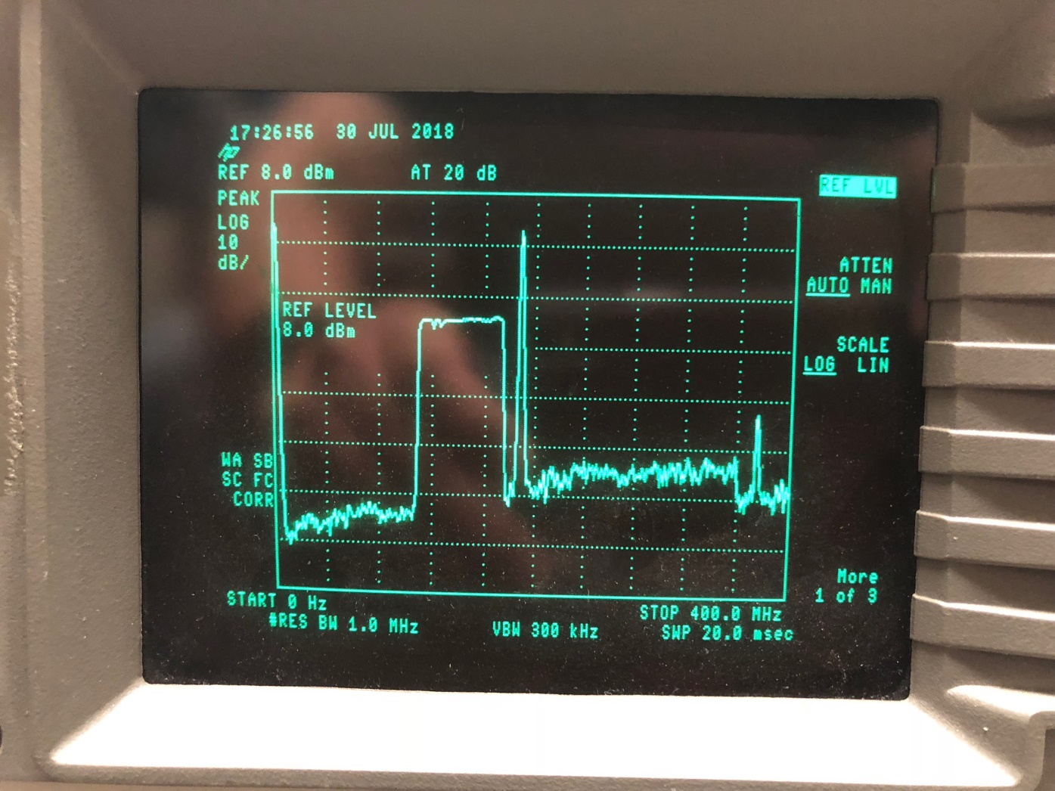
Internal (PATHSEL1 = 0)

Slide 4
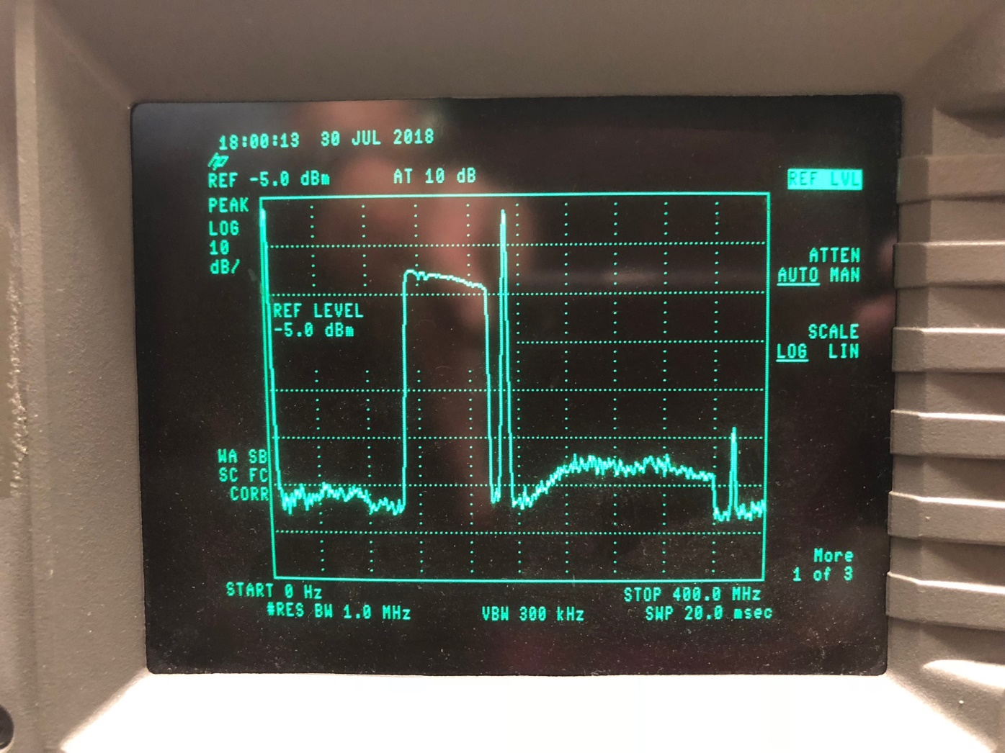
Internal (PATHSEL1 = 1)

Slide 5
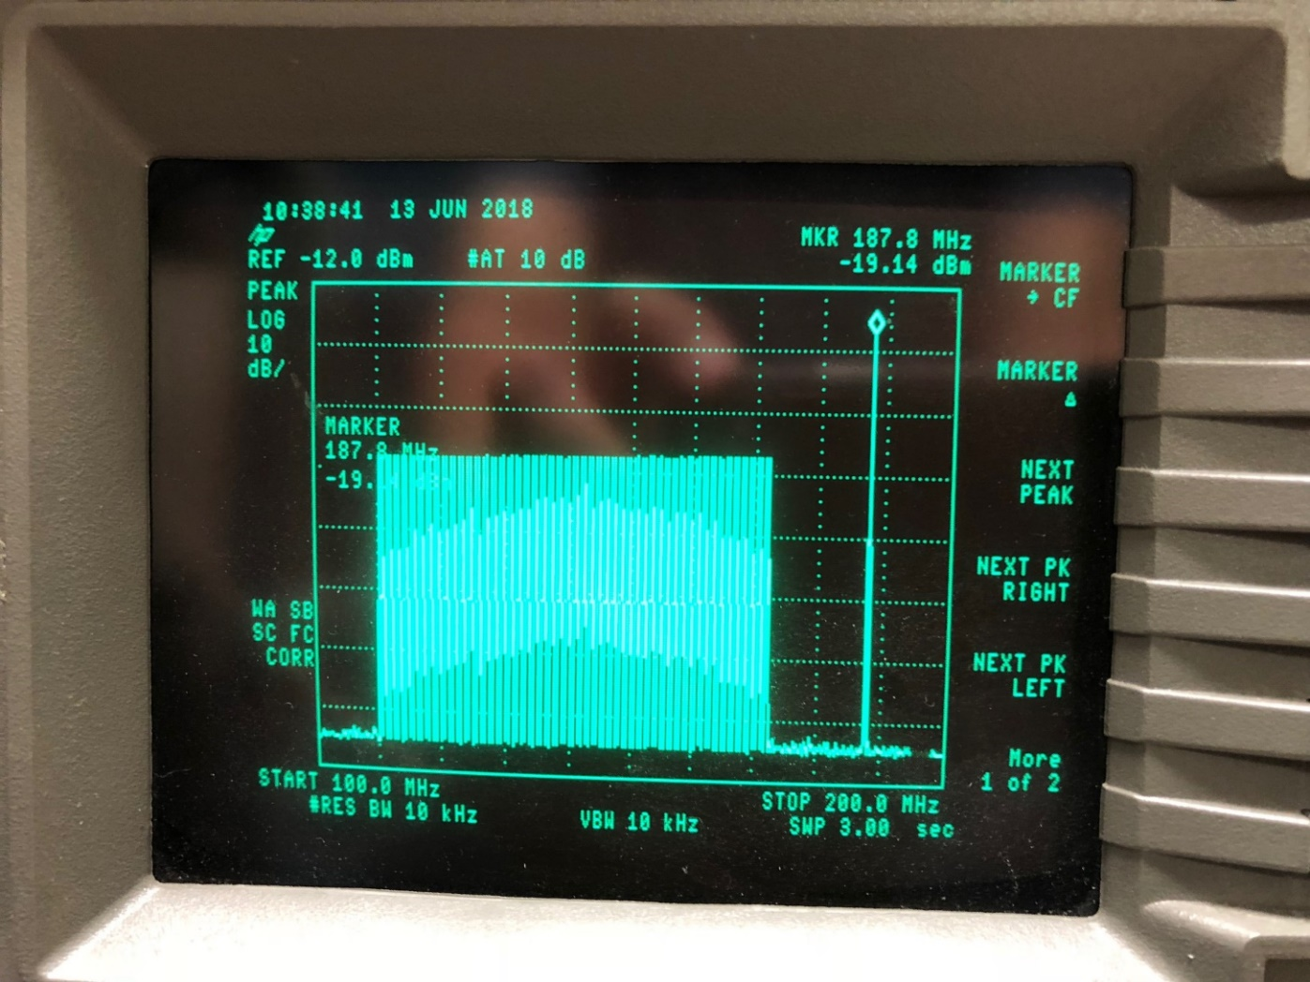
RF Transformer Path (J10)

