Slide 1
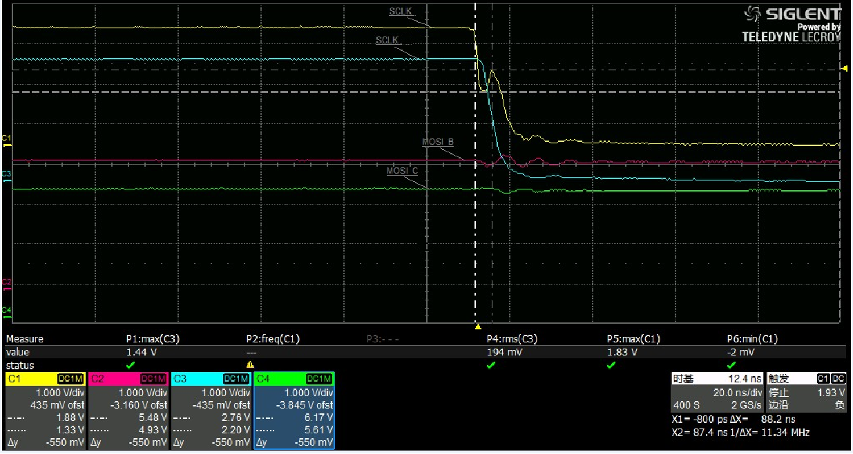
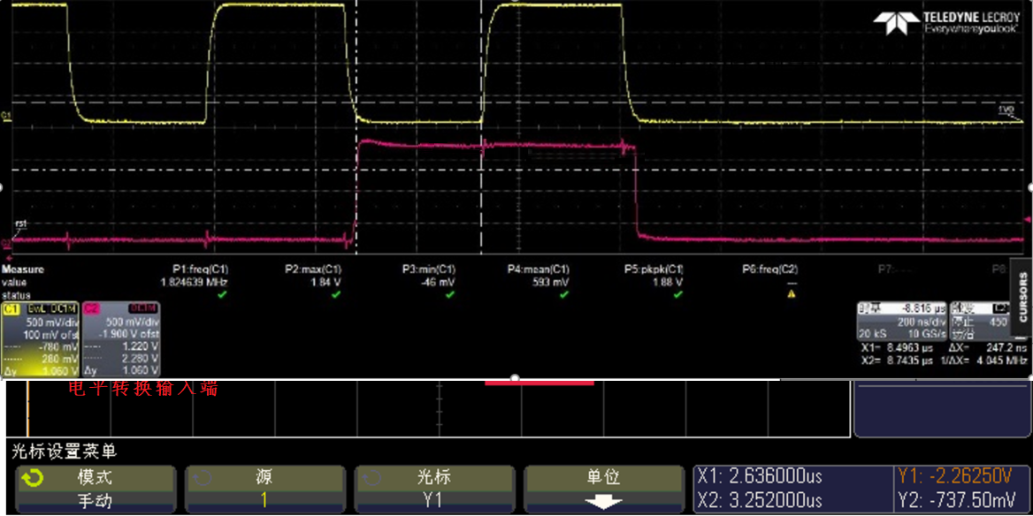
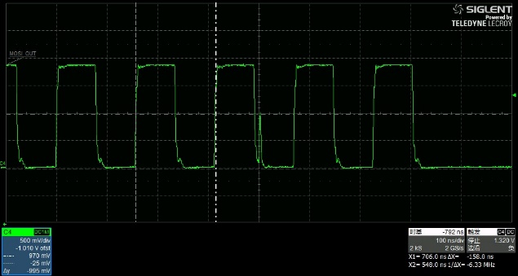
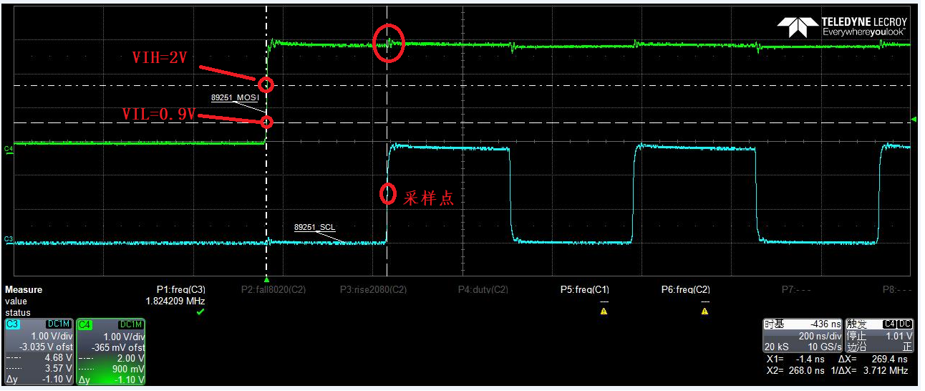
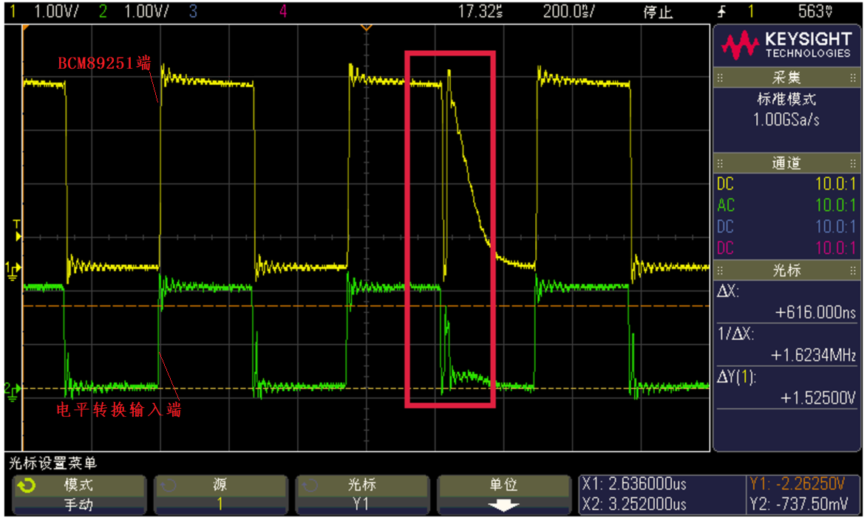
Normal temperature : There's a hook on falling ege
yellow channel for point C
SPI_SCLK
SOC
TXS0108
A
B
D
BCM89251
C
-40℃ OK
Normal temperature OK
But below -20℃ NG
Normal temperature OK
-20℃~-40℃ NG
（yellow channel for point D, green channel for point B）

Slide 2
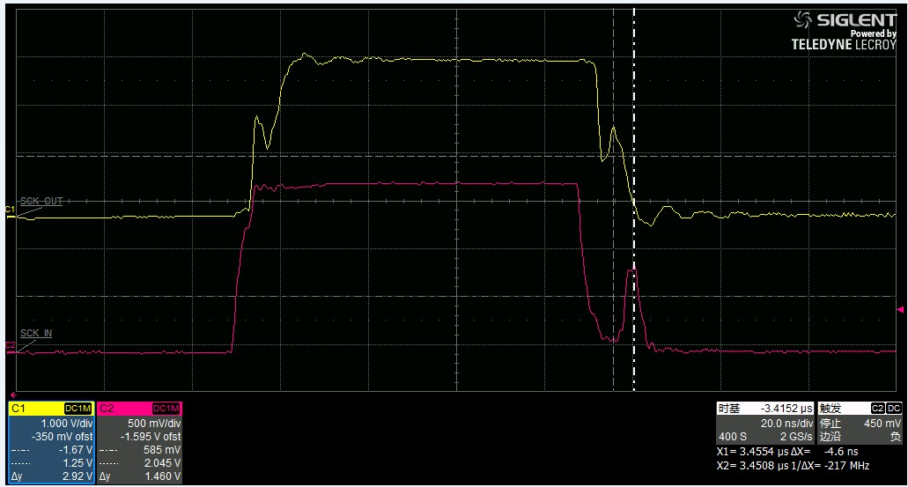
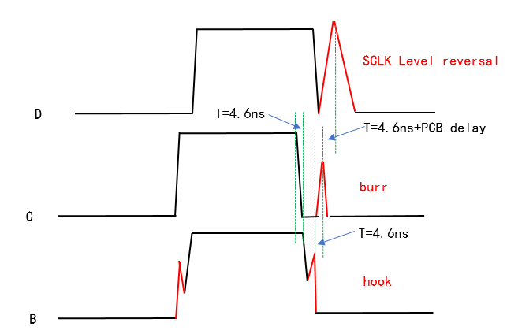
Point B
Point C
Point B
Point B

Slide 3


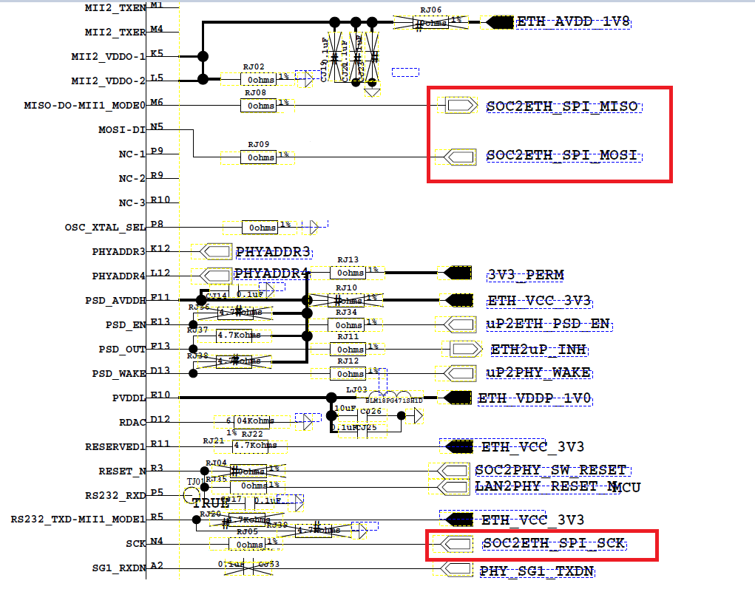

Slide 4
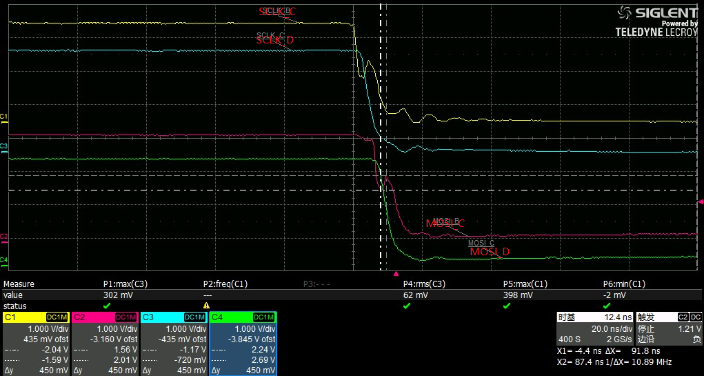
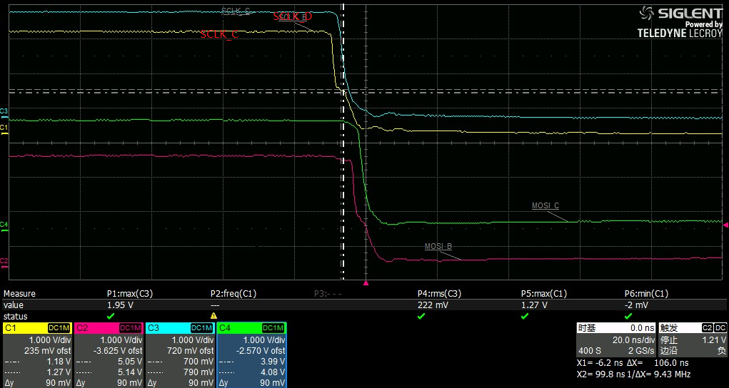
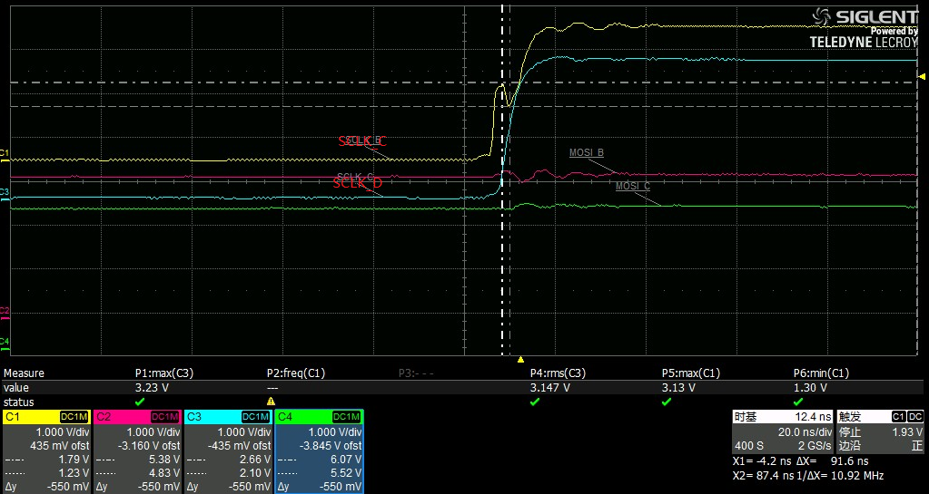
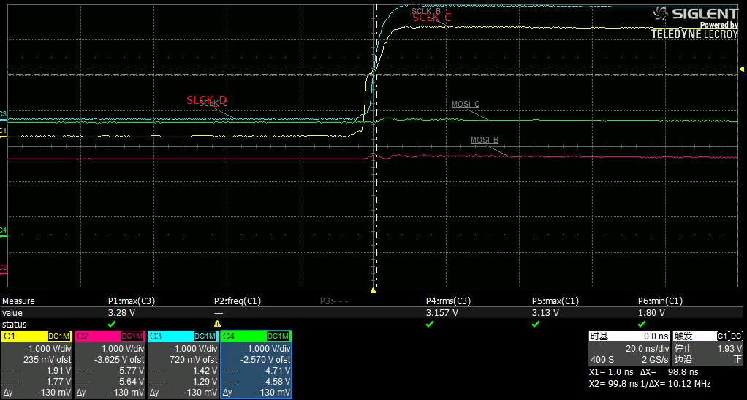
Series resistance=0ohm
Series resistance=33ohm

