Slide 1
24.576MHz Oscillator test

Slide 2
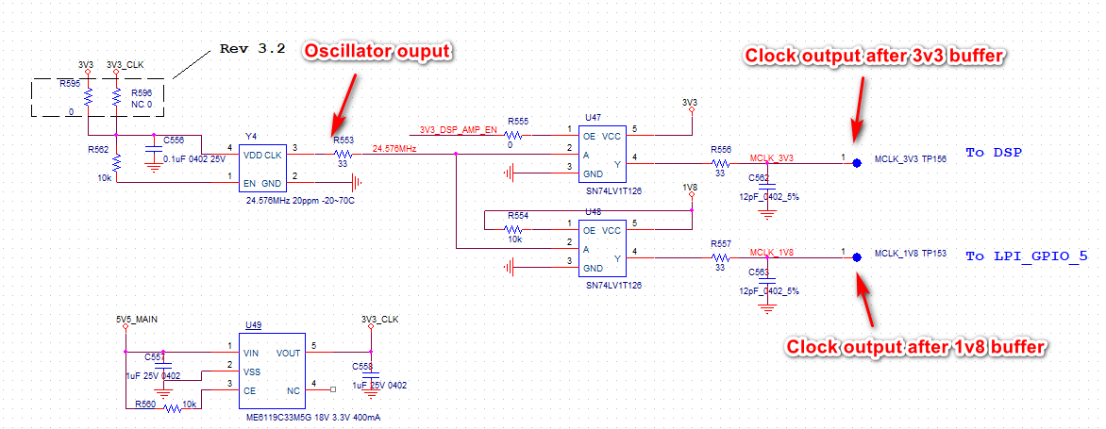
Test for 24.576MHz

Slide 3
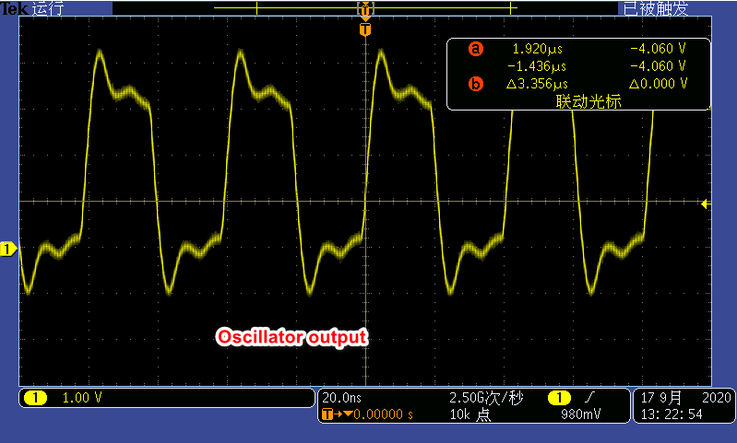
Oscillator output

Slide 4
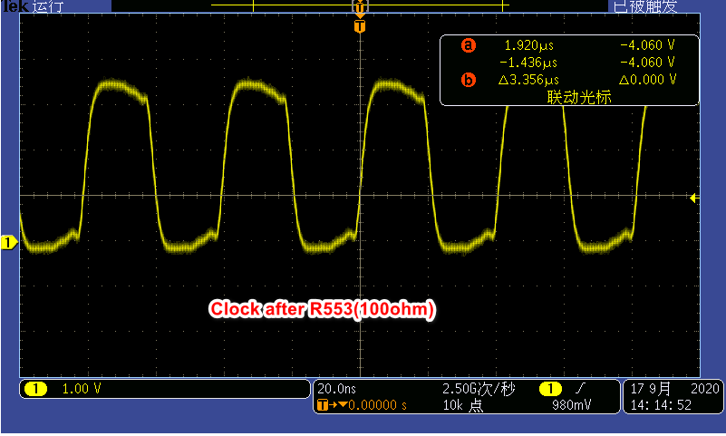
Clock after R553(100ohm)

Slide 5
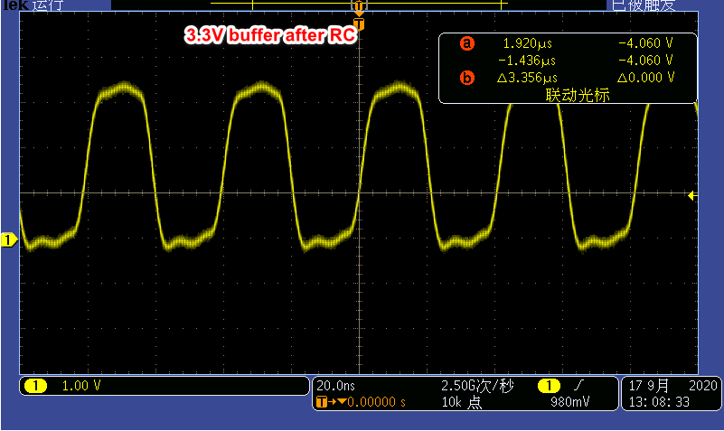
Clock after 3v3 buffer

Slide 6
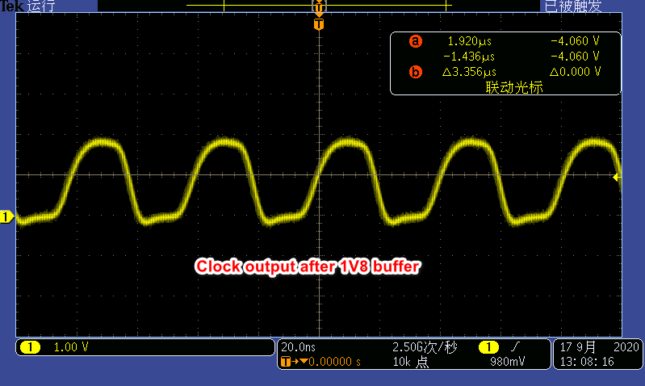
Clock output after 1V8 buffer

Slide 7
Question
1. The clock output after the 1V8 buffer had a high jitter. And the 1V8 rise time is slow.

