Slide 1
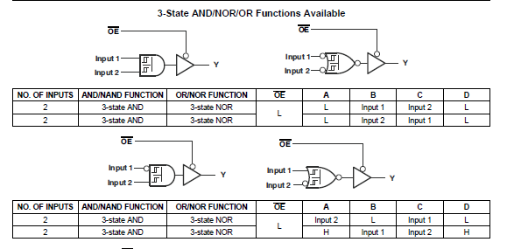

Slide 2
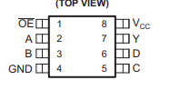
= +5V
To pfc
= GND
= +5V
50
48
46
44
42
40
38
36
34
32
30
28
26
24
49
47
45
43
41
39
37
35
33
31
29
27
25
23
100
98
96
94
92
90
88
86
84
82
80
78
76
74
99
97
95
93
91
89
87
85
83
81
79
77
75
73
TMS320F28035 CONTROL CARD PINOUTS
Top view

