Slide 1
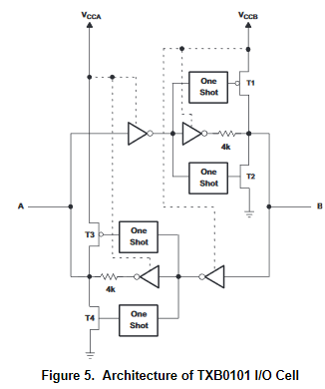
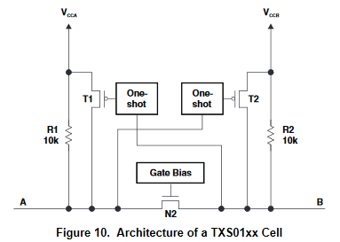
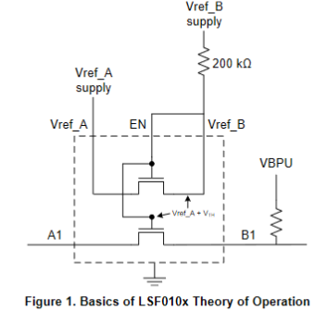
Auto-Bidirectional Translators
Metrics | TXB | TXS | LSF
Drive strength | Very low drive of 20ua due to 4K buffer | Passive translation with NMOS; no drive | Passive translation with NMOS; no drive
Applications/ Interface | Mostly suitable for push-pull applications | Suitable for open drain applications | Push pull and open drain applications
Speed | Up to 140Mbps | Up to 24Mbps | High speed up to 200Mbps
Translation flexibility | Buffered; Fixed translation | Integrated 10k resistors-reduces BOM cost of the system; but inflexible | Flexible translation due to external resistors Frequency vs load balance trade-off
I/O ports | Referenced to Vcca or Vccb | Referenced to Vcca or Vccb | Multi-voltage translation in single device
Edge- acceleration | Integrated one-shot | Integrated one-shot | No integrated one-shot
Vih/Vil requirements | Datasheet spec has Vih/Vil | D/S has Vih /Vil spec, no Ron for the FET | No Vih / Vil conditions, has Ron spec
Additional care-about | Vcc<=Vccb | Vcca<=Vccb | Vccb>Vcca+0.8

