Slide 1
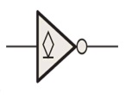
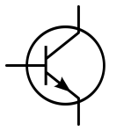
5V
5V
3.3V
VCC
R
R
A
Y
GPIO
(220uA max)
VIL<1.5V
VCE
Vibration Sensor
Buffer
Processor
If transistor is On
VCE<1V
IC<50mA
Option 1= SN74LV07A
Option 2=SN74LVC2G06
We have to interface one vibration sensor to our processor.
Vibration sensor have an open drain output (VCE=<1V)
Processor VIL is <0.8V.
To avoid the risk to connect sensor output directly to Processor, we have planned to use one buffer.
We have found the above two buffers with open drain output.
As per our understanding, For LV-A family, output current will be low.
And for LVC family, output current will be 24mA max.
If we use LV-A family, we can reduce the power consumption.
For this requirement, Can we use the above mentioned buffers?
From the above 2 parts, which part will TI suggest?

