Slide 1
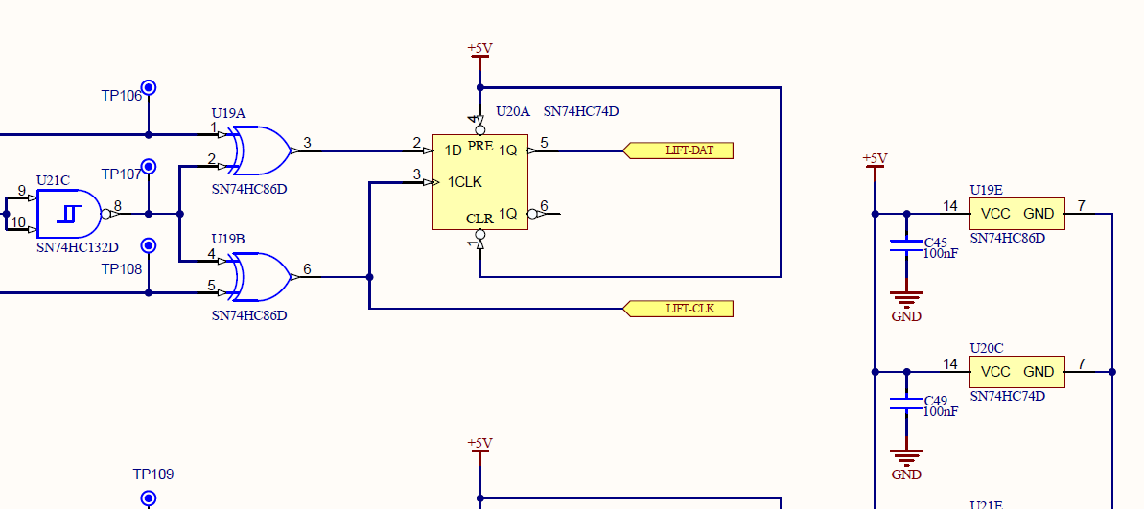
1. No source +5V

Slide 2
2. Apply source 1.3V 2mA to U20-2 to GND
Io
Vm
Vs
Rs
2mA
1.3V

Slide 3
3. Measure Voltage at U20-2 to GND for clamping diode test
Io
Vm
Vs
Rs
2mA
1.3V
Question: Is this test method is affect on U19?

