Slide 1
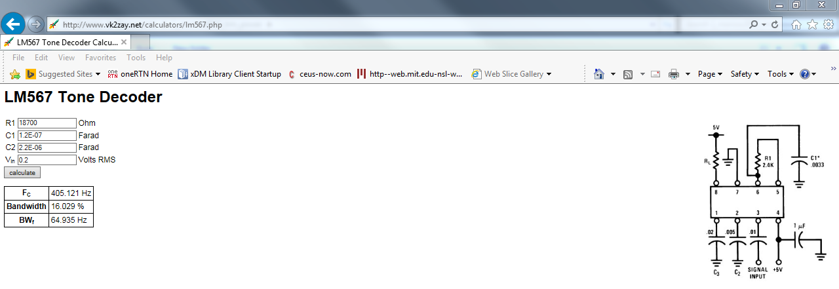
FOUND IN THE WEB.
THIS SITE CALCULATES VALUES VERY DIFFERENT FROM D/S EQUATIONS

Slide 2
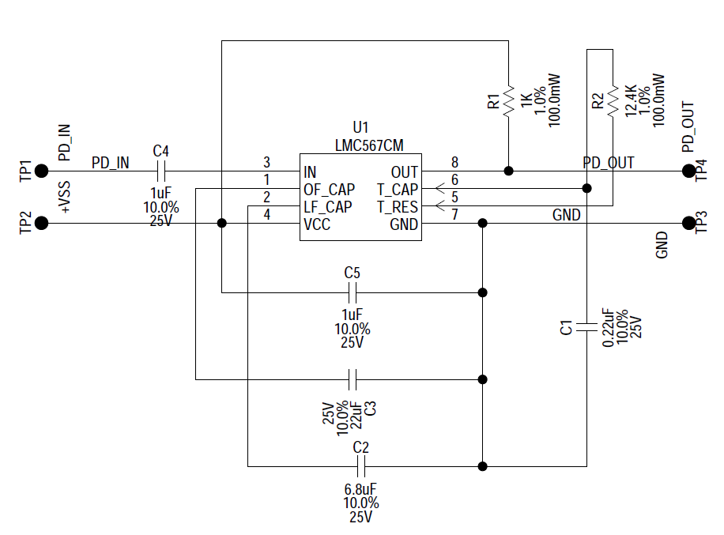
Dual Tone Decoder PLL
Remove all copper around traces
assy
Schematic: 400 Hz PLL NEW VALUES MAY 5, 2017
50 Ω
18.7K
.12uF
10uF
2.2uF

