Slide 1

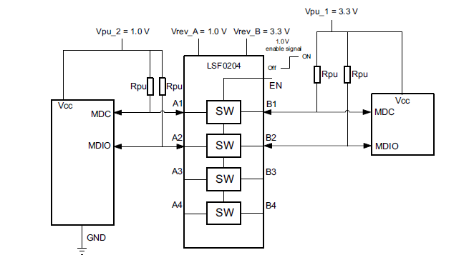
Vref_A = 1.8V
Vref_B = 3.3V
Rpd = 1k ohm
Vpu_2=1.8V
MCU GPIO(3.3V) from outside
Rpd = 1k ohm
when Vref_A and EN stopped (=open) and still Vref_B alive, about 0.3 to 0.4V appears on Vref_A.
Then, 1k ohm Rpd had placed on Vref_A and EN, took measurement again.
The Vref_A voltage was reduced to about 20 to 30mV, however, the voltage still appears.
The customer wants to reduce it to 0V.
Please let us know the appropriate value for Rpd or any method to meet their requirement.

