Slide 1
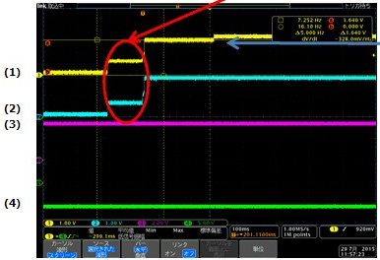
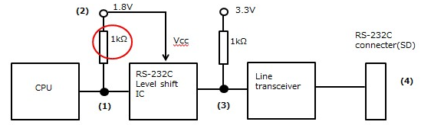
When system startup, 1.8V gradually power up, 0～0.6V/100ms～1.8V.
(1)reach 1.64V
(2)Vin=High
Vout=all time Low
whatever Vin value
RS-232 Tx signal is Low
=operates successfully
LVC07A

