Slide 1

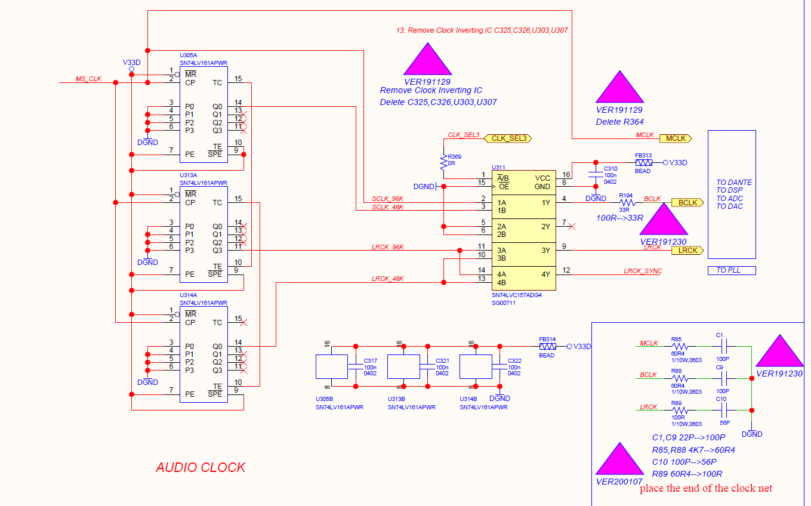
I mean when I select “LRCK”

