Slide 1
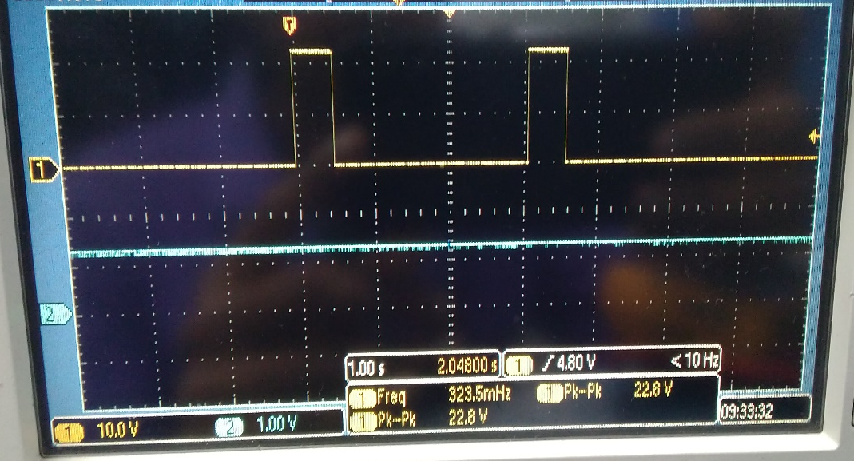
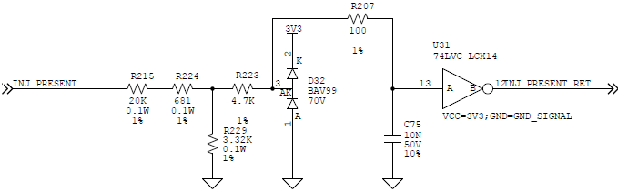
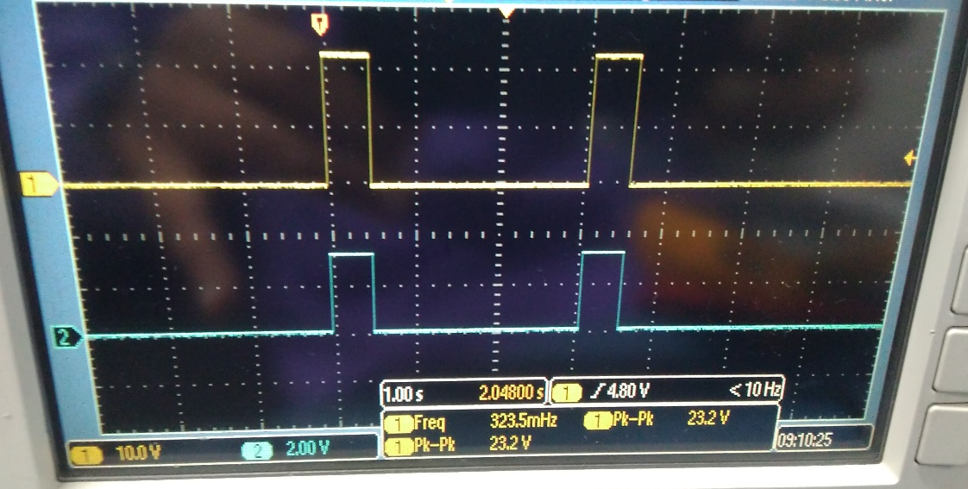
Waveforms from non-working board (U31 failure)
INJ_PRESENT
U31.12
Voltage at U31.12 is ~1.2V always
INJ_PRESENT
U31.13

