Slide 1
5V
3.3V
5V
VCCA
VCCB
10k-ohm
Power supply for VCCB is 0V
at start up sequence.
_OE
DIR
A1
B1
SN74LVC8T245PWR

Slide 2
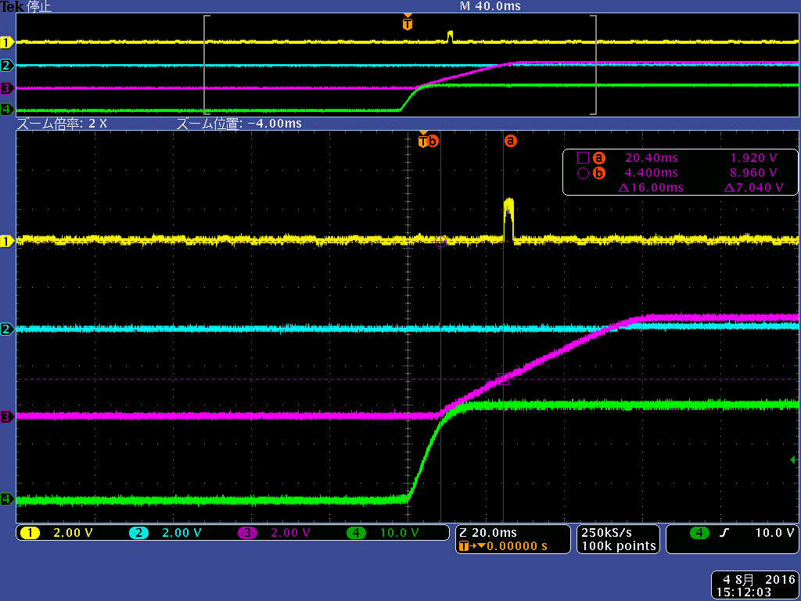
What is this?
A1 Output
B1 Input
VCCA(5V) power supply
24V power supply(24V-> 5V)
VCCB is 0V at this waveform

Slide 3
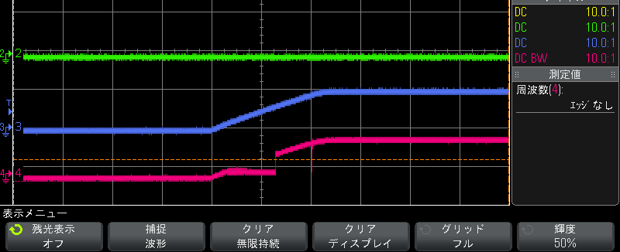
B1 Input
VCCA(5V) power supply
_OE
Sometimes , _OE has delay at start-up.

