Slide 1
SIMULATION with LSF0101
 |  | Typ 1.8V Spec
HOST-to-CLIENT | Vil Max (0.35 x Vddio) | 0.63
 | Vih_min (0.65 x Vddio) | 1.17
 |  | Typ 1.05V
CLIENT-to-HOST | Vil Max (0.275 x Vref) | 0.3
 | Vih_min (0.725 x Vref) | 0.76
Note: Rpd is Pull Down resistor at HOST to maintain IDLE state (Rpd range 225E to 650E)

Slide 2
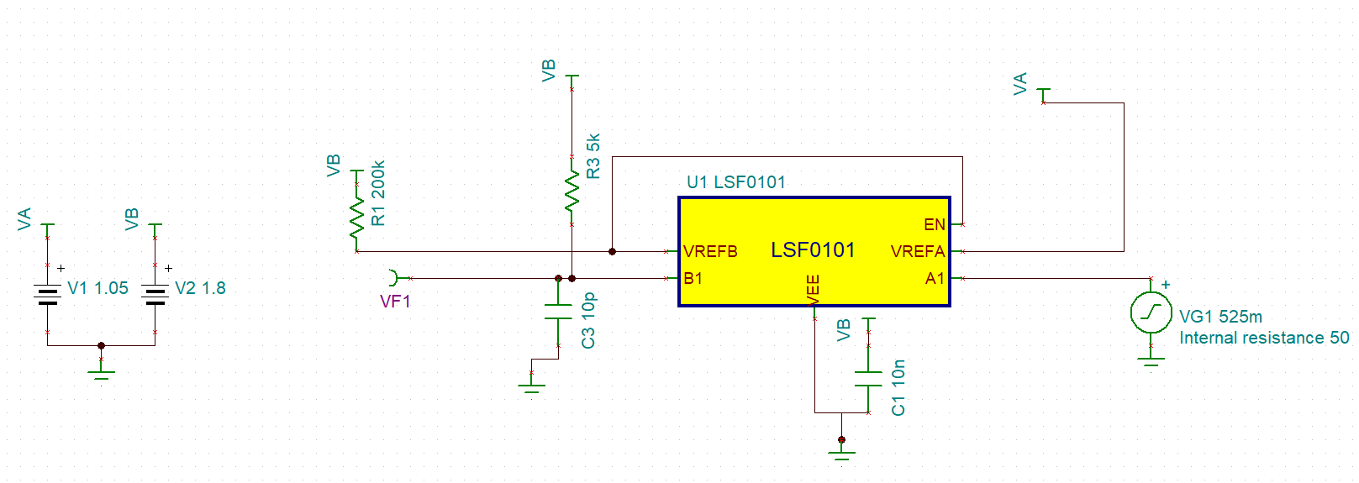
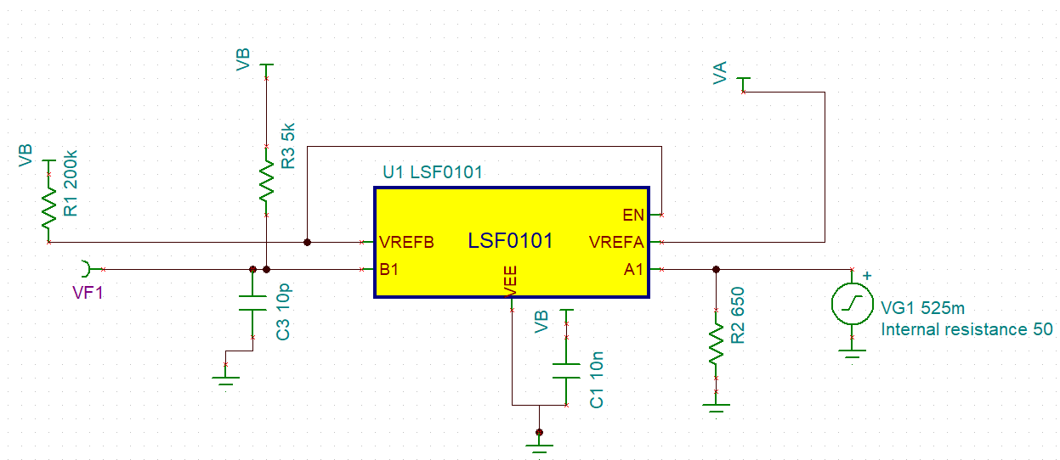
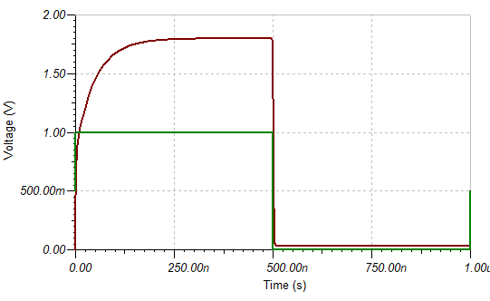
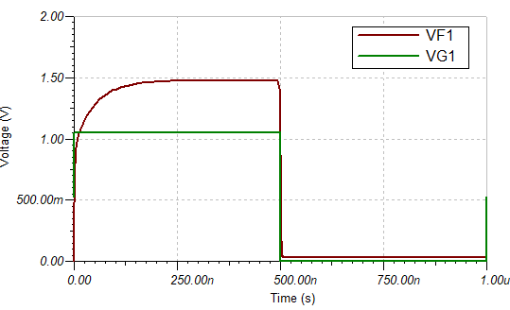
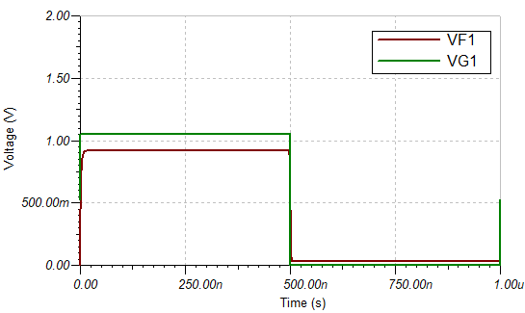
HOST-to-CLIENT
CLIENT
HOST
1.05V
1MHz
Rpd added on EC side
VA=1.8V
VB= 1V
VF1 = 1.8V
VA=1.8V
VB= 1.05V
VF1 = 1.8V
VA=1.8V
VB= 1.05V
Rpd (R2) = 650E
VF1 = 1.48V
VA=1.8V
VB= 1.05V
Rpd (R2) = 225E
VF1 = 0.915V

Slide 3
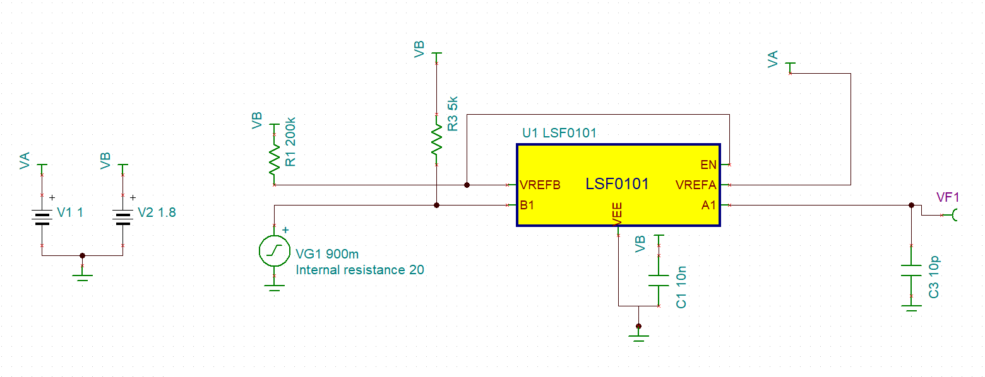
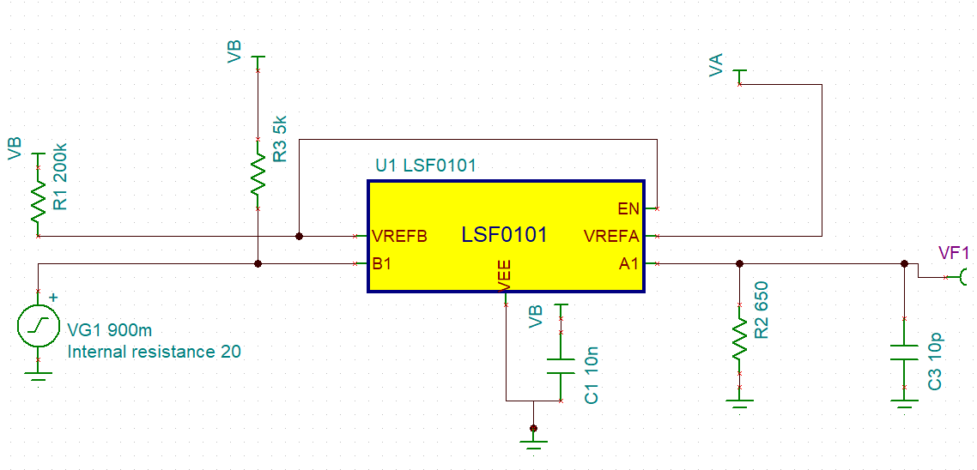
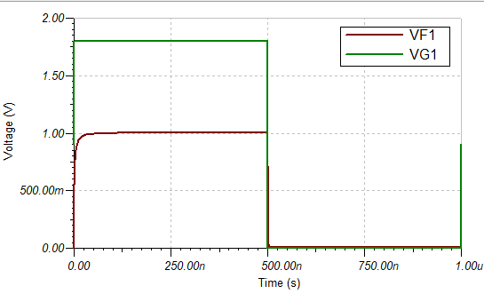
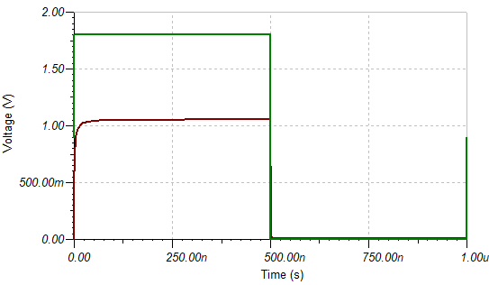
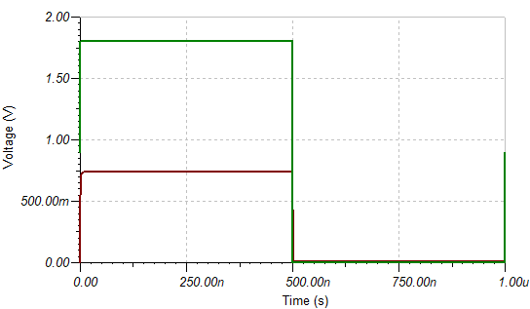
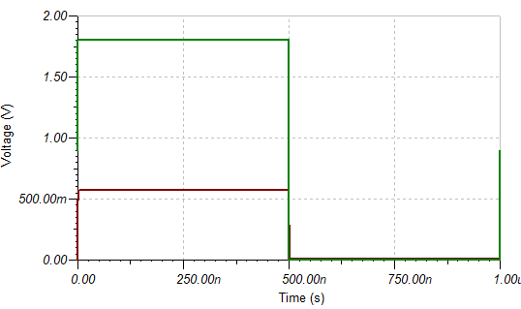
CLIENT-to-HOST
SIMULATION without Rpd on HOST SIDE
SIMULATION with Rpd on HOST SIDE
CLIENT
HOST
1.8V
1MHz
Rpd added on HOST side
VA=1.8V
VB= 1V
VF1 = 1V
VA=1.8V
VB= 1.05V
VF1 = 1.05V
VA=1.8V
VB= 1.05V
Rpd (R2) = 650E
VF1 = 0.735V
VA=1.8V
VB= 1.05V
Rpd (R2) = 225E
VF1 = 0.57V

